Slide 1


Slide 2

Three
Intuitive Education Lessons
Practical examples of conventional topics that are becoming spiritual.
John Bickart, Ph.D.
bickart.org
Notes:
My name is John Bickart – I’m a teacher – and I’m grateful to be here to share 3 educational lessons. These are practical examples of conventional topics that are becoming spiritual.
Intuitive Education simply means to me, being open to ‘learning live’, while the lesson is going on. Becoming spiritual means to me, “Thinking With Your Heart - leading from the heart.”
***

Slide 3
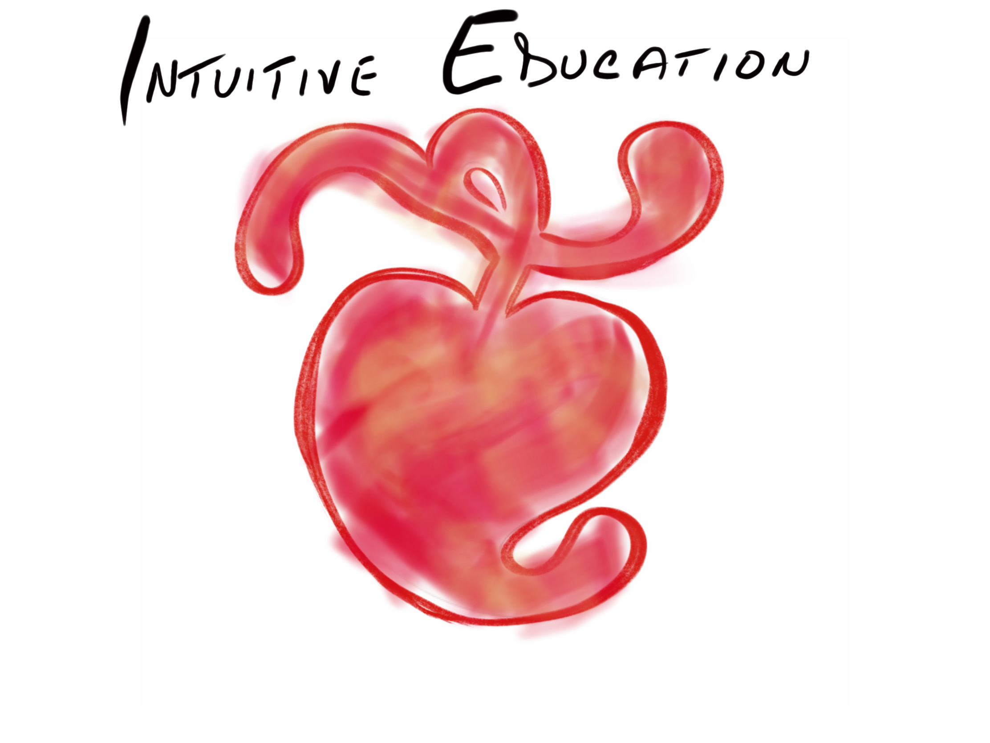
up next … quotes

Slide 4

Overview
Telling, I became a teacher.
Listening, I became a student.
Thanking, I became a friend.
Notes:
***

Slide 5
Overview
“Everyone hears what you say.
Friends listen to what you say.
Best friends listen to what you don't say."
Notes:
Let’s start with an exercise that typifies this whole workshop. May I have a volunteer to simply read the next slide.
***

Slide 6
up next … words

Slide 7
Overview
Plasee raed tihs aluod and ntoe the seepd at wihch you poreced. A hamun bnieg lokos mroe for cnotxet and wolhe wrdos tahn for ecaxt sllpneig. Yuor inceiblre mnid mstoly lkoos for the fsirt and lsat ltretes of a wrod. Yuong cilhrden wtcah for eevn brodaer ctenoxutal cleus. Trefheore, mkae srue taht you aenttd to btoh the wlohe and its prats.
Notes:
Wholes and parts head and hearts – people use lots of terms to speak about this. Here is your first quiz.
***

Slide 8

Overview
“It is very simple to be happy; but it is very difficult to be simple.” - Rabindranath Tagore
Head | Heart
*(Nisbett, 2003)
Notes:
***

Slide 9
Overview
“It is very simple to be happy; but it is very difficult to be simple.” - Rabindranath Tagore
Head | Heart
Left Brain
*(Nisbett, 2003)
Notes:
***

Slide 10
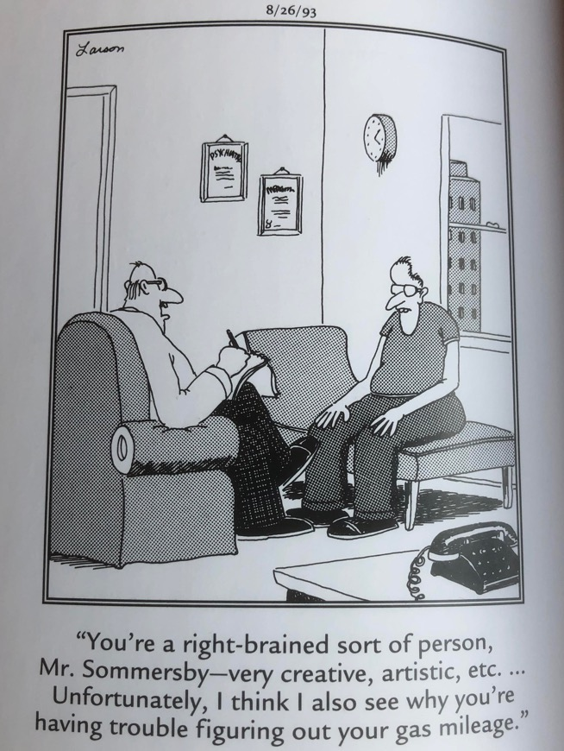
Overview
“It is very simple to be happy; but it is very difficult to be simple.” - Rabindranath Tagore
Head | Heart
Left Brain | Right Brain
*(Nisbett, 2003)
Notes:
***

Slide 11
Overview
“It is very simple to be happy; but it is very difficult to be simple.” - Rabindranath Tagore
Head | Heart
Left Brain | Right Brain
Intuitive
*(Nisbett, 2003)
Notes:
***

Slide 12
Overview
“It is very simple to be happy; but it is very difficult to be simple.” - Rabindranath Tagore
Head | Heart
Left Brain | Right Brain
Analytic | Intuitive
*(Nisbett, 2003)
Notes:
***

Slide 13
Overview
“It is very simple to be happy; but it is very difficult to be simple.” - Rabindranath Tagore
Head | Heart
Left Brain | Right Brain
Analytic | Intuitive
Child
Adult
*(Nisbett, 2003)
Notes:
***

Slide 14
Overview
“It is very simple to be happy; but it is very difficult to be simple.” - Rabindranath Tagore
Head | Heart
Left Brain | Right Brain
Analytic | Intuitive
Adult | Child
Moderns
Ancients
*(Nisbett, 2003)
Notes:
***

Slide 15
Overview
“It is very simple to be happy; but it is very difficult to be simple.” - Rabindranath Tagore
Head | Heart
Left Brain | Right Brain
Analytic | Intuitive
Adult | Child
Moderns | Ancients
*(Nisbett, 2003)
Notes:
***

Slide 16
Overview
“It is very simple to be happy; but it is very difficult to be simple.” - Rabindranath Tagore
Head | Heart
Left Brain | Right Brain
Analytic | Intuitive
Adult | Child
Moderns | Ancients
West
East
*(Nisbett, 2003)
Notes:
***

Slide 17
Overview
“It is very simple to be happy; but it is very difficult to be simple.” - Rabindranath Tagore
Head | Heart
Left Brain | Right Brain
Analytic | Intuitive
Adult | Child
Moderns | Ancients
West (current N. America & W. Europe)* | East (current Asia)*
*(Nisbett, 2003)
Notes:
***

Slide 18
Overview
“For out of the overflow of his heart his mouth speaks.” – Christ (Luke 6:45)
Head
vs
Heart
Some Ways to Lead with Your …
  analyzing, articulating, solving, being logistical, planning, being right, quick to respond, intensity, heaviness, seriousness, “stop that or else”, “you’re wrong”, “don’t even tell me your way”, “because I said so”.
Some Ways to Lead with Your …
  intuiting, observing, connecting, feeling, pausing, centering, touching, empathizing, eye contact, slow to respond, keep it light, playful, humorous, “let’s go another way”, “I see what you’re feeling”, “do you think that will work?”.
Notes:
Put in vertical and horizontal integration
***

Slide 19
Overview
“See the false as false - the true as true. Look into your heart." - Buddha
Some Ways to Lead with Your Head …
  analyzing, articulating, solving, being logistical, planning, being right, quick to respond, intensity, heaviness, seriousness, “stop that or else”, “you’re wrong”, “don’t even tell me your way”, “because I said so”.
Some Ways to Lead with Your Heart …
  intuiting, observing, connecting, feeling, pausing, centering, touching, empathizing, eye contact, slow to respond, keep it light, playful, humorous, “let’s go another way”, “I see what you’re feeling”, “do you think that will work?”.
Notes:
Put in vertical and horizontal integration
***

Slide 20
up next … citations

Slide 21
Overview
“The only reward of virtue is virtue; the only way to have a friend is to be one ..." - Emerson
Some Long-Standing Problems in Education:
  Left Brain Dominance (McGilchrist, 2009; Siegel, 2018)
  1800s Factory Model (Skinner, 1953; Thorndike, 1913/2010)
  Children are Little Adults (Piaget, 1929/2007)
  Too Much Testing (Darling-Hammond, 2010)
  People are Machines (Dewey, 1916/2005)
  Assumed Separateness (Kuhn, 2004)
  Right Answers, Restricted Resources, No help, No questions (Dintersmith, 2018)
Notes:
Before I present my 3 lessons, I wanted to share a little of my research … [READ SLIDE]
***

Slide 22
Overview
“The heart has its reasons in which reason cannot understand." - Blaise Pascal
Some Things ?Coming? to Education:
  Children & Spirituality (T. Hart, 2014; T. R. B. I. Hart, 2010; Miller, 2015)
  Awareness and Mindsight (Siegel, 2010, 2018)
  Belief (Dispenza, 2017; Lipton, 2006)
  Mindfulness and Nondual Awareness (D. Chopra, 2021; Lantieri, 2008; Palmer, 1993, 1998, 2004; Palmer, Zajonc, & Scribner, 2010)
  Emotional and Social Intelligence, Presence (Goleman & Boutsikaris, 2006; Goleman & Senge, 2007; Goleman & Whitener, 2005; Senge, 2000, 2008)
  Students-only, Community-centered, Not tests, Not algebra, Not control, Not norms, Ed. does not equal School, Integrated Disciplines, Inspirational (Dintersmith, 2018; T. Hart, 2001)
Notes:
Citations
Bickart, J. (2013). The possible role of intuition in the child's epistemic beliefs in the Piagetian data set. (Ph.D. Dissertation). UNCC, Charlotte, NC. DAI/A 74-11(E) database. (3589794)
Bickart, J. (2018). The next version of you: 12 stories that highlight the use of intuition to update your life.
Bickart, K. C., Wright, C. I., Dautoff, R. J., Dickerson, B. C., Barrett, L. F. (2011). Amygdala volume and social network size in humans. Nature neuroscience, 14(2), 163-164.
Chopra, D. (2021). METAHUMAN : unleashing your infinite potential. [S.l.]: HARMONY CROWN.
Darling-Hammond, L. (2010). The flat world and education: how America's commitment to equity will determine our future. New York: Teachers College Press.
Dintersmith, T. (2018). What school could be : insights and inspiration from teachers across America.
Dispenza, J. (2017). Becoming supernatural: how common people are doing the uncommon. Carlsbad: Hay House.
Goleman, D., & Boutsikaris, D. (2006). Social intelligence the new science of human relationships. New York: Audio Renaissance.
Goleman, D., & Senge, P. M. (2007). Working with presence. New York: Audio Renaissance.
Goleman, D., & Whitener, B. (2005). Emotional intelligence. Prince Frederick, MD: Landmark Audiobooks.
Hart, T. (2001). From information to transformation: Education for the evolution of consciousness. New York: P. Lang.
Hart, T. (2014). The four virtues : presence, heart, wisdom, creation. Retrieved from https://www.overdrive.com/search?q=215A5244-ED4B-4285-A43A-AFDFDA9BB2B5
Hart, T. R. B. I. (2010). The secret spiritual world of children the breakthrough discovery that profoundly alters our conventional view of children's mystical experiences. Retrieved from https://rbdigital.rbdigital.com
Kuhn, T. S. (2004). The structure of scientific revolutions. Chicago [u.a.]: Univ. of Chicago Press.
Lantieri, L. (2008). Building inner resilience. Reclaiming Children and Youth, 17(2), 43-46.
Lindbergh, C. A. (1953). The Spirit of St. Louis. New York: Scribner.
Lipton, B. H. (2006). The wisdom of your cells: How your beliefs control your biology. Boulder: Sounds True.
McGilchrist, I. (2009). The master and his emissary: the divided brain and the making of the Western world. New Haven: Yale University Press.
Miller, L. (2015). The spiritual child: The new science on parenting for health and lifelong thriving.
Nisbett, R. E. (2003). The geography of thought : how Asians and Westerners think differently -- and why. New York: Free Press.
Palmer, P. J. (1993). To know as we are known: Education as a spiritual journey. San Francisco: HarperSanFrancisco.
Palmer, P. J. (1998). The courage to teach: Exploring the inner landscape of a teacher's life. San Francisco, Calif.: Jossey-Bass.
Palmer, P. J. (2004). A hidden wholeness: The journey toward an undivided life: welcoming the soul and weaving community in a wounded world. San Francisco, CA: Jossey-Bass.
Palmer, P. J., Zajonc, A., & Scribner, M. (2010). The heart of higher education: a call to renewal. San Francisco: Jossey-Bass.
Piaget, J. (1929/2007). The child's conception of the world. Lanham, MD: Rowman & Littlefield.
Senge, P. M. (2000). Schools that learn: A fifth discipline fieldbook for educators, parents, and everyone who cares about education. New York: Doubleday.
Senge, P. M. (2008). The necessary revolution : how individuals and organizations are working together to create a sustainable world. New York: Doubleday.
Siegel, D. J. (2010). Mindsight: the new science of personal transformation. New York: Bantam Books.
Siegel, D. J. (2018). Aware : the science and practice of presence, a complete guide to the groundbreaking Wheel of Awareness meditation practice.
Whorf, B. L., & Carroll, J. B. (1964). Language, thought, and reality: selected writings of Benjamin Lee Whorf. Cambridge, Mass.: M.I.T. Press.
***

Slide 23
up next … literature

Slide 24

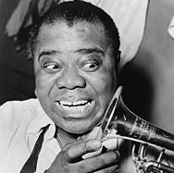
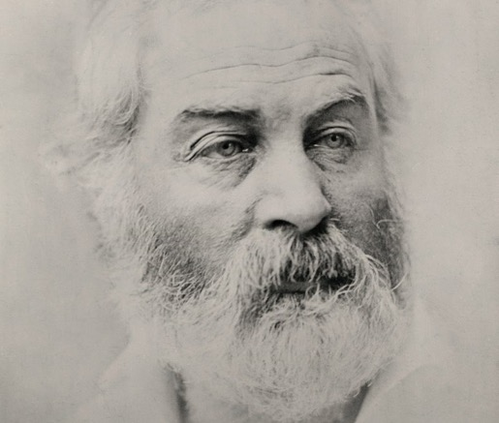
Lesson #1 – Telling Stories
(Literature)
Before becoming spiritual:
Reasoning
After:
Simply Observing
Notes:
All things bright and beautiful,
All creatures great and small,
All things wise and wonderful:
The Lord God made them all.
Each little flow’r that opens,
Each little bird that sings,
He made their glowing colors,
He made their tiny wings.
The rich man in his castle,
The poor man at his gate,
God made them high and lowly,
And ordered their estate… - Alexander
What a Wonderful World sung by Louis Armstrong, Israel Kamakawiwoʻole
I see trees of green, red roses too
I see them bloom for me and you
And I think to myself what a wonderful world
I see skies of blue and clouds of white
The bright blessed day, the dark sacred night
And I think to myself what a wonderful world
The colors of the rainbow so pretty in the sky
Are also on the faces of people going by
I see friends shaking hands saying how do you do
They’re really saying I love you
I hear babies crying, I watch them grow
They’ll learn much more than I’ll never know
And I think to myself what a wonderful world
Yes I think to myself what a wonderful world – Thiele, Douglas, Weiss
Song of Myself …
And the running blackberry would adorn the parlors of heaven,
And the narrowest hinge in my hand puts to scorn all machinery,
And the cow crunching with depressed head surpasses any statue,
And a mouse is miracle enough to stagger sextillions of infidels,
And I could come every afternoon of my life to look at the farmer’s girl
boiling her iron tea-kettle and baking shortcake… - Whitman
***

Slide 25
up next … legends

Slide 26
Lesson #1 – Telling Stories (Literature)
Don’t You Just Love Whitman
"Words that are strictly true seem to be paradoxical." (Tzu, 2012/circa 500 BC, Verse 78)
Lesson #1 – Telling Stories
(Literature)
Before: Choose Good over Evil …
Two Wolves
  An old Cherokee was teaching his grandson about life.
  "A fight is going on inside me," he said to the boy.
  "It is a terrible fight and it is between two wolves.
  One is evil, the other is good.
  The same fight is going on inside you –
  and inside every other person, too."
  The grandson thought about it for a minute
  and then asked his grandfather,
  "Which wolf will win?"
  The old Cherokee simply replied,
  "The one you feed."
  - an Ancient Cherokee Legend
Notes:
Here is our first before-and-after lesson. The before is an ancient story the Cherokee of North America pass down. It’s about good and evil. I’d like to read it – then, offer an alternative way to look at it. Listen carefully as I read it and see if you can hear anything you might change.
… [READ SLIDE]
My new version of this legend is a little different. In teaching emotionally disturbed NJ high school students, then in the Chinese school system, then the NC prisons, my views of good and bad people changed. Something shifted. Lately, I have been teaching the children of incarcerated individuals. So, with this scaffolding, I give you Two Wolves II …
***

Slide 27
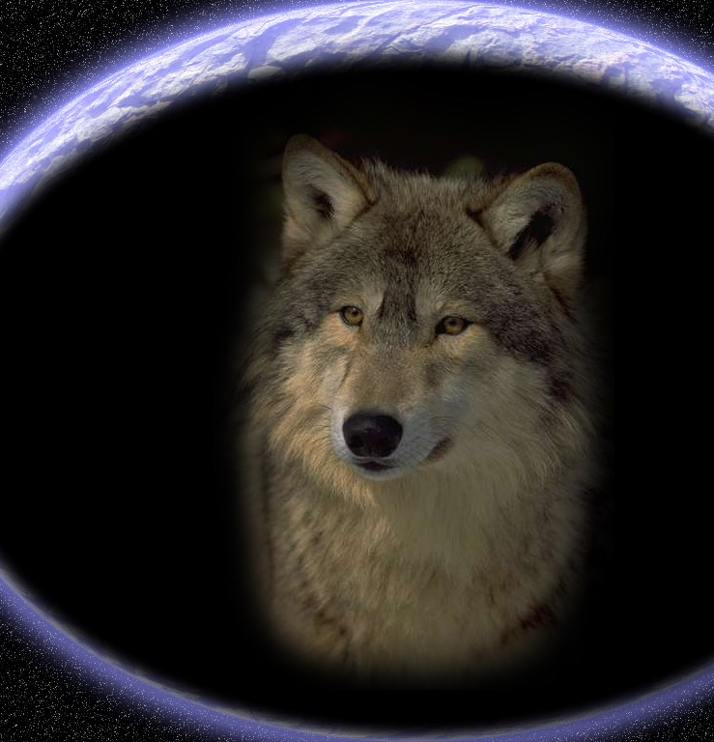
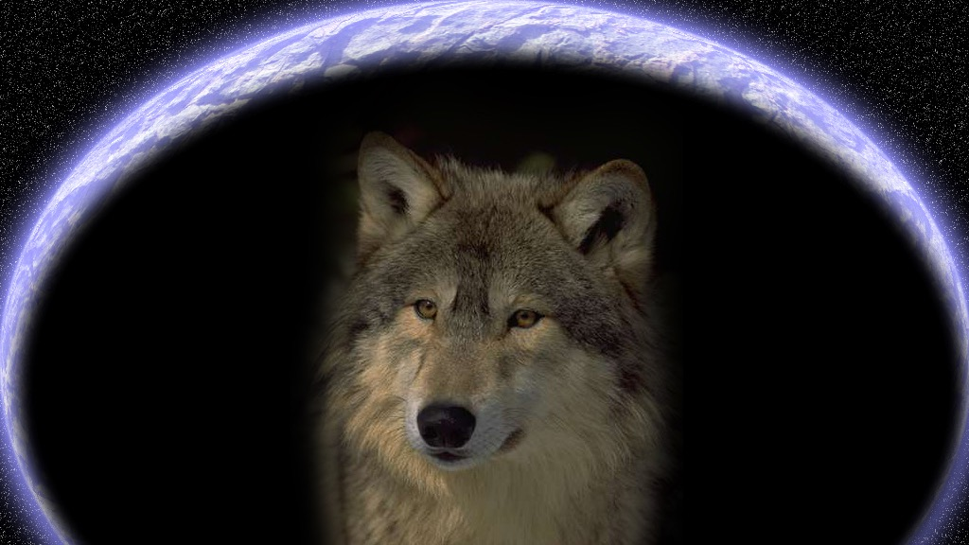
After: Beyond Good & Evil to Inclusion …
Two Wolves II
Two wolves live
inside of me.
One is trapped
the other free.
The two of them
just want to be.
They fight sometimes.
Now good, now bad.
The trapped one wants
what the other had.
I feel this fight
when I am sad.
Grandpa said,
“Watch who you feed.
He will win.
He’ll take the lead.”
I hope some day
that both are freed.
- John Bickart 2011, inspired by an Ancient Cherokee Legend
Notes:
… [READ SLIDE]
Should we touch ancient legends? I apologize if this offends … but it seems that we humans stand at an important moment in our history. There is a question as to whether or not we will survive the great change that is upon us. Perhaps many of us will step up or maybe not. And if stepping up means re-writing the codes we have lived by for thousands of years – then so be it.
What old ways should we leave behind? What is the blood and guts of a new story?
Perhaps the new way has something to do with inclusion … perhaps we will find a way to include both the light and the dark … an honoring of the light, while transforming the dark.
***

Slide 28
Lesson #1 – Telling Stories (Literature)
Don’t You Just Love Whitman
"Words that are strictly true seem to be paradoxical." (Tzu, 2012/circa 500 BC, Verse 78)
Lesson #1 – Telling Stories
(Literature)
More Before & Afters
Before:
Everything is Separate
Everything is Random
The Observer does not matter
We are Machines
The World is Unchanging
After:
Look for Connection
Look for Meaning and Intention
Aim for Relationship by Observing
We Affect Everything around us
There is Potential for Change
See bickart.org: Science Lesson #7
Notes:
Here is our first before-and-after lesson. The before is an ancient story the Cherokee of North America pass down. It’s about good and evil. I’d like to read it – then, offer an alternative way to look at it. Listen carefully as I read it and see if you can hear anything you might change.
… [READ SLIDE]
My new version of this legend is a little different. In teaching emotionally disturbed NJ high school students, then in the Chinese school system, then the NC prisons, my views of good and bad people changed. Something shifted. Lately, I have been teaching the children of incarcerated individuals. So, with this scaffolding, I give you Two Wolves II …
***

Slide 29
up next … science

Slide 30

Lesson #2 – Reading the Book of Nature
(Science)
Observation vs Analysis
Make an (O/A) sheet.
  First, Observe. [Heart]
  Then, Fantasize what you observed. [Heart]
  Then, Draw what you observed. [Heart]
  Then, Write what you observed. [Heart]
  Finally, Analyze. [Head]
See bickart.org: Science Lesson #2
Notes:
The second lesson comes from science – a science demonstration. Research shows that the Before-and-After is that the 20th century saw education racing to name, categorize, and analyze in order to find right answers. The new paradigms circulate around deeper observations before doing this.
Here’s an exercise to help a student to hold off the tendency to jump to conclusions and analysis too soon. It’s simple. The teacher asks the students remain in a state of observation four different ways before even talking about what they think or analyze. Since the 70s, I have had students make O/As. It’s a great process where the student first does an Observation, then an Analysis – an O/A.
Pretend you are in my science class. You are told that
first, we will observe a science demonstration. I light a candle. Now I take some iron filings and sprinkle them on the flame. They sparkle.
Now you are asked to close your eyes and replay – in your mind – a fantasy movie of what you saw – complete with anything your senses took in - adding or subtracting nothing. Just play it as closely to what actually happened, as possible.
Then you are asked to draw it.
Then you are asked to write it. Note that all this while you are still dealing with Observations. If students start to make deductions or inference or conclusions of any kind, they are told to hold them off for a moment.
Finally, students are asked to share their ideas about what happened. This is the time to finally analyze.
Siegel's Horizontal and Vertical Integration
Horizontal - left integrates with right - if connected you are emotionally intelligent - in order to connect, find the side that is dominating the other side and “CONNECT AND REDIRECT"
Vertical - upper brain: prefrontal cortex integrates with lower brain: limbic & amygdala (K. C. Bickart, Wright, C. I., Dautoff, R. J., Dickerson, B. C., Barrett, L. F., 2011) to connect upper and lower, helping the child to identify the emotion is a key in what Dr. Siegel calls the “NAME IT TO TAME IT” process.
***

Slide 31
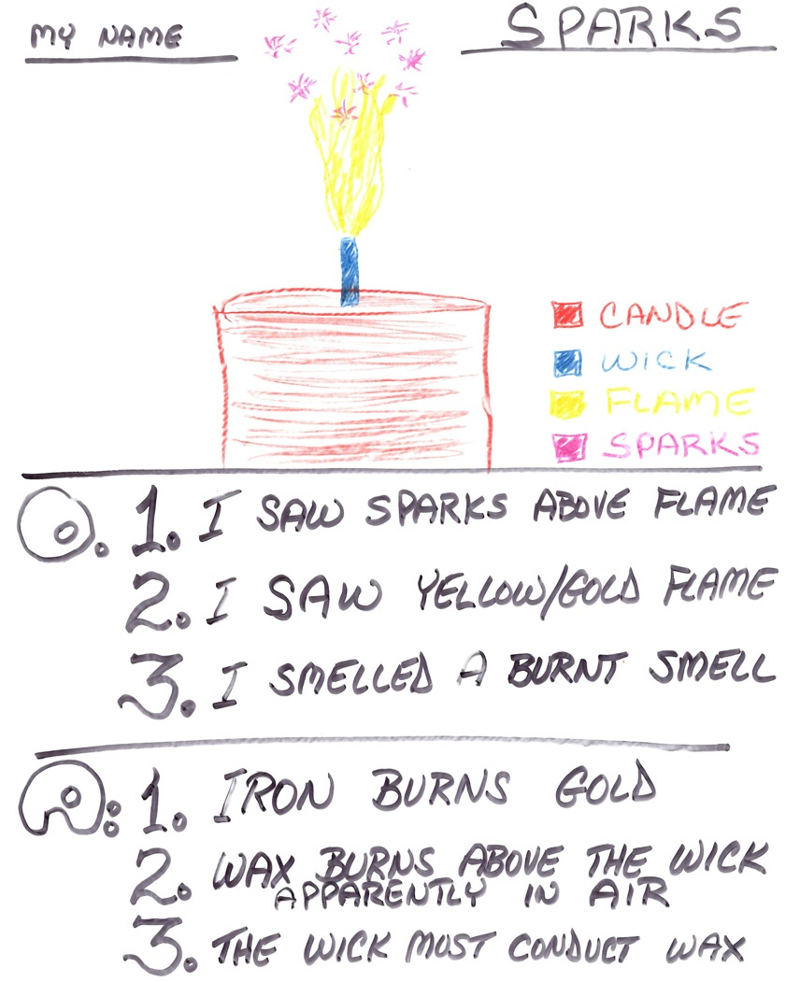
Notes:
Here is a typical Observation/Analysis sheet. After observing the science demonstration, then replaying it in the mind, you see the drawing, then 3 brief observations, followed by 3 analyses.
… [READ SLIDE]
This technique is quite powerful in nurturing the mindfulness it takes to remain in the experience before jumping to left brain activity that articulates about the experience. It can also be done with a literary work or the analysis of a political or economic demonstration, too.
Now, let’s move to our third and last before-and-after lesson.
***

Slide 32
up next … 3 bowls

Slide 33
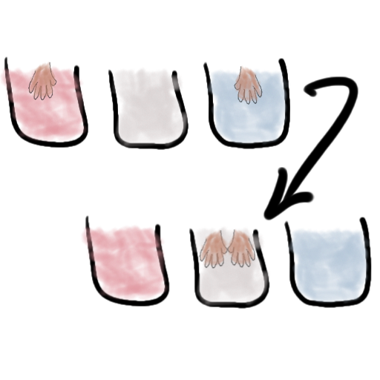
Lesson #2 – Reading the Book of Nature
(Science)
3 Bowls
Before:
  Put one hand in cold water, the other in hot. Now put both in medium water.
  Note that the hot hand feels cold and the other hot.
  Conclusions:
    “Your senses cannot be trusted because they reported the temperature incorrectly.”
    You are a machine that does not perform very well. Scientific instruments are better.
See bickart.org: Science Lesson #3
Notes:
Fantastic 3BOWLS: unnamed mainstream science statement about senses: … speaking on near death experiences … “one of the lowest forms of evidence you could possibly invoke is eye-witness testimony … just give me something that does not have to flow through your senses “ – quoted from a currently popular spokesman for science
Before we move to Intuitive type of Education …
TEXT
***

Slide 34
3 Bowls
After:
  Start from the Heart
  Your senses are the gateway to suspending analytical thought.
  Your senses allow you to be an observer.
  Your body told you the direction of the heat flow.
  If you need accurate temperature, use a thermometer.
Notes:
After we move to Intuitive type of Education …
TEXT
If we are not a machine … what are we? … OBSERVERS!
The Observer Effect in Quantum Physics supposes that watching the world changes outcomes.
Goethe asserts that nature is waiting to be seen. When we observe nature, is nature saying, “You complete me?”
***

Slide 35
up next … social studies

Slide 36
Lesson #3 – Other People’s Stories
(Social Studies)
‘Primitive’ Languages: Case in point - The Hopi
Before:
  The Hopi say “flash” instead of “the light flashes” or “the light flashed”.
    Lack of subject / predicate separation
    Lack of verb tense separation
    Historically seen as primitive
See bickart.org: Science Lesson #13
Notes:
Let’s look at other people’s stories (what the U.S. calls Social Studies or the study of History).
Before, in the old school view of ancients and indigenous, we used the word ‘Primitive’ to describe peoples who were ‘not civilized’ . Research describes this as a projection of modern head thinking onto: ancients, indigenous, and also onto children. We used to jump to the conclusion that if a culture did not use grammar like us, then they were somehow inferior.
Here is an example from the terrific set of interviews of Benjamin Lee Whorf (later to launch the Sapir Whorf Hypothesis) of how the North American Hopi would communicate about a flash or spark from a fire …
[READ SLIDE]
Perhaps we could see the lack of separation as an acknowledgement of UNITY or ONENESS.
In meditation we see that the unity of time is necessary in order to be here, now – increase our presence.
In quantum physics we need to imagine the objects of the physical world connected in order to make sense of entanglement and the observer effect.
“The thoughts of a Hopi about events always include both space and time, for neither is found alone in his world view. Thus his language gets along adequately without tenses for its verbs, and permits him to think habitually in terms of space-time. Properly to understand Einstein's relativity a Westerner must abandon his spoken tongue and take to the language of calculus. But a Hopi, Whorf implies, has a sort of calculus built into him.” (Whorf & Carroll, 1964, p. viii)
Perhaps we could teach that the Hopi were - and are to this day - quite advanced in their lack of separation of subject and predicate in grammar. According to linguistic research, several ancient cultures did not see human beings as nouns. Neither did they see us as verbs – human doings. Perhaps if we could learn from them, we could move forward as a species to see ourselves as human becomings.
Perhaps we could learn to move forward with both legs, with both lobes of the brain, with both head and heart.
***

Slide 37
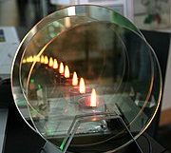

picture a candle between two reflectors …

Slide 38
The Hopi on Particles versus Waves
ha’fi it is bent in a rounded angle
hafi’fita it lies in a meandering line
ho”ci it forms a sharp acute angle
hoci’cita it is zigzag
pa”ci it is notched
paci’cita it is serrated
wa’la it makes one wave (in liquid)
wala’lata it is tossing in waves
The Hopi world view
always knew:
Every static particle or singular pulse is also …
a singular pulse of a tendency of a field of vibrations or a wave.
Quantum physics has only recently started to realize the complementarity of particles and waves.
p. 85, Whorf, B. L., & Carroll, J. B. (1964). Language, thought, and reality: selected writings of Benjamin Lee Whorf. Cambridge, Mass.: M.I.T. Press.

Slide 39
Lesson #3 – Other People’s Stories
(Social Studies)
“Only then, will you transcend tense
To fully be here now.
Only then, no harm
will the universe proffer
nor you to her,
for you will be
not you but she
and both – the universal Great Integrity.
- Lao Tzu (Tao Te Ching, Verse 13 Identity)
Notes:
"Verse 20
THE SADNESS OF SUPERFICIALITIES AND OF THE UNFULFILLED GREAT INTEGRITY
It is sometimes deeply depressing to be a rebel,
knowing that we can never share most people's way of life, nor can they share ours.
Schooling stuffs the brains of our children with trivia.
The more trivia, the more their anxieties.
They indoctrinate the children to believe that the consequences are grave
when they fail to distinguish "good" from "evil", and agreement from disagreement.
What gross nonsense!
To escape the rubbish of all this so-called knowledge,
in the winter people run to the great feasts of lamb, pork, and ox,
and they climb high in the mountains to view the first signs of spring.
We are so different! Having no desire for the trivialities,
nor for their compensations, we are like infants not yet knowing how to laugh!
Ever wandering, and having no home to which we may return.
While most people are obsessed with superficialities, we feel empty.
While most people feel they know so much, we feel simple-minded.
While most people believe they live happily in the best of all possible worlds,
we are depressed to witness this world!
It is so painful to know that we will always be outsiders,
endlessly moving like the ocean, aimlessly blowing like the wind.
While we fear what others fear, we don't treasure what others treasure.
Our treasure is the Great Integrity.
However, until it is shared, it will not be the Universal Integrity,
for we are part of them, and they are part of us."
(Laozi, 2005/circa 500 BC)
Laozi, D. R. A. C. J. (2005/circa 500 BC). Tao te ching : a new translation & commentary. New York: Barnes & Noble.

Slide 40
Lesson #3 – Other People’s Stories
(Social Studies)
After:
    Meditate to stay in the present - outside of
    Time and Space.
    Achieve greater comprehension and possible advances in Quantum Physics.
    Consider ourselves neither to be human beings as nouns, nor human doings as verbs – instead, perhaps
    human becomings as both.

Slide 41
Lesson #3 – Other People’s Stories
(Social Studies)
Activity:
  Be the Hopi!
  Start from your Heart
Notes:
TEXT … Do it. ‘Be the Hopi’ … see the tree as a subject and predicate … see the tree as all tenses - the whole life of the tree – ironically, it’s a flash
The beauty is that we have representatives of ancient and indigenous wisdom right in our midst – the children.
***
Lao Tzu
“All things alike go through their processes of activity, and we see them return. When things have displayed their luxuriant growth, we see each of them return to its root. This returning to their root is what we call the state of stillness; and that stillness may be called a reporting that they have fulfilled their appointed end.” (Tzu, 2012/circa 500 BC, p. Verse 16)
William James
“And the faculty of voluntarily bringing back a wandering attention, over and over again, is the very root of judgment, character, and will. ... An education which should improve this faculty would be the education par excellence.” - William James
Incarcerated Individuals
(On giving advice to a child)
"Don't do anything in the dark you wouldn't want to come to light." J. Powell
"Remember you are always loved. Love is gold. Give your gold to everyone you meet, just as it was given to you but never with a price. This is your treasure, nothing more, nothing less." J. LeJeune
"We all make mistakes. When you get knocked down you have to get back up. 'Fake it until you become it'" (A. Kempeny).
"I had people all the time telling me what I should do or shouldn't do, but I had to learn the hard way. My advice to you is always be honest regardless if it hurts someone's feelings because once the pain goes away they will respect you for your honesty. Never forget to be yourself, don't do things because everyone else is doing them, because when you get out of your character you will about 8 times out of 10 find yourself in an awkward situation. Young man the most important thing I can tell you is to love. Love your friends and family - even love your enemies. When you love, things you say and things you do for people won't go unnoticed because they'll know it came from a sincere heart. And always remember to love yourself, because you can't love others until you love yourself first." C. Barnes
"I've learned to not take family, friends or freedom for granted, at any given time any of these can be taken from you. ... my grandmother always told me, 'worrying is like rocking in a rocking chair, you can do it for days and never get anywhere.'" T. Lackey
"We all make mistakes. When you get knocked down you have to get back up. 'Fake it until you become it.'" A. Kempeny
"Son, do this for me if you can. Be a simple kind of man. Be someone people can love and understand. Be strong, tough and work hard, but also be caring, loving and sympathetic for those who are weaker than you. Always remember that family comes first. Take care and protect them with your love and compassion." T. Joynes

Slide 42
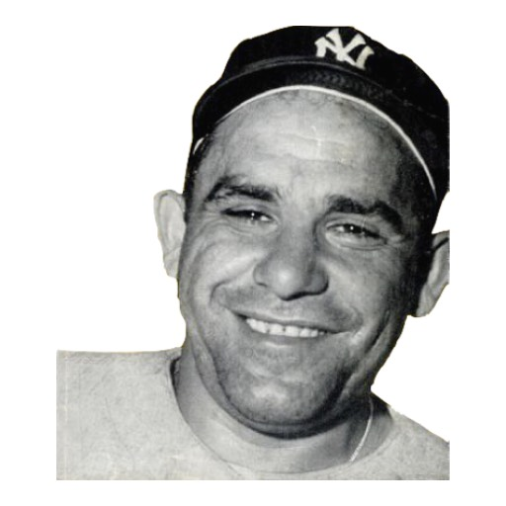
Conclusion
“When you come to a fork in the road,
take it.”
– Yogi Berra
Thank You!
Notes:
Thank you.

Slide 43
up next … hemisphericity

Slide 44
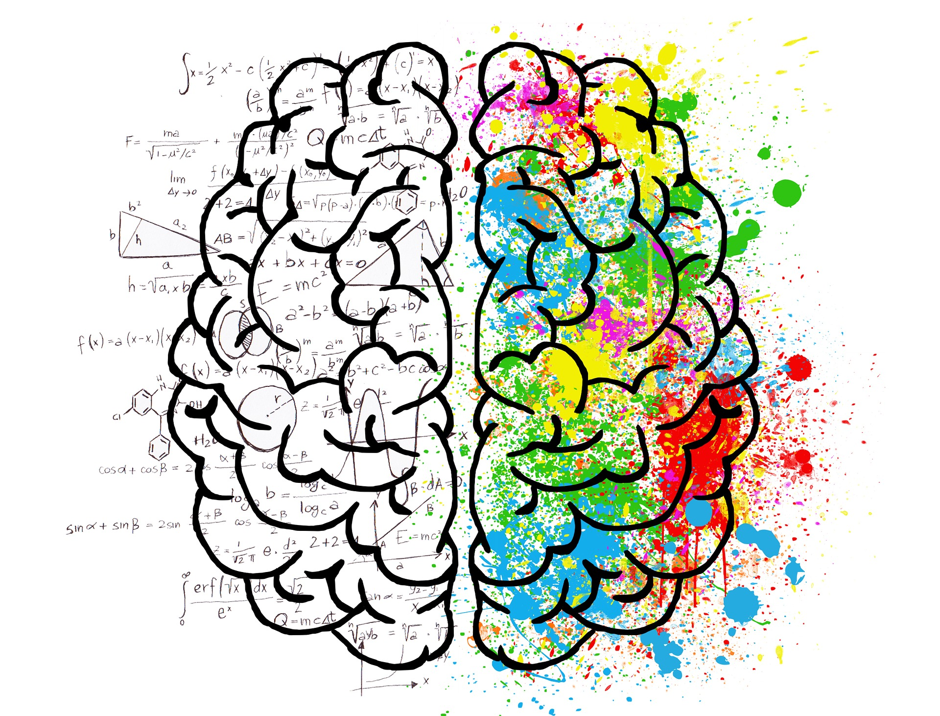
Sample Brain Hemisphericity Inventory
(excerpted from the CA Dept. of Ed.)
Which Side Are You On? Just 6 questions …
(Keep track of your “As” or “Bs”.)
Notes:
Chopra includes entire Nondual Embodiment Thematic Inventory (NETI) in his book, Metahuman (METAHUMAN : unleashing your infinite potential, D. Chopra, Publisher: HARMONY CROWN 2021.). Scores from 20-100, higher being more self-awareness. In all questions, score 1 - Never, 2 - Rarely, 3 - Sometimes, 4 - Most of the time, 5 - All of the time.
Nondual Embodiment Thematic Inventory*
Instructions: Please indicate how often the following occur for you.
1. An inner contentment that is not contingent or dependent upon circumstances, objects, or the actions of other people.
2. Accepting (not struggling with) whatever experience I may be having.
3. An interest in clearly seeing the reality or truth about myself, the world, and others, rather than in feeling a particular way.
4. A sense that I am not protecting or defending a self-image or concept I hold about myself.
5. Deep love and appreciation for everyone and everything I encounter in life.
6. Understanding that there is ultimately no separation between what I call my ‘‘self’’ and the whole of existence.
7. Feeling deeply at ease, wherever I am or whatever situation or circumstance I may find myself in.
8. A sense that my actions in life are not motivated by fear or mistrust.
9. Conscious awareness of my nonseparation from (essential oneness with) a transcendent reality, source, higher power, spirit, god, etc.
10. Not being personally invested in or attached to my own ideas and concepts.
11. An unwavering awareness of a stillness/quietness, even in the midst of movement and noise.
12. Acting without assuming a role or identity based on my own or others’ expectations.
13. A sense of immense freedom and possibility in my moment-to-moment experience.
14. A lack of desire to be understood by others.
15. A lack of concern or discomfort about either the past or future.
16. A lack of a sense of fear or anxiety that inhibits my actions.
17. A feeling of profound aliveness and vitality.
18. Acting without a desire to change anybody or anything.
19. Feelings of gratitude and/or open curiosity about all experiences.
20. A sense of the flawlessness and beauty of everything and everyone, just as they are.
Questions: 1, 4, 8, 14, 15, 16 - have been changed to indicate the negative of the original.
*Adapted from ”Nondual Embodiment Thematic Inventory” by John Astin and David A. Butlein**.
** Butlein D. Nondual Embodiment Thematic Inventory. Institute of Transpersonal Psychology, 2005. Unpublished doctoral dissertation.

Slide 45
Sample Brain Hemisphericity Inventory
(excerpted from the CA Dept. of Ed.)
1.
A. At home, my room has organized drawer and closets. I even try to organize other things around the house.
B. At home, I like the "lived-in" look. I clean as I see a need and when I have the time.
Notes:
Chopra includes entire Nondual Embodiment Thematic Inventory (NETI) in his book, Metahuman (METAHUMAN : unleashing your infinite potential, D. Chopra, Publisher: HARMONY CROWN 2021.). Scores from 20-100, higher being more self-awareness. In all questions, score 1 - Never, 2 - Rarely, 3 - Sometimes, 4 - Most of the time, 5 - All of the time.
Nondual Embodiment Thematic Inventory*
Instructions: Please indicate how often the following occur for you.
1. An inner contentment that is not contingent or dependent upon circumstances, objects, or the actions of other people.
2. Accepting (not struggling with) whatever experience I may be having.
3. An interest in clearly seeing the reality or truth about myself, the world, and others, rather than in feeling a particular way.
4. A sense that I am not protecting or defending a self-image or concept I hold about myself.
5. Deep love and appreciation for everyone and everything I encounter in life.
6. Understanding that there is ultimately no separation between what I call my ‘‘self’’ and the whole of existence.
7. Feeling deeply at ease, wherever I am or whatever situation or circumstance I may find myself in.
8. A sense that my actions in life are not motivated by fear or mistrust.
9. Conscious awareness of my nonseparation from (essential oneness with) a transcendent reality, source, higher power, spirit, god, etc.
10. Not being personally invested in or attached to my own ideas and concepts.
11. An unwavering awareness of a stillness/quietness, even in the midst of movement and noise.
12. Acting without assuming a role or identity based on my own or others’ expectations.
13. A sense of immense freedom and possibility in my moment-to-moment experience.
14. A lack of desire to be understood by others.
15. A lack of concern or discomfort about either the past or future.
16. A lack of a sense of fear or anxiety that inhibits my actions.
17. A feeling of profound aliveness and vitality.
18. Acting without a desire to change anybody or anything.
19. Feelings of gratitude and/or open curiosity about all experiences.
20. A sense of the flawlessness and beauty of everything and everyone, just as they are.
Questions: 1, 4, 8, 14, 15, 16 - have been changed to indicate the negative of the original.
*Adapted from ”Nondual Embodiment Thematic Inventory” by John Astin and David A. Butlein**.
** Butlein D. Nondual Embodiment Thematic Inventory. Institute of Transpersonal Psychology, 2005. Unpublished doctoral dissertation.

Slide 46
Sample Brain Hemisphericity Inventory
(excerpted from the CA Dept. of Ed.)
2.
A. My desk is usually clean and has everything in place.
B. I leave my work out on my desk so I can work as I am inspired by ideas.
Notes:
Chopra includes entire Nondual Embodiment Thematic Inventory (NETI) in his book, Metahuman (METAHUMAN : unleashing your infinite potential, D. Chopra, Publisher: HARMONY CROWN 2021.). Scores from 20-100, higher being more self-awareness. In all questions, score 1 - Never, 2 - Rarely, 3 - Sometimes, 4 - Most of the time, 5 - All of the time.
Nondual Embodiment Thematic Inventory*
Instructions: Please indicate how often the following occur for you.
1. An inner contentment that is not contingent or dependent upon circumstances, objects, or the actions of other people.
2. Accepting (not struggling with) whatever experience I may be having.
3. An interest in clearly seeing the reality or truth about myself, the world, and others, rather than in feeling a particular way.
4. A sense that I am not protecting or defending a self-image or concept I hold about myself.
5. Deep love and appreciation for everyone and everything I encounter in life.
6. Understanding that there is ultimately no separation between what I call my ‘‘self’’ and the whole of existence.
7. Feeling deeply at ease, wherever I am or whatever situation or circumstance I may find myself in.
8. A sense that my actions in life are not motivated by fear or mistrust.
9. Conscious awareness of my nonseparation from (essential oneness with) a transcendent reality, source, higher power, spirit, god, etc.
10. Not being personally invested in or attached to my own ideas and concepts.
11. An unwavering awareness of a stillness/quietness, even in the midst of movement and noise.
12. Acting without assuming a role or identity based on my own or others’ expectations.
13. A sense of immense freedom and possibility in my moment-to-moment experience.
14. A lack of desire to be understood by others.
15. A lack of concern or discomfort about either the past or future.
16. A lack of a sense of fear or anxiety that inhibits my actions.
17. A feeling of profound aliveness and vitality.
18. Acting without a desire to change anybody or anything.
19. Feelings of gratitude and/or open curiosity about all experiences.
20. A sense of the flawlessness and beauty of everything and everyone, just as they are.
Questions: 1, 4, 8, 14, 15, 16 - have been changed to indicate the negative of the original.
*Adapted from ”Nondual Embodiment Thematic Inventory” by John Astin and David A. Butlein**.
** Butlein D. Nondual Embodiment Thematic Inventory. Institute of Transpersonal Psychology, 2005. Unpublished doctoral dissertation.

Slide 47
Sample Brain Hemisphericity Inventory
(excerpted from the CA Dept. of Ed.)
A. I like using the "tried and true" method.
B. I like creating new methods.
Notes:
Chopra includes entire Nondual Embodiment Thematic Inventory (NETI) in his book, Metahuman (METAHUMAN : unleashing your infinite potential, D. Chopra, Publisher: HARMONY CROWN 2021.). Scores from 20-100, higher being more self-awareness. In all questions, score 1 - Never, 2 - Rarely, 3 - Sometimes, 4 - Most of the time, 5 - All of the time.
Nondual Embodiment Thematic Inventory*
Instructions: Please indicate how often the following occur for you.
1. An inner contentment that is not contingent or dependent upon circumstances, objects, or the actions of other people.
2. Accepting (not struggling with) whatever experience I may be having.
3. An interest in clearly seeing the reality or truth about myself, the world, and others, rather than in feeling a particular way.
4. A sense that I am not protecting or defending a self-image or concept I hold about myself.
5. Deep love and appreciation for everyone and everything I encounter in life.
6. Understanding that there is ultimately no separation between what I call my ‘‘self’’ and the whole of existence.
7. Feeling deeply at ease, wherever I am or whatever situation or circumstance I may find myself in.
8. A sense that my actions in life are not motivated by fear or mistrust.
9. Conscious awareness of my nonseparation from (essential oneness with) a transcendent reality, source, higher power, spirit, god, etc.
10. Not being personally invested in or attached to my own ideas and concepts.
11. An unwavering awareness of a stillness/quietness, even in the midst of movement and noise.
12. Acting without assuming a role or identity based on my own or others’ expectations.
13. A sense of immense freedom and possibility in my moment-to-moment experience.
14. A lack of desire to be understood by others.
15. A lack of concern or discomfort about either the past or future.
16. A lack of a sense of fear or anxiety that inhibits my actions.
17. A feeling of profound aliveness and vitality.
18. Acting without a desire to change anybody or anything.
19. Feelings of gratitude and/or open curiosity about all experiences.
20. A sense of the flawlessness and beauty of everything and everyone, just as they are.
Questions: 1, 4, 8, 14, 15, 16 - have been changed to indicate the negative of the original.
*Adapted from ”Nondual Embodiment Thematic Inventory” by John Astin and David A. Butlein**.
** Butlein D. Nondual Embodiment Thematic Inventory. Institute of Transpersonal Psychology, 2005. Unpublished doctoral dissertation.

Slide 48
Sample Brain Hemisphericity Inventory
(excerpted from the CA Dept. of Ed.)
4.
A. I follow directions carefully when I build a model, make a craft, etc.
B. I like to build a model my way, making my own creation.
Notes:
Chopra includes entire Nondual Embodiment Thematic Inventory (NETI) in his book, Metahuman (METAHUMAN : unleashing your infinite potential, D. Chopra, Publisher: HARMONY CROWN 2021.). Scores from 20-100, higher being more self-awareness. In all questions, score 1 - Never, 2 - Rarely, 3 - Sometimes, 4 - Most of the time, 5 - All of the time.
Nondual Embodiment Thematic Inventory*
Instructions: Please indicate how often the following occur for you.
1. An inner contentment that is not contingent or dependent upon circumstances, objects, or the actions of other people.
2. Accepting (not struggling with) whatever experience I may be having.
3. An interest in clearly seeing the reality or truth about myself, the world, and others, rather than in feeling a particular way.
4. A sense that I am not protecting or defending a self-image or concept I hold about myself.
5. Deep love and appreciation for everyone and everything I encounter in life.
6. Understanding that there is ultimately no separation between what I call my ‘‘self’’ and the whole of existence.
7. Feeling deeply at ease, wherever I am or whatever situation or circumstance I may find myself in.
8. A sense that my actions in life are not motivated by fear or mistrust.
9. Conscious awareness of my nonseparation from (essential oneness with) a transcendent reality, source, higher power, spirit, god, etc.
10. Not being personally invested in or attached to my own ideas and concepts.
11. An unwavering awareness of a stillness/quietness, even in the midst of movement and noise.
12. Acting without assuming a role or identity based on my own or others’ expectations.
13. A sense of immense freedom and possibility in my moment-to-moment experience.
14. A lack of desire to be understood by others.
15. A lack of concern or discomfort about either the past or future.
16. A lack of a sense of fear or anxiety that inhibits my actions.
17. A feeling of profound aliveness and vitality.
18. Acting without a desire to change anybody or anything.
19. Feelings of gratitude and/or open curiosity about all experiences.
20. A sense of the flawlessness and beauty of everything and everyone, just as they are.
Questions: 1, 4, 8, 14, 15, 16 - have been changed to indicate the negative of the original.
*Adapted from ”Nondual Embodiment Thematic Inventory” by John Astin and David A. Butlein**.
** Butlein D. Nondual Embodiment Thematic Inventory. Institute of Transpersonal Psychology, 2005. Unpublished doctoral dissertation.

Slide 49
Sample Brain Hemisphericity Inventory
(excerpted from the CA Dept. of Ed.)
5.
A. I complete one project at a time.
B. I like to start many different projects, but do not like to finish them.
Notes:
Chopra includes entire Nondual Embodiment Thematic Inventory (NETI) in his book, Metahuman (METAHUMAN : unleashing your infinite potential, D. Chopra, Publisher: HARMONY CROWN 2021.). Scores from 20-100, higher being more self-awareness. In all questions, score 1 - Never, 2 - Rarely, 3 - Sometimes, 4 - Most of the time, 5 - All of the time.
Nondual Embodiment Thematic Inventory*
Instructions: Please indicate how often the following occur for you.
1. An inner contentment that is not contingent or dependent upon circumstances, objects, or the actions of other people.
2. Accepting (not struggling with) whatever experience I may be having.
3. An interest in clearly seeing the reality or truth about myself, the world, and others, rather than in feeling a particular way.
4. A sense that I am not protecting or defending a self-image or concept I hold about myself.
5. Deep love and appreciation for everyone and everything I encounter in life.
6. Understanding that there is ultimately no separation between what I call my ‘‘self’’ and the whole of existence.
7. Feeling deeply at ease, wherever I am or whatever situation or circumstance I may find myself in.
8. A sense that my actions in life are not motivated by fear or mistrust.
9. Conscious awareness of my nonseparation from (essential oneness with) a transcendent reality, source, higher power, spirit, god, etc.
10. Not being personally invested in or attached to my own ideas and concepts.
11. An unwavering awareness of a stillness/quietness, even in the midst of movement and noise.
12. Acting without assuming a role or identity based on my own or others’ expectations.
13. A sense of immense freedom and possibility in my moment-to-moment experience.
14. A lack of desire to be understood by others.
15. A lack of concern or discomfort about either the past or future.
16. A lack of a sense of fear or anxiety that inhibits my actions.
17. A feeling of profound aliveness and vitality.
18. Acting without a desire to change anybody or anything.
19. Feelings of gratitude and/or open curiosity about all experiences.
20. A sense of the flawlessness and beauty of everything and everyone, just as they are.
Questions: 1, 4, 8, 14, 15, 16 - have been changed to indicate the negative of the original.
*Adapted from ”Nondual Embodiment Thematic Inventory” by John Astin and David A. Butlein**.
** Butlein D. Nondual Embodiment Thematic Inventory. Institute of Transpersonal Psychology, 2005. Unpublished doctoral dissertation.

Slide 50
Sample Brain Hemisphericity Inventory
(excerpted from the CA Dept. of Ed.)
6. When I am asked to write a report on a subject, I........
A. research information, then outline and organize my writing.
B. work in my own self-inspired direction.
Notes:
Chopra includes entire Nondual Embodiment Thematic Inventory (NETI) in his book, Metahuman (METAHUMAN : unleashing your infinite potential, D. Chopra, Publisher: HARMONY CROWN 2021.). Scores from 20-100, higher being more self-awareness. In all questions, score 1 - Never, 2 - Rarely, 3 - Sometimes, 4 - Most of the time, 5 - All of the time.
Nondual Embodiment Thematic Inventory*
Instructions: Please indicate how often the following occur for you.
1. An inner contentment that is not contingent or dependent upon circumstances, objects, or the actions of other people.
2. Accepting (not struggling with) whatever experience I may be having.
3. An interest in clearly seeing the reality or truth about myself, the world, and others, rather than in feeling a particular way.
4. A sense that I am not protecting or defending a self-image or concept I hold about myself.
5. Deep love and appreciation for everyone and everything I encounter in life.
6. Understanding that there is ultimately no separation between what I call my ‘‘self’’ and the whole of existence.
7. Feeling deeply at ease, wherever I am or whatever situation or circumstance I may find myself in.
8. A sense that my actions in life are not motivated by fear or mistrust.
9. Conscious awareness of my nonseparation from (essential oneness with) a transcendent reality, source, higher power, spirit, god, etc.
10. Not being personally invested in or attached to my own ideas and concepts.
11. An unwavering awareness of a stillness/quietness, even in the midst of movement and noise.
12. Acting without assuming a role or identity based on my own or others’ expectations.
13. A sense of immense freedom and possibility in my moment-to-moment experience.
14. A lack of desire to be understood by others.
15. A lack of concern or discomfort about either the past or future.
16. A lack of a sense of fear or anxiety that inhibits my actions.
17. A feeling of profound aliveness and vitality.
18. Acting without a desire to change anybody or anything.
19. Feelings of gratitude and/or open curiosity about all experiences.
20. A sense of the flawlessness and beauty of everything and everyone, just as they are.
Questions: 1, 4, 8, 14, 15, 16 - have been changed to indicate the negative of the original.
*Adapted from ”Nondual Embodiment Thematic Inventory” by John Astin and David A. Butlein**.
** Butlein D. Nondual Embodiment Thematic Inventory. Institute of Transpersonal Psychology, 2005. Unpublished doctoral dissertation.

Slide 51
Sample Brain Hemisphericity Inventory
(excerpted from the CA Dept. of Ed.)
How did you do?
“A”s were left brain and “B”s were right brain.
(not definitively)
Notes:
Chopra includes entire Nondual Embodiment Thematic Inventory (NETI) in his book, Metahuman (METAHUMAN : unleashing your infinite potential, D. Chopra, Publisher: HARMONY CROWN 2021.). Scores from 20-100, higher being more self-awareness. In all questions, score 1 - Never, 2 - Rarely, 3 - Sometimes, 4 - Most of the time, 5 - All of the time.
Nondual Embodiment Thematic Inventory*
Instructions: Please indicate how often the following occur for you.
1. An inner contentment that is not contingent or dependent upon circumstances, objects, or the actions of other people.
2. Accepting (not struggling with) whatever experience I may be having.
3. An interest in clearly seeing the reality or truth about myself, the world, and others, rather than in feeling a particular way.
4. A sense that I am not protecting or defending a self-image or concept I hold about myself.
5. Deep love and appreciation for everyone and everything I encounter in life.
6. Understanding that there is ultimately no separation between what I call my ‘‘self’’ and the whole of existence.
7. Feeling deeply at ease, wherever I am or whatever situation or circumstance I may find myself in.
8. A sense that my actions in life are not motivated by fear or mistrust.
9. Conscious awareness of my nonseparation from (essential oneness with) a transcendent reality, source, higher power, spirit, god, etc.
10. Not being personally invested in or attached to my own ideas and concepts.
11. An unwavering awareness of a stillness/quietness, even in the midst of movement and noise.
12. Acting without assuming a role or identity based on my own or others’ expectations.
13. A sense of immense freedom and possibility in my moment-to-moment experience.
14. A lack of desire to be understood by others.
15. A lack of concern or discomfort about either the past or future.
16. A lack of a sense of fear or anxiety that inhibits my actions.
17. A feeling of profound aliveness and vitality.
18. Acting without a desire to change anybody or anything.
19. Feelings of gratitude and/or open curiosity about all experiences.
20. A sense of the flawlessness and beauty of everything and everyone, just as they are.
Questions: 1, 4, 8, 14, 15, 16 - have been changed to indicate the negative of the original.
*Adapted from ”Nondual Embodiment Thematic Inventory” by John Astin and David A. Butlein**.
** Butlein D. Nondual Embodiment Thematic Inventory. Institute of Transpersonal Psychology, 2005. Unpublished doctoral dissertation.

Slide 53
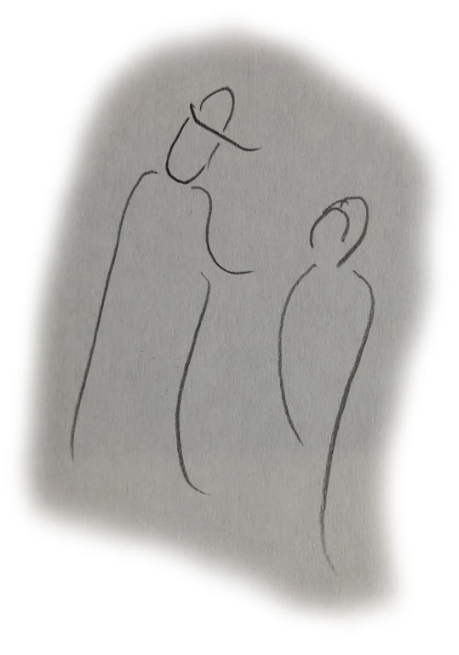

#2 The Man of Medicine
and the Girl
A man of medicine who was dedicated to helping and healing people came upon a little girl in the forest who had hurt herself. She had brushed her leg against a poison plant and it had already started to become infected. The good doctor quickly took charge. As he examined her leg, he comforted the little girl saying, “I do not know about this poisonous plant, so be patient while I try many possible medicines to see which one will heal you.” Surprised at this, the little girl asked the doctor, “Why not just ask the Forest Spirit? He knows every plant and herb and their uses.” The doctor recoiled as one who has tasted something bitter. Seeing the problem, the little girl offered the advice, “Why then good doctor, shall I ask the Forest Spirit for you? He is quite close and is already telling me that this herb beneath our feet will heal me. After all, is it not better to know what to do than to try in vain?”
WHY KEEP TRYING
WHEN YOU CAN KNOW
- Bickart, J. (2020). Bickart’s Just-in-Time Fables (Vol. 1). Asheville, NC: Red Shirt Interactive Group.

Slide 54
#97 The First Rider
Once, a very clever monkey was watching a herd of horses. He admired the way they could run over hills and valleys with the swiftness of the wind. One day, he went to the wise leader of the troop of monkeys and asked if he might try to ride these beautiful horses. The leader admitted that it sounded like fun, so the monkey made friends with the horses and asked for a ride. As it turned out, the horses were more than happy to oblige. Delirious with excitement, the monkey tried to choose between a stunning white horse and a gorgeous brown one. Unable to decide, he tried to ride both at once! But alas, upon trying to execute this unlikely undertaking, the monkey’s legs spread so far apart that he fell instantly and was left in the dust. The monkey went crying to his leader and asked what went wrong. His leader simply said, “My little friend, you have only one butt, so you need to put it on only one horse.”
THE DIVIDED SELF GOES NOWHERE
- Bickart, J. (2020). Bickart’s Just-in-Time Fables (Vol. 2). Asheville, NC: Red Shirt Interactive Group.

Slide 55
#91 The Traveling Puppeteer
A renowned master puppeteer made a wonderful puppet theater. He took it from town to town as a traveling show. When it arrived in the big town square, children from the smaller villages came to see it. During the show the master puppeteer held ropes that were above the puppets. He was behind a curtain, so the children could not see him; but they could see the puppets. The story was about a brave and beautiful woman riding a white horse. She was searching for a magical tree that could transform her into a princess and show her where to go to find her very own castle in her very own kingdom. Over and over she rode through the same path past the same trees without finding the magical tree. As she repeated her search, the woods started to become familiar and her life became routine. By and by a sadness befell her and she lay down to sleep.
The village children watched the puppet show with great intensity. They wanted to help the beautiful woman to become a princess. Suddenly, the master puppeteer appeared. He pulled back the curtain to let the children see his hands and arms and the ropes he held from above to allow the puppets to move. He spoke to the children, “Do you want to help the brave woman?” “YES!”, the children shouted as if in one, single voice. “Well, look here,” and he pointed to a tree that she had passed over and over, “She cannot tell that this is the magical tree! You can see it is magical if you look from up here, but she is only looking from down on the ground. If you want to help her, you must wake her up and show her that she has to look from above. Tell her to climb the ropes and come join me. This is how to make all of her dreams come true!”
BREAK ROUTINE BY LOOKING FROM ABOVE
- Bickart, J. (2020). Bickart’s Just-in-Time Fables (Vol. 2). Asheville, NC: Red Shirt Interactive Group.

Slide 56
#100 The First Three Lessons
A farmer truly loved his three sons. He raised them by teaching many morals, always imparting a lesson to go with each of their chores on the farm. One might have thought that they would follow in the father’s footsteps, at least that is what the father supposed. But the first son wanted to move away. “That is not right – you should stay here on the family farm,” said the father. But the son planned to leave anyway. This was inconceivable to the father, but what could he do? So, the father gave his blessing. The second son stayed, but instead of becoming a farmer, he became a writer. The father tried to show him that it is only right that he should farm. The father used every argument he had to prove his point. But seeing the son’s love of writing, he ultimately wished him well and sent him off to his new life with all of the love he could give. The third son came to his father and announced that the family farm should become a school. This was utterly unthinkable to the father. He tried in vain to reason with his son, then he tried in vain to reason with himself. Finally, though this seemed all wrong to the father, he supported his son with all of his heart and became the school’s first teacher.
TO WAKE UP …
INSTEAD OF TRYING TO BE RIGHT, TRY COMPASSION
- Bickart, J. (2020). Bickart’s Just-in-Time Fables (Vol. 2). Asheville, NC: Red Shirt Interactive Group.

Slide 57
#121 The Old Badger and the French Hen
An old badger was pouring his usual bowl of coffee to go sit for his morning routine by the edge of the garden, nestled between the servant’s quarters and the stables. He had invited his friend, a French hen, who also enjoyed life’s little pleasures. He had his kitchen prepare some of her favorites: a wonderfully crusty baguette with butter and strawberry jam, pain au chocolate, and a perfectly ripe, sliced peach with crème fraîche. “The morning sun promises a delightful hour,” observed the badger.” “I quite agree,” rejoined the hen, “I do believe it is bringing out the full fragrance of the privet blossoms.”
Unbeknownst to the consumers, their morning gathering was also joined by a host of little spiritual beings. Here were the actual chefs. Here were the ones responsible for the feast of tastes and smells. Here were the workers that grew the fruits and flowers, encouraged the wind and the sun and the dew, supported the cooks in the kitchen and the servants in their quarters, and made the morning itself possible. They watched with great satisfaction that their labors had not gone unnoticed. But what about them - the beings behind the scenes? As the little ones relished the morning repast, they enjoyed a hearty laugh, gently making fun of the old badger and the French hen. “And when will they appreciate us? Yes, we are little, yet all of our little deeds basically run all of nature!”
DO NOT MISS OUT ON LIFE’S LITTLE PLEASURES
- Bickart, J. (2020). Bickart’s Just-in-Time Fables (Vol. 3). Asheville, NC: Red Shirt Interactive Group.

Slide 58
#123 The Oven and the Radio
An inquisitive young boy named Marshall walked through the woods to his Grandma’s house. As he entered, she greeted him with a big hug, announcing that a fresh batch of cookies were about to come out of the oven! Marshall practically shook with anticipation as he sat in Grandma’s warm kitchen and listened to her old music, on her old radio. Looking around at the radio and the oven and the wallpaper, Marshall innocently observed, “Grandma, everything in your house is old.” “Well, I guess that’s right,” laughed Grandma, “including me!” Just then, the little bell on the stove rang and Grandma took the cookies out of the oven. She put two on a plate for Marshall, then poured a glass of milk. Biting into the soft, warm cookie, Marshall got a dreamy look in his eye, as if he were contemplating a far-off land. “Grandma,” he asked in a sing song voice, “where do IDEAS come from?” Grandma paused to consider the question, then answered, “Well, that is certainly a good question. I don’t rightly know. But I guess some ideas come from putting two and two together.” “What does that mean?” probed Marshall. “Well,” began his Grandma, “if I asked you how much two plus two is and you answered ‘four’, then I would say that you got that idea from inside your head. It would be kind of like the oven. You put the two and two into your head like I put the raw cookies into the oven. Then you cooked up the answer ‘four’, like I baked the cookies.” “I see,” said Marshall with his eyes darting around as if he were preparing an extremely complex interrogation, “but what about if I got a new idea that I never thought about before? Like this morning … I suddenly got the idea to visit you! And somehow, I was already thinking you might have cookies! Do all of those ideas come from inside my head like the cookies in the oven?” “Well, my word, you DO ask good questions!” admired his Grandma, “I guess those ideas are different. I suppose that ovens only give back what you put in.” Grandma fell silent for a moment, then suddenly burst out with an inspired thought, “Perhaps fresh ideas that just appear in your mind are like the songs on the radio! Maybe those ideas come floating in on waves from outside of you.” “I see, Grandma!” exclaimed Marshall grabbing another full measure of cookies, milk, and satisfaction, “sometimes I’m an oven, and sometimes I’m a radio!”
Marshall went home satisfied, at least for the present. But Grandma was left pondering what would inevitably be the next question on a subsequent visit, namely, “And where were those ideas before they were received in my radio?”
WHERE DO INTUITIONS COME FROM?
- Bickart, J. (2020). Bickart’s Just-in-Time Fables (Vol. 3). Asheville, NC: Red Shirt Interactive Group.

Slide 59
#106 The Three Muskrats Trilogy
The Three Muskrats I
Long, long ago, before anyone wrote words, there were three muskrats. They played all day, every day. They were great friends. They lived in a cave next to a wide river below a ring of trees that lay below a cliff. The citadel you see in the illustration was not built yet. It is in the next story, “The Three Muskrats II”. Their favorite game was listening to stories that gnomes would tell them. Gnomes are the spiritual elemental beings that live in the rocks. All three muskrats could see and hear the gnomes.
One day, one of the three muskrats started to write symbols on the wall of the cave. He said he was writing the story of the three muskrats. The other two muskrats did not read the symbols, just the one muskrat. All of a sudden, a gnome came to tell a story. The muskrat who wrote symbols could no longer see the gnome. The gnome started the story, but only the other two muskrats could hear him. The one who learned to write, lost the ability to see and hear the gnome.
As the years went by, the two friends kept telling the third muskrat that the gnome was visiting. They told him the stories, too, but the third muskrat started to have trouble believing them, for he could no longer see or hear spiritual beings.
IT IS HARD TO BELIEVE WHAT YOU CANNOT SEE

Slide 60
The Three Muskrats II
As thousands of years passed by, a citadel was built on the cliffs above the ring of trees above the river. Three new muskrats were born in a cave. They became very great friends, as did their ancestors. Also, like the one ancestor who lost the ability to see and hear the gnomes, all three of these muskrats had no idea that the gnomes were in the rocks of the cave. The gnomes wanted to tell them stories, but the muskrats could not see nor hear them.
One day, one of the three muskrats started to become aware of a story. He did not hear words in his ears, he imagined the story in his mind. As he told the other two muskrats the story, he began to see the gnome who was telling the story. He got very excited and told the other two muskrats all about the gnome, so that they might see him, too. But, try as he might, the other two muskrats could not see or hear the gnome.
As the years went by, the two friends kept telling the third muskrat that they were not aware of any gnome. They told him that they had trouble believing that he could see or hear spiritual beings.
SOMETIMES THE MAJORITY RULES OUT POSSIBILITIES

Slide 61
The Three Muskrats III
A short time passed. Even though the one muskrat kept saying that he could see the gnome and the other two had trouble believing him, the three muskrats remained very great friends.
One day, the one muskrat said that the gnome had come to tell a story. The gnome said that the story was for all three friends. It was a most beautiful and exciting story. So, all three sat, while the one who could see and hear the gnome related the story. It was a tale of how the muskrats’ ancestors used to be able to genuinely see and hear the gnomes. It explained that the gnomes wanted to tell the muskrats all of the secrets of nature, but to hear the stories, the muskrats would have to want to see and hear them.
So, being very great friends, all three muskrats acted as if
they were one, and made a wish. They closed their eyes and wished with all their hearts that they could believe in and learn from the gnomes. And lo and behold, all three opened their eyes and there in the cave was a gnome sitting right in front of them. The gnome was so happy to be seen, that he called elemental beings of the water and plants and air and fire to come to celebrate. In addition to the gladness of being seen, the elementals brought very great and valuable gifts to the three muskrats. The gifts were secret tricks of how to gather food and swim in the water and fly in the air and play with fire. Never again did the three muskrats doubt each other.
ONE FOR ALL AND ALL FOR ONE
- Bickart, J. (2020). Bickart’s Just-in-Time Fables (Vol. 3). Asheville, NC: Red Shirt Interactive Group.

