Slide 1


Reawakening Your Love of Learning During Strife
Do you believe in getting up after falling?
Belief is a cause - not a consequence.”
Notes:
Think of a wish or something you were working on that collapsed at some point in your life. Now, think of what happened next?
– Was it easy?
– Was it quick?
– Who or what helped you?
"We all have opportunities to learn and change ourselves - transform ourselves - make our lives a little better.
What we sometimes forget is that these opportunities are greatest when we are in depression, trauma - when we are in strife."
Verse 20 The Sadness of Superficialities and of The Unfulfilled Great Integrity
"It is sometimes deeply depressing to be a rebel,
knowing that we can never share most people's way of life, nor can they share ours.
Schooling stuffs the brains of our children with trivia.
The more trivia, the more their anxieties.
They indoctrinate the children to believe that the consequences are grave
when they fail to distinguish "good" from "evil", and agreement from disagreement.
What gross nonsense!
To escape the rubbish of all this so-called knowledge,
in the winter people run to the great feasts of lamb, pork, and ox,
and they climb high in the mountains to view the first signs of spring.
We are so different! Having no desire for the trivialities,
nor for their compensations, we are like infants not yet knowing how to laugh!
Ever wandering, and having no home to which we may return.
While most people are obsessed with superficialities, we feel empty.
While most people feel they know so much, we feel simple-minded.
While most people believe they live happily in the best of all possible worlds,
we are depressed to witness this world!
It is so painful to know that we will always be outsiders,
endlessly moving like the ocean, aimlessly blowing like the wind.
While we fear what others fear, we don't treasure what others treasure.
Our treasure is the Great Integrity.
However, until it is shared, it will not be the Universal Integrity,
for we are part of them, and they are part of us."
(Laozi, 2005/circa 500 BC)
***
Opening of the Workshop
Does anyone here meditate? I do – or at least let’s say, “I try.” You never want to take a workshop on meditation with me – or even sit next to me when you meditate – especially if you are an intuitive and could hear my thoughts. They’re all over the place. When you meditate, does your mind keep coming back in with thoughts? Sometimes, I think I’m meditating, and I suddenly realize that I’ve been singing a song. One night it was the song from Mama Mia about the Dancing Queen. I was even tapping my toes. The tapping was what woke me to the fact that I was not exactly achieving the state of ‘no mind’. So, I have a question. My friend Justin, says that every question is a quest. So, let’s take a small journey – perhaps a hero’s journey and ask the question, “How do you feel, when you come back to your senses – return to meditation – arrive back in the here and now? In other words, when you return to meditating, is your glass half empty or half full – do you bemoan the fact that you just went to the Bahamas, or do you celebrate the homecoming?”
It is traumatic and depressing to fail – especially if you fail several times a week. So, since we are imperfect people who have real problems, we’re going to fail repeatedly. But nevertheless, it is our choice to celebrate or get depressed. When we realize how we are failing, we can be glad that we are aware of the problem. We don’t have to wait to celebrate until a problem is completely solved. We can give ourselves minor breaks whenever there is a little progress or even a little awareness of the problem. We are in a time that is very difficult. It may get worse before it gets better. Therefore, it is important to support ourselves and each other with strong, practical tools instead of wishing wildly for major changes that are pipe dreams – unrealistic hopes that set ourselves up for even greater disappointment and depression.
Margaret Wheatley, in her book, Who Do We Choose to Be?: Facing Reality, Claiming Leadership, Restoring Sanity (2023), recommends that we prepare for the collapse of many things as we know them by choosing to serve ourselves and those around us, rather than holding on to hopes of keeping our world the way it has been. She calls these empty hopes, ‘hopium’ – and says that they set us up for fear and failure. When we fix our wishes and dreams and beliefs and on something that we wish to remain the same, it is like knocking on the same door that is not opening. If we keep knocking, it is just a matter of time before we become disappointed, disenchanted. Change is the only thing we can count on. So, instead of seeing the problem as something that is permanent, and work on unrealistic long-term solutions, we need to see it as temporary, and focus on the immediate next thing to do.
Magaret Wheatley on Hopium
The problem with hope is that it’s bipolar. Every time we rely on hope, we always bring in fear. Wisdom teaches that hope and fear are two sides of the same dynamic. You already know this from your own experience. Think of when you put great hope and effort in a project, cause, or person. You worked very hard for its success, but then it failed from causes beyond your control. How did you feel then?
Too many of us good people dedicated to creating change have become addicted to hope. We feel despair for the destruction of planet, peoples, species, and the future. Yet we still need to make a difference, so we grasp for hope to motivate and energize us.
As Holocaust survivor, Hannah Arendt, said, "Hope is a dangerous barrier to acting courageously in dark times. In hope, the soul overleaps reality, as in fear it shrinks back from it.”
It’s time to be aware of this cycle and liberate ourselves from the drug of Hopium. Hopium never gives us the energy and motivation we need to contribute and persevere. As we free ourselves from the cycle of hope and fear, we don’t become useless, hopeless people. Instead, we become people who can see clearly how to contribute in meaningful ways. We discover work that makes a different difference. We contribute meaningfully within our sphere of influence to a person, a community, a local cause.
Those who deeply care about a friend or family member who’s addicted will sometimes create an intervention for the person to see their addiction and discover a better way. It’s my heartfelt aspiration that we liberate ourselves from Hopium so that we can discover meaningful work to serve the human spirit and the spirit of life.
Hope blinds us to our path of contribution. With insight and compassion, we discover abundant ways to contribute to this time of great suffering for peoples and planet.
Margaret Wheatley is a celebrated author of many books. Excerpt above is from her Medium article Freeing Ourselves from the Addiction of Hope.

Slide 2
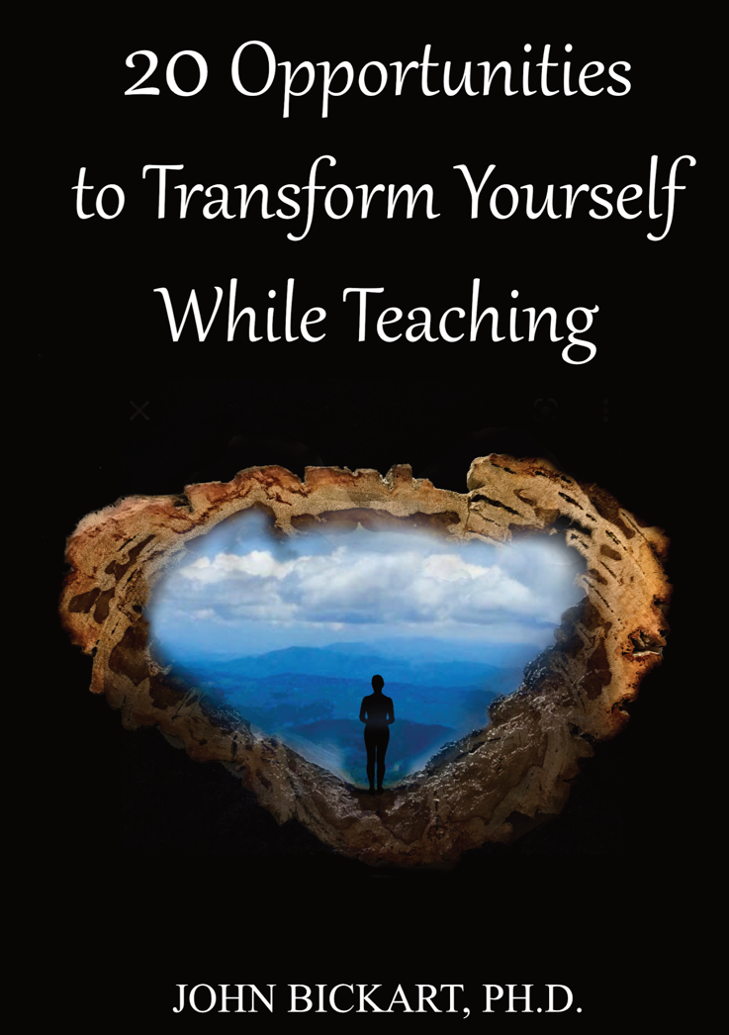
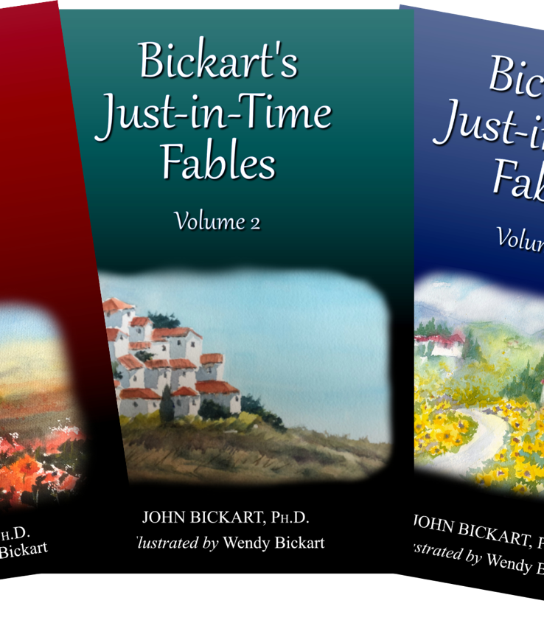
Notes:
…
Reference Notes
Books the Workshop is based on …
- from the back cover of 20 Opportunities to Transform Yourself While Teaching
“Do you remember when you were very young?
There is a wisdom to early childhood which we would do well to remember and regain. Children are intuitive, inquisitive, and interested in everything. A child's day is full of wonder and joy. How many ways of being have you forgotten as you grew up? For most people, life has two stages. You start out very young, then you grow up. But there are rare individuals who are gifted enough to find a third stage. Either as young adults or as old adults, they find a way to transform themselves - rediscovering the wisdom they had when they were a child.
This book is for you if you can answer "yes" to any of these questions.
- Would you like to reawaken the wisdom of the child?
- Would you like to rediscover the wisdom of the ancestors?
- Would you like to regain the wisdom of the heart?
​- Would you like to transform yourself to once again access that wisdom?
This book is a set of exercises and reminders of the way you used to think with your heart - 'heart thought', if you will.”
***
Introduction to 20 Opportunities to Transform Yourself While Teaching
The Whole Book
The spiritual lessons herein came from ancient wisdom. They are incredibly hard to sum up or group or reduce. They defy categorization as you are going to see - they are, each one, a whole life's work and a whole solution to life's big questions. I could have introduced every one of the 20 chapters by saying, "All of life is about ... ," and then named one of the opportunities: heart thought or belief or reawakening the child in the adult or whatever. The reason for this is that a true spiritual lesson actually contains all of the other spiritual lessons in it. So, my recommendation for reading this kind of book is to come back to it often, crack it open on any random chapter, then let yourself go and have fun in that chapter as if you are reading the secret of secrets and there is no need to know anything else.
The 20 Opportunities
These are my favorite exercises. I've used most of them for about half a century. They are simple things. Each one of them takes less than a minute. They are answering a question that has been nagging at my brain - and perhaps yours - our whole life. The question is something like, "Do you want to change? Do you wish you could be another version of yourself, one that is a little bit better in some ways? Do you wish to help the world?" Well, that is what transformations are all about. They are exercises to spiritually awaken so that we can do some of those things.
What is spiritual? Do you remember when you were a child? Do you remember the time before life heaped layers of experiences upon you? If you could recover how you were when you were a child, that would be a spiritual awakening. Why? Because, when you were a child, you were pure and innocent, and, in a certain way, you knew what good was in the highest sense. You knew what GOOD was. That is spiritual - for your higher self to know what you really want. And for most of us this takes change ... transformation. That's all there is to it.
Transformation. So, how to transform? Let me get a few rules down, here. There are a few things you have to know. Number one, it's not easy. Number two, it's not fast. And, number three, you have got to do it yourself. You can't get anyone to change you with some kind of a quick fix. You have to go through what an addict has to go through, because we are addicted to the head! And we have to get back to the heart. So, if that's your addiction, how do you handle it? You 'unlayer'. You let go of your thinking that is in your head, and you learn what it takes to have a heart thought.
What is a heart thought? It's a thought that includes what your head knows and what your gut knows. It's where your heart is the boss over the head, heart, and gut. It's the highest truth you know. The spiritual awakening. So, I'm going in circles. Yes. All of my exercises go in circles, because they say, "If you want to transform yourself, yes, go transform yourself!" But, that's basically it. You kind of know somewhere inside you, what you wish at any one time in your life, if you stop and heart-think about it.
The Method
Getting there is the whole problem. Rabindranath Tagore said, “It is very simple to be happy; but it is very difficult to be simple.” It's an 'unlayering' of everything - a dismantling - a letting go of stuff. And guess where that stuff is? In the head. So, if you can let go of those kinds of thoughts and clear out and get back to the heart, then you are awakening. You are transforming yourself.
So, the basic method is to do it repeatedly. That is how you do it to yourself. Keep coming back here to listen to these one-minute exercises or read some good books or listen to some people who are mentally and spiritually healthy. Do this repeatedly - while your day is in progress. By using this repetition method, you will find yourself slowly becoming the next version of yourself.
That's it. I wish you luck. I hope that you enjoy them, and I'll see you when you come back, in one of those tomorrows.

Slide 3
Literature Review as seen on bickart.org
- Science of Emotions (Keltner, 2009, 2023)
- Childhood & Spirituality (Hart, 2001, 2010, 2014a, 2014b; L. Miller, 2015; L. W. E. S. Miller, 2021)
- Left Brain Dominance (McGilchrist, 2009; Taylor, 2008)
- Mindfulness and Nondual Awareness (Chopra, 2021; Chopra, Ford, & Williamson, 2010; Lantieri, 2008; Palmer, 1993, 1998, 2004; Palmer, Zajonc, & Scribner, 2010)
- Emotional and Social Intelligence, Presence (Goleman & Boutsikaris, 2006; Goleman & Senge, 2007; Goleman & Whitener, 2005; Senge, 2000, 2008)
- Awareness and Mindsight (Siegel, 2010, 2018)
- Wisdom Teaching and Practical Exercises (Laozi, 2005/circa 500 BC)
- Belief (Dispenza, 2017; Dispenza & Boyce, 2016; Dispenza, Knight, & Encephalon, 2005; B. H. Lipton, 2005, 2006, 2014; B. H. Lipton, Bhaerman, S., 2009)
- Early Opposition to the Mechanical View of Humans (Dewey, 1910, 1916/2005)
- Historically Assumed Separateness (Kuhn, 2004)
- Reduced Importance of Childhood (Piaget, 1929/2007, 1950, 1959, 1965, 1973, 1976; Piaget & Inhelder, 1969; Piaget & Valsiner, 1927/2001)
- Excessive Testing (Darling-Hammond, 2010; González & Darling-Hammond, 1997; Gurwitz, Darling-Hammond, Pease, Education., & Corporation., 1981; Haggstrom, Darling-Hammond, Grissmer, & Center for the Study of the Teaching Profession (Rand Corporation), 1988; Koppich, Merseth, Darling-Hammond, American Association of Colleges for Teacher Education., & National Commission on Teaching & America's Future (U.S.), 2000; Millman & Darling-Hammond, 1990; Wise, Darling-Hammond, Berry, Profession., & Education, 1987; Wise, Darling-Hammond, & Klein, 1986; Zeichner et al., 2000)
- Education: Students-only, Community-centered, Right Answers, Restricted Resources, Not tests, Not algebra, Not control, Not norms, Brick & Mortar Schools, Integrated Disciplines, Inspirational Content (Dintersmith, 2018; Hart, 2001)
- 1800s Factory Model (Skinner, 1953; Thorndike, 1913/2010)
Notes:
References
Chopra, D. (2021). METAHUMAN : unleashing your infinite potential. [S.l.]: HARMONY CROWN.
Chopra, D., Ford, D., & Williamson, M. (2010). The shadow effect: Illuminating the hidden power of your true self. New York: HarperOne.
Darling-Hammond, L. (2010). The flat world and education: how America's commitment to equity will determine our future. New York: Teachers College Press.
Dewey, J. (1910). How we think. Boston: D.C. Heath & Co.
Dewey, J. (1916/2005). Democracy and education: An introduction to the philosophy of education. New York: Cosimo Classics.
Dintersmith, T. (2018). What school could be : insights and inspiration from teachers across America.
Dispenza, J. (2017). Becoming supernatural: how common people are doing the uncommon. Carlsbad: Hay House.
Dispenza, J., & Boyce, A. (2016). You Are the Placebo. [United States]: Author's Republic : Made available through hoopla.
Dispenza, J., Knight, J. Z., & Encephalon, L. L. C. (2005). Mastering the art of observation. Rainier, WA: Encephalon.
Goleman, D., & Boutsikaris, D. (2006). Social intelligence the new science of human relationships. New York: Audio Renaissance.
Goleman, D., & Senge, P. M. (2007). Working with presence. New York: Audio Renaissance.
Goleman, D., & Whitener, B. (2005). Emotional intelligence. Prince Frederick, MD: Landmark Audiobooks.
González, J. M., & Darling-Hammond, L. (1997). New concepts for new challenges: Professional development for teachers of immigrant youth. [Washington, D.C.], McHenry, IL: Center for Applied Linguistics ; Delta Systems Co.
Gurwitz, A. S., Darling-Hammond, L., Pease, S. R., Education., U. S. D. o., & Corporation., R. (1981). Maintenance of effort provisions: An instrument of federalism in education. Santa Monica, CA: Rand Corp.
Haggstrom, G. W., Darling-Hammond, L., Grissmer, D. W., & Center for the Study of the Teaching Profession (Rand Corporation). (1988). Assessing teacher supply and demand. Santa Monica, CA: Rand, Center for the Study of the Teaching Profession.
Hart, T. (2001). From information to transformation: Education for the evolution of consciousness. New York: P. Lang.
Hart, T. (2010). The secret spiritual world of children the breakthrough discovery that profoundly alters our conventional view of children's mystical experiences. [S.l.]: New World Library.
Hart, T. (2014a). The four virtues : presence, heart, wisdom, creation. New York: Atria Books/Beyond Words.
Hart, T. (2014b). The integrative mind : transformative education for a world on fire.
Keltner, D. (2009). Born to be good : the science of a meaningful life (1st ed.). New York: W.W. Norton & Co. New York.
Keltner, D. (2023). Awe : the new science of everyday wonder and how it can transform your life. New York: Penguin Press New York.
Koppich, J., Merseth, K. K., Darling-Hammond, L., American Association of Colleges for Teacher Education., & National Commission on Teaching & America's Future (U.S.). (2000). Studies of excellence in teacher education: Preparation in a five-year program. Washington, DC: AACTE Publications.
Kuhn, T. S. (2004). The structure of scientific revolutions. Chicago [u.a.]: Univ. of Chicago Press.
Lantieri, L. (2008). Building inner resilience. Reclaiming Children and Youth, 17(2), 43-46.
Laozi, D. R. A. C. J. (2005/circa 500 BC). Tao te ching : a new translation & commentary. New York: Barnes & Noble.
Lipton, B. H. (2005). The biology of belief: Unleashing the power of consciousness, matter and miracles. Santa Rosa, CA: Mountain of Love/Elite Books.
Lipton, B. H. (2006). The wisdom of your cells: How your beliefs control your biology. Boulder: Sounds True.
Lipton, B. H. (2014). The honeymoon effect: the science of creating heaven on earth. Boulder, CO: Sounds True.
Lipton, B. H., Bhaerman, S. (2009). Spontaneous evolution: Our positive future (and a way to get there from here). Carlsbad, Calif.: Hay House.
McGilchrist, I. (2009). The master and his emissary: the divided brain and the making of the Western world. New Haven: Yale University Press.
Miller, L. (2015). The spiritual child: The new science on parenting for health and lifelong thriving.
Miller, L. W. E. S. (2021). The awakened brain : the new science of spirituality and our quest for an inspired life.
Millman, J., & Darling-Hammond, L. (1990). The New handbook of teacher evaluation: assessing elementary and secondary school teachers. Newbury Park, Calif.: Sage Publications.
Palmer, P. J. (1993). To know as we are known: Education as a spiritual journey. San Francisco: HarperSanFrancisco.
Palmer, P. J. (1998). The courage to teach: Exploring the inner landscape of a teacher's life. San Francisco, Calif.: Jossey-Bass.
Palmer, P. J. (2004). A hidden wholeness: The journey toward an undivided life: welcoming the soul and weaving community in a wounded world. San Francisco, CA: Jossey-Bass.
Palmer, P. J., Zajonc, A., & Scribner, M. (2010). The heart of higher education: a call to renewal. San Francisco: Jossey-Bass.
Piaget, J. (1929/2007). The child's conception of the world. Lanham, MD: Rowman & Littlefield.
Piaget, J. (1950). The psychology of intelligence. London: Routledge & Paul.
Piaget, J. (1959). The language and thought of the child. New York: Humanities Press.
Piaget, J. (1965). The moral judgment of the child. New York: Free Press.
Piaget, J. (1973). The child and reality; problems of genetic psychology. New York: Grossman Publishers.
Piaget, J. (1976). The grasp of consciousness: action and concept in the young child. Cambridge: Harvard University Press.
Piaget, J., & Inhelder, B. (1969). The psychology of the child. New York: Basic Books.
Piaget, J., & Valsiner, J. (1927/2001). The child's conception of physical causality. New Brunswick (N. J.); London: Transaction Publishers.
Senge, P. M. (2000). Schools that learn: A fifth discipline fieldbook for educators, parents, and everyone who cares about education. New York: Doubleday.
Senge, P. M. (2008). The necessary revolution : how individuals and organizations are working together to create a sustainable world. New York: Doubleday.
Siegel, D. J. (2010). Mindsight: the new science of personal transformation. New York: Bantam Books.
Siegel, D. J. (2018). Aware : the science and practice of presence : the groundbreaking meditation practice.
Skinner, B. F. (1953). Science and human behavior. New York: Macmillan.
Taylor, J. B. (2008). My stroke of insight : a brain scientist's personal journey.
Thorndike, E. L. (1913/2010). Educational psychology. [Charleston, SC]: Nabu Press, [BiblioBazaar].
Wise, A. E., Darling-Hammond, L., Berry, B., Profession., R. C. C. f. t. S. o. t. T., & Education, N. I. o. (1987). Effective teacher selection: From recruitment to retention. Santa Monica, CA: Rand, Center for the Study of the Teaching Profession.
Wise, A. E., Darling-Hammond, L., & Klein, S. P. (1986). Evaluating the teaching skills of beginning teachers a report to the Senate Education Committee and House Education Committee. Santa Monica, Calif.: Rand,.
Zeichner, K. M., Miller, L., Silvernail, D. L., Darling-Hammond, L., American Association of Colleges for Teacher Education., & National Commission on Teaching & America's Future (U.S.). (2000). Studies of excellence in teacher education: Preparation in the undergraduate years. Washington, DC: AACTE Publications.
***

Slide 4

Reawakening Your Love of Learning During Strife
Do you remember when you were a child? Do you remember the time before life heaped layers of experiences upon you?
If you could access how you were when you were a child, that would reawaken your love of learning. The world was a place of wonder and wonder-filled lessons. Why? Because, when you were a child, you were pure and innocent, and in a certain way, you believed the world was good. You knew what good was!
You knew what GOOD was.
Notes:
A study just published in the spring of 2023, "Fostering Hope and Resilience Through Children’s Literature" (Arnold & Sableski, 2023)
Dayton Ohio 2019
early in year - frontline episode focused on opioid crisis
summer - Ku Klux Klan selects city center as a site for a rally
Memorial Day weekend - several tornadoes
August - mass shooting in entertainment district
Recommendations to teachers:
As educators, it is critical that we do not avoid the difficult conversations
Literature can be instrumental
one pre-service teacher wrote "Before reading I did not think that the children would connect this with the tornado that came through Dayton. I was surprised how this was brought up and the children all wanted to share their stories after one child did. Then the children connected the book to their personal lives. One child connected the book to how she loves her father and how although he is in prison he is still connected to her. Another child then shared a similar story about his uncle, who is also in prison."
"it can give them hope that things can rebuild and that their life and their city will flourish even after a tragedy"
"As students experience and live through traumatic events (and in the case of our community and many others, multiple traumatic events) there is the danger of becoming “desensitized” to the traumatic contexts. It is critical that a teacher understands and embraces the importance of empathy and compassion ..."
build strong teachers by discussing challenging contexts
Arnold, J. M., & Sableski, M.-K. (2023). Fostering Hope and Resilience Through Children’s Literature. LEARNing Landscapes, 16(1), 43-57. doi:10.36510/learnland.v16i1.1090
***
Moving on ... Using tragedy to come together ...
It would be disrespectful to use a tragedy, like the recent events in Uvalde, Texas (mass shooting that occurred on May 24, 2022) to become sensational. We need, instead to listen and learn. Here are comments from the townspeople.
“It’s sad to think this tragedy would bring us closer, but I think in Uvalde, I think that will happen.”
- Uvalde resident
“I’m very thankful and I’m very happy that we’ve come together. We need to be unified. We need to strengthen each other. But there’s nothing like unity. And if there’s one thing that we need in this world, it is more unity.”
- Uvalde resident
"I hope they’ll know Uvalde for a town that can come together, and a town that can rise from the ashes.”
- Uvalde resident
Advice from counselors of how to field questions that young people will definitely have after a tragedy ...
Underscore the power of their questions to hold a safe space with a young person.
Say, "I don’t know, but … ."
Value the importance of their questions.
If it's true, affirm that you wonder about such questions, also.
Thank anyone willing to share.
Look to meet again.
What about you, the caregiver?
Implement self care.
Check your own emotional health.
Avoid overexposure to media.
Maintain contact with friends and family.
Focus on practices and people and events which are meaningful and comforting.
Seek the help of others.
***
3 Interactive Activities fro the Workshop
Activity #1: Process and cope with Depression & Trauma by recovering childhood in adulthood.
Activity #2: Reawaken Our Love of Learning by using our senses as a gateway to observation.
Activity #3: Balance Our Believing Brain through vertical and horizontal brain wholeness integration exercises.

Slide 5
Reawakening Your Love of Learning During Strife
Look through the children’s eyes …
Notes:
Lain McGilchrist, The Master and His Emissary, Jill Bolte Taylor, My Stroke of Insight

Slide 6
belief:
“a state or habit of mind in which trust or confidence is placed in some person or thing”
- Merriam-Webster Dictionary
Notes:
…

Slide 7
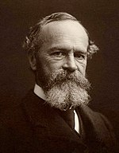
The world we see that seems so insane is the result of a belief system that is not working. To perceive the world differently, we must be willing to change our belief system, let the past slip away, expand our sense of now, and dissolve the fear in our minds.
- William James
Notes:
…

Slide 8
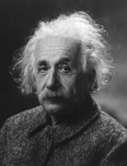
“The most important decision we make is whether we believe we live in a friendly or hostile universe.”
– Albert Einstein
Notes:
"A human being is a part of the whole, called by us “Universe,” a part limited in time and space.
He experiences himself, his thoughts and feelings as something separate from the rest—a kind of optical delusion of his consciousness.
The striving to free oneself from this delusion is the one issue of true religion.
Not to nourish it but to try to overcome it is the way to reach the attainable measure of peace of mind.
- Albert Einstein" (Wheatley, 2023, pp. 231-233)

Slide 9
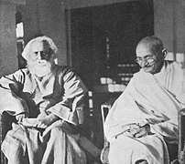
“It is very simple to be happy;
but it is very difficult to be simple.”
- Rabindranath Tagore
“Your beliefs become your thoughts, Your thoughts become your words, Your words become your actions, Your actions become your habits, Your habits become your values, Your values become your destiny.”
- M. K. Gandhi
Notes:
…

Slide 10
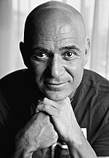
You’ve got to believe you can win.
But I believe respect for the fact that you can lose is what you always have to keep in mind so that nothing surprises you.
- Andre Agassi
Notes:
…

Slide 11
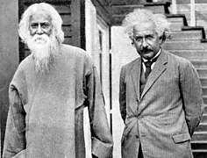
EINSTEIN: The mind acknowledges realities outside of it, independent of it. For instance, nobody may be in this house, yet that table remains where it is.
TAGORE: Yes, it remains outside the individual mind, but not the universal mind. The table is that which is perceptible by some kind of consciousness we possess.
Rabindranath Tagore first Indian to win Nobel Prize
in conversation with Albert Einstein
JULY 14, 1930, about 4 o’clock
Notes:
…
Reference Notes
Rabindranath Tagore In Conversation with Albert Einstein
Collected by Avijit Roy
[Excepted from – “Einstein and Tagore Plumb the truth : Scientist and Poet Exchange Thoughts on the possibility of its Existence without relation to Humanity” by Dmitri Marianoff, published in NewYork Times, August 10, 1930]
JULY 14, 1930 ON THE NATURE OF REALITY
Near Potsdam is a small place called Caputh. There, upon a hill, stands a brown wooden house with a red tile roof. Round about, like sentinels, stand the slim trunks of pine trees. In the wooden villa dwells the mathematician, Albert Einstein.
At about 4 o’clock one recent afternoon Rabindranath Tagore walked along the sandy path to the house. he wore a suit of soft, blue cloth; he leaned a bit forward as he walked and one hand was bent behind his back. Beside him stood sturdy, erect Einstein …
TAGORE: You have been busy, hunting down with mathematics, the two ancient entities, time and space, while I have been lecturing in this country on the eternal world of man, the universe of reality.
EINSTEIN: Do you believe in the divine isolated from the world?
TAGORE: Not isolated. The infinite personality of man comprehends the universe. There cannot be anything that cannot be subsumed by the human personality, and this proves that the truth of the universe is human truth.
EINSTEIN: There are two different conceptions about the nature of the universe – the world as a unity dependent on humanity, and the world as reality independent of the human factor.
TAGORE: When our universe is in harmony with man, the eternal, we know it as truth, we feel it as beauty.
EINSTEIN: This is a purely human conception of the universe.
TAGORE: ThE world is a human world – the scientific view of it is also that of the scientific man. Therefore, the world apart from us does not exist; it is a relative world, depending for its reality upon our consciousness. There is some standard of reason and enjoyment which gives it truth, the standard of the eternal man whose experiences are made possible through our experiences.
EINSTEIN: This is a realization of the human entity.
TAGORE: Yes, one eternal entity. We have to realize it through our emotions and activities. We realize the supreme man, who has no individuaL limitations, through our limitations.
Science is concerned with that which is not confined to individuals; it is the impersonal human world of truths. Religion realizes these truths and links them up with our deeper needs. Our individual consciousness of truth gains universal significance. Religion applies values to truth, and we know truth as good through own harmony with it.
EINSTEIN Truth, then, or beauty, is not independent of man?
TAGORE: No, I do not say so.
EINSTEIN: If there were no human beings any more, the Apollo Belvedere no longer would be beautiful?
TAGORE: No!
EINSTEIN: I agree with this conception of beauty, but not with regard to truth.
TAGORE Why not? Truth is realized through men.
EINSTEIN I cannot prove my conception is right, but that is my religion.
TAGORE Beauty is in the ideal of perfect harmony, which is in the universal being; truth is the perfect comprehension of the universal mind. We individuals approach it through our own mistakes and blunders, through our accumulated experience, through our illumined consciousness. How otherwise can we know truth?
EINSTEIN: I cannot prove, but I believe in the Pythagorean argument, that the truth is independent of human beings. It is the problem of the logic of continuity.
TAGORE : Truth, which is one with the universal being, must be essentially human; otherwise, whatever we individuals realize as true, never can be called truth. At least, the truth which is described as scientific and which only can be reached through the process of logic – —in other words, by an organ of thought which is human. According to the Indian philosophy there is Brahman, the absolute truth, which cannot be conceived by the isolation of the individual mind or described by words, but can be realized only by merging the individual in its infinity. But such a truth cannot belong to science. The nature of truth which we are discussing is an appearance; that is to say, what appears to be true to the human mind, and therefore is human, and may be called maya, or illusion.
EINSTEIN It is no illusion of the individual, but of the species.
TAGORE: The species also belongs to a unity, to humanity. Therefore the entire human mind realizes truth; the Indian and the European mind meet in a common realization.
EINSTEIN: The word species is used in German for all human beings; as a matter of fact, even the apes and the frogs would belong to it. The problem is whether truth is independent of our consciousness.
TAGORE: What we call truth lies in the rational harmony between the subjective and objective aspects of reality, both of which belong to the superpersonal man.
EINSTEIN: We do things with our mind, even in our everyday life, for which we are not responsible. The mind acknowledges realities outside of it, independent of it. For instance, nobody may be in this house, yet that table remains where it is.
TAGORE: Yes, it remains outside the individual mind, but not the universal mind. The table is that which is perceptible by some kind of consciousness we possess.
EINSTEIN: If nobody were in the house the table would exist all the same, but this is already illegitimate from your point of view, because we cannot explain what it means, that the table is there, independently of us. Our natural point of view in regard to the existence of truth apart from humanity cannot be explained or proved, but it is a belief which nobody can lack – —not even primitive beings. We attribute to truth a superhuman objectivity. It is indispensable for us – —this reality which is independent of our existence and our experience and our mind – though we cannot say what it means.
TAGORE: In any case, if there be any truth absolutely unrelated to humanity, then for us it is absolutely non-existing.
EINSTEIN: Then I am more religious than you are!
TAGORE: My religion is in the reconciliation of the superpersonal man, the universal spirit, in my own individual being.
The individual feels the nothingness of human desires and aims and the sublimity and marvellous order which reveal themselves both in nature and in the world of thought. He looks upon individual existence as a sort of prison and wants to experience the universe as a single significant whole, the beginnings of cosmic religious feeling already appear in early stages of development – e.g. in many of the Psalms of David and in some of the Prophets. Buddhism, as we have learnt from the wonderful writings of Schopenhauer especially, contains much stronger elements of it. The religion of the future will he a cosmic religion. It should transcend a personal God and avoid dogmas and theology. Covering both the natural and the spiritual, it should he based on a religious sense arising from the experience of all things, natural and spiritual and a meaningful unity. Buddhism answers this description. If there is any religion that would cope with modern scientific needs it would be Buddhism.
Albert Einstein (1879-1955) German American physicist, mathematician.
Winner of the Nobel Prize
AUGUST 19, 1930 ON MODERN PHYSICS, MUSIC ETC.
Excerpted from “Three conversations: Tagore Talks with Einstein, with Rolland, and Wells” (ASIA 3/1931, p.139-143,196 f.)
TAGORE: I was discussing with Dr. Mendel today the new mathematical discoveries which tell us that in the realm of infinitesimal atoms chance has its play; the drama of existence is not absolutely predestined in character.
EINSTEIN: The facts that make science tend toward this view do not say good-bye to causality.
TAGORE: Maybe not, yet it appears that the idea of causality is not in the elements, but that some other force builds up with them an organized universe.
EINSTEIN: One tries to understand in the higher plane how the order is. The order is there, where the big elements combine and guide existence, but in the minute elements this order is not perceptible.
TAGORE: Thus duality is in the depths of existence, the contradiction of free impulse and the directive will which works upon it and evolves an orderly scheme of things.
EINSTEIN: Modern physics would not say they are contradictory. Clouds look as one from a distance, but if you see them nearby, they show themselves as disorderly drops of water.
TAGORE: I find a parallel in human psychology. Our passions and desires are unruly, but our character subdues these elements into a harmonious whole. Does something similar to this happen in the physical world? Are the elements rebellious, dynamic with individual impulse? And is there a principle in the physical world which dominates them and puts them into an orderly organization?
EINSTEIN: Even the elements are not without statistical order; elements of radium will always maintain their specific order, now and ever onward, just as they have done all along. There is, then, a statistical order in the elements.
TAGORE: Otherwise, the drama of existence would be too desultory. It is the constant harmony of chance and determination which makes it eternally new and living.
EINSTEIN: I believe that whatever we do or live for has its causality; it is good, however, that we cannot see through to it.
TAGORE: There is in human affairs an element of elasticity also, some freedom within a small range which is for the expression of our personality. It is like the musical system in India, which is not so rigidly fixed as western music. Our composers give a certain definite outline, a system of melody and rhythmic arrangement, and within a certain limit the player can improvise upon it. He must be one with the law of that particular melody, and then he can give spontaneous expression to his musical feeling within the prescribed regulation. We praise the composer for his genius in creating a foundation along with a superstructure of melodies, but we expect from the player his own skill in the creation of variations of melodic flourish and ornamentation. In creation we follow the central law of existence, but if we do not cut ourselves adrift from it, we can have sufficient freedom within the limits of our personality for the fullest self-expression.
EINSTEIN: That is possible only when there is a strong artistic tradition in music to guide the people’s mind. In Europe, music has come too far away from popular art and popular feeling and has become something like a secret art with conventions and traditions of its own.
TAGORE: You have to be absolutely obedient to this too complicated music. In India, the measure of a singer’s freedom is in his own creative personality. He can sing the composer’s song as his own, if he has the power creatively to assert himself in his interpretation of the general law of the melody which he is given to interpret.
EINSTEIN: It requires a very high standard of art to realize fully the great idea in the original music, so that one can make variations upon it. In our country, the variations are often prescribed.
TAGORE: If in our conduct we can follow the law of goodness, we can have real liberty of self-expression. The principle of conduct is there, but the character which makes it true and individual is our own creation. In our music there is a duality of freedom and prescribed order.
EINSTEIN: Are the words of a song also free? I mean to say, is the singer at liberty to add his own words to the song which he is singing?
TAGORE: Yes. In Bengal we have a kind of song- kirtan , we call it-which gives freedom to the singer to introduce parenthetical comments, phrases not in the original song. This occasions great enthusiasm, since the audience is constantly thrilled by some beautiful, spontaneous sentiment added by the singer.
EINSTEIN: Is the metrical form quite severe?
TAGORE: Yes, quite. You cannot exceed the limits of versification; the singer in all his variations must keep the rhythm and the time, which is fixed. In European music you have a comparative liberty with time, but not with melody.
EINSTEIN: Can the Indian music be sung without words? Can one understand a song without words?
TAGORE: Yes, we have songs with unmeaning words, sounds which just help to act as carriers of the notes. In North India, music is an independent art, not the interpretation of words and thoughts, as in Bengal. The music is very intricate and subtle and is a complete world of melody by itself.
EINSTEIN: Is it not polyphonic?
TAGORE: Instruments are used, not for harmony, but for keeping time and adding to the volume and depth. Has melody suffered in your music by the imposition of harmony?
EINSTEIN: Sometimes it does suffer very much. Sometimes the harmony swallows up the melody altogether.
TAGORE: Melody and harmony are like lines and colors in pictures. A simple linear picture may be completely beautiful; the introduction of color may make it vague and insignificant. Yet color may, by combination with lines, create great pictures, so long as it does not smother and destroy their value.
EINSTEIN: It is a beautiful comparison; line is also much older than color. It seems that your melody is much richer in structure than ours. Japanese music also seems to be so.
TAGORE: It is difficult to analyze the effect of eastern and western music on our minds. I am deeply moved by the western music; I feel that it is great, that it is vast in its structure and grand in its composition. Our own music touches me more deeply by its fundamental lyrical appeal. European music is epic in character; it has a broad background and is Gothic in its structure.
EINSTEIN: This is a question we Europeans cannot properly answer, we are so used to our own music. We want to know whether our own music is a conventional or a fundamental human feeling, whether to feel consonance and dissonance is natural, or a convention which we accept.
TAGORE: Somehow the piano confounds me. The violin pleases me much more.
EINSTEIN: It would be interesting to study the effects of European music on an Indian who had never heard it when he was young.
TAGORE: Once I asked an English musician to analyze for me some classical music, and explain to me what elements make for the beauty of the piece.
EINSTEIN: The difficulty is that the really good music, whether of the East or of the West, cannot be analyzed.
TAGORE: Yes, and what deeply affects the hearer is beyond himself.
EINSTEIN: The same uncertainty will always be there about everything fundamental in our experience, in our reaction to art, whether in Europe or in Asia. Even the red flower I see before me on your table may not be the same to you and me.
TAGORE: And yet there is always going on the process of reconciliation between them, the individual taste conforming to the universal standard.
2. Ilya Prigogine’s (Noble Laureate Chemist, 1977) comment:
The question of meaning of reality was the central subject of a fascinating dialog between Einstein and Tagore. Einstein emphasized that the science had to be independent of the existence of any observer. This led him to deny the reality of time as irreversibility, as evolution. On the contrary Tagore maintained that even if absolute truth could exist, it would be inaccessible to the human mind. Curiously enough, the present evolution of science is running in the direction stated by great poet.
3. RUSSELL’S COMMENT ON TAGORE’S MYSTICISM :
Bertrand Russell (1872 – 1970), the great philosopher of the modern era, wrote after hearing Thakur’s lecture on ‘The realisation of Brahma’:
Here I am back from Tagore’s lecture, after walking most of the way home. It was unmitigated rubbish- cut-and- dried conventional stuff about the river becoming one with the Ocean and man becoming one with Brahma. The man is sincere and in earnest but merely rattling old dry bones. I spoke to him before the lecture afterwards I avoided him.’
Russell had more such strong and strenuous commentson Thakur and as quoted recently in the work of Krishna Dutta and Andrew Robinson:
‘I regret I can not agree with Tagore. His talk about the infinite is vague nonsense. The sort of language that is admired by many Indians unfortunately does not, in fact, mean any thing at all.’
3. Tagore’s Letter To Bertrand Russell
37 Alfred Place W, South Kensington, London 13 October 1912
Dear Mr Russell
Thanks for your kind letter. I will ask Dr Seal to pay you a visit at Cambridge, when you will have an opportunity to know him. I read your article on the Essence of Religion in the last issue of the Hibbert Journal with very great interest. It reminded me of a verse in the Upanishad which runs thus-
Yato veiche nivartante aprapya manasa saha Anandam Brahmano Vidvan na vibheti Kutushchama.
‘From him words, as well as mind, come back baffled. Yet he who knows the joy of Brahman (the Infinite) is free from all fear.’
Through knowledge you cannot apprehend him; yet when you live the life of the Infinite and are not bound within the limits of the finite self you realize that great joy which is above all the pleasures and pains of our selfish life and so you are free from all fear.
This joy itself is the positive perception of Brahman. It is not a greed which authority imposes on us but an absolute realization of the Infinite which we can only attain by breaking through the bonds of the narrow self and setting our will and love free.
Yours sincerely
Rabindranath Tagore

Slide 12
Reawakening Your Love of Learning During Strife
So, how do you make a wish that always comes true?
Notes:
…

Slide 13

Notes:
…

Slide 14
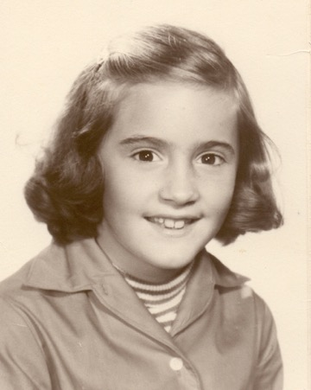
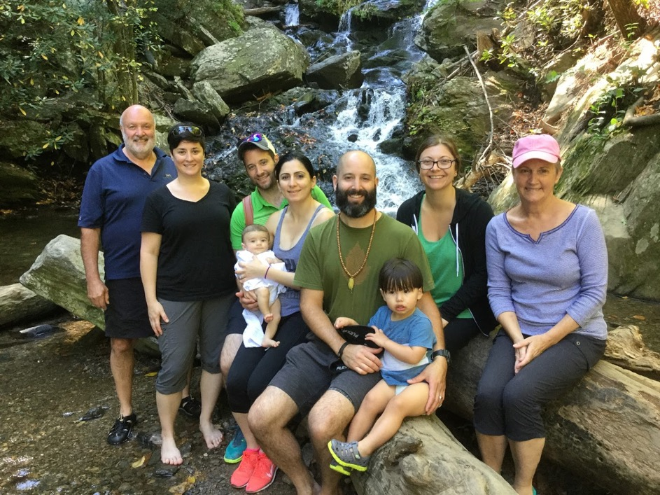

Activity #1 The Story of Wendy Grace …
Opportunities #7 & #10
“When I heard the word, ‘Grace’ spoken aloud in my head, I felt special and taken care of and I could let go.”
Notes:
Wendy Grace
1985 Summer - Wendy is 38, canoe trip hurts her back from reaching up and over to paddle a raft - Wendy is bed ridden most of each day
1986 Wendy totally in bed - only went to hospital once with Barbara Moreland - Summer - Family reunion in Texas, Wendy gets worse, totally bed ridden - try chiropractor, then neurologist
1987 Wendy - May - Kevin is bit by dog and hospitalized, then staff infection - Fall - Rachel gets lyme disease - visits to Dr. Ryland - John sr. starts company
1988 - John gets ALL for next 3 1/2 years - Wendy can only visit with someone driving, lying down in waiting room - John sr. gives up GE contract - accidental dropping of hospitalization (creditors calling for $47,000 collections) - cash in stocks and savings hit $250
1990 - Wendy hits rock bottom and hears "Grace" - she told me, "I was lying there, heard the word 'Grace' spoken aloud in my head and felt that I was given a spiritual help to deal with the situation at hand and let go of the results. The help was not the end result or the logistics. It was that I was taken care of and I could let go." - Wendy lost her ability to make a home: take care of the family, cook, weave, quilt, drive, shop, go to childrens' sports. She said, "I lost my identity, my personality."
1991-1996 Wendy has chronic pain, but slowly getting better.
1997 - Wendy gets breast cancer - not even as meaningful as the devastation of previous 10 years
1998-present - She still has chronic pain, but believes it is temporary. She has an identity - not her personality - her identity is Wendy Grace.
“When I heard the word, ‘Grace’ spoken aloud in my head, I felt special and taken care of and I could let go.” – Wendy
“I slept and dreamt that life was joy. I awoke and saw that life was service. I acted and behold, service was joy.” - Rabindranath Tagore

Slide 15
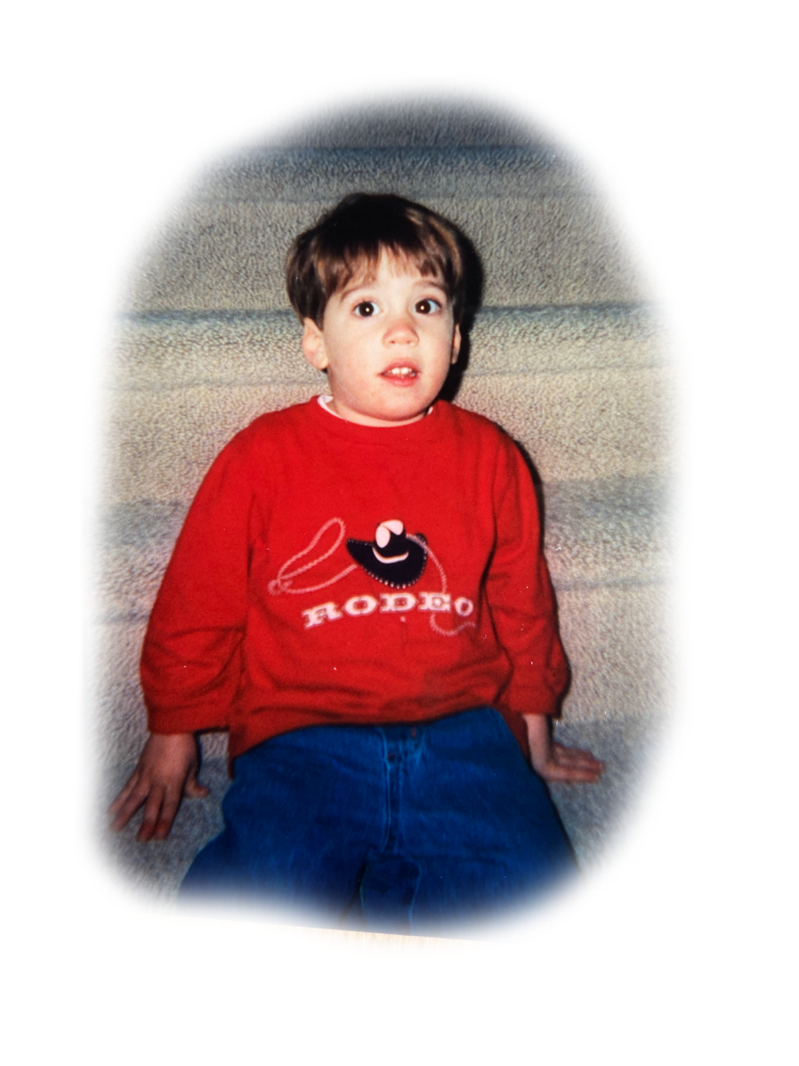
Do you believe that life ‘has your back’?
Notes:
…
Reference Notes
_______ Begin spoken conclusion to book ________
Ok, here is the whole thing in miniature. Picture this. My first grandson, Nick is having a birthday. He's old enough to understand when we tell him, "This is your cake. We're going to put candles in it. We're going to blow out the candles on your cake. We're going to cut up your cake. It will be delicious - you're going to love your cake." And we don't know that he's hearing, "It's MY cake!" He thinks the whole cake is his. We don't know this until we sing the song, blow out the candles, cut the cake, and hand the first piece to one of the 20 adults in the room who are all watching. This has become a family story, because it was so cute to see what happened to his face. As the first piece of cake is being handed away, his face goes from very happy and excited - taking in everyone looking at him and the song being sung to him - to an incredible tragedy. In five seconds, we watched his face transform to a square mouth and he starts crying, thinking, "Oh, what's happening? You're giving away MY cake!" The whole room is melting because it's so cute! Now, Nick ... is in tragedy. He's in utter suffering and we're laughing hysterically. We think that this is the cutest thing because we know - and of course it did happen - that in a couple of seconds, in the next minute - he's going to be fine again. And of course, we gave him his piece, and he started eating it, and his mom is explaining as she is doing so, "Oh, don't worry Nick. As soon as we share your cake, you'll get to have some. There's plenty for everybody." And now he's ok.
I had a picture over the years, that this episode is a miniature picture of where humanity is. Is humankind, Nick? How is it possible to have all of this unbelievable non-sharing of our resources, our money, our land? We carve out a piece of land for OUR house or OUR land and then we kick out all of the animals and anything else that was there before, and the other plants that used to live there, and we say, "No, no, no. This is mine, now." It seems that we are still in a mentality that is young.
Maybe we are not so selfish; maybe we simply don't know how to share because we are young.
Maybe a consciousness shift will cause us to - all of a sudden - want to share, to be in a state where we feel that there is plenty for everyone. There is plenty of food and resources on this planet ... for everyone. What's the problem? That we're young. That we can't see that piece of cake going away from us to anything or anyone else and still feel ok. It's utter tragedy.
Most people would say of this stage of humankind that it is an utter tragedy the way we treat each other. And it is. Well, it is. But how are we going to get to that next step that is so elusive ... world peace? Well, I think it's sharing. And I think that all we have to do is believe that it's possible. My grandson Nick had the belief that there are adults or higher beings or wiser beings than him that are really taking care of the show. He had the feeling that his world, this earthly existence, is a good place. Somebody's going to cut the cake and give me a piece, too! There is an overseeing.
That's a belief. And if you had that belief, you would act differently to maybe take the step to the higher consciousness where we actually would share and realize in reality that things are ok - we would make this place a party.
So, the dedication to my book says, "Compasses are like real friends. They constantly tell you when you are heading the wrong way. This book is dedicated to my 'realest' friend, Wendy." It's a back-handed compliment. That's the dedication to the book! What I'm saying is that - yes - she's always telling me how I'm doing it wrong. But isn't that what you do with a child. Isn't that what we all need. You tell the child every five minutes, "No, that's not how you cross the street. You'll get killed that way. Did you notice anybody else in the room, while you're telling all of your great stories? Are you going to share some of yourself with the rest of the room - share some of the space with the rest of the people?" I mean, there's a lot of things that we all need to hear. And it's by redirecting.
So ... you have to believe that what you are aiming for can happen. And ... you have to be ready to get redirected. That's my final message for the final part of the book. I really do wish to see you in one of those tomorrows. I hope we're all together in some fashion, in the near future. So, thank you for listening. I'm signing off. That's it. Bye.
_______ End spoken conclusion ________

Slide 16

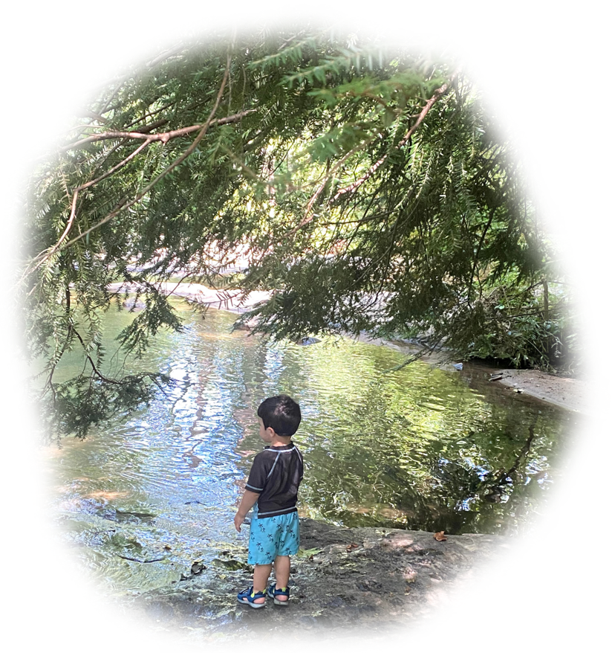
The Spiral
Holistic versus The Divided Self
Opportunities #15, #17, #19
Notes:
The Beginning of Language – and left brain thinking. – Wheatley, Harari, Chopra
first lines of the book Metahuman … “This book is an invitation to find out who you really are, beginning with two simple questions. ‘In moments when you feel very happy, do you also watch yourself being happy? When you happen to get angry, is some part of you totally free of anger?’ If you answer yes to both questions, you can stop listening. You have arrived. You have gone beyond everyday awareness and this going beyond is what it takes to know who you really are.”
Margaret Wheatley - from Who Do We Choose to Be?: Facing Reality, Claiming Leadership, Restoring Sanity (2023)
"I know it is possible to experience grace and joy in the midst of tragedy and loss." (Wheatley, 2023, p. 17)
"... a false perception that identity is individual rather than collective is the reason we have landed here ..." (Wheatley, 2023, p. 20)
"Nothing is immediately clear, but given time and the workings of nonlinearity and Grace, your ideas and feelings will self-organize into insights." (Wheatley, 2023, p. 29)
"I shudder at the predominant images of cavemen—apes with a few human features—grunting and making crude gestures at one another. This portrayal is how we express our assumed superiority—look at those primitives, look at how magnificent we are. This practice of claiming superiority is how Western colonizers treated Indigenous peoples in the past and, alarmingly, still today. We continue to prove our superiority by putting down others as inferior, especially those whose appearance or culture is different. Here are a few examples revealed by recent archeology.24 ■ The first evidence of a stone implement skillfully carved but never used, clearly offered as a gift in burial, is 350,000 years old. It is a very beautiful object of two-colored rose quartz, material transported from seventy-five miles away.25 Thirty-two bodies were found buried at this site, the Pit of Bones in southern Spain.26 ■ Flutes tuned to the pentatonic scale (still the most common scale among humans) were skillfully carved from the wing bones of birds forty thousand years ago. These flutes can still play modern tunes today.27 ■ The Chauvet cave paintings in France are about thirty-six thousand years old. They have a level of artistry not seen again until the Italian Renaissance. ■ Bone necklaces found in both northern and southern Africa date from one hundred thousand years ago. It is assumed such necklaces were worn to indicate social stratification or clans." (Wheatley, 2023, pp. 196-197)
Story #19b
Holistic versus The Divided Self
19. Respect technology, instrumentation, and mechanized measurement without disrespecting the unseen, immeasurable, and non-physical.
(The Teacher's Bill of Rights)
I've been making this carving of a spiral with Mammoth Kauri wood that has been found in New Zealand in a bog where air could not get to the buried trees. Therefore, the trees have survived quite a long time, an estimated 30,000 years. So, I did a little bit of research and found that the 32 symbols, found in rock caves, that are the oldest known to humans are about that age. These symbols were found in 370 separate rock cave sites that are scattered across different continents. So, this means to me that something synchronous happened when this tree was growing, to cause people to start making the spiral and 31 other symbols. This is the same general dating of cave drawings and therefore the first writing.
That got me to thinking. You know, Lao Tzu, in Verse 65 of the Tao Te Ching (Laozi, 2005/circa 500 BC) says that there was an age of innocence a while ago - of primal simplicity. He says that then a great fragmentation occurred, right after the age of innocence, where cleverness overtook wisdom. And I got to thinking about this. Could it be that we used to be in our right brain where we perceived everything as a whole, and then we went more to the left brain? During that time, we started using language, symbols, and dividing everything up. In Lao Tzu's first verse of the Tao he says that a while ago we broke up the Great Integrity. We used to see things as a whole - the Great Integrity. And then, we broke it up into ten thousand things. We started naming things. Well, this isn't necessarily a bad thing, but it is a definite shift. If you look at Harari' best-selling book Sapiens (2017), you see very good research about the accomplishments of the homo sapiens. Though I do not agree with his conclusions - that we are headed to become cyborgs - he reports convincingly, from anthropological studies, that 30,000 to 70,000 years ago the homo sapiens went through a cognitive revolution. I believe that this was the move to using our left brain much more than the right brain. This was the beginning of naming and language and symbols. His conclusion is that if we proceed this way and continue, we are going to become cyborgs because we are becoming mechanical. Well, that's the left brain. If we continue with the left brain, then I agree with Harari.
But. I agree instead with Chopra. Deepak Chopra says, in his book, Metahuman (2021) (meaning 'the next human'), that we are at the stage of the next human. He says what Lao Tzu says. Lao Tzu's first verse in the Tao Te Ching is "Transcending" - that this Great Integrity was broken apart, but now is the time to come back together. And I believe that he is specifically referring to the left and right brain - that there is a time when we can put the lobes of the brain together, transcend what we were, and in Deepak Chopra's words, become the Metahuman, which he claims has infinite potential.
That's what I vote for. I want to be whole again. I want to stop paying attention to all the different things that we pay attention to and just be with the person I'm with - just be with the food that I'm eating - listen to what I'm listening to - stop seeing political and societal factions as us and them. I want to come back together. Isn't there a chance? It looks like it's on the horizon. It looks possible. And so, we'll have to make an effort. And ... don't ask me what it looks like, because the next stage is going to be different. But somehow, I think we can do it. So, I'll see you in one of those tomorrows!
_____________________
"THE LOSS OF INNOCENCE
In recent times,
before there were those who were governed,
and those who governed over,
the sage blended with others,
and all was done through the Primal Simplicity.
People lived in innocence.
When the Great Fragmentation
replaced the Great Integrity
cleverness defeated wisdom.
Even some enlightened sages
became victims of the rulers
commanding the highest intrique."
(Laozi, 2005/circa 500 BC, Verse 65 The Loss of Innocence)
"TRANSCENDING
The Tao that can be told
is not the universal Tao.
The name that can be named
is not the universal name.
In the infancy of the universe,
there were no names.
Naming fragments the mysteries of life
into ten thousand things
and their manifestations.
Yet mysteries and manifestations
spring from the same source:
The Great Integrity
which is the mystery within manifestation,
the manifestation within mystery,
the naming of the un-named,
and the un-naming of the named.
When these interpenetrations
are in full attendance,
we will pass the gates of naming notions
in our journey toward transcendence."
(Laozi, 2005/circa 500 BC, Verse 1 Transcending)
References
Chopra, D. (2021). METAHUMAN : unleashing your infinite potential. [S.l.]: HARMONY CROWN.
Harari, Y. N. P. D. O. I. (2017). Sapiens.
Laozi, D. R. A. C. J. (2005/circa 500 BC). Tao te ching : a new translation & commentary. New York: Barnes & Noble.

Slide 17


The True Teacher
Telling, I became a teacher.
Listening, I became a student.
Thanking, I became a friend.
And then I woke up to find ...
I was Truly Teaching!
Opportunity #2
2. Learn something from your student that transforms you, then show your gratitude. In other words, truly teach by modeling true learning!
(The Teacher's Bill of Rights)
Notes:
Ray Bock, Alex Shevrin Venet (Unconditional Learning, originally from Carl Rogers) – beyond the 3Rs to the 3Ws
Story #2b
The True Teacher
Telling, I became a teacher.
Listening, I became a student.
Thanking, I became a friend.
And then I woke up to find ...
I was Truly Teaching!
2. Learn something from your student that transforms you, then show your gratitude. In other words, truly teach by modeling true learning!
(The Teacher's Bill of Rights)
If you are telling somebody something, you could be teaching. If you are listening, you could be a student. If you are thanking, you could be a friend. But, if you find yourself, as a teacher, listening to a student so well that they taught you something, and you were being moved at having just learned something new, and then, you thanked them ... then you were being a true teacher. You were modeling to them how to learn. You were modeling learning. That is the highest thing for a teacher to do. You want them to thank you, so ... that is what you want to model to your student.
A story. It's back in 2007. I'm in Shanghai International Studies University - SISU, in China. I'm in a position of teaching people who are of all ages. They range from 12 years old to adult. I had students who were doctors, parents, and children. We were going over very simple things having to do with speaking English.
I think it was the first or second day. We split them up into two groups at big round tables and said, "We are going to have a debate. Oh yeah, we know how to teach debating. In America, we argue a lot. We're really good at it. So, I gave them opposite points of view, and I said, "Work on your point of view and decide how to defend it, because you are going to argue against the other group."
I'm standing in the room watching and every single person sitting at the tables is leaning in. They are listening to each other as if every single person - even the 12-year-olds - are the most important people in the world! And I lose it. I have to go the corner of the room for a minute because I'm crying. It is such a moving experience for me to see this beautiful listening that is going on.
Well, the lesson is a bust. They start debating and they did a terrible job. Every time the other group would say the opposite viewpoint, the arguing group would say, "Well, I could see that. I see that point, too. In fact, I needed that opposite point of view in order to complete my view. In fact, I see a middle way."
So, they did not learn the debating, but they taught me a great lesson. By the end of the day, I ended up telling the students, "You taught me about the middle way all over again. It's not like I had never heard of the middle way. It's not like I don't know of the yin and yang for years, but today, you took me another step forward. You showed me how to actually implement a form of listening for the middle way. I just grew. Thank you very much!"
So, although my lesson was a bust, I found myself thanking them for what they taught me. So in the end, it was a very great success. I was a true teacher that day! And that is what I wish for you - to be the true teacher. That's it for today. I'll see you in one of those tomorrows.

Slide 18
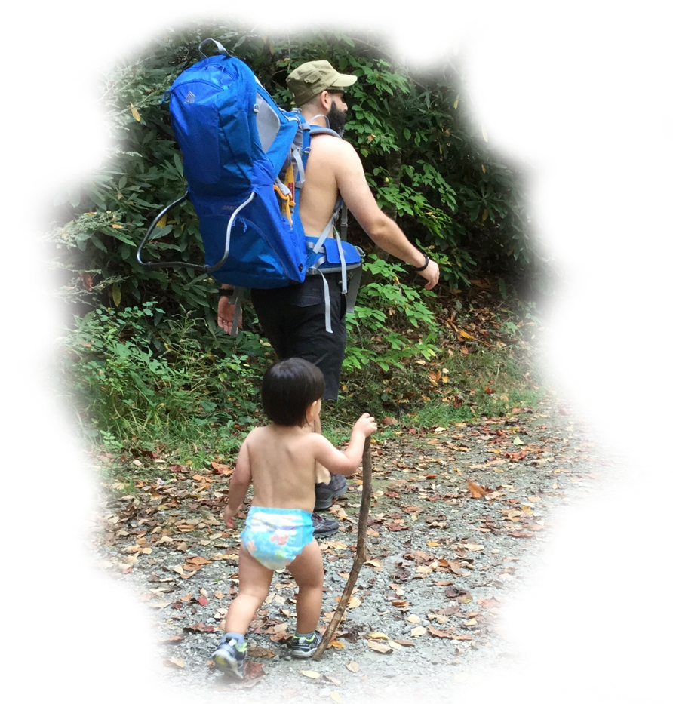
Holistic Education
Plasee raed tihs aluod and ntoe the seepd at wihch you poreced.
A hamun bnieg lokos mroe for cnotxet and wolhe wrdos tahn for ecaxt sllpneig. Yuor inceiblre mnid mstoly lkoos for the fsirt and lsat ltretes of a wrod. Yuong cilhrden wtcah for eevn brodaer ctenoxutal cleus. Trefheore, mkae srue taht you aenttd to btoh the wlohe and its prats.
Notes:
…
, in another one of Lisa's chapters called "INTEGRATION IS KEY", she describes integrating both your awareness to achieve and to be awake. She calls this orientation, the Quest Orientation, like you are on a gallant quest to find something. She writes:
"Quest orientation is characterized by a tendency to journey in life: to search for answers to meaningful personal decisions and big existential questions; to perceive doubt as positive; and to be open to change, or more accurately, open to perceiving with fresh eyes, and then using new experience to fuel change. In quest, we open ourselves to the messages from life, take seriously this discovery, and then actively use learning to shape our decisions and actions—our personal operating manual" (Miller, 2021, p. 169).
Wake Up Call #19a
Holistic versus The Divided Self
I love how Ralph Alan Dale does a translation of the Tao Te Ching. In Verse 21, he has this one paragraph that just blows me away.
"The Great Integrity [John: that's when we perceived everything as one] was apparent
before time, space and matter appeared to separate. [John: which is pretty much as long as we remember nowadays. We think everything is separate.]
How can we re-mind and re-infuse ourselves
with this very touchstone of all essentialities and connections?"
(Laozi, 2005/circa 500 BC, Verse 21 The Great Integrity is a Paradox, Tao te ching : a new translation & commentary)
That's our goal for today. How can we remind ourselves that things are really whole? Well, Socrates said all learning is remembering. You know that re-member means to put the members back together - that were whole - that you forgot are whole. You forgot. We forgot.
So, I have a little exercise to re-member that we're really all whole. Just look at the sky. The sunlight is coming in and makes all light around us, so during the day you can't see the stars. But they're there. And, according to where you are on the earth and how good your eyes are and how the cloud cover is, you can see five to ten thousand stars. Ok? But how many are up there? Well, we don't know. But the latest scientific reports are that we think there are some sextillions of stars.
They're all there, ok? When you look up, and you see all of them, all of those individual beams of light - some of which are not a star, it's a galaxy itself with thousands and millions and trillions of stars within a galaxy - sometimes they're coming into your eye as separate beams. And they are all in the iris of your eye at one time - joined. But by the time it gets from the front of your iris, to the back of your eye, they're separate and you see a separate picture- something that is whole, that has parts. And when you take a step a little bit over to the side, you can still see all of them. That means all of the stars are shining light on that step also - and over here - and over there - and over here - and over here. They're shining light everywhere - something that can be whole and taken apart - that has sextillions of parts, at least. (That's just modern science. We don't know anything. Who knows what is really out there?)
So, the next time you look at it, remember that there is a whole that has many parts that is coming together in your eye - and shining on you - and giving you something - that we used to understand - that we are just starting to re-member. That's it. And it takes sixty seconds to do it. You know what you do? You look up at the sky. And just remember, you're a whole - there's a whole - not an 'us & them' - we're all together. I'll see you in one of those tomorrows.
References
Laozi, D. R. A. C. J. (2005/circa 500 BC). Tao te ching : a new translation & commentary. New York: Barnes & Noble.

Slide 19
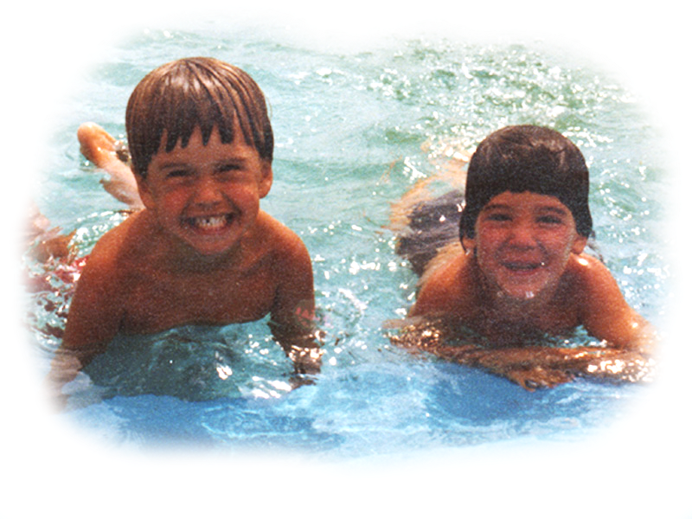
Notes:
I just liked this picture.

Slide 20
Dare we touch ancient legends?
Two Wolves
  An old Cherokee was teaching his grandson about life.
  "A fight is going on inside me," he said to the boy.
  "It is a terrible fight and it is between two wolves.
  One is evil, the other is good.
  The same fight is going on inside you –
  and inside every other person, too."
  The grandson thought about it for a minute
  and then asked his grandfather,
  "Which wolf will win?"
  The old Cherokee simply replied,
  "The one you feed."
  - an Ancient Cherokee Legend
Notes:
...
Ancient msg: Choose Good over Evil …
Should we touch ancient legends? I apologize if this offends … but it seems that we humans stand at an important moment in our history. There is a question as to whether or not we will survive the great change that is upon us. Perhaps many of us will step up or maybe not. And if stepping up means re-writing the codes we have lived by for thousands of years – then so be it.
What old ways should we leave behind? What is the blood and guts of a new story?
Perhaps the new way has something to do with inclusion … perhaps we will find a way to include both the light and the dark … an honoring of the light, while transforming the dark.
***

Slide 21
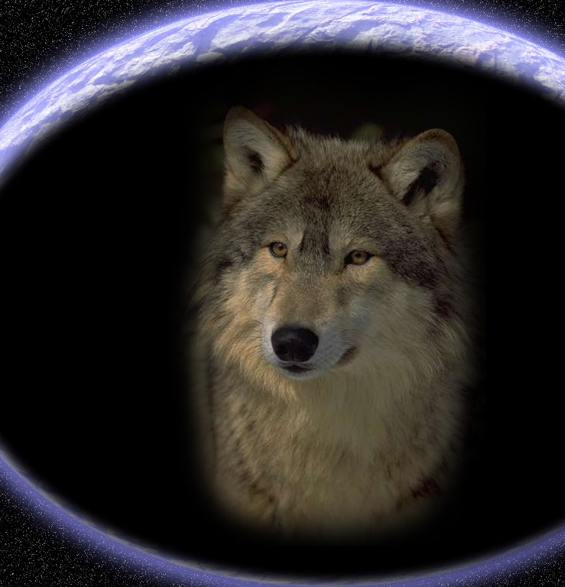
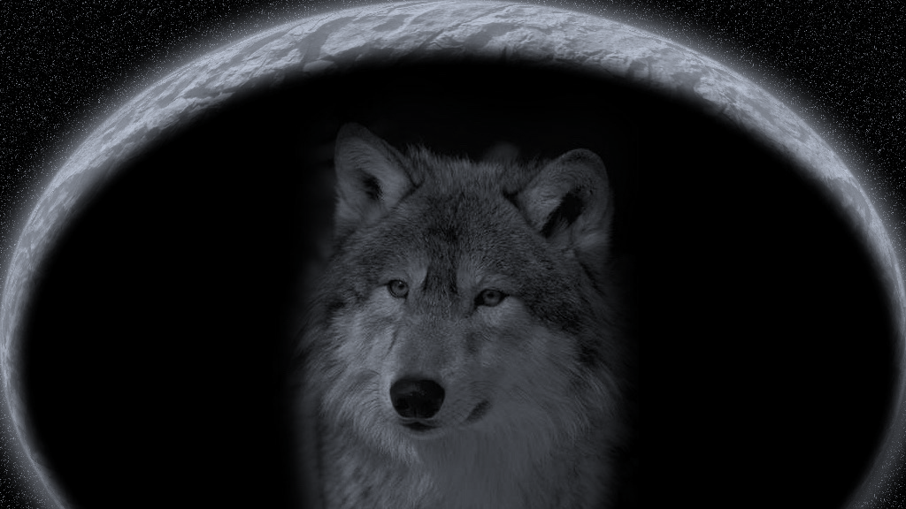
Two Wolves II
Two wolves live
inside of me.
One is trapped
the other free.
The two of them
just want to be.
They fight sometimes.
Now good, now bad.
The trapped one wants
what the other had.
I feel this fight
when I am sad.
Grandpa said,
“Watch who you feed.
He will win.
He’ll take the lead.”
…
I hope some day
that both are freed.
- John Bickart 2011, inspired by an Ancient Cherokee Legend
Notes:
Planting Trees - from the Four Rivers Charter School, MA … The Roots of Change: 2024 Senior Documentary (https://www.youtube.com/watch?v=-ZgnGqvS3Sc)
2024 services for formerly and presently incarcerated individuals:
All Inclusive Support Services
https://hcsoma.org/hcso-facilities/all-inclusive-support-services-2/
UNC Asheville Prison Education Program
prisoneducation@unca.edu
https://prisoneducation.unca.edu/
Warren Wilson College
Turning Education Inside-Out
https://www.warren-wilson.edu/2018/10/01/inside-out/
ABTech
Programs in Prisons Offer Fresh Starts for Residents
https://abtech.edu/news/programs-prisons-offer-fresh-starts-residents
The Compost Cooperative
https://thecompostcooperative.com/collections/all
Emerge Connecticut
New Haven, CT
https://www.emergect.net/
Garden Time
Provicence, RI
https://www.gardentime.us/
Groundwork Rhode Island
Pawtucket, RI
https://groundworkri.org/
Yale School of the Environment
Urban Resources Initiative
https://uri.yale.edu/
***
Matt Leaf, administrator, Four Rivers Charter School, MA:
Incarcerated individuals mixed with students
senior documentary interviews prioritizing in the green category - powerful and transformative - youtube channel "roots of change"
Status of teaching right now (2/19/24)
challenges are there but some people are doing quite well
kids having learning interrupted from covid: greater anxiety, teachers compassion is waning
burnt out, teacher shortages, some have lost it and going straight to punitive - what's wrong with this kid, end of the rope
Matt gives kids a space to calm down before discussing, identify self-defeating patterns and advocate for self - the pace expected does not move at kids' pace
hard knowing how many kids trust adults
one kid during pandemic saw abusive relationship between mom & boyfriend - he showed up
teacher training programs should have social emotional learning - expeditionary learning good here - sel for staff
two levels of sel for kids, tell teachers to care for self, honor feelings they have - sel into program in the class - get explicit - work on how to disagree, pursue goals
strong depression must be normalized - way less stigma on getting mental help -
matt came to it from personal growth from camp - try not to be depressed
we need metrics, testing
things were changing before the pandemic
***

Slide 22
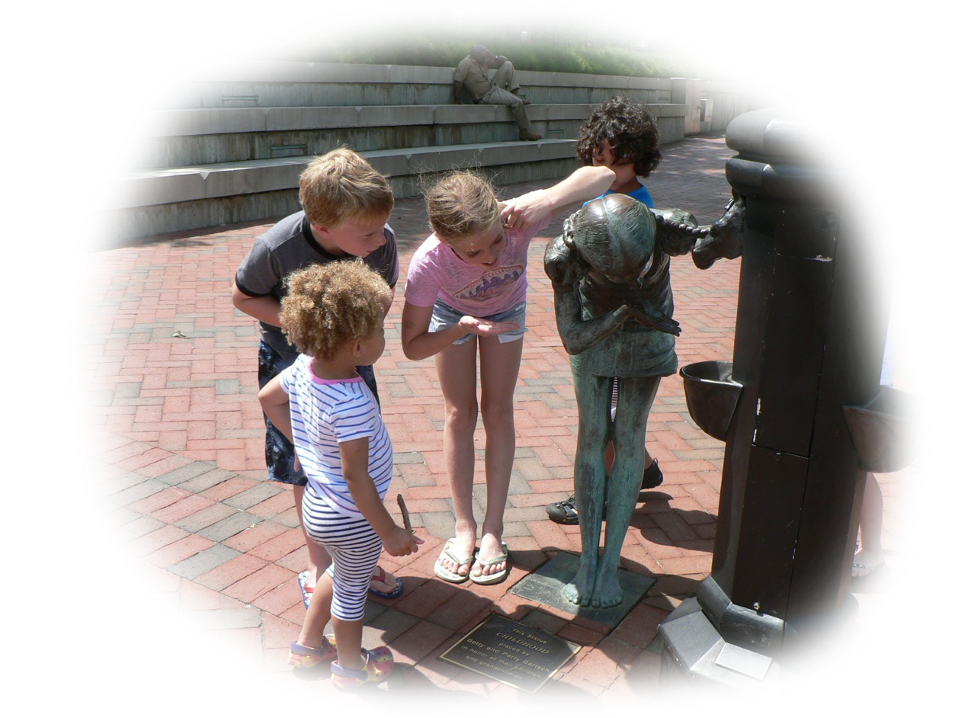
Conclusion to Part 1 of 5
Notes:
cool picture
from Wake Up Call #17a
Naming, Categorizing, Labeling
The World Health Organization has names for 19 food classifications.
We have categorized 118 scientific elements on the periodic table.
6,500 languages have been labeled as those spoken today across the world.
There are 4,000 recognized religions and some 300,000 plus English words, 5,000 new per year, of which 1,000 make it to print.
[added in 2024 …]
The National Health Institute calims that the average child knows about 50 words at age one, 1,000 at age 3, then in the next couple of years they know 10,000 or more.
Whatsapp produces over 100 billion AI-processed messages each day
Nearly 100 million people are expected to work in the artificial intelligence space by next year
We're increasing the sub-divisions of articulating everything about our world, but we're looking less. With the increase in naming and labeling, we notice less - we connect less.
I used to do this exercise. It's almost 50 years now I've done this in classrooms with my students. I select one student. I have the person come up to the front of the room and I turn my back on the student. And then I start naming and categorizing and labeling what about them - all complimentary things - very nice things. But, nevertheless, I'm not looking at the student. And of course, the class knows exactly what I'm doing. Nobody feels bad or anything.
Next, I start saying all of the traits we know about this student. And then I stop. And I say, "But what if today, this student has come to school and a tragedy occurred last night in her home. I wouldn't know that. I'm describing what I know of that student as of yesterday - as of this morning - maybe as of 10 minutes ago. But, did I look into the student? Or did I just look at what she is wearing today? "Oh, here's the student who I know is always ... this way." I'm looking at the outsides, and I'm looking at the historical person - not her. If I looked into her, maybe I would say, "What's the matter? You seem to have something on your heart - on your mind? Are you ok?" But I wouldn't notice it if I don't look.
The ancients used to say, "I see you." They're not looking at the person's body. They're looking at the person's soul. So, today's wake up exercise is to try to undo that. We are in a period of history where the naming is increasing, so we have to increase the connection. We have to undo our separation.
Here's a recommended exercise I'll give to you. Go to the mirror. Face it. Maybe it's the morning. Maybe you're getting ready to go out and get dressed. Now, turn your back on your mirror. And give yourself an encouragement - "You can do it today" - some kind of a statement that you would like to say to yourself that is soulful - something that is right to the heart of YOU. And now, turn around and look into the mirror and do it. And look into your eyes - into you. And see if you feel a difference.
Now, see if you remember not to turn your back on the world - and the people you'll be with - and the trees and the flowers and the air and the birds. Try to not 'phone it in' today. And give yourself this reminder - maybe at the beginning of the day.
That's the wake up call. I know you've heard a million people say this and it's not a unique thing. I'm just a reminder. So, I'll see you in one of those tomorrows.
Story #17b
Naming, Categorizing, Labeling
17. Aim more at the transformation of your students through the experiences they have in your class,
than the information they may receive.
(The Teacher's Bill of Rights)
We're always about the names and the categories and the labels. Deepak Chopra talks about this. He said that children know everything that is of the pure knowing quality, before they learn to label things as such. He said that at 74 years of age, to this day, even though he has practiced many spiritual exercises and techniques and really invests in them since he was a teenager, he still has problems when the language that we must use causes him to take things apart or separate from reality - or what he would call existence. He would say that a baby does not separate. The baby looks all around oneself and says, "That's me. Everything is me and it's all one."
I have a friend who is a social worker who is the glue to many different communities and families. He has an expression that, somehow, I have picked up. He says, "Are we paying attention enough, here? Are we living live!?" He says this because he considers that we are starting to separate from reality, the second we get into our heads with names and categories.
Dr. Lisa Miller, in her book, The Awakened Brain, speaks about this. In an interview with Deepak Chopra, she said that on day one we are inherently spiritual. She believes that there is a pure spiritual knowing that a child has. She gives an example where a child can say that they know something with total surety, without having been told - before learning. She also cites that children can love a homeless person as much as their mother. This shows their unabashed connection to all things. She would say that this shows a top-down causality - that the child knew certain things from within. This is in opposition to learning things in the world, which would be a bottom-up causality.
You know, back in 1937 there was a meeting of Rabindranath Tagore (the Indian poet and sage - first non-European to get the Nobel Prize) and Einstein. They had an excellent discussion - actually a few. If you look at the transcripts of the exact words they exchanged with each other, it's fascinating. Einstein was professing the scientific view of the time (although he was ahead of his time) as bottom-up causality. He said that everything can be understood by examining the particles and the smallest pieces on up of the physical world that we live in. Tagore was saying that he did not think so. He said that he thought that the top-down was causal. He said that there is more to the world that is non-material and non-physical that fulfills the whole. He inferred that the world is caused by consciousness, feelings, and meditative places that you go ... a top-down causation.
So, be careful. When we name and categorize, we're teaching information. Tobin Hart, in his book, From Information to Transformation (Hart, 2001) would say not to solely teach information - teach transformation. He would encourage you to let the student have an experience, not just a lot of names and categories.
We have to have them in order to have our language, but do we have to only have them? That's our message for today. I'll see you in one of those tomorrows.

Slide 23

Notes:
The child, the teacher, and the ancient are naturally holistic.

Slide 24
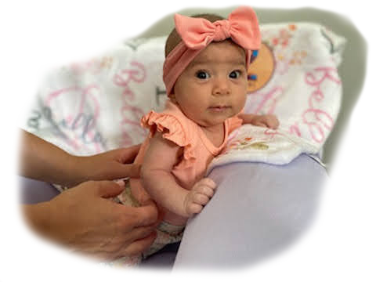
Activity #2
Baby Bella
The senses as a gateway to observation.
Opportunities #13 & #18
Notes:
…
Wake Up Call #18a
The Senses as a Gateway to Observation
"Hot water, cold water, and room temperature water" (my hands are being placed - one hand in cold water, the other in hot. Then I put both in the room temperature water).
You've done this experiment when you were young, right? The hand from the hot feels cold and the hand from the cold feels hot. But, the science textbooks say, “Your senses cannot be trusted because they reported the temperature incorrectly.” Well, that's right. They do tell the wrong temperature. You're not a machine. They're comparing you to a thermometer or a machine. You're not a machine. You're a sense being. And your senses are a gateway to observation. Don't ever tell the kids, "Don't go to your senses." Yes, don't trust them if you want to know the temperature. By the way, if you want to know heat flow, the human body is an awesome detector of heat flow. That's why you kiss the baby's forehead. Because your lips are so sensitive, you can tell if the baby's temperature is getting a little bit warmer or cooler.
But that's not the point. The point is that you should go to your senses. When you go to your senses, you're in your observation. You're not thinking, you're paying attention to what is being received. You are being attentive, and loving attention is one of the foundations of spiritual growth.
So, the wake up call today is, "Use your senses as a gateway to observation! And stay in them all day, all of the time." Every morning I go out on the porch - I close my eyes and I take in - sometimes there's a smell, the fragrance of the outside - I listen to the birds - I have just looked at some of the trees or bushes or the sky or the clouds - and I take in the beauty of that scene and what I heard. Then I close my eyes and replay it. And then, I start my day. It takes less than sixty seconds.
So, guess what your exercise is for today - your wake up call? Go take in something coming into your senses. Especially if it's something growing or alive. I consider almost everything alive. So, take it in. Goethe said, if you take in the beauty of a flower, you complete the flower's mission in life. It has a purpose - it's alive - it's a sentient being - and it's really grateful that you took it in. So, you get a double good for this experiment.
So, I'll see you in one of those tomorrows.
Story #18b
The Senses as a Gateway to Observation
18. Give permission to your student and yourself to observe something without thinking of conclusions - then, later ... see what thoughts arise.
(The Teacher's Bill of Rights)
You know, observation is one of the highest spiritual activities that you can perform. It causes you to be here. Giving loving attention to the world is just a wonderful thing. And your senses cause you to pay attention to the world. So, they are a gateway to observation. But using your senses does not necessarily imply that you are eating food or smelling flowers or listening to music. It also can mean that you are simply paying attention to what's going on around you. You are open with your awareness to everything around you.
Well, somebody taught me this. Her name is Ali. She passed when she was 52 years old, but I knew her since she was a little girl. She was my neighbor. She and her brother and sister were in the carpool with my son and I going to the school where I was teaching. So, I would drive them every day and really got to know them. We played in the park on the weekends and I got to know her as an athlete. She was quite an athlete. She paid attention to her sports as well as everything else, eventually becoming an Olympic Athlete for the American Handball Team.
As she was growing, I watched her serious perseverance - but also her presence. And it struck me to see that as her mom got sick, Ali chose to stay home. Of the whole family, she chose to stay home and have a job while nursing her mother until her mom's passing. And besides that, she went back to school to become a doctor. I mean, medical school is hard. But she had perseverance and presence for that too, which I also admired.
Several years later, she was visiting me. She was out here for nine days with her soon to become wife, Aida and Aida's mom. But, for all of the hikes we were supposed to go on, Ali kept saying that she was sick and didn't feel well. This was very unusual. A person with this much perseverance - staying home from a hike? It was unheard of! Then it turned out, the next month when she got home, she found out that she was in stage four of lung cancer.
Well, she persevered in that the way she persevered in everything else. She battled the cancer and lived her life! I got to proceed at her wedding. During it, I said to she and Aida and the group that was present, "Ali is one of the people who is a voice in my head." Since she was little, I could draw on who she was as somebody that I really respected.
Ali eventually went to Colorado Springs and lived right in sight of Pike's Peak and took hikes up into the mountains. I took a hike with her right before her passing, and although she was in so much pain that she was crying, she wanted to do the whole hike. She just loved the mountains and loved the outdoors and wanted to finish what she had started. She was persevering and enjoying her life right till the end. But it wasn't till just now - years later - making this video that I realized how she is a voice in my head. Normally, when you say someone is a voice in your head, you mean that you can think of things that they say. You hear words, you here phrases that come back to you. But she is a voice in my head for who she was in demonstrating - how to go to your senses. She is an example I draw on quite often actually. I think, what would Ali do? How would she approach this situation? Not just to persevere through - but to be present. And that takes your senses.
And so, thank you Ali and thank you for listening. I'll see you in one of those tomorrows.

Slide 25
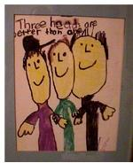
Activity #3: Balance Our Believing Brain through vertical and horizontal brain wholeness integration exercises.
Opportunities #1 & #20
Illustrated by Daniel Bickart
“Three Heads are Better than One”
Notes:
Brain integration – Dan Siegel, Daniel Goleman, Linda Lantieri
Horizontal Integration – left and right lobes of the brain - left: analytical, logical, ‘head’ - right: intuitive, creative, heart - INTEGRATES = like a person who is quite aware of others, yet achieve personal goals - ‘heart thought’
Vertical Integration –cerebral cortex (upstairs): planning, self-understanding, social-emotional – stem, limbic region and the amygdala (downstairs): automatic responses, emotional, impulsive
Dan Siegel, Awareness and Mindsight (Siegel, 2010, 2018) compares vertical and horizontal brain integration to a choir of many voices. Each voice is separate, but the whole choir has a vitality of harmony.
I don't know about you, but I went to the school of hard knocks. When I was very young, everything looked good. As I got older, not so much. I guess the hard knocks got to me. Life brought difficulties, responsibilities, good days, and hard ones, too. Then, I started teaching. The youth I taught have given me a fresh start! If I consciously use their eyes to perceive the world, I have a window into the beautiful and the good. Yes, I have to make the effort, but it works. I believe that it works because the world is inherently good and the youth are innately wise enough to know this. They have a spiritual knowing that is true. They KNOW that the world is good. So, when I need to reawaken my love of teaching, I look into their eyes and through their eyes ... and there it is - the knowing that I had temporarily forgotten.
Reference Notes
***

Slide 26
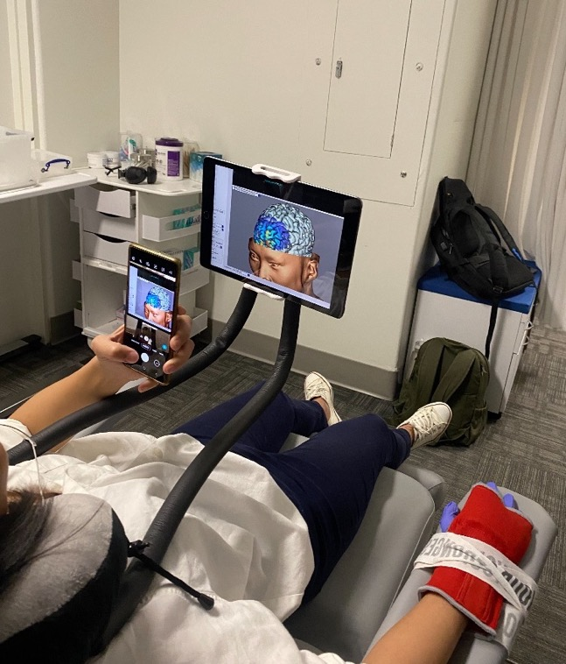
Brain Integration
Veritcal Integration
– cerebral cortex (upstairs): planning, self-understanding, social-emotional
– stem, limbic region and the amygdala (downstairs): automatic responses, emotional, impulsive
Integration: You temper a ‘fight or flight’ decision.
Horizontal Integration
– left lobe of the brain (head): analytical, logical
– right lobe (heart): intuitive, creative
Integration: Heart Thought!
A post concussion patient watching (in real time) a Transcranial Magnetic Stimulation FMRI readout of her brain as the doctor (my son, Kevin) performs a stimulation. Kevin wonders if her ability to watch will cause a placebo effect.
Notes:
Dr. Kevin Bickart is a neurologist/neuroscientist, double board certified in brain injury medicine and behavioral neurology/neuropsychiatry currently at UCLA.

Slide 27
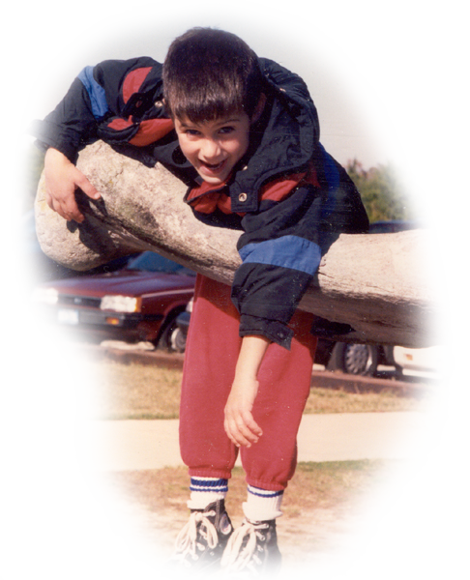
How do you talk to yourself?
Believing is a Cause
not a Consequence
Don’t ask yourself
if you believe 100% …
just ask yourself,
“Is it more yes or no?”
“The warrior's approach is to say ‘yes’ to life: ‘yes’ to it all. We cannot cure the world of sorrows, but we can choose to live in joy.” - Joseph Campbell
Notes:
Dacher Keltner of UC Berkeley, in his recent book BORN to BE GOOD, said that laughter is the primordial deep breath - that laughter probably preceded language.. Laughter is extremely contagious and builds bonds, cooperative responses in others. George Bonnano of Columbia University unconventionally found in a study of trauma that after trauma, rather than suffer prolonged periods of maladjustment, anxiety, distress, and depression, his findings in every study he has conducted for 10 years that they experience distress and upset, but within a year more poignant and wiser. Laughter is also what he says is key. He tells in his chapter on Compassion of George Orwell coming face to face in the Spanish Civil War with an enemy soldier who was half dressed, holding his pants up with his hand. Orwell refused to shoot.
Victor Frankl suggests in Man's Search for Meaning (2021), from his experiences in a concentration camp. He suggests that you focus on something - instead of the pain - that has real meaning for you in your life at this time - not the meaning of life - meaning for you, right now! That's a great thing for you to do and it's a re-direction of your focus.
…
There are times where the opposite of redirecting your focus is to focus directly on the pain, itself. At times, Victor Frankl recommends that you make an intense study of what's going wrong, and face the problem. If it's not going away by thinking of something else, then you go in toward it. Byron Katie would say in Loving What Is (2002), that it is what it is. It's not going away. Maybe it's something from your past that keeps haunting you - it keeps coming up. You don't like what happened. Well, it happened. It is what it is.”
Wake Up Call #20a
The Role of Belief
Belief is the king of it all. If you can believe something and conceive of something, you can probably achieve it. You've heard that saying, maybe?
Let's look at your hands, first. What do you do when you are thinking of making a wish or a prayer? Some people put their hands together, like bringing the lobes of the brain together so your head and your heart and your wholeness is wishing for one thing. Some people put their hands open and receive and thank whatever is coming. And some people cross their fingers and cross their heart. When you cross the body, there's an integration of the left and right lobe of the brain.
I helped a student in high school (when I was a senior in high school) to come out. He was emotionally disturbed. He could not negotiate the world. And so, we played a lot of games where we crossed the body - ping pong - threw balls. I gave him a private gym class. He came out. It was the most wonderful thing to see. He got a job. He started driving around town on his bicycle. And his family was unbelievably happy. So, there is a lot to this action (crossing my hands).
So, how do you make a wish? Well, today's wake up call is to make a wish. But, there's two steps to it. First, you have to hitch your wagon to a star. What's the star you're wishing for? What is the end result you want - that you are making the wish about? Step two, do you believe it? Do you believe it can happen? You can conceive of it - but can you believe it? Because, the step three that everybody is always talking about - how to get there - how to accomplish your wish - is non-important compared to these two steps. What's the star you are hitching your wagon to and do you believe it's possible. From that comes all of the logistics of how to get there, and the determination and the will and the energy with which you will get there.
So, your wake up call for today is hitch your wagon and believe. That's the role of belief. Belief is a cause, not a consequence.
So, thank you very much - I'll see you in one of those tomorrows.

Slide 28
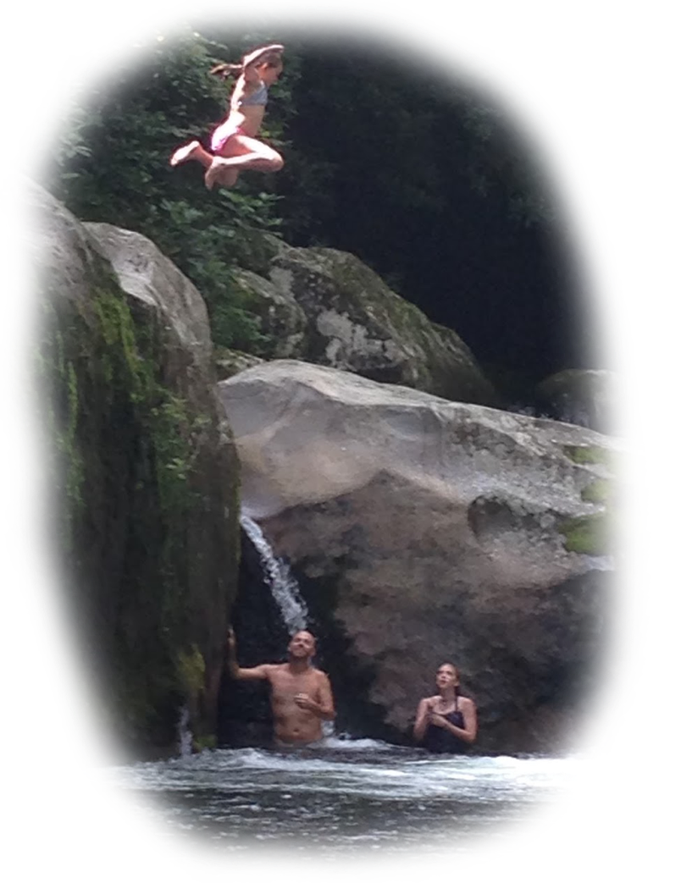
The Leap
Picture what you really wish.
…
Is it for a friend to end an addiction?
Is it to get along with someone?
Is it to surface from deep depression?
Is it to believe in advance that whatever happens is already good?
…
Now, notice which way you lean.
Can you say, “I think this can work?”
Are you already grateful?
Notes:
…
Story #20b
The Role of Belief
20. Allow for the possibility of becoming inspired by a belief prior to its arrival in your conscious mind; but then,
check it out analytically to see if it makes sense.
(The Teacher's Bill of Rights)
Ok, for the final 20th one, The Role of Belief. Do you remember on my first one - the first Wake Up Call and the first Story, I said, First Change Yourself? Well, yeah. Do you want to be the change you wish to see in the world? Then, you have to change yourself. You have to be the change.
Lisa Miller said it better than I could say it. "This is perhaps the biggest revelation of the awakened brain: that it’s in our innate nature to build a better world. That what’s good for everyone is also what’s best for each one of us." (Miller, 2021, p. 224) We could do this. It's in our innate nature.
In all of my talks, I constantly am trying to say that if you want to make a change to yourself - or anything:
- first, figure out what you want to change,
- then, believe it,
- then plan it.
Belief comes before planning. Belief is a causative, not a consequence. First believe it, then plan it. Going around planning things without really being invested doesn't work. So, yes, you have to arrive at a plan, but you have to believe that you are going to do it first. You must invest all of your effort in that belief stage. That's where we fail. That's why we don't have world peace. It's because we can't really believe it - "Oh, I don't think that's really going to happen." We say it at a pageant. "Oh, the thing I want most is world peace!" But everybody goes home saying, "Yeah, but I can't see how it's going to happen!"
Today's message is perhaps my biggest message. It's got the most juice in it. This is important. You can't see the next version of yourself from the current version of yourself. That's why it's the NEXT version of yourself! You're going to be different in the next version of yourself - you will have made the change you wanted to make. You could have imagined certain qualities of it. Perhaps the change or star you hitched your wagon to is sharing. Or perhaps you wished to see the human race not fighting. I would like to see peace. I would like to see happiness. But, how you are going to get there is always the question that stops you! The problem is that we let that question of the plan stop us.
What everyone does - that is the blind spot of our time is to say, "Well, I can't see how to get there." Right! You can't because, that's precisely why we're not there. The current version of us can't see how to get to our next version or else we would be at the next version. There's enough food on the planet. We just can't see how to share it.
The human race has to be told, "Believe that there will be enough. Believe that after you start doing this act of sharing - that you cannot conceive of at this time - everything will be alright." You can't conceive of your next version at this time - a version where you will want to share, where you won't be happy until the person next to you is happy. You can't conceive of it in your current condition, because you're not there (in the next version of consciousness). But the way to get to that future consciousness is by starting to believe. You take a step in pure belief, and you don't even see the net. But it will appear. And then, you start to feel a little bit for your fellow human, a little bit more than yesterday. And then you see the next step because you took that step. And the way to proceed is in the dark, with blinders on, because of your belief. And then ... you get to plan. You cannot ever get the plan for the next thing that you are going to be, before you ARE it.
This is a giant blind spot of our time. This is what you must overcome, if you want to change or transform yourself. That is my final and best message that I've got. So, I want to go see one of those tomorrows, because it's going to be better than today. I just know it. And thank you very much if you've been listening.
References
Miller, L. W. E. S. (2021). The awakened brain : the new science of spirituality and our quest for an inspired life.
***
“So you have to trust that the dots will somehow connect in your future. You have to trust in something - your gut, destiny, life, karma, whatever. Because believing that the dots will connect down the road will give you the confidence to follow your heart even when it leads you off the well-worn path and that will make all the difference.”
He started Apple in a garage, grew to $2 billion in 10 years - got fired - devastated - but still loving what he did, - not seeing the dots - had the most creative period of his life. He started Next computers, Pixar animation studios, and met his wife. Pixar released Toy Story and became the most successful animation studio in the world - Next was bought by Apple - and he was happily married - Steve Jobs' 2005 Stanford Commencement Address
***

Slide 29
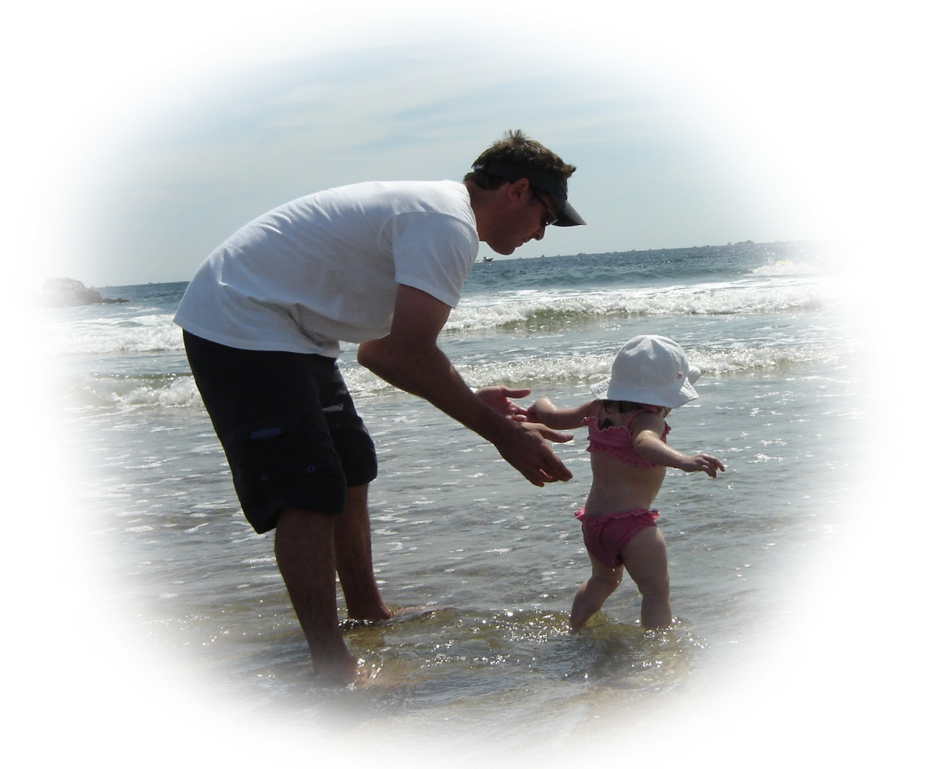
Belief is a cause -
not a consequence.
Believing in someone
(or yourself)
sometimes means letting go.
Letting go
can awaken learning.
Notes:
"... in the future no human being is to find peace in the enjoyment of happiness if others beside him are unhappy."
- Rudolf Steiner
***

