Slide 1
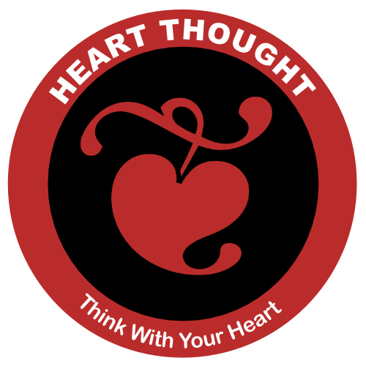
Notes:
Wake Up Call #10a
Heart Thought
Today's wake up call is a great way to think with your heart. Our goal will be to integrate head thought and heart thought, but primarily lead from the heart.
This is brought to you thanks to Lisa Miller, from her book, The Awakened Brain. In a chapter called "THE TWO MODES OF AWARENESS" she writes about the difference between having a day where you are only paying attention to what you have to get done or achieve. She calls this an achieving awareness. The other mode of awareness involves waking up to what is happening all around you. She calls this an awakened awareness.
"﻿As a result of this awakened awareness, our eyes move to meaningful events. In achieving awareness, the stranger who starts talking to us on the bus might be annoying or intrusive, or just invisible. In awakened awareness, we might hear what he says—and even see how it’s relevant to our own lives" (Miller, 2021, p. 165).
Then, in another one of Lisa's chapters called "INTEGRATION IS KEY", she describes integrating both your awareness to achieve and to be awake. She calls this orientation, the Quest Orientation, like you are on a gallant quest to find something. She writes:
"Quest orientation is characterized by a tendency to journey in life: to search for answers to meaningful personal decisions and big existential questions; to perceive doubt as positive; and to be open to change, or more accurately, open to perceiving with fresh eyes, and then using new experience to fuel change. In quest, we open ourselves to the messages from life, take seriously this discovery, and then actively use learning to shape our decisions and actions—our personal operating manual" (Miller, 2021, p. 169).
So, here' the wake up exercise I'm recommending today. In the next week, try this exercise, if necessary, several times. Maybe it will work right now! Do you have any annoying or intrusive situations in your life? Well, as my wife says, "Turn that little frown upside down." Let's try to turn a "doubt or downer" to at least consider that this problem can be used to fuel change. Ready? Ok, right now, picture one of your problems. Is it something financial, health, or a relationship? If nothing comes to mind, picture it later.
Next, clear out your lower awareness of it and wait ... Can you see any way this could be used to fuel a change or a learning experience? Then, for this next week, use Lisa's "quest orientation" to catch yourself several times a day with "doubts and downers" and look for life's deeper messages.
That's it! That's the whole exercise. I'll see you in one of those tomorrows.
References
Miller, L. W. E. S. (2021). The awakened brain : the new science of spirituality and our quest for an inspired life.

Slide 2
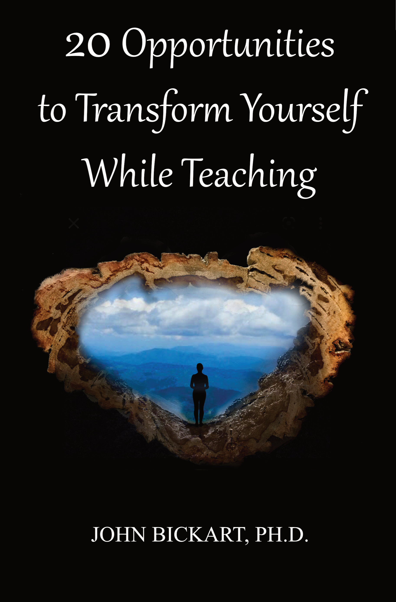
The Believing Brain
(taken from chapters 17-20)
Notes:
Introduction
"... in the future no human being is to find peace in the enjoyment of happiness if others beside him are unhappy."
- Rudolf Steiner
The Whole Book
The spiritual lessons herein came from ancient wisdom. They are incredibly hard to sum up or group or reduce. They defy categorization as you are going to see - they are, each one, a whole life's work and a whole solution to life's big questions. I could have introduced every one of the 20 chapters by saying, "All of life is about ... ," and then named one of the opportunities: heart thought or belief or reawakening the child in the adult or whatever. The reason for this is that a true spiritual lesson actually contains all of the other spiritual lessons in it. So, my recommendation for reading this kind of book is to come back to it often, crack it open on any random chapter, then let yourself go and have fun in that chapter as if you are reading the secret of secrets and there is no need to know anything else.
The 20 Opportunities
These are my favorite exercises. I've used most of them for about half a century. They are simple things. Each one of them takes less than a minute. They are answering a question that has been nagging at my brain - and perhaps yours - our whole life. The question is something like, "Do you want to change? Do you wish you could be another version of yourself, one that is a little bit better in some ways? Do you wish to help the world?" Well, that is what transformations are all about. They are exercises to spiritually awaken so that we can do some of those things.
What is spiritual? Do you remember when you were a child? Do you remember the time before life heaped layers of experiences upon you? If you could recover how you were when you were a child, that would be a spiritual awakening. Why? Because, when you were a child, you were pure and innocent, and, in a certain way, you knew what good was in the highest sense. You knew what GOOD was. That is spiritual - for your higher self to know what you really want. And for most of us this takes change ... transformation. That's all there is to it.
Transformation. So, how to transform? Let me get a few rules down, here. There are a few things you have to know. Number one, it's not easy. Number two, it's not fast. And, number three, you have got to do it yourself. You can't get anyone to change you with some kind of a quick fix. You have to go through what an addict has to go through, because we are addicted to the head! And we have to get back to the heart. So, if that's your addiction, how do you handle it? You 'unlayer'. You let go of your thinking that is in your head, and you learn what it takes to have a heart thought.
What is a heart thought? It's a thought that includes what your head knows and what your gut knows. It's where your heart is the boss over the head, heart, and gut. It's the highest truth you know. The spiritual awakening. So, I'm going in circles. Yes. All of my exercises go in circles, because they say, "If you want to transform yourself, yes, go transform yourself!" But, that's basically it. You kind of know somewhere inside you, what you wish at any one time in your life, if you stop and heart-think about it.
The Method
Getting there is the whole problem. Rabindranath Tagore said, “It is very simple to be happy; but it is very difficult to be simple.” It's an 'unlayering' of everything - a dismantling - a letting go of stuff. And guess where that stuff is? In the head. So, if you can let go of those kinds of thoughts and clear out and get back to the heart, then you are awakening. You are transforming yourself.
So, the basic method is to do it repeatedly. That is how you do it to yourself. Keep coming back here to listen to these one-minute exercises or read some good books or listen to some people who are mentally and spiritually healthy. Do this repeatedly - while your day is in progress. By using this repetition method, you will find yourself slowly becoming the next version of yourself.
That's it. I wish you luck. I hope that you enjoy them, and I'll see you when you come back, in one of those tomorrows.

Slide 3
Literature Review as seen on bickart.org
Wisdom Teaching and Practical Exercises (Laozi, 2005/circa 500 BC)
Childhood & Spirituality (Bickart, 2013, 2018, 2020a, 2020b, 2020c, 2022; Hart, 2001, 2010, 2014a, 2014b; L. Miller, 2015; L. W. E. S. Miller, 2021)
Awareness, Mindsight, and Flow (Csikszentmihalyi, 1994; Csikszentmihalyi & Pratt, 2017; Siegel, 2010, 2018)
Mindfulness and Nondual Awareness (Chopra, 2021; Chopra, Ford, & Williamson, 2010; Lantieri, 2008; Palmer, 1993, 1998, 2004; Palmer, Zajonc, & Scribner, 2010)
Emotional and Social Intelligence, Presence (Goleman & Boutsikaris, 2006; Goleman & Senge, 2007; Goleman & Whitener, 2005; Senge, 2000, 2008)
Belief (Dispenza, 2017; Dispenza & Boyce, 2016; Dispenza, Knight, & Encephalon, 2005; B. H. Lipton, 2005, 2006, 2014; B. H. Lipton, Bhaerman, S., 2009)
Right versus Left Brain Dominance (McGilchrist, 2009)
Early Opposition to the Mechanical View of Humans (Dewey, 1910, 1916/2005)
Historically Assumed Separateness (Kuhn, 2004)
Reduced Importance of Childhood (Piaget, 1929/2007, 1950, 1959, 1965, 1973, 1976; Piaget & Inhelder, 1969; Piaget & Valsiner, 1927/2001)
Excessive Testing (Darling-Hammond, 2010; González & Darling-Hammond, 1997; Gurwitz, Darling-Hammond, Pease, Education., & Corporation., 1981; Haggstrom, Darling-Hammond, Grissmer, & Center for the Study of the Teaching Profession (Rand Corporation), 1988; Koppich, Merseth, Darling-Hammond, American Association of Colleges for Teacher Education., & National Commission on Teaching & America's Future (U.S.), 2000; Millman & Darling-Hammond, 1990; Wise, Darling-Hammond, Berry, Profession., & Education, 1987; Wise, Darling-Hammond, & Klein, 1986; Zeichner et al., 2000)
Education: Students-only, Community-centered, Right Answers, Restricted Resources, Not tests, Not algebra, Not control, Not norms, Brick & Mortar Schools, Integrated Disciplines, Inspirational Content (Dintersmith, 2018; Hart, 2001)
1800s Factory Model (Skinner, 1953; Thorndike, 1913/2010)
Notes:
References
Bickart, J. (2013). The possible role of intuition in the child's epistemic beliefs in the Piagetian data set. (Ph.D. Dissertation). UNCC, Charlotte, NC. DAI/A 74-11(E) database. (3589794)
Bickart, J. (2018). The next version of you: 12 stories that highlight the use of intuition to update your life.
Bickart, J. (2020a). Bickart’s Just-in-Time Fables (Vol. 3). Asheville, NC: Red Shirt Interactive Group.
Bickart, J. (2020b). Bickart’s Just-in-Time Fables (Vol. 2). Asheville, NC: Red Shirt Interactive Group.
Bickart, J. (2020c). Bickart’s Just-in-Time Fables (Vol. 1). Asheville, NC: Red Shirt Interactive Group.
Bickart, J. (2022). 20 Opportunities to Transform Yourself While Teaching. Asheville, NC: Red Shirt Interactive Group.
Chopra, D. (2021). METAHUMAN : unleashing your infinite potential. [S.l.]: HARMONY CROWN.
Chopra, D., Ford, D., & Williamson, M. (2010). The shadow effect: Illuminating the hidden power of your true self. New York: HarperOne.
Csikszentmihalyi, M. (1994). Flow : living at the peak of your abilities. Niles, Ill.: Nightingale-Conant Corp.
Csikszentmihalyi, M., & Pratt, S. (2017). Finding flow : [the psychology of engagement with everyday life].
Darling-Hammond, L. (2010). The flat world and education: how America's commitment to equity will determine our future. New York: Teachers College Press.
Dewey, J. (1910). How we think. Boston: D.C. Heath & Co.
Dewey, J. (1916/2005). Democracy and education: An introduction to the philosophy of education. New York: Cosimo Classics.
Dintersmith, T. (2018). What school could be : insights and inspiration from teachers across America.
Dispenza, J. (2017). Becoming supernatural: how common people are doing the uncommon. Carlsbad: Hay House.
Dispenza, J., & Boyce, A. (2016). You Are the Placebo. [United States]: Author's Republic : Made available through hoopla.
Dispenza, J., Knight, J. Z., & Encephalon, L. L. C. (2005). Mastering the art of observation. Rainier, WA: Encephalon.
Goleman, D., & Boutsikaris, D. (2006). Social intelligence the new science of human relationships. New York: Audio Renaissance.
Goleman, D., & Senge, P. M. (2007). Working with presence. New York: Audio Renaissance.
Goleman, D., & Whitener, B. (2005). Emotional intelligence. Prince Frederick, MD: Landmark Audiobooks.
González, J. M., & Darling-Hammond, L. (1997). New concepts for new challenges: Professional development for teachers of immigrant youth. [Washington, D.C.], McHenry, IL: Center for Applied Linguistics ; Delta Systems Co.
Gurwitz, A. S., Darling-Hammond, L., Pease, S. R., Education., U. S. D. o., & Corporation., R. (1981). Maintenance of effort provisions: An instrument of federalism in education. Santa Monica, CA: Rand Corp.
Haggstrom, G. W., Darling-Hammond, L., Grissmer, D. W., & Center for the Study of the Teaching Profession (Rand Corporation). (1988). Assessing teacher supply and demand. Santa Monica, CA: Rand, Center for the Study of the Teaching Profession.
Hart, T. (2001). From information to transformation: Education for the evolution of consciousness. New York: P. Lang.
Hart, T. (2010). The secret spiritual world of children the breakthrough discovery that profoundly alters our conventional view of children's mystical experiences. [S.l.]: New World Library.
Hart, T. (2014a). The four virtues : presence, heart, wisdom, creation. New York: Atria Books/Beyond Words.
Hart, T. (2014b). The integrative mind : transformative education for a world on fire.
Koppich, J., Merseth, K. K., Darling-Hammond, L., American Association of Colleges for Teacher Education., & National Commission on Teaching & America's Future (U.S.). (2000). Studies of excellence in teacher education: Preparation in a five-year program. Washington, DC: AACTE Publications.
Kuhn, T. S. (2004). The structure of scientific revolutions. Chicago [u.a.]: Univ. of Chicago Press.
Lantieri, L. (2008). Building inner resilience. Reclaiming Children and Youth, 17(2), 43-46.
Laozi, D. R. A. C. J. (2005/circa 500 BC). Tao te ching : a new translation & commentary. New York: Barnes & Noble.
Lipton, B. H. (2005). The biology of belief: Unleashing the power of consciousness, matter and miracles. Santa Rosa, CA: Mountain of Love/Elite Books.
Lipton, B. H. (2006). The wisdom of your cells: How your beliefs control your biology. Boulder: Sounds True.
Lipton, B. H. (2014). The honeymoon effect: the science of creating heaven on earth. Boulder, CO: Sounds True.
Lipton, B. H., Bhaerman, S. (2009). Spontaneous evolution: Our positive future (and a way to get there from here). Carlsbad, Calif.: Hay House.
McGilchrist, I. (2009). The master and his emissary: the divided brain and the making of the Western world. New Haven: Yale University Press.
Miller, L. (2015). The spiritual child: The new science on parenting for health and lifelong thriving.
Miller, L. W. E. S. (2021). The awakened brain : the new science of spirituality and our quest for an inspired life.
Millman, J., & Darling-Hammond, L. (1990). The New handbook of teacher evaluation: assessing elementary and secondary school teachers. Newbury Park, Calif.: Sage Publications.
Palmer, P. J. (1993). To know as we are known: Education as a spiritual journey. San Francisco: HarperSanFrancisco.
Palmer, P. J. (1998). The courage to teach: Exploring the inner landscape of a teacher's life. San Francisco, Calif.: Jossey-Bass.
Palmer, P. J. (2004). A hidden wholeness: The journey toward an undivided life: welcoming the soul and weaving community in a wounded world. San Francisco, CA: Jossey-Bass.
Palmer, P. J., Zajonc, A., & Scribner, M. (2010). The heart of higher education: a call to renewal. San Francisco: Jossey-Bass.
Piaget, J. (1929/2007). The child's conception of the world. Lanham, MD: Rowman & Littlefield.
Piaget, J. (1950). The psychology of intelligence. London: Routledge & Paul.
Piaget, J. (1959). The language and thought of the child. New York: Humanities Press.
Piaget, J. (1965). The moral judgment of the child. New York: Free Press.
Piaget, J. (1973). The child and reality; problems of genetic psychology. New York: Grossman Publishers.
Piaget, J. (1976). The grasp of consciousness: action and concept in the young child. Cambridge: Harvard University Press.
Piaget, J., & Inhelder, B. (1969). The psychology of the child. New York: Basic Books.
Piaget, J., & Valsiner, J. (1927/2001). The child's conception of physical causality. New Brunswick (N. J.); London: Transaction Publishers.
Senge, P. M. (2000). Schools that learn: A fifth discipline fieldbook for educators, parents, and everyone who cares about education. New York: Doubleday.
Senge, P. M. (2008). The necessary revolution : how individuals and organizations are working together to create a sustainable world. New York: Doubleday.
Siegel, D. J. (2010). Mindsight: the new science of personal transformation. New York: Bantam Books.
Siegel, D. J. (2018). Aware : the science and practice of presence, a complete guide to the groundbreaking Wheel of Awareness meditation practice.
Skinner, B. F. (1953). Science and human behavior. New York: Macmillan.
Thorndike, E. L. (1913/2010). Educational psychology. [Charleston, SC]: Nabu Press, [BiblioBazaar].
Wise, A. E., Darling-Hammond, L., Berry, B., Profession., R. C. C. f. t. S. o. t. T., & Education, N. I. o. (1987). Effective teacher selection: From recruitment to retention. Santa Monica, CA: Rand, Center for the Study of the Teaching Profession.
Wise, A. E., Darling-Hammond, L., & Klein, S. P. (1986). Evaluating the teaching skills of beginning teachers a report to the Senate Education Committee and House Education Committee. Santa Monica, Calif.: Rand,.
Zeichner, K. M., Miller, L., Silvernail, D. L., Darling-Hammond, L., American Association of Colleges for Teacher Education., & National Commission on Teaching & America's Future (U.S.). (2000). Studies of excellence in teacher education: Preparation in the undergraduate years. Washington, DC: AACTE Publications.
***

Slide 4
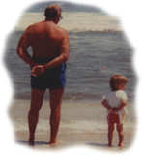
“I get better looking every day”
The Believing Brain
sets intentions.
We are not a bunch of nouns – beliefs.
Our believing brain is active.
It integrates left & right brains – head & heart.
Notes:
So, a little story. It's about my father when I was little. I had a brother, two sisters and my mom. We would all be sitting together around the table at breakfast and at dinner as we did back in the day. My father would say this joke, constantly, throughout my childhood. He would wait for the right moment, then say, "Oh. Kids. I can't wait for tomorrow!" Now, when he would say this, we would get very excited. We lived near the beach, so we would say, "Oh, are we going to the beach?" Or we would say, "Are we going to the drive-in movies?" We would sometimes go to the drive-in movies. It was one of our favorite outings - you play on the playground, then you watch the movie. Then my dad would say, "Oh, no, no, no kids. It's just that I get better looking every day."
So, this joke worked for many years, though it may be hard to believe. Finally, we caught on and he couldn't fool us anymore. But then, we started fooling our cousins, and then we started fooling our children. And now the family has lots of grandchildren. I have nine grandchildren, and we fool them. It's a family joke.
But you know... he would say it very often - more often than not - in the morning. And I got to thinking about that as I got older. Why would someone say, "I can't wait for tomorrow," in the morning? And then it dawned on me, he was setting his intentions. He was saying. "I'm going to have a good day, because the whole world is going to look beautiful to me. Everything is going to taste good. Everything is going to be a good experience for today. I choose to have a good day. It's up to me. I'm the master of my destiny."

Slide 5
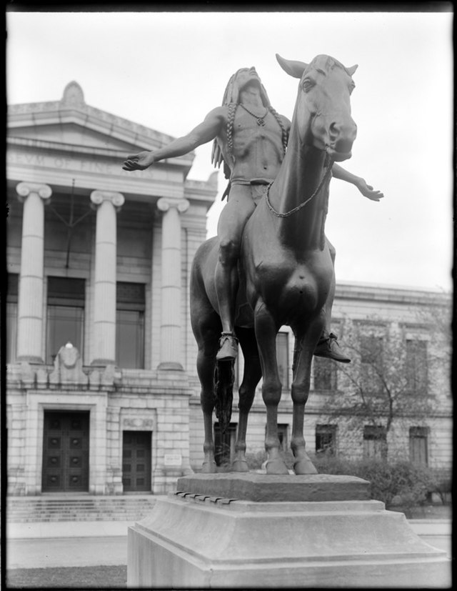
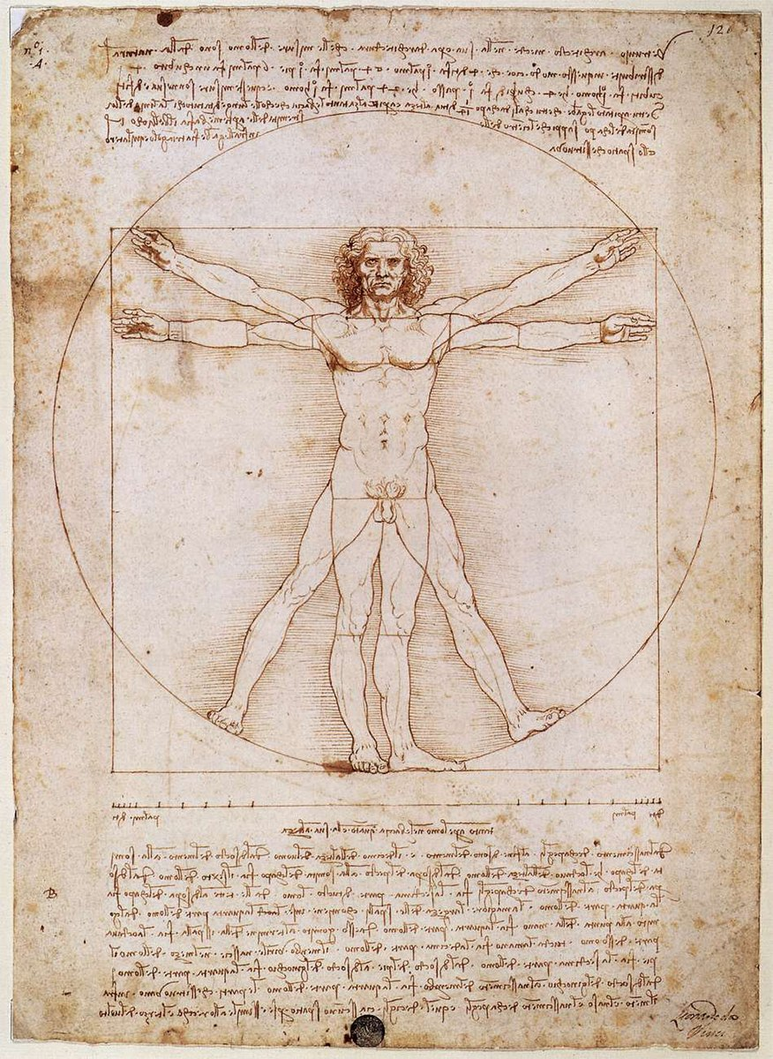
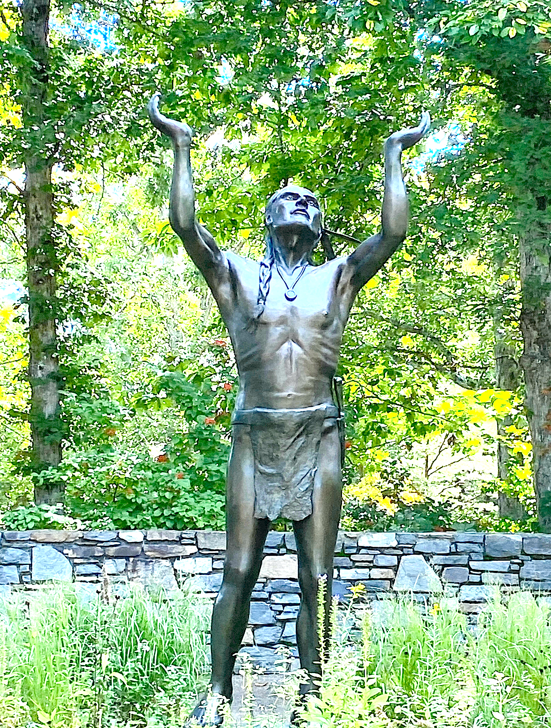
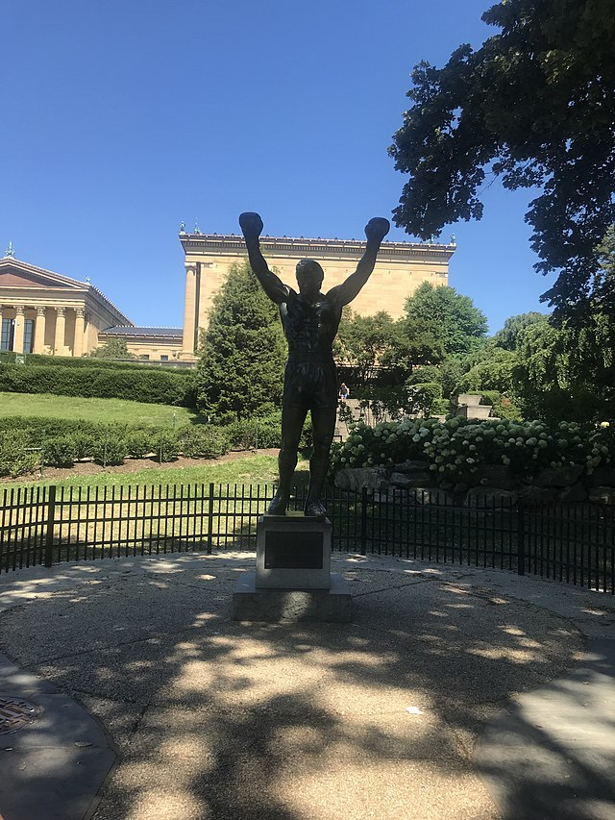
Setting intentions can use both vertical and horizontal brain integration.
If you are believing big, your left brain may not even be able to explain what your right brain heard.
Notes:
Personal Statement: John Bickart’s Workshops
1) For over 50 years I have taught both children and adults in private and public schools, corporations, and state prisons. I love letting ideas speak for themselves. One idea that has faithfully come to me since I was a child is that we empower ourselves when we listen to our hearts. Observing life promises to help me learn better to teach awareness, compassion, and engagement, instead of simply talking about these to my students. In my teaching, I have connected to these through observing, using heart-thought, and actively learning from my students.
2) Recent research in neuroscience highlights both horizontal integration of the brain as well as vertical integration of the body, brainstem, limbic areas, and cortex. Horizontal integration means connecting “our left hemisphere’s narrator function with the autobiographical memory storage of our right hemisphere” (Siegel, 2010, p. 74). A great joy for me is that our time embraces spirituality in education through the research being done on the integration of right and left brain and the parallel integration of heart thought and head thought. In other words, the right hemisphere uses our intuitive abilities for observation while the left hemisphere uses our analytical abilities to narrate what we have observed. Students experience spiritual values when they start with the heart, then follow with intellect (McGilchrist, 2009). This is why we need intuitive education - a way to let students remain in an intuitive state of observation before they engage their analytical ability to narrate and reflect.
At this crucial time in history, we need to leave certain habits behind and re-learn the truly ancient way of giving to each other.
When educators are trained to disregard intuitive world views, there can arise losses of inclusion of paradigms of thinking from our past (Kuhn, 2004), appreciation of indigenous thought (Whorf & Carroll, 1964), and understanding of ancient Eastern (Nisbett, 2003) and African (Asante, 1991) philosophy. ... In addition, character education could suffer in a decreased appreciation of social diversity resulting in lesser awareness of the 'other' in education (Dewey, 1910, 1916/2005; Freire, 1998a, 1998b, 2000; Freire & Freire, 1994), less sensitivity to sustainability of the environment (Senge, 2008), and decreased attention to family and community (Bruner, 1960, 1983, 1986, 2004; Foucault, 1971). We are already seeing these changes. (Bickart, 2013, pp. 112-113)

Slide 6
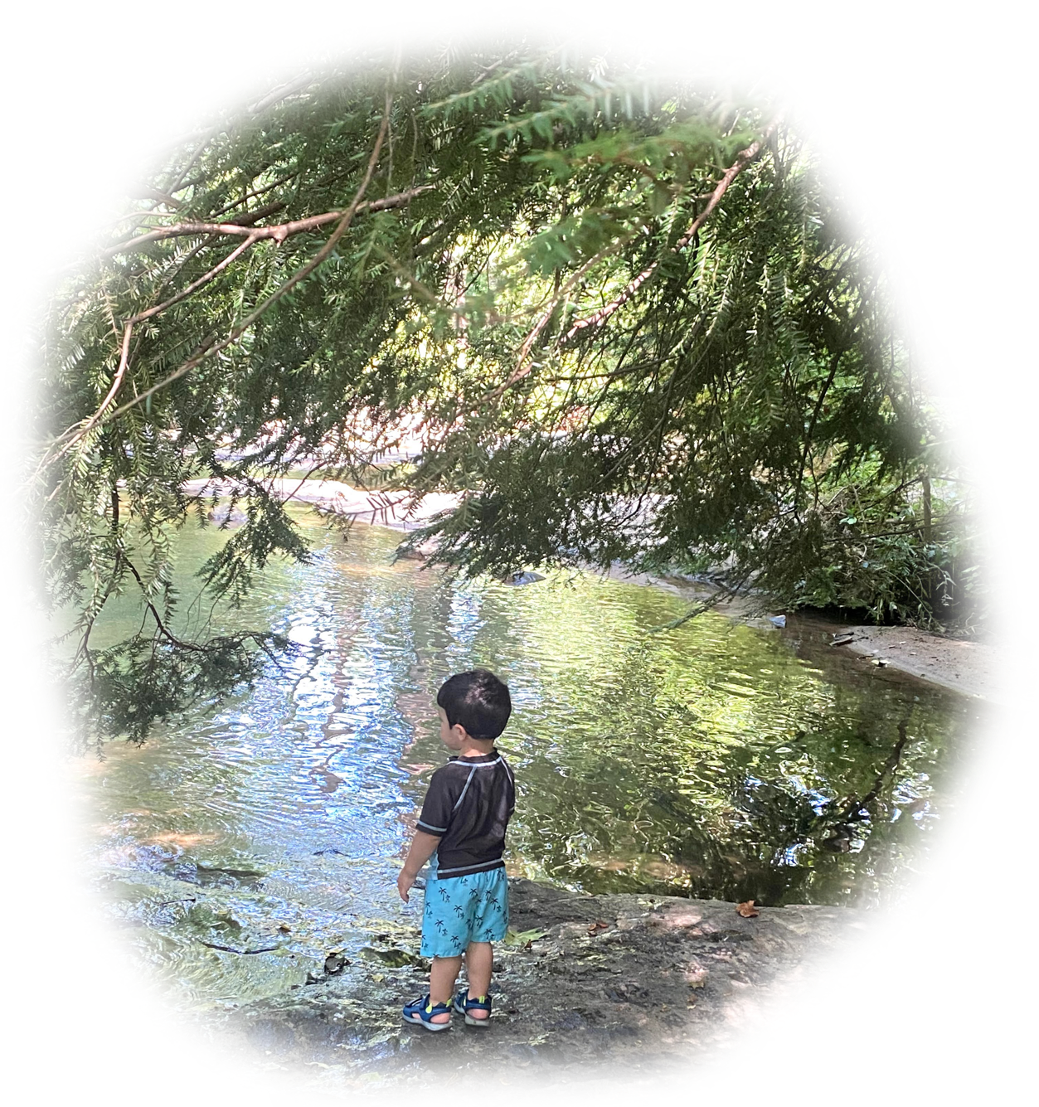
We started to use
our left brain, and gained language, but …
it was the end of simplicity …
the end of living in the right brain …
the end of heart thought …
the end of
The Top of our Game.
“It is very simple to be happy;
but it is very difficult to be simple.” - Rabindranath Tagore
Notes:
Synchronization
It has been suggested that there are synchronizations between one person’s heartbeat and …
a group of people
breaths per day
the earth, moon & sun
Plato’s Great Year of the heavens
Can we synchronize our
believing heart & head?
The Dawning of Language
The Spiral is one of 32 symbols that recent paleoanthropological studies have found repeated in over 370 rock art sites on separate continents all over the earth, created 10,000 to 40,000 years ago.
“In ancient times, before there were those who were governed, and those who governed over, the sage blended with others, and all was done through the Primal Simplicity.
People lived in innocence.”
(Lao Tzu, in Verse 65 of the Tao Te Ching)

Slide 7
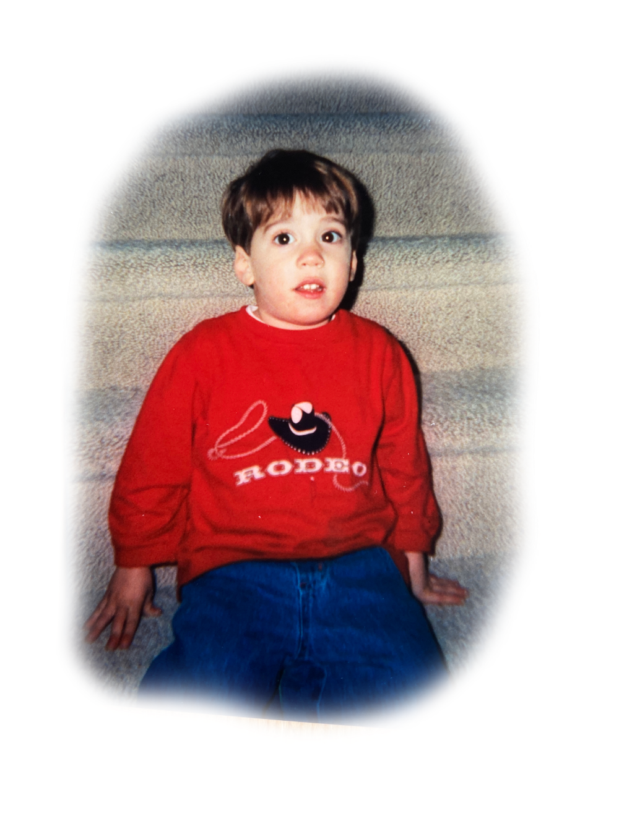
Be Nick
Notes:
"... in the future no human being is to find peace in the enjoyment of happiness if others beside him are unhappy."
- Rudolf Steiner
_______ Begin spoken conclusion ________
Ok, here is the whole thing in miniature. Picture this. My first grandson, Nick is having a birthday. He's old enough to understand when we tell him, "This is your cake. We're going to put candles in it. We're going to blow out the candles on your cake. We're going to cut up your cake. It will be delicious - you're going to love your cake." And we don't know that he's hearing, "It's MY cake!" He thinks the whole cake is his. We don't know this until we sing the song, blow out the candles, cut the cake, and hand the first piece to one of the 20 adults in the room who are all watching. This has become a family story, because it was so cute to see what happened to his face. As the first piece of cake is being handed away, his face goes from very happy and excited - taking in everyone looking at him and the song being sung to him - to an incredible tragedy. In five seconds, we watched his face transform to a square mouth and he starts crying, thinking, "Oh, what's happening? You're giving away MY cake!" The whole room is melting because it's so cute! Now, Nick ... is in tragedy. He's in utter suffering and we're laughing hysterically. We think that this is the cutest thing because we know - and of course it did happen - that in a couple of seconds, in the next minute - he's going to be fine again. And of course, we gave him his piece, and he started eating it, and his mom is explaining as she is doing so, "Oh, don't worry Nick. As soon as we share your cake, you'll get to have some. There's plenty for everybody." And now he's ok.
I had a picture over the years, that this episode is a miniature picture of where humanity is. Is humankind, Nick? How is it possible to have all of this unbelievable non-sharing of our resources, our money, our land? We carve out a piece of land for OUR house or OUR land and then we kick out all of the animals and anything else that was there before, and the other plants that used to live there, and we say, "No, no, no. This is mine, now." It seems that we are still in a mentality that is young.
Maybe we are not so selfish; maybe we simply don't know how to share because we are young.
Maybe a consciousness shift will cause us to - all of a sudden - want to share, to be in a state where we feel that there is plenty for everyone. There is plenty of food and resources on this planet ... for everyone. What's the problem? That we're young. That we can't see that piece of cake going away from us to anything or anyone else and still feel ok. It's utter tragedy.
Most people would say of this stage of humankind that it is an utter tragedy the way we treat each other. And it is. Well, it is. But how are we going to get to that next step that is so elusive ... world peace? Well, I think it's sharing. And I think that all we have to do is believe that it's possible. My grandson Nick had the belief that there are adults or higher beings or wiser beings than him that are really taking care of the show. He had the feeling that his world, this earthly existence, is a good place. Somebody's going to cut the cake and give me a piece, too! There is an overseeing.
That's a belief. And if you had that belief, you would act differently to maybe take the step to the higher consciousness where we actually would share and realize in reality that things are ok - we would make this place a party.
So, the dedication to my book says, "Compasses are like real friends. They constantly tell you when you are heading the wrong way. This book is dedicated to my 'realest' friend, Wendy." It's a back-handed compliment. That's the dedication to the book! What I'm saying is that - yes - she's always telling me how I'm doing it wrong. But isn't that what you do with a child. Isn't that what we all need. You tell the child every five minutes, "No, that's not how you cross the street. You'll get killed that way. Did you notice anybody else in the room, while you're telling all of your great stories? Are you going to share some of yourself with the rest of the room - share some of the space with the rest of the people?" I mean, there's a lot of things that we all need to hear. And it's by redirecting.
So ... you have to believe that what you are aiming for can happen. And ... you have to be ready to get redirected. That's my final message for the final part of the book. I really do wish to see you in one of those tomorrows. I hope we're all together in some fashion, in the near future. So, thank you for listening. I'm signing off. That's it. Bye.
_______ End spoken conclusion ________

Slide 8
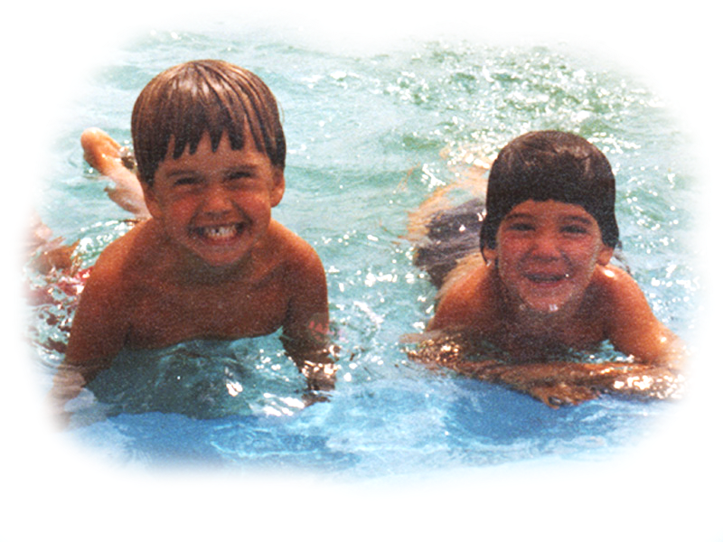
"This book it is an invitation to find out who you really are, beginning with two simple questions. In moments when you feel very happy, do you also watch yourself being happy? When you happen to get angry, is some part of you totally free of anger? If you answer "yes" to both questions, you can stop reading. You have arrived."
(Chopra, METAHUMAN : Unleashing Your Infinite Potential, 2021, p. 1)
Notes:
Story #19b
Holistic versus The Divided Self
19. Respect technology, instrumentation, and mechanized measurement without disrespecting the unseen, immeasurable, and non-physical.
(The Teacher's Bill of Rights)
I've been making this carving of a spiral with Mammoth Kauri wood that has been found in New Zealand in a bog where air could not get to the buried trees. Therefore, the trees have survived quite a long time, an estimated 30,000 years. So, I did a little bit of research and found that the 32 symbols, found in rock caves, that are the oldest known to humans are about that age. These symbols were found in 370 separate rock cave sites that are scattered across different continents. So, this means to me that something synchronous happened when this tree was growing, to cause people to start making the spiral and 31 other symbols. This is the same general dating of cave drawings and therefore the first writing.
That got me to thinking. You know, Lao Tzu, in Verse 65 of the Tao Te Ching (Laozi, 2005/circa 500 BC) says that there was an age of innocence a while ago - of primal simplicity. He says that then a great fragmentation occurred, right after the age of innocence, where cleverness overtook wisdom. And I got to thinking about this. Could it be that we used to be in our right brain where we perceived everything as a whole, and then we went more to the left brain? During that time, we started using language, symbols, and dividing everything up. In Lao Tzu's first verse of the Tao he says that a while ago we broke up the Great Integrity. We used to see things as a whole - the Great Integrity. And then, we broke it up into ten thousand things. We started naming things. Well, this isn't necessarily a bad thing, but it is a definite shift. If you look at Harari' best-selling book Sapiens (2017), you see very good research about the accomplishments of the homo sapiens. Though I do not agree with his conclusions - that we are headed to become cyborgs - he reports convincingly, from anthropological studies, that 30,000 to 70,000 years ago the homo sapiens went through a cognitive revolution. I believe that this was the move to using our left brain much more than the right brain. This was the beginning of naming and language and symbols. His conclusion is that if we proceed this way and continue, we are going to become cyborgs because we are becoming mechanical. Well, that's the left brain. If we continue with the left brain, then I agree with Harari.
But. I agree instead with Chopra. Deepak Chopra says, in his book, Metahuman (2021) (meaning 'the next human'), that we are at the stage of the next human. He says what Lao Tzu says. Lao Tzu's first verse in the Tao Te Ching is "Transcending" - that this Great Integrity was broken apart, but now is the time to come back together. And I believe that he is specifically referring to the left and right brain - that there is a time when we can put the lobes of the brain together, transcend what we were, and in Deepak Chopra's words, become the Metahuman, which he claims has infinite potential.
That's what I vote for. I want to be whole again. I want to stop paying attention to all the different things that we pay attention to and just be with the person I'm with - just be with the food that I'm eating - listen to what I'm listening to - stop seeing political and societal factions as us and them. I want to come back together. Isn't there a chance? It looks like it's on the horizon. It looks possible. And so, we'll have to make an effort. And ... don't ask me what it looks like, because the next stage is going to be different. But somehow, I think we can do it. So, I'll see you in one of those tomorrows!
_____________________
"THE LOSS OF INNOCENCE
In recent times,
before there were those who were governed,
and those who governed over,
the sage blended with others,
and all was done through the Primal Simplicity.
People lived in innocence.
When the Great Fragmentation
replaced the Great Integrity
cleverness defeated wisdom.
Even some enlightened sages
became victims of the rulers
commanding the highest intrique."
(Laozi, 2005/circa 500 BC, Verse 65 The Loss of Innocence)
"TRANSCENDING
The Tao that can be told
is not the universal Tao.
The name that can be named
is not the universal name.
In the infancy of the universe,
there were no names.
Naming fragments the mysteries of life
into ten thousand things
and their manifestations.
Yet mysteries and manifestations
spring from the same source:
The Great Integrity
which is the mystery within manifestation,
the manifestation within mystery,
the naming of the un-named,
and the un-naming of the named.
When these interpenetrations
are in full attendance,
we will pass the gates of naming notions
in our journey toward transcendence."
(Laozi, 2005/circa 500 BC, Verse 1 Transcending)
References
Chopra, D. (2021). METAHUMAN : unleashing your infinite potential. [S.l.]: HARMONY CROWN.
Harari, Y. N. P. D. O. I. (2017). Sapiens.
Laozi, D. R. A. C. J. (2005/circa 500 BC). Tao te ching : a new translation & commentary. New York: Barnes & Noble.

Slide 9
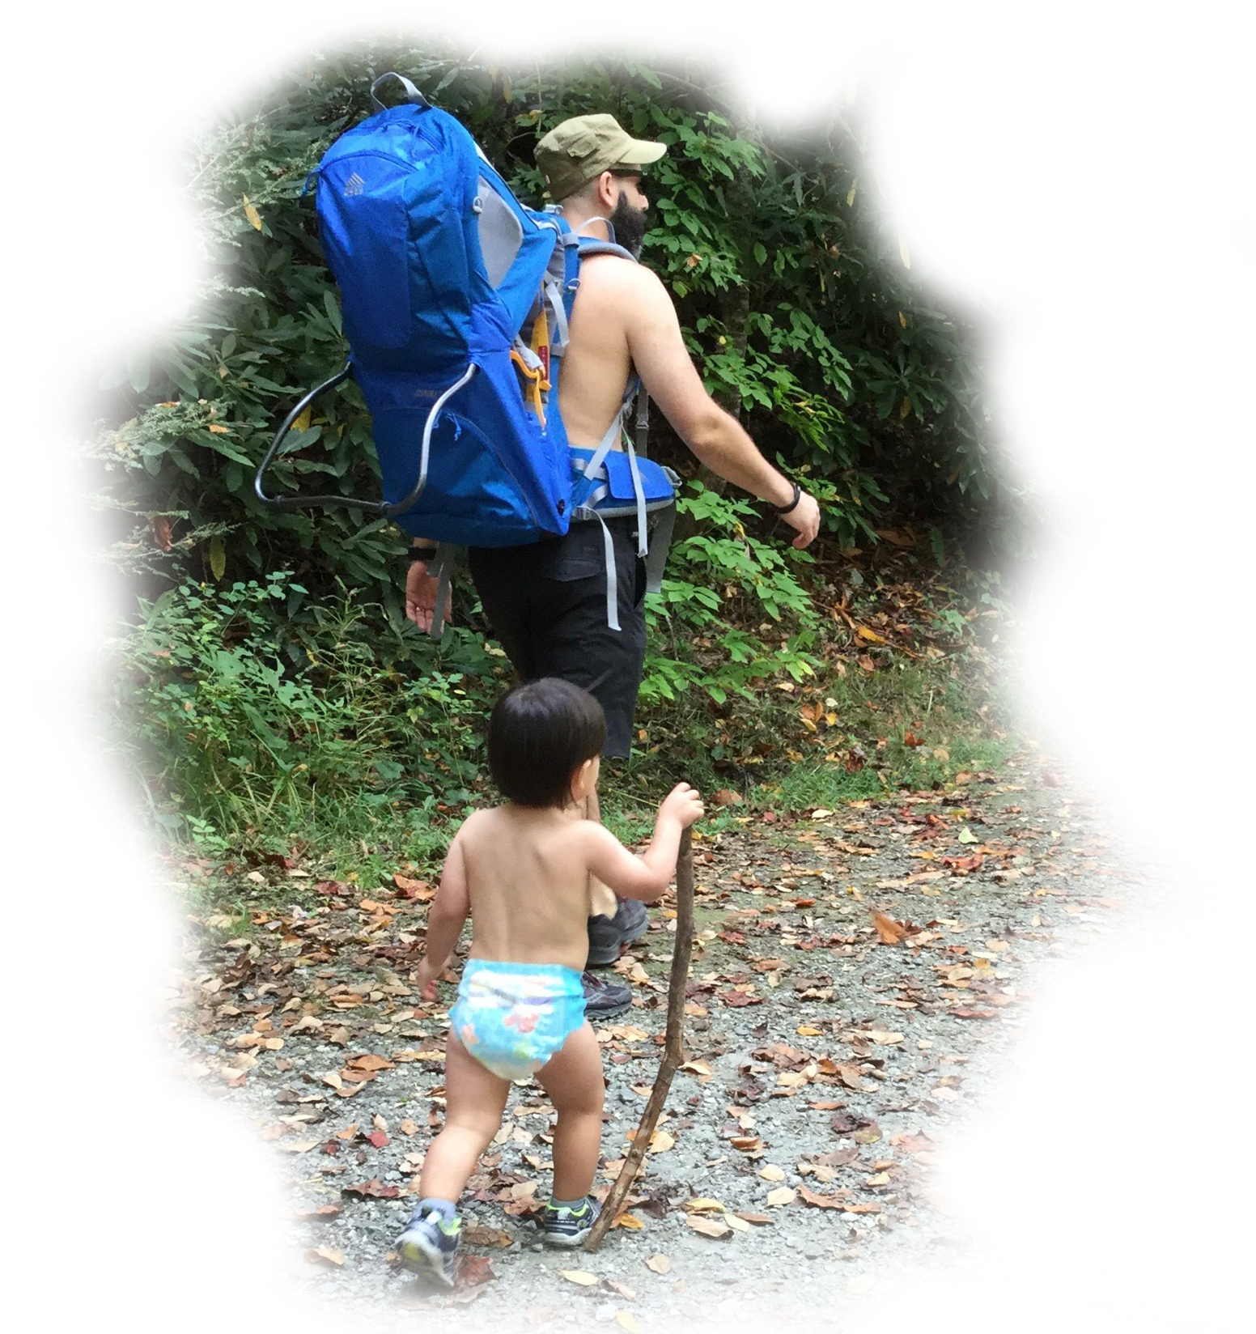
Simplicity Exercise #1
You can
have your cake
and eat it, too!
Notes:
Wake Up Call #19a
Holistic versus The Divided Self
I love how Ralph Alan Dale does a translation of the Tao Te Ching. In Verse 21, he has this one paragraph that just blows me away.
"The Great Integrity [John: that's when we perceived everything as one] was apparent
before time, space and matter appeared to separate. [John: which is pretty much as long as we remember nowadays. We think everything is separate.]
How can we re-mind and re-infuse ourselves with this very touchstone of all essentialities and connections?"
(Laozi, 2005/circa 500 BC, Verse 21 The Great Integrity is a Paradox, Tao te ching : a new translation & commentary)
That's our goal for today. How can we remind ourselves that things are really whole? Well, Socrates said all learning is remembering. You know that re-member means to put the members back together - that were whole - that you forgot are whole. You forgot. We forgot.
So, I have a little exercise to re-member that we're really all whole. Just look at the sky. The sunlight is coming in and makes all light around us, so during the day you can't see the stars. But they're there. And, according to where you are on the earth and how good your eyes are and how the cloud cover is, you can see five to ten thousand stars. Ok? But how many are up there? Well, we don't know. But the latest scientific reports are that we think there are some sextillions of stars.
They're all there, ok? When you look up, and you see all of them, all of those individual beams of light - some of which are not a star, it's a galaxy itself with thousands and millions and trillions of stars within a galaxy - sometimes they're coming into your eye as separate beams. And they are all in the iris of your eye at one time - joined. But by the time it gets from the front of your iris, to the back of your eye, they're separate and you see a separate picture- something that is whole, that has parts. And when you take a step a little bit over to the side, you can still see all of them. That means all of the stars are shining light on that step also - and over here - and over there - and over here - and over here. They're shining light everywhere - something that can be whole and taken apart - that has sextillions of parts, at least. (That's just modern science. We don't know anything. Who knows what is really out there?)
So, the next time you look at it, remember that there is a whole that has many parts that is coming together in your eye - and shining on you - and giving you something - that we used to understand - that we are just starting to re-member. That's it. And it takes sixty seconds to do it. You know what you do? You look up at the sky. And just remember, you're a whole - there's a whole - not an 'us & them' - we're all together. I'll see you in one of those tomorrows.
References
Laozi, D. R. A. C. J. (2005/circa 500 BC). Tao te ching : a new translation & commentary. New York: Barnes & Noble.

Slide 10
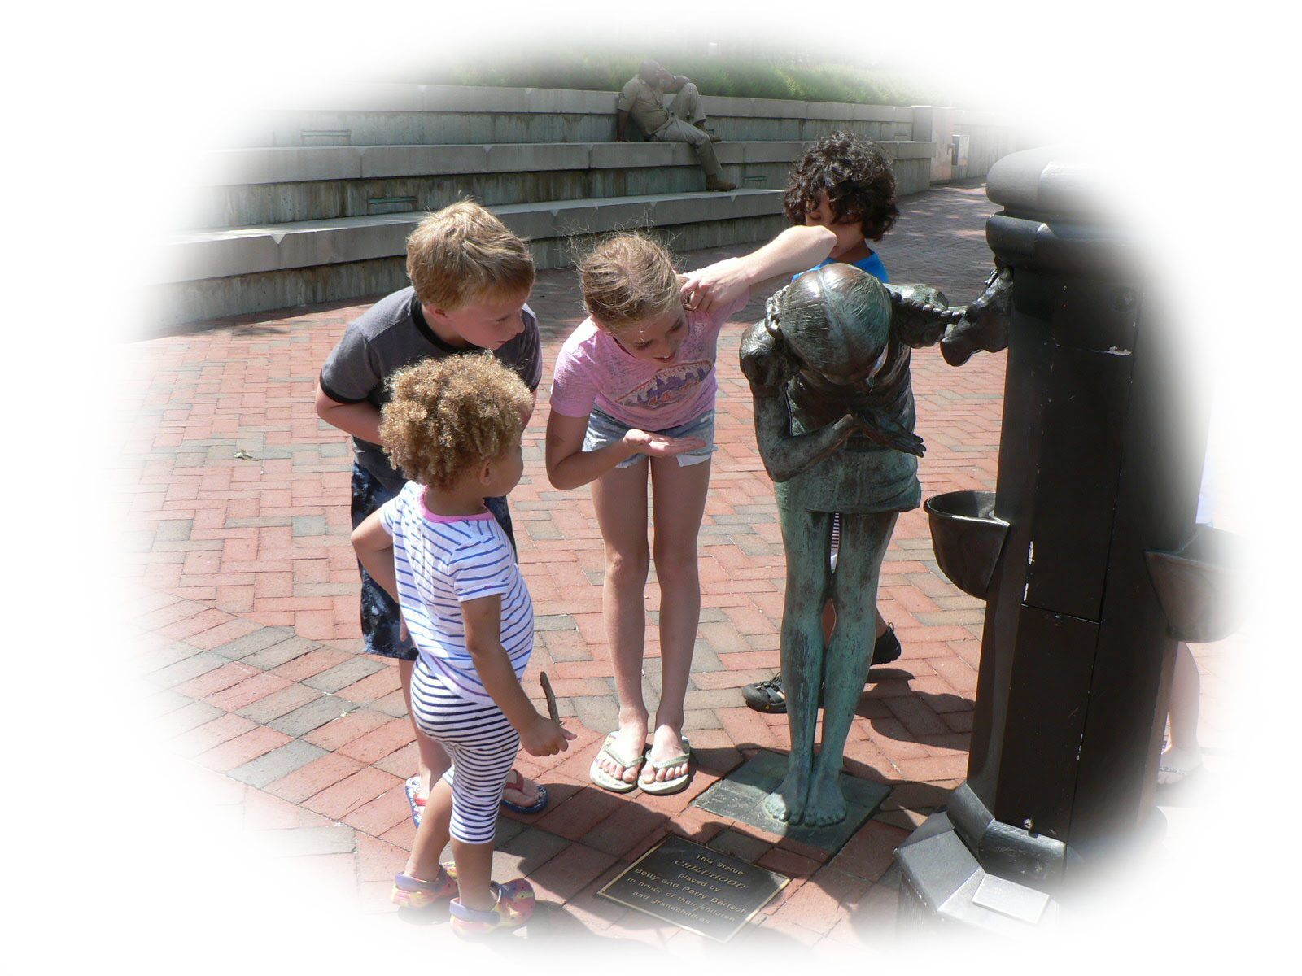
Conclusion to Part 1 of 5
Lisa Miller, in an interview with Deepak Chopra, said that on day one we are inherently spiritual.
She and he believe that a child has a pure spiritual knowing.
Notes:
Wake Up Call #17a
Naming, Categorizing, Labeling
Naming, Categorizing, and Labeling. The World Health Organization has names for 19 food classifications. We have categorized 118 scientific elements on the periodic table. 6,500 languages have been labeled as those spoken today across the world. There are 4,000 recognized religions and some 300,000 plus English words, 5,000 new per year, of which 1,000 make it to print.
We're increasing the sub-divisions of articulating everything about our world, but we're looking less. With the increase in naming and labeling, we notice less - we connect less.
I used to do this exercise. It's almost 50 years now I've done this in classrooms with my students. I select one student. I have the person come up to the front of the room and I turn my back on the student. And then I start naming and categorizing and labeling what about them - all complimentary things - very nice things. But, nevertheless, I'm not looking at the student. And of course, the class knows exactly what I'm doing. Nobody feels bad or anything.
Next, I start saying all of the traits we know about this student. And then I stop. And I say, "But what if today, this student has come to school and a tragedy occurred last night in her home. I wouldn't know that. I'm describing what I know of that student as of yesterday - as of this morning - maybe as of 10 minutes ago. But, did I look into the student? Or did I just look at what she is wearing today? "Oh, here's the student who I know is always ... this way." I'm looking at the outsides, and I'm looking at the historical person - not her. If I looked into her, maybe I would say, "What's the matter? You seem to have something on your heart - on your mind? Are you ok?" But I wouldn't notice it if I don't look.
The ancients used to say, "I see you." They're not looking at the person's body. They're looking at the person's soul. So, today's wake up exercise is to try to undo that. We are in a period of history where the naming is increasing, so we have to increase the connection. We have to undo our separation.
Here's a recommended exercise I'll give to you. Go to the mirror. Face it. Maybe it's the morning. Maybe you're getting ready to go out and get dressed. Now, turn your back on your mirror. And give yourself an encouragement - "You can do it today" - some kind of a statement that you would like to say to yourself that is soulful - something that is right to the heart of YOU. And now, turn around and look into the mirror and do it. And look into your eyes - into you. And see if you feel a difference.
Now, see if you remember not to turn your back on the world - and the people you'll be with - and the trees and the flowers and the air and the birds. Try to not 'phone it in' today. And give yourself this reminder - maybe at the beginning of the day.
That's the wake up call. I know you've heard a million people say this and it's not a unique thing. I'm just a reminder. So, I'll see you in one of those tomorrows.
Story #17b
Naming, Categorizing, Labeling
17. Aim more at the transformation of your students through the experiences they have in your class,
than the information they may receive.
(The Teacher's Bill of Rights)
We're always about the names and the categories and the labels. Deepak Chopra talks about this. He said that children know everything that is of the pure knowing quality, before they learn to label things as such. He said that at 74 years of age, to this day, even though he has practiced many spiritual exercises and techniques and really invests in them since he was a teenager, he still has problems when the language that we must use causes him to take things apart or separate from reality - or what he would call existence. He would say that a baby does not separate. The baby looks all around oneself and says, "That's me. Everything is me and it's all one."
I have a friend who is a social worker who is the glue to many different communities and families. He has an expression that, somehow, I have picked up. He says, "Are we paying attention enough, here? Are we living live!?" He says this because he considers that we are starting to separate from reality, the second we get into our heads with names and categories.
Dr. Lisa Miller, in her book, The Awakened Brain, speaks about this. In an interview with Deepak Chopra, she said that on day one we are inherently spiritual. She believes that there is a pure spiritual knowing that a child has. She gives an example where a child can say that they know something with total surety, without having been told - before learning. She also cites that children can love a homeless person as much as their mother. This shows their unabashed connection to all things. She would say that this shows a top-down causality - that the child knew certain things from within. This is in opposition to learning things in the world, which would be a bottom-up causality.
You know, back in 1937 there was a meeting of Rabindranath Tagore (the Indian poet and sage - first non-European to get the Nobel Prize) and Einstein. They had an excellent discussion - actually a few. If you look at the transcripts of the exact words they exchanged with each other, it's fascinating. Einstein was professing the scientific view of the time (although he was ahead of his time) as bottom-up causality. He said that everything can be understood by examining the particles and the smallest pieces on up of the physical world that we live in. Tagore was saying that he did not think so. He said that he thought that the top-down was causal. He said that there is more to the world that is non-material and non-physical that fulfills the whole. He inferred that the world is caused by consciousness, feelings, and meditative places that you go ... a top-down causation.
So, be careful. When we name and categorize, we're teaching information. Tobin Hart, in his book, From Information to Transformation (Hart, 2001) would say not to solely teach information - teach transformation. He would encourage you to let the student have an experience, not just a lot of names and categories.
We have to have them in order to have our language, but do we have to only have them? That's our message for today. I'll see you in one of those tomorrows.

Slide 11
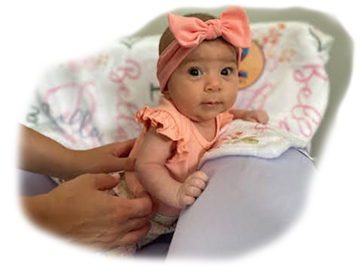
Simplicity Exercise #2
Baby Bella
The senses as a gateway to observation.
Notes:
Wake Up Call #18a
The Senses as a Gateway to Observation
"Hot water, cold water, and room temperature water" (my hands are being placed - one hand in cold water, the other in hot. Then I put both in the room temperature water).
You've done this experiment when you were young, right? The hand from the hot feels cold and the hand from the cold feels hot. But, the science textbooks say, “Your senses cannot be trusted because they reported the temperature incorrectly.” Well, that's right. They do tell the wrong temperature. You're not a machine. They're comparing you to a thermometer or a machine. You're not a machine. You're a sense being. And your senses are a gateway to observation. Don't ever tell the kids, "Don't go to your senses." Yes, don't trust them if you want to know the temperature. By the way, if you want to know heat flow, the human body is an awesome detector of heat flow. That's why you kiss the baby's forehead. Because your lips are so sensitive, you can tell if the baby's temperature is getting a little bit warmer or cooler.
But that's not the point. The point is that you should go to your senses. When you go to your senses, you're in your observation. You're not thinking, you're paying attention to what is being received. You are being attentive, and loving attention is one of the foundations of spiritual growth.
So, the wake up call today is, "Use your senses as a gateway to observation! And stay in them all day, all of the time." Every morning I go out on the porch - I close my eyes and I take in - sometimes there's a smell, the fragrance of the outside - I listen to the birds - I have just looked at some of the trees or bushes or the sky or the clouds - and I take in the beauty of that scene and what I heard. Then I close my eyes and replay it. And then, I start my day. It takes less than sixty seconds.
So, guess what your exercise is for today - your wake up call? Go take in something coming into your senses. Especially if it's something growing or alive. I consider almost everything alive. So, take it in. Goethe said, if you take in the beauty of a flower, you complete the flower's mission in life. It has a purpose - it's alive - it's a sentient being - and it's really grateful that you took it in. So, you get a double good for this experiment.
So, I'll see you in one of those tomorrows.
Story #18b
The Senses as a Gateway to Observation
18. Give permission to your student and yourself to observe something without thinking of conclusions - then, later ... see what thoughts arise.
(The Teacher's Bill of Rights)
You know, observation is one of the highest spiritual activities that you can perform. It causes you to be here. Giving loving attention to the world is just a wonderful thing. And your senses cause you to pay attention to the world. So, they are a gateway to observation. But using your senses does not necessarily imply that you are eating food or smelling flowers or listening to music. It also can mean that you are simply paying attention to what's going on around you. You are open with your awareness to everything around you.
Well, somebody taught me this. Her name is Ali. She passed when she was 52 years old, but I knew her since she was a little girl. She was my neighbor. She and her brother and sister were in the carpool with my son and I going to the school where I was teaching. So, I would drive them every day and really got to know them. We played in the park on the weekends and I got to know her as an athlete. She was quite an athlete. She paid attention to her sports as well as everything else, eventually becoming an Olympic Athlete for the American Handball Team.
As she was growing, I watched her serious perseverance - but also her presence. And it struck me to see that as her mom got sick, Ali chose to stay home. Of the whole family, she chose to stay home and have a job while nursing her mother until her mom's passing. And besides that, she went back to school to become a doctor. I mean, medical school is hard. But she had perseverance and presence for that too, which I also admired.
Several years later, she was visiting me. She was out here for nine days with her soon to become wife, Aida and Aida's mom. But, for all of the hikes we were supposed to go on, Ali kept saying that she was sick and didn't feel well. This was very unusual. A person with this much perseverance - staying home from a hike? It was unheard of! Then it turned out, the next month when she got home, she found out that she was in stage four of lung cancer.
Well, she persevered in that the way she persevered in everything else. She battled the cancer and lived her life! I got to proceed at her wedding. During it, I said to she and Aida and the group that was present, "Ali is one of the people who is a voice in my head." Since she was little, I could draw on who she was as somebody that I really respected.
Ali eventually went to Colorado Springs and lived right in sight of Pike's Peak and took hikes up into the mountains. I took a hike with her right before her passing, and although she was in so much pain that she was crying, she wanted to do the whole hike. She just loved the mountains and loved the outdoors and wanted to finish what she had started. She was persevering and enjoying her life right till the end. But it wasn't till just now - years later - making this video that I realized how she is a voice in my head. Normally, when you say someone is a voice in your head, you mean that you can think of things that they say. You hear words, you here phrases that come back to you. But she is a voice in my head for who she was in demonstrating - how to go to your senses. She is an example I draw on quite often actually. I think, what would Ali do? How would she approach this situation? Not just to persevere through - but to be present. And that takes your senses.
And so, thank you Ali and thank you for listening. I'll see you in one of those tomorrows.

Slide 12
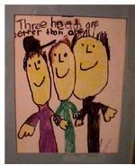
The iBELIEVE Team
and Earl Nightingale say:
“What you can conceive
and believe
you can achieve.”
Illustrated by Daniel Bickart
“Three Heads are Better than One”
Notes:
Story: from Prairie Hill Waldorf School, Pewaukee, WI (~2000)
- Transcending Our Technology - Electric Technology on trial - class trip to ocean
- You try another tact, “Isn’t there anything about this you need to remember?” To which she replies, “I like where I am, who I am, my friends, my family, and my time. I’m not at war with any people, nor any part of nature. I don’t need a clock. I’m not trying to get ahead in life – I’m not trying at all. I’m actually happy. There is enough food - so more isn’t better. My friends and I share clothing, housing, and club accessories, so I don’t need money. There are no transportation or communication devices, so I have no appointments with the local garage or internet service provider or phone company. So, what do I need to remember? To remember actually means to put back a part (a member) of something that used to be whole. I am whole. My life is whole. I know what I need to know when I need to know it. The member parts of my life are all together. I do not need to re-member. So I do not need to write things down.”
***

Slide 13
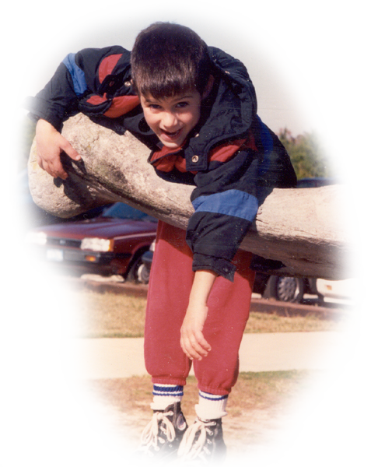
Believing is a Cause not a Consequence
Don’t ask if you believe 100% in your intentions …
just ask yourself,
“Is it a yes or a no?”
Notes:
Wake Up Call #20a
The Role of Belief
Belief is the king of it all. If you can believe something and conceive of something, you can probably achieve it. You've heard that saying, maybe?
Let's look at your hands, first. What do you do when you are thinking of making a wish or a prayer? Some people put their hands together, like bringing the lobes of the brain together so your head and your heart and your wholeness is wishing for one thing. Some people put their hands open and receive and thank whatever is coming. And some people cross their fingers and cross their heart. When you cross the body, there's an integration of the left and right lobe of the brain.
I helped a student in high school (when I was a senior in high school) to come out. He was emotionally disturbed. He could not negotiate the world. And so, we played a lot of games where we crossed the body - ping pong - threw balls. I gave him a private gym class. He came out. It was the most wonderful thing to see. He got a job. He started driving around town on his bicycle. And his family was unbelievably happy. So, there is a lot to this action (crossing my hands).
So, how do you make a wish? Well, today's wake up call is to make a wish. But, there's two steps to it. First, you have to hitch your wagon to a star. What's the star you're wishing for? What is the end result you want - that you are making the wish about? Step two, do you believe it? Do you believe it can happen? You can conceive of it - but can you believe it? Because, the step three that everybody is always talking about - how to get there - how to accomplish your wish - is non-important compared to these two steps. What's the star you are hitching your wagon to and do you believe it's possible. From that comes all of the logistics of how to get there, and the determination and the will and the energy with which you will get there.
So, your wake up call for today is hitch your wagon and believe. That's the role of belief. Belief is a cause, not a consequence.
So, thank you very much - I'll see you in one of those tomorrows.

Slide 14
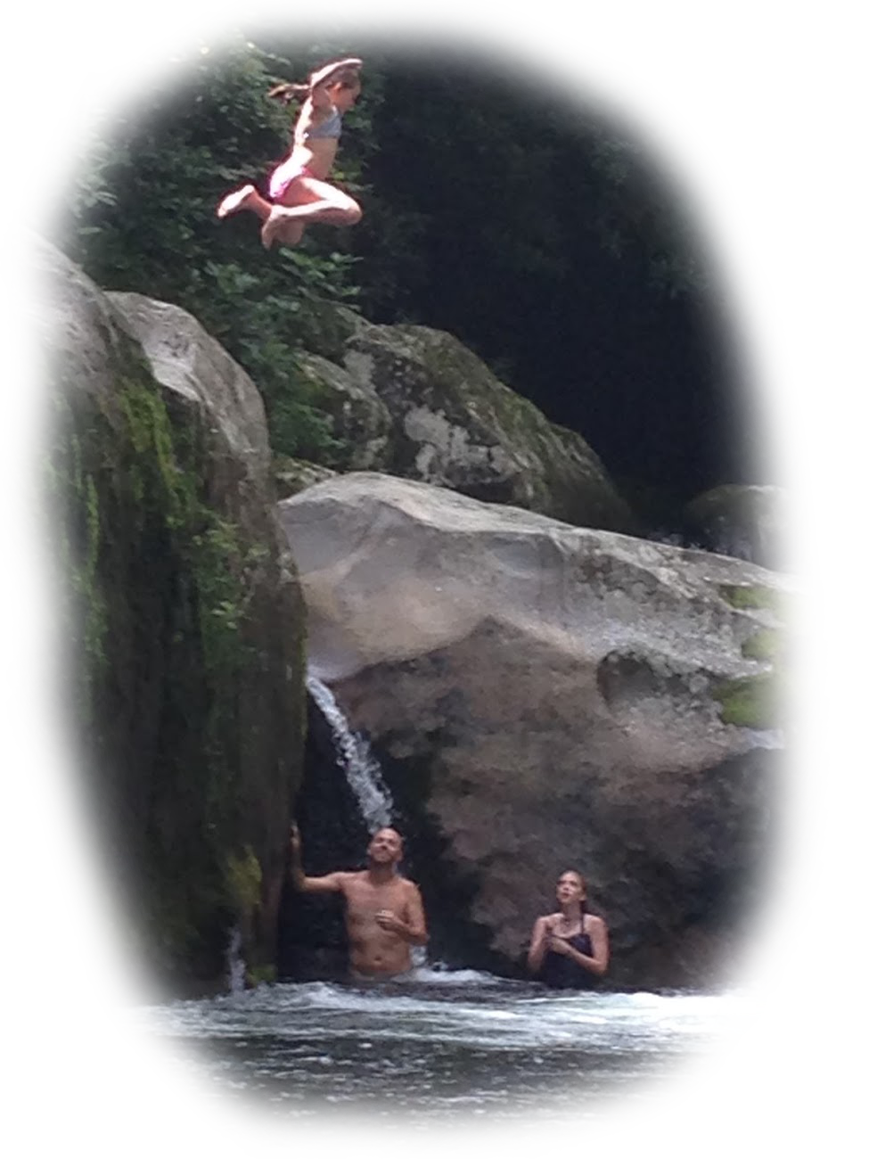
Simplicity Exercise #3
The Leap …
Picture what you REALLY wish.
Is it for a friend to end an addiction?
Is it to get along with someone?
Is it to surface from deep depression?
Is it to believe in a higher goal? …
Now, notice which way you lean.
Notes:
Story #20b
The Role of Belief
20. Allow for the possibility of becoming inspired by a belief prior to its arrival in your conscious mind; but then,
check it out analytically to see if it makes sense.
(The Teacher's Bill of Rights)
Ok, for the final 20th one, The Role of Belief. Do you remember on my first one - the first Wake Up Call and the first Story, I said, First Change Yourself? Well, yeah. Do you want to be the change you wish to see in the world? Then, you have to change yourself. You have to be the change.
Lisa Miller said it better than I could say it. "This is perhaps the biggest revelation of the awakened brain: that it’s in our innate nature to build a better world. That what’s good for everyone is also what’s best for each one of us." (Miller, 2021, p. 224) We could do this. It's in our innate nature.
In all of my talks, I constantly am trying to say that if you want to make a change to yourself - or anything:
- first, figure out what you want to change,
- then, believe it,
- then plan it.
Belief comes before planning. Belief is a causative, not a consequence. First believe it, then plan it. Going around planning things without really being invested doesn't work. So, yes, you have to arrive at a plan, but you have to believe that you are going to do it first. You must invest all of your effort in that belief stage. That's where we fail. That's why we don't have world peace. It's because we can't really believe it - "Oh, I don't think that's really going to happen." We say it at a pageant. "Oh, the thing I want most is world peace!" But everybody goes home saying, "Yeah, but I can't see how it's going to happen!"
Today's message is perhaps my biggest message. It's got the most juice in it. This is important. You can't see the next version of yourself from the current version of yourself. That's why it's the NEXT version of yourself! You're going to be different in the next version of yourself - you will have made the change you wanted to make. You could have imagined certain qualities of it. Perhaps the change or star you hitched your wagon to is sharing. Or perhaps you wished to see the human race not fighting. I would like to see peace. I would like to see happiness. But, how you are going to get there is always the question that stops you! The problem is that we let that question of the plan stop us.
What everyone does - that is the blind spot of our time is to say, "Well, I can't see how to get there." Right! You can't because, that's precisely why we're not there. The current version of us can't see how to get to our next version or else we would be at the next version. There's enough food on the planet. We just can't see how to share it.
The human race has to be told, "Believe that there will be enough. Believe that after you start doing this act of sharing - that you cannot conceive of at this time - everything will be alright." You can't conceive of your next version at this time - a version where you will want to share, where you won't be happy until the person next to you is happy. You can't conceive of it in your current condition, because you're not there (in the next version of consciousness). But the way to get to that future consciousness is by starting to believe. You take a step in pure belief, and you don't even see the net. But it will appear. And then, you start to feel a little bit for your fellow human, a little bit more than yesterday. And then you see the next step because you took that step. And the way to proceed is in the dark, with blinders on, because of your belief. And then ... you get to plan. You cannot ever get the plan for the next thing that you are going to be, before you ARE it.
This is a giant blind spot of our time. This is what you must overcome, if you want to change or transform yourself. That is my final and best message that I've got. So, I want to go see one of those tomorrows, because it's going to be better than today. I just know it. And thank you very much if you've been listening.
References
Miller, L. W. E. S. (2021). The awakened brain : the new science of spirituality and our quest for an inspired life.

Slide 15
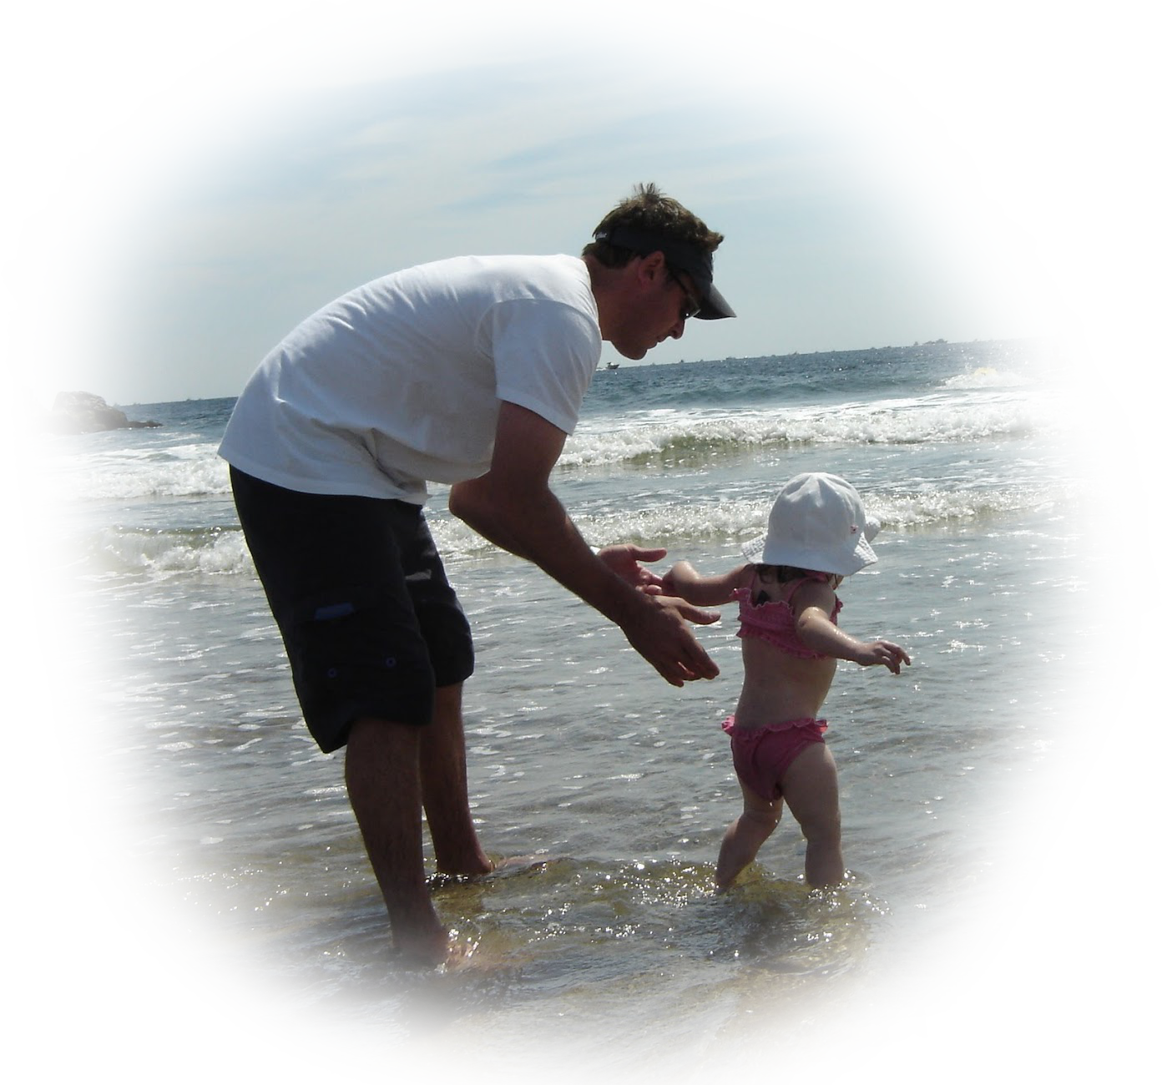
” This is perhaps the biggest revelation of the awakened brain: that it’s in our innate nature to build a better world. That what’s good for everyone is also what’s best for each one of us." (Miller, The Awakened Brain, 2021, p. 224)
Notes:
***

