Slide 1
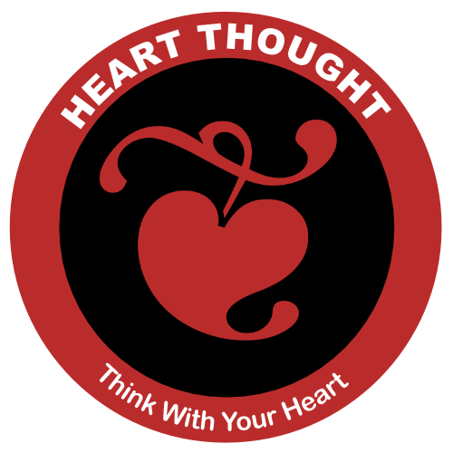
The Believing Brain
Notes:
Wake Up Call #10a
Heart Thought
Today's wake up call is a great way to think with your heart. Our goal will be to integrate head thought and heart thought, but primarily lead from the heart.
This is brought to you thanks to Lisa Miller, from her book, The Awakened Brain. In a chapter called "THE TWO MODES OF AWARENESS" she writes about the difference between having a day where you are only paying attention to what you have to get done or achieve. She calls this an achieving awareness. The other mode of awareness involves waking up to what is happening all around you. She calls this an awakened awareness.
"﻿As a result of this awakened awareness, our eyes move to meaningful events. In achieving awareness, the stranger who starts talking to us on the bus might be annoying or intrusive, or just invisible. In awakened awareness, we might hear what he says—and even see how it’s relevant to our own lives" (Miller, 2021, p. 165).
Then, in another one of Lisa's chapters called "INTEGRATION IS KEY", she describes integrating both your awareness to achieve and to be awake. She calls this orientation, the Quest Orientation, like you are on a gallant quest to find something. She writes:
"Quest orientation is characterized by a tendency to journey in life: to search for answers to meaningful personal decisions and big existential questions; to perceive doubt as positive; and to be open to change, or more accurately, open to perceiving with fresh eyes, and then using new experience to fuel change. In quest, we open ourselves to the messages from life, take seriously this discovery, and then actively use learning to shape our decisions and actions—our personal operating manual" (Miller, 2021, p. 169).
So, here' the wake up exercise I'm recommending today. In the next week, try this exercise, if necessary, several times. Maybe it will work right now! Do you have any annoying or intrusive situations in your life? Well, as my wife says, "Turn that little frown upside down." Let's try to turn a "doubt or downer" to at least consider that this problem can be used to fuel change. Ready? Ok, right now, picture one of your problems. Is it something financial, health, or a relationship? If nothing comes to mind, picture it later.
Next, clear out your lower awareness of it and wait ... Can you see any way this could be used to fuel a change or a learning experience? Then, for this next week, use Lisa's "quest orientation" to catch yourself several times a day with "doubts and downers" and look for life's deeper messages.
That's it! That's the whole exercise. I'll see you in one of those tomorrows.
References
Miller, L. W. E. S. (2021). The awakened brain : the new science of spirituality and our quest for an inspired life.

Slide 2
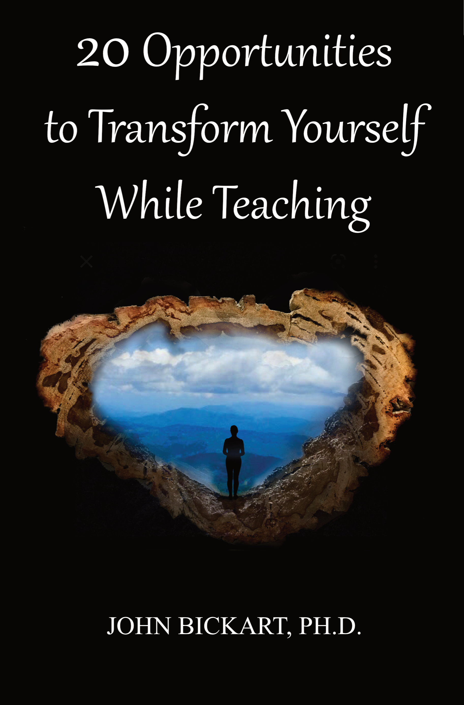
The Believing Brain
prepared for The IIRP World Conference – Inviting Collective Energy
Taken from chapters 17-20 of 20 Opportunities to Transform Yourself While Teaching
(Bickart, J. (2022). 20 Opportunities to Transform Yourself While Teaching. Asheville, NC: Red Shirt Interactive Group.)
Notes:
Introduction
"... in the future no human being is to find peace in the enjoyment of happiness if others beside him are unhappy."
- Rudolf Steiner
The Whole Book
The spiritual lessons herein came from ancient wisdom. They are incredibly hard to sum up or group or reduce. They defy categorization as you are going to see - they are, each one, a whole life's work and a whole solution to life's big questions. I could have introduced every one of the 20 chapters by saying, "All of life is about ... ," and then named one of the opportunities: heart thought or belief or reawakening the child in the adult or whatever. The reason for this is that a true spiritual lesson actually contains all of the other spiritual lessons in it. So, my recommendation for reading this kind of book is to come back to it often, crack it open on any random chapter, then let yourself go and have fun in that chapter as if you are reading the secret of secrets and there is no need to know anything else.
The 20 Opportunities
These are my favorite exercises. I've used most of them for about half a century. They are simple things. Each one of them takes less than a minute. They are answering a question that has been nagging at my brain - and perhaps yours - our whole life. The question is something like, "Do you want to change? Do you wish you could be another version of yourself, one that is a little bit better in some ways? Do you wish to help the world?" Well, that is what transformations are all about. They are exercises to spiritually awaken so that we can do some of those things.
What is spiritual? Do you remember when you were a child? Do you remember the time before life heaped layers of experiences upon you? If you could recover how you were when you were a child, that would be a spiritual awakening. Why? Because, when you were a child, you were pure and innocent, and, in a certain way, you knew what good was in the highest sense. You knew what GOOD was. That is spiritual - for your higher self to know what you really want. And for most of us this takes change ... transformation. That's all there is to it.
Transformation. So, how to transform? Let me get a few rules down, here. There are a few things you have to know. Number one, it's not easy. Number two, it's not fast. And, number three, you have got to do it yourself. You can't get anyone to change you with some kind of a quick fix. You have to go through what an addict has to go through, because we are addicted to the head! And we have to get back to the heart. So, if that's your addiction, how do you handle it? You 'unlayer'. You let go of your thinking that is in your head, and you learn what it takes to have a heart thought.
What is a heart thought? It's a thought that includes what your head knows and what your gut knows. It's where your heart is the boss over the head, heart, and gut. It's the highest truth you know. The spiritual awakening. So, I'm going in circles. Yes. All of my exercises go in circles, because they say, "If you want to transform yourself, yes, go transform yourself!" But, that's basically it. You kind of know somewhere inside you, what you wish at any one time in your life, if you stop and heart-think about it.
The Method
Getting there is the whole problem. Rabindranath Tagore said, “It is very simple to be happy; but it is very difficult to be simple.” It's an 'unlayering' of everything - a dismantling - a letting go of stuff. And guess where that stuff is? In the head. So, if you can let go of those kinds of thoughts and clear out and get back to the heart, then you are awakening. You are transforming yourself.
So, the basic method is to do it repeatedly. That is how you do it to yourself. Keep coming back here to listen to these one-minute exercises or read some good books or listen to some people who are mentally and spiritually healthy. Do this repeatedly - while your day is in progress. By using this repetition method, you will find yourself slowly becoming the next version of yourself.
That's it. I wish you luck. I hope that you enjoy them, and I'll see you when you come back, in one of those tomorrows.

Slide 3
Literature Review as seen on bickart.org
Wisdom Teaching and Practical Exercises (Laozi, 2005/circa 500 BC)
Childhood & Spirituality (Bickart, 2013, 2018, 2020a, 2020b, 2020c, 2022; Hart, 2001, 2010, 2014a, 2014b; L. Miller, 2015; L. W. E. S. Miller, 2021)
Awareness, Mindsight, and Flow (Csikszentmihalyi, 1994; Csikszentmihalyi & Pratt, 2017; Siegel, 2010, 2018)
Mindfulness and Nondual Awareness (Chopra, 2021; Chopra, Ford, & Williamson, 2010; Lantieri, 2008; Palmer, 1993, 1998, 2004; Palmer, Zajonc, & Scribner, 2010)
Emotional and Social Intelligence, Presence (Goleman & Boutsikaris, 2006; Goleman & Senge, 2007; Goleman & Whitener, 2005; Senge, 2000, 2008)
Belief (Dispenza, 2017; Dispenza & Boyce, 2016; Dispenza, Knight, & Encephalon, 2005; B. H. Lipton, 2005, 2006, 2014; B. H. Lipton, Bhaerman, S., 2009)
Right versus Left Brain Dominance (McGilchrist, 2009)
Early Opposition to the Mechanical View of Humans (Dewey, 1910, 1916/2005)
Historically Assumed Separateness (Kuhn, 2004)
Reduced Importance of Childhood (Piaget, 1929/2007, 1950, 1959, 1965, 1973, 1976; Piaget & Inhelder, 1969; Piaget & Valsiner, 1927/2001)
Excessive Testing (Darling-Hammond, 2010; González & Darling-Hammond, 1997; Gurwitz, Darling-Hammond, Pease, Education., & Corporation., 1981; Haggstrom, Darling-Hammond, Grissmer, & Center for the Study of the Teaching Profession (Rand Corporation), 1988; Koppich, Merseth, Darling-Hammond, American Association of Colleges for Teacher Education., & National Commission on Teaching & America's Future (U.S.), 2000; Millman & Darling-Hammond, 1990; Wise, Darling-Hammond, Berry, Profession., & Education, 1987; Wise, Darling-Hammond, & Klein, 1986; Zeichner et al., 2000)
Education: Students-only, Community-centered, Right Answers, Restricted Resources, Not tests, Not algebra, Not control, Not norms, Brick & Mortar Schools, Integrated Disciplines, Inspirational Content (Dintersmith, 2018; Hart, 2001)
1800s Factory Model (Skinner, 1953; Thorndike, 1913/2010)
Notes:
References
Bickart, J. (2013). The possible role of intuition in the child's epistemic beliefs in the Piagetian data set. (Ph.D. Dissertation). UNCC, Charlotte, NC. DAI/A 74-11(E) database. (3589794)
Bickart, J. (2018). The next version of you: 12 stories that highlight the use of intuition to update your life.
Bickart, J. (2020a). Bickart’s Just-in-Time Fables (Vol. 3). Asheville, NC: Red Shirt Interactive Group.
Bickart, J. (2020b). Bickart’s Just-in-Time Fables (Vol. 2). Asheville, NC: Red Shirt Interactive Group.
Bickart, J. (2020c). Bickart’s Just-in-Time Fables (Vol. 1). Asheville, NC: Red Shirt Interactive Group.
Bickart, J. (2022). 20 Opportunities to Transform Yourself While Teaching. Asheville, NC: Red Shirt Interactive Group.
Chopra, D. (2021). METAHUMAN : unleashing your infinite potential. [S.l.]: HARMONY CROWN.
Chopra, D., Ford, D., & Williamson, M. (2010). The shadow effect: Illuminating the hidden power of your true self. New York: HarperOne.
Csikszentmihalyi, M. (1994). Flow : living at the peak of your abilities. Niles, Ill.: Nightingale-Conant Corp.
Csikszentmihalyi, M., & Pratt, S. (2017). Finding flow : [the psychology of engagement with everyday life].
Darling-Hammond, L. (2010). The flat world and education: how America's commitment to equity will determine our future. New York: Teachers College Press.
Dewey, J. (1910). How we think. Boston: D.C. Heath & Co.
Dewey, J. (1916/2005). Democracy and education: An introduction to the philosophy of education. New York: Cosimo Classics.
Dintersmith, T. (2018). What school could be : insights and inspiration from teachers across America.
Dispenza, J. (2017). Becoming supernatural: how common people are doing the uncommon. Carlsbad: Hay House.
Dispenza, J., & Boyce, A. (2016). You Are the Placebo. [United States]: Author's Republic : Made available through hoopla.
Dispenza, J., Knight, J. Z., & Encephalon, L. L. C. (2005). Mastering the art of observation. Rainier, WA: Encephalon.
Goleman, D., & Boutsikaris, D. (2006). Social intelligence the new science of human relationships. New York: Audio Renaissance.
Goleman, D., & Senge, P. M. (2007). Working with presence. New York: Audio Renaissance.
Goleman, D., & Whitener, B. (2005). Emotional intelligence. Prince Frederick, MD: Landmark Audiobooks.
González, J. M., & Darling-Hammond, L. (1997). New concepts for new challenges: Professional development for teachers of immigrant youth. [Washington, D.C.], McHenry, IL: Center for Applied Linguistics ; Delta Systems Co.
Gurwitz, A. S., Darling-Hammond, L., Pease, S. R., Education., U. S. D. o., & Corporation., R. (1981). Maintenance of effort provisions: An instrument of federalism in education. Santa Monica, CA: Rand Corp.
Haggstrom, G. W., Darling-Hammond, L., Grissmer, D. W., & Center for the Study of the Teaching Profession (Rand Corporation). (1988). Assessing teacher supply and demand. Santa Monica, CA: Rand, Center for the Study of the Teaching Profession.
Hart, T. (2001). From information to transformation: Education for the evolution of consciousness. New York: P. Lang.
Hart, T. (2010). The secret spiritual world of children the breakthrough discovery that profoundly alters our conventional view of children's mystical experiences. [S.l.]: New World Library.
Hart, T. (2014a). The four virtues : presence, heart, wisdom, creation. New York: Atria Books/Beyond Words.
Hart, T. (2014b). The integrative mind : transformative education for a world on fire.
Koppich, J., Merseth, K. K., Darling-Hammond, L., American Association of Colleges for Teacher Education., & National Commission on Teaching & America's Future (U.S.). (2000). Studies of excellence in teacher education: Preparation in a five-year program. Washington, DC: AACTE Publications.
Kuhn, T. S. (2004). The structure of scientific revolutions. Chicago [u.a.]: Univ. of Chicago Press.
Lantieri, L. (2008). Building inner resilience. Reclaiming Children and Youth, 17(2), 43-46.
Laozi, D. R. A. C. J. (2005/circa 500 BC). Tao te ching : a new translation & commentary. New York: Barnes & Noble.
Lipton, B. H. (2005). The biology of belief: Unleashing the power of consciousness, matter and miracles. Santa Rosa, CA: Mountain of Love/Elite Books.
Lipton, B. H. (2006). The wisdom of your cells: How your beliefs control your biology. Boulder: Sounds True.
Lipton, B. H. (2014). The honeymoon effect: the science of creating heaven on earth. Boulder, CO: Sounds True.
Lipton, B. H., Bhaerman, S. (2009). Spontaneous evolution: Our positive future (and a way to get there from here). Carlsbad, Calif.: Hay House.
McGilchrist, I. (2009). The master and his emissary: the divided brain and the making of the Western world. New Haven: Yale University Press.
Miller, L. (2015). The spiritual child: The new science on parenting for health and lifelong thriving.
Miller, L. W. E. S. (2021). The awakened brain : the new science of spirituality and our quest for an inspired life.
Millman, J., & Darling-Hammond, L. (1990). The New handbook of teacher evaluation: assessing elementary and secondary school teachers. Newbury Park, Calif.: Sage Publications.
Palmer, P. J. (1993). To know as we are known: Education as a spiritual journey. San Francisco: HarperSanFrancisco.
Palmer, P. J. (1998). The courage to teach: Exploring the inner landscape of a teacher's life. San Francisco, Calif.: Jossey-Bass.
Palmer, P. J. (2004). A hidden wholeness: The journey toward an undivided life: welcoming the soul and weaving community in a wounded world. San Francisco, CA: Jossey-Bass.
Palmer, P. J., Zajonc, A., & Scribner, M. (2010). The heart of higher education: a call to renewal. San Francisco: Jossey-Bass.
Piaget, J. (1929/2007). The child's conception of the world. Lanham, MD: Rowman & Littlefield.
Piaget, J. (1950). The psychology of intelligence. London: Routledge & Paul.
Piaget, J. (1959). The language and thought of the child. New York: Humanities Press.
Piaget, J. (1965). The moral judgment of the child. New York: Free Press.
Piaget, J. (1973). The child and reality; problems of genetic psychology. New York: Grossman Publishers.
Piaget, J. (1976). The grasp of consciousness: action and concept in the young child. Cambridge: Harvard University Press.
Piaget, J., & Inhelder, B. (1969). The psychology of the child. New York: Basic Books.
Piaget, J., & Valsiner, J. (1927/2001). The child's conception of physical causality. New Brunswick (N. J.); London: Transaction Publishers.
Senge, P. M. (2000). Schools that learn: A fifth discipline fieldbook for educators, parents, and everyone who cares about education. New York: Doubleday.
Senge, P. M. (2008). The necessary revolution : how individuals and organizations are working together to create a sustainable world. New York: Doubleday.
Siegel, D. J. (2010). Mindsight: the new science of personal transformation. New York: Bantam Books.
Siegel, D. J. (2018). Aware : the science and practice of presence, a complete guide to the groundbreaking Wheel of Awareness meditation practice.
Skinner, B. F. (1953). Science and human behavior. New York: Macmillan.
Thorndike, E. L. (1913/2010). Educational psychology. [Charleston, SC]: Nabu Press, [BiblioBazaar].
Wise, A. E., Darling-Hammond, L., Berry, B., Profession., R. C. C. f. t. S. o. t. T., & Education, N. I. o. (1987). Effective teacher selection: From recruitment to retention. Santa Monica, CA: Rand, Center for the Study of the Teaching Profession.
Wise, A. E., Darling-Hammond, L., & Klein, S. P. (1986). Evaluating the teaching skills of beginning teachers a report to the Senate Education Committee and House Education Committee. Santa Monica, Calif.: Rand,.
Zeichner, K. M., Miller, L., Silvernail, D. L., Darling-Hammond, L., American Association of Colleges for Teacher Education., & National Commission on Teaching & America's Future (U.S.). (2000). Studies of excellence in teacher education: Preparation in the undergraduate years. Washington, DC: AACTE Publications.
***

Slide 4
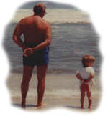
Where The Role of Belief enters the Restorative Practices
Lisa Miller (The Awakened Brain) The child’s innate knowing
Restoring the Childhood View
Build Resilience in Children
Teach the children through the heart, not the head
Experience over instruction
2022 article citing suicide related to ACEs ... "Research on adverse childhood experiences (ACEs) has proliferated over the last couple of decades." (Thompson, M. P., & Sugg, M. (2022). Adverse Childhood Experiences and their Impact on Suicidal Behaviors. The Journal Of The Blue Cross NC Institute For Health & Human Services, Volume 2: Adverse Childhood Experiences, 22 , p. 22)
Notes:
***

Slide 5
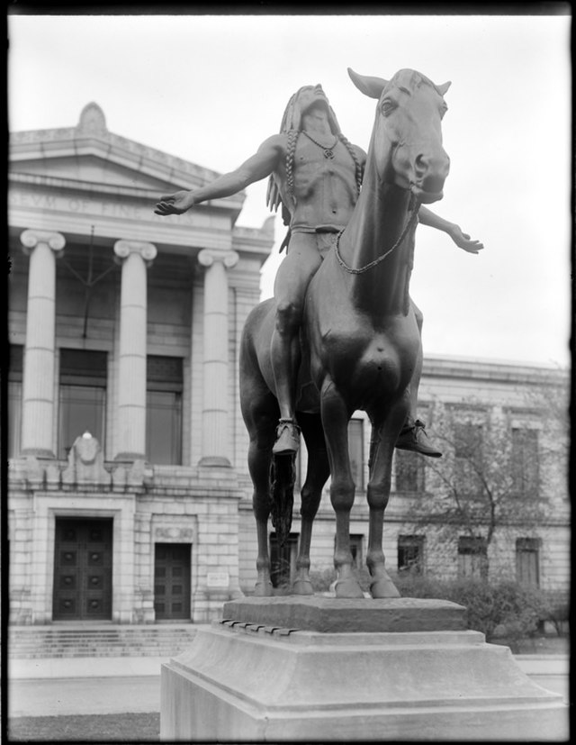
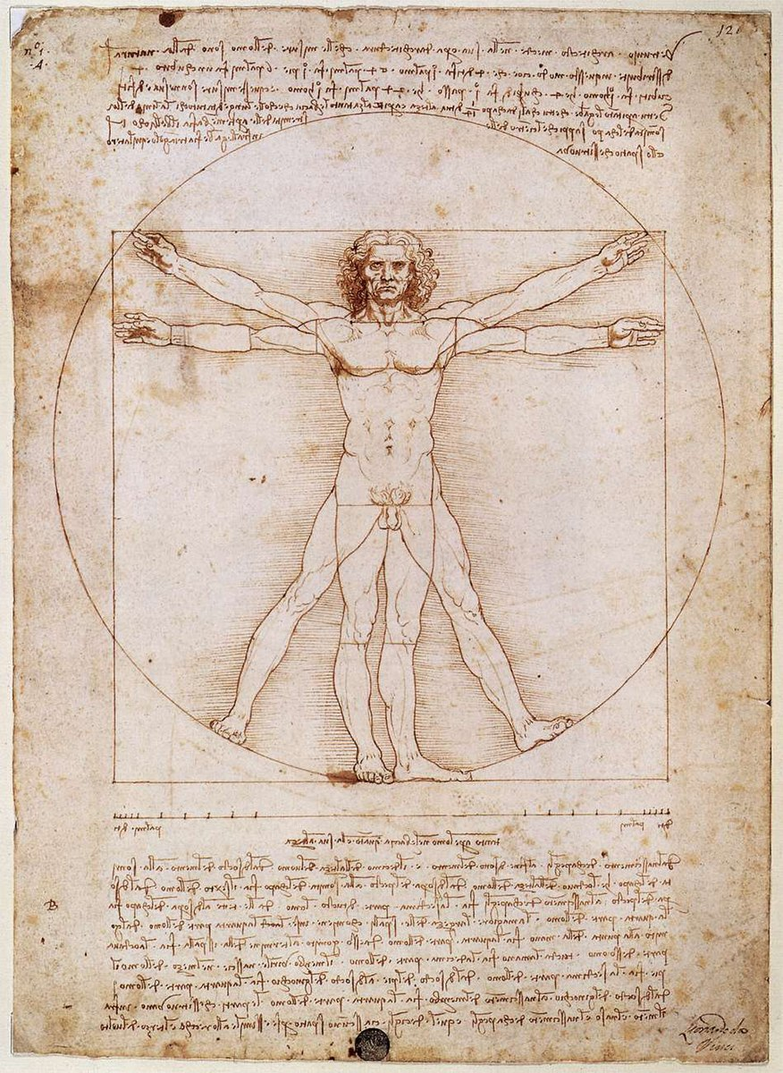
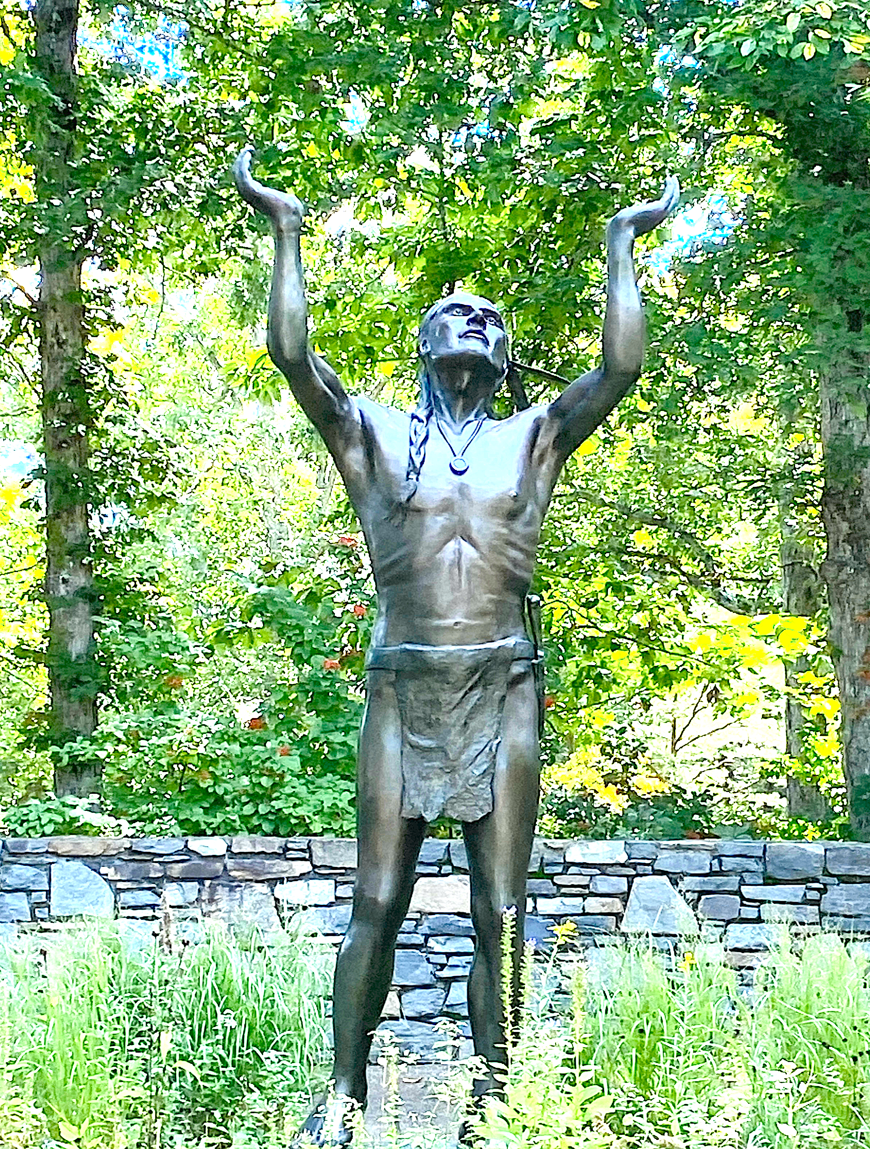
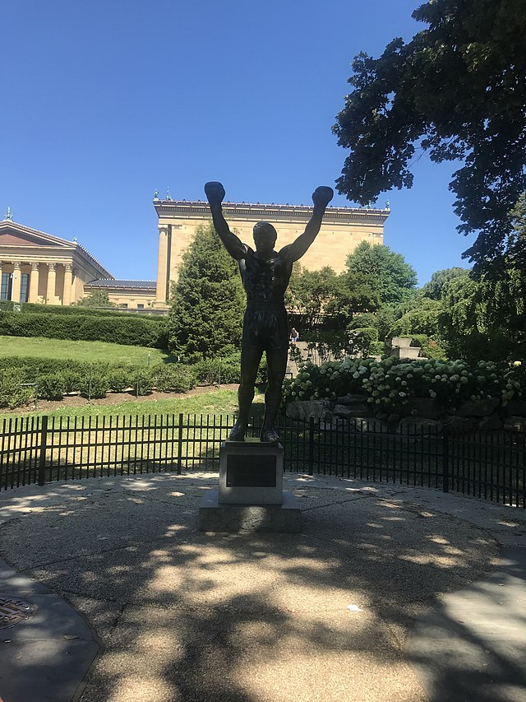
Setting intentions can use both vertical and horizontal brain integration.
In layman's terms: your head and your heart.
Notes:
Personal Statement: John Bickart’s Workshops
1) For over 50 years I have taught both children and adults in private and public schools, corporations, and state prisons. I love letting ideas speak for themselves. One idea that has faithfully come to me since I was a child is that we empower ourselves when we listen to our hearts. Observing life promises to help me learn better to teach awareness, compassion, and engagement, instead of simply talking about these to my students. In my teaching, I have connected to these through observing, using heart-thought, and actively learning from my students.
2) Recent research in neuroscience highlights both horizontal integration of the brain as well as vertical integration of the body, brainstem, limbic areas, and cortex. Horizontal integration means connecting “our left hemisphere’s narrator function with the autobiographical memory storage of our right hemisphere” (Siegel, 2010, p. 74). A great joy for me is that our time embraces spirituality in education through the research being done on the integration of right and left brain and the parallel integration of heart thought and head thought. In other words, the right hemisphere uses our intuitive abilities for observation while the left hemisphere uses our analytical abilities to narrate what we have observed. Students experience spiritual values when they start with the heart, then follow with intellect (McGilchrist, 2009). This is why we need intuitive education - a way to let students remain in an intuitive state of observation before they engage their analytical ability to narrate and reflect.
At this crucial time in history, we need to leave certain habits behind and re-learn the truly ancient way of giving to each other.
When educators are trained to disregard intuitive world views, there can arise losses of inclusion of paradigms of thinking from our past (Kuhn, 2004), appreciation of indigenous thought (Whorf & Carroll, 1964), and understanding of ancient Eastern (Nisbett, 2003) and African (Asante, 1991) philosophy. ... In addition, character education could suffer in a decreased appreciation of social diversity resulting in lesser awareness of the 'other' in education (Dewey, 1910, 1916/2005; Freire, 1998a, 1998b, 2000; Freire & Freire, 1994), less sensitivity to sustainability of the environment (Senge, 2008), and decreased attention to family and community (Bruner, 1960, 1983, 1986, 2004; Foucault, 1971). We are already seeing these changes. (Bickart, 2013, pp. 112-113)

Slide 6
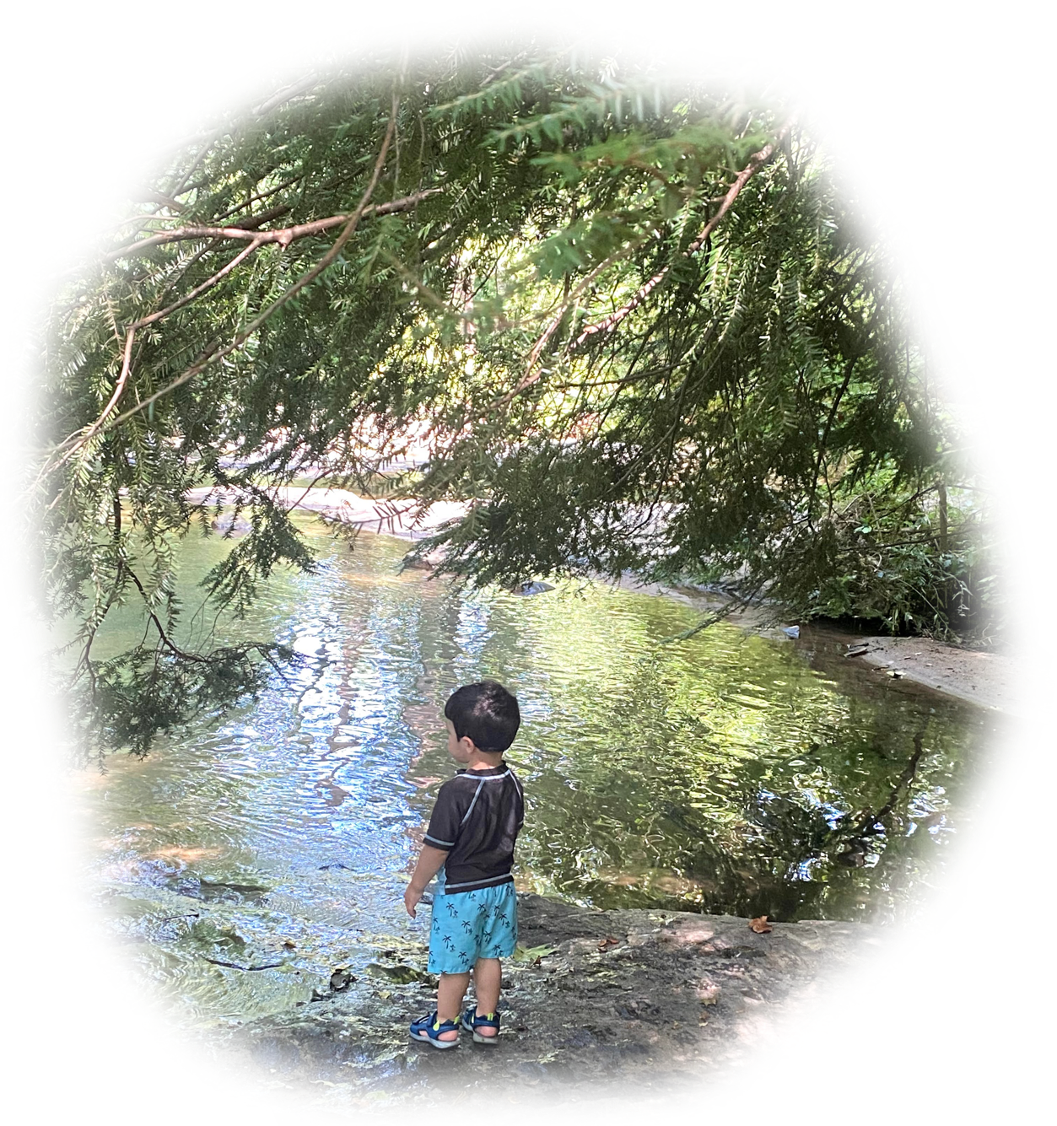
We started to use
our left brain, and gained language, but …
it was the end of simplicity …
the end of living in the right brain …
the end of heart thought …
the end of
The Top of our Game.
“It is very simple to be happy;
but it is very difficult to be simple.” - Rabindranath Tagore
Notes:
Synchronization
It has been suggested that there are synchronizations between one person’s heartbeat and …
a group of people
breaths per day
the earth, moon & sun
Plato’s Great Year of the heavens
Can we synchronize our
believing heart & head?
The Dawning of Language
The Spiral is one of 32 symbols that recent paleoanthropological studies have found repeated in over 370 rock art sites on separate continents all over the earth, created 10,000 to 40,000 years ago.
“In ancient times, before there were those who were governed, and those who governed over, the sage blended with others, and all was done through the Primal Simplicity.
People lived in innocence.”
(Lao Tzu, in Verse 65 of the Tao Te Ching)

Slide 7
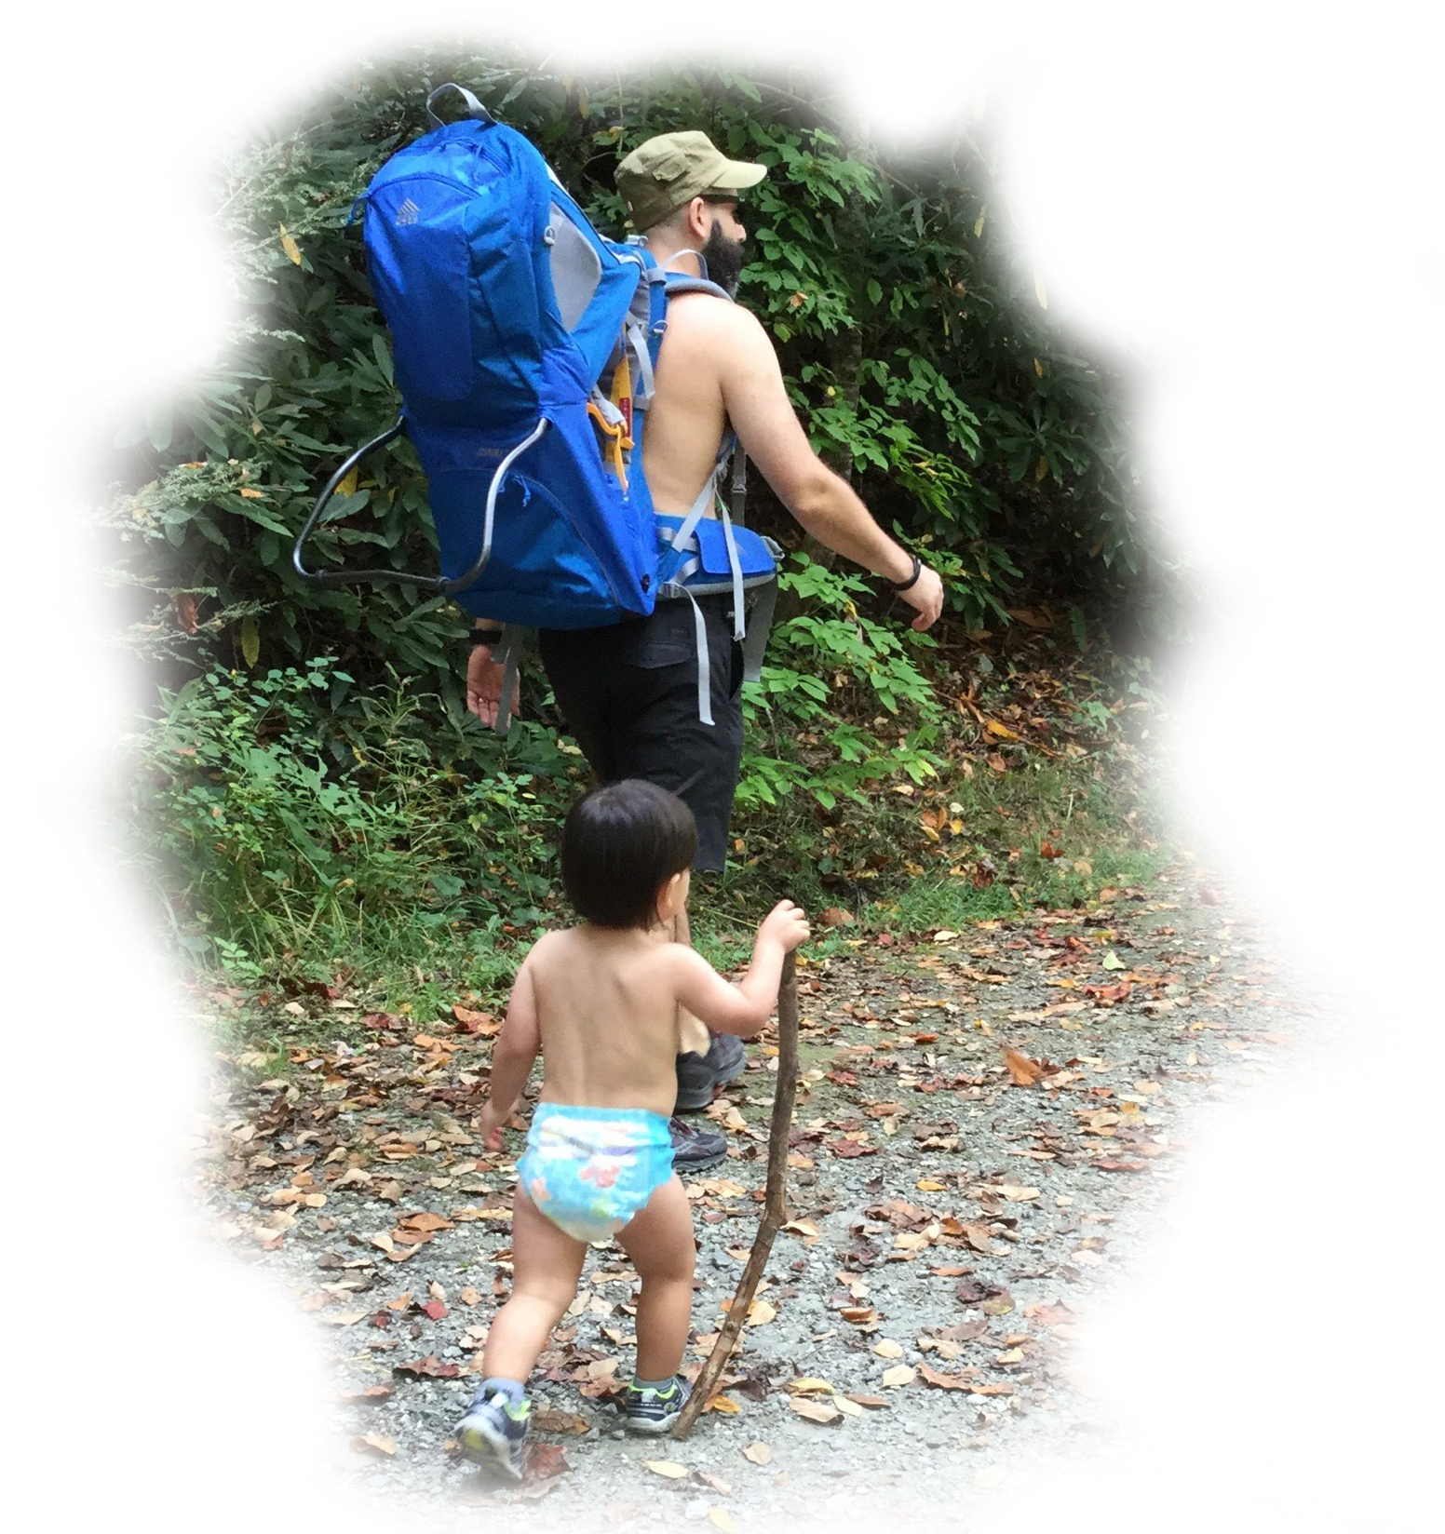
Simplicity Exercise #1
Look at the Stars
Notes:
Wake Up Call #19a
Holistic versus The Divided Self
I love how Ralph Alan Dale does a translation of the Tao Te Ching. In Verse 21, he has this one paragraph that just blows me away.
"The Great Integrity [John: that's when we perceived everything as one] was apparent
before time, space and matter appeared to separate. [John: which is pretty much as long as we remember nowadays. We think everything is separate.]
How can we re-mind and re-infuse ourselves with this very touchstone of all essentialities and connections?"
(Laozi, 2005/circa 500 BC, Verse 21 The Great Integrity is a Paradox, Tao te ching : a new translation & commentary)
That's our goal for today. How can we remind ourselves that things are really whole? Well, Socrates said all learning is remembering. You know that re-member means to put the members back together - that were whole - that you forgot are whole. You forgot. We forgot.
So, I have a little exercise to re-member that we're really all whole. Just look at the sky. The sunlight is coming in and makes all light around us, so during the day you can't see the stars. But they're there. And, according to where you are on the earth and how good your eyes are and how the cloud cover is, you can see five to ten thousand stars. Ok? But how many are up there? Well, we don't know. But the latest scientific reports are that we think there are some sextillions of stars.
They're all there, ok? When you look up, and you see all of them, all of those individual beams of light - some of which are not a star, it's a galaxy itself with thousands and millions and trillions of stars within a galaxy - sometimes they're coming into your eye as separate beams. And they are all in the iris of your eye at one time - joined. But by the time it gets from the front of your iris, to the back of your eye, they're separate and you see a separate picture- something that is whole, that has parts. And when you take a step a little bit over to the side, you can still see all of them. That means all of the stars are shining light on that step also - and over here - and over there - and over here - and over here. They're shining light everywhere - something that can be whole and taken apart - that has sextillions of parts, at least. (That's just modern science. We don't know anything. Who knows what is really out there?)
So, the next time you look at it, remember that there is a whole that has many parts that is coming together in your eye - and shining on you - and giving you something - that we used to understand - that we are just starting to re-member. That's it. And it takes sixty seconds to do it. You know what you do? You look up at the sky. And just remember, you're a whole - there's a whole - not an 'us & them' - we're all together. I'll see you in one of those tomorrows.
References
Laozi, D. R. A. C. J. (2005/circa 500 BC). Tao te ching : a new translation & commentary. New York: Barnes & Noble.

Slide 8
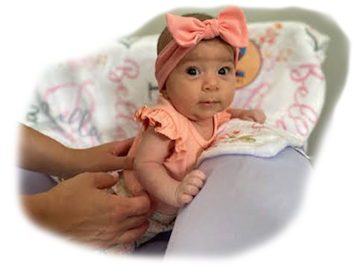
Simplicity Exercise #2
Baby Bella
The senses as a gateway to observation.
Notes:
Wake Up Call #18a
The Senses as a Gateway to Observation
"Hot water, cold water, and room temperature water" (my hands are being placed - one hand in cold water, the other in hot. Then I put both in the room temperature water).
You've done this experiment when you were young, right? The hand from the hot feels cold and the hand from the cold feels hot. But, the science textbooks say, “Your senses cannot be trusted because they reported the temperature incorrectly.” Well, that's right. They do tell the wrong temperature. You're not a machine. They're comparing you to a thermometer or a machine. You're not a machine. You're a sense being. And your senses are a gateway to observation. Don't ever tell the kids, "Don't go to your senses." Yes, don't trust them if you want to know the temperature. By the way, if you want to know heat flow, the human body is an awesome detector of heat flow. That's why you kiss the baby's forehead. Because your lips are so sensitive, you can tell if the baby's temperature is getting a little bit warmer or cooler.
But that's not the point. The point is that you should go to your senses. When you go to your senses, you're in your observation. You're not thinking, you're paying attention to what is being received. You are being attentive, and loving attention is one of the foundations of spiritual growth.
So, the wake up call today is, "Use your senses as a gateway to observation! And stay in them all day, all of the time." Every morning I go out on the porch - I close my eyes and I take in - sometimes there's a smell, the fragrance of the outside - I listen to the birds - I have just looked at some of the trees or bushes or the sky or the clouds - and I take in the beauty of that scene and what I heard. Then I close my eyes and replay it. And then, I start my day. It takes less than sixty seconds.
So, guess what your exercise is for today - your wake up call? Go take in something coming into your senses. Especially if it's something growing or alive. I consider almost everything alive. So, take it in. Goethe said, if you take in the beauty of a flower, you complete the flower's mission in life. It has a purpose - it's alive - it's a sentient being - and it's really grateful that you took it in. So, you get a double good for this experiment.
So, I'll see you in one of those tomorrows.
Story #18b
The Senses as a Gateway to Observation
18. Give permission to your student and yourself to observe something without thinking of conclusions - then, later ... see what thoughts arise.
(The Teacher's Bill of Rights)
You know, observation is one of the highest spiritual activities that you can perform. It causes you to be here. Giving loving attention to the world is just a wonderful thing. And your senses cause you to pay attention to the world. So, they are a gateway to observation. But using your senses does not necessarily imply that you are eating food or smelling flowers or listening to music. It also can mean that you are simply paying attention to what's going on around you. You are open with your awareness to everything around you.
Well, somebody taught me this. Her name is Ali. She passed when she was 52 years old, but I knew her since she was a little girl. She was my neighbor. She and her brother and sister were in the carpool with my son and I going to the school where I was teaching. So, I would drive them every day and really got to know them. We played in the park on the weekends and I got to know her as an athlete. She was quite an athlete. She paid attention to her sports as well as everything else, eventually becoming an Olympic Athlete for the American Handball Team.
As she was growing, I watched her serious perseverance - but also her presence. And it struck me to see that as her mom got sick, Ali chose to stay home. Of the whole family, she chose to stay home and have a job while nursing her mother until her mom's passing. And besides that, she went back to school to become a doctor. I mean, medical school is hard. But she had perseverance and presence for that too, which I also admired.
Several years later, she was visiting me. She was out here for nine days with her soon to become wife, Aida and Aida's mom. But, for all of the hikes we were supposed to go on, Ali kept saying that she was sick and didn't feel well. This was very unusual. A person with this much perseverance - staying home from a hike? It was unheard of! Then it turned out, the next month when she got home, she found out that she was in stage four of lung cancer.
Well, she persevered in that the way she persevered in everything else. She battled the cancer and lived her life! I got to proceed at her wedding. During it, I said to she and Aida and the group that was present, "Ali is one of the people who is a voice in my head." Since she was little, I could draw on who she was as somebody that I really respected.
Ali eventually went to Colorado Springs and lived right in sight of Pike's Peak and took hikes up into the mountains. I took a hike with her right before her passing, and although she was in so much pain that she was crying, she wanted to do the whole hike. She just loved the mountains and loved the outdoors and wanted to finish what she had started. She was persevering and enjoying her life right till the end. But it wasn't till just now - years later - making this video that I realized how she is a voice in my head. Normally, when you say someone is a voice in your head, you mean that you can think of things that they say. You hear words, you here phrases that come back to you. But she is a voice in my head for who she was in demonstrating - how to go to your senses. She is an example I draw on quite often actually. I think, what would Ali do? How would she approach this situation? Not just to persevere through - but to be present. And that takes your senses.
And so, thank you Ali and thank you for listening. I'll see you in one of those tomorrows.

Slide 9
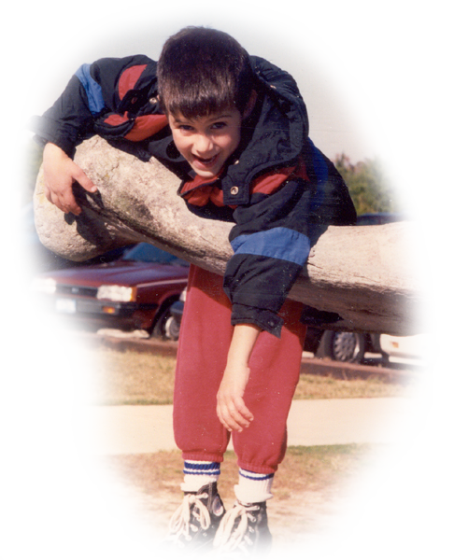
Believing is a Cause not a Consequence
Don’t ask if you believe 100% in your intentions …
just ask yourself,
“Is it a yes or a no?”
Notes:
Wake Up Call #20a
The Role of Belief
Belief is the king of it all. If you can believe something and conceive of something, you can probably achieve it. You've heard that saying, maybe?
Let's look at your hands, first. What do you do when you are thinking of making a wish or a prayer? Some people put their hands together, like bringing the lobes of the brain together so your head and your heart and your wholeness is wishing for one thing. Some people put their hands open and receive and thank whatever is coming. And some people cross their fingers and cross their heart. When you cross the body, there's an integration of the left and right lobe of the brain.
I helped a student in high school (when I was a senior in high school) to come out. He was emotionally disturbed. He could not negotiate the world. And so, we played a lot of games where we crossed the body - ping pong - threw balls. I gave him a private gym class. He came out. It was the most wonderful thing to see. He got a job. He started driving around town on his bicycle. And his family was unbelievably happy. So, there is a lot to this action (crossing my hands).
So, how do you make a wish? Well, today's wake up call is to make a wish. But, there's two steps to it. First, you have to hitch your wagon to a star. What's the star you're wishing for? What is the end result you want - that you are making the wish about? Step two, do you believe it? Do you believe it can happen? You can conceive of it - but can you believe it? Because, the step three that everybody is always talking about - how to get there - how to accomplish your wish - is non-important compared to these two steps. What's the star you are hitching your wagon to and do you believe it's possible. From that comes all of the logistics of how to get there, and the determination and the will and the energy with which you will get there.
So, your wake up call for today is hitch your wagon and believe. That's the role of belief. Belief is a cause, not a consequence.
So, thank you very much - I'll see you in one of those tomorrows.

Slide 10
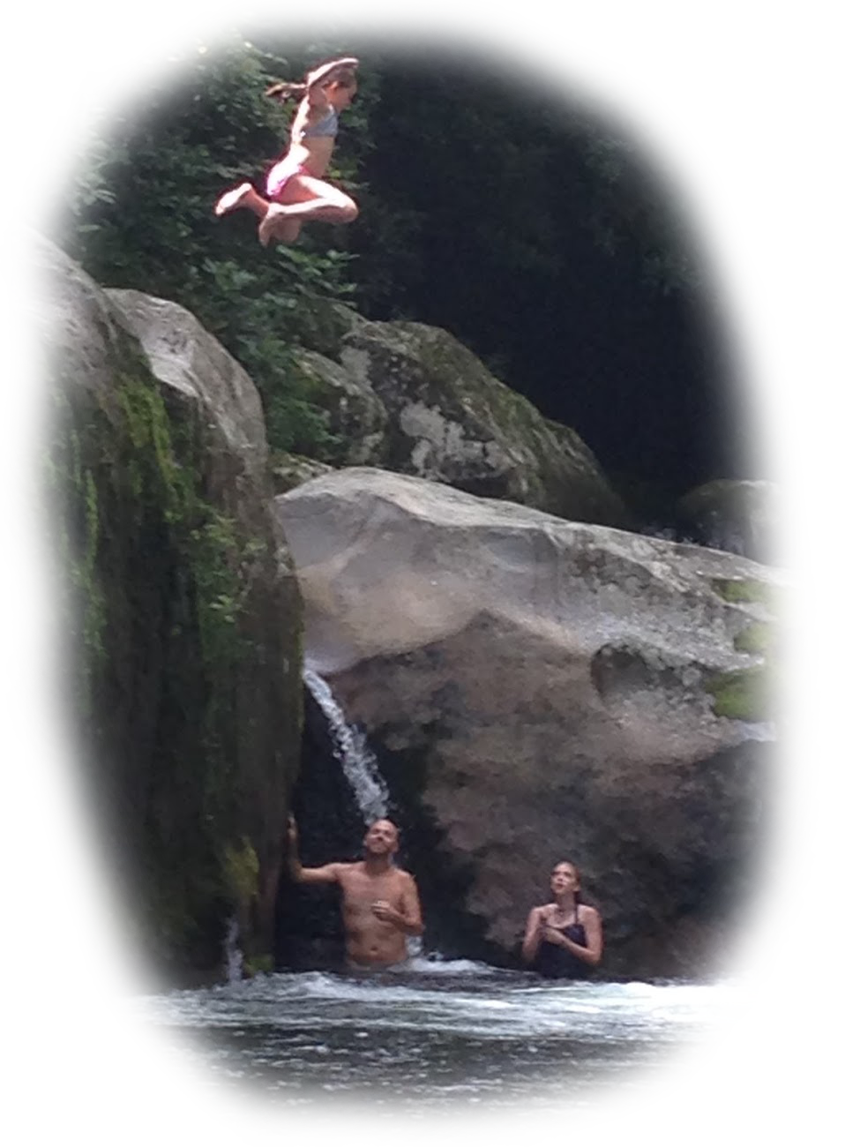
Simplicity Exercise #3
The Leap …
Picture what you REALLY wish.
Is it for a friend to end an addiction?
Is it to get along with someone?
Is it to surface from deep depression?
Is it to believe in a higher goal? …
Now, notice which way you lean.
Notes:
Story #20b
The Role of Belief
20. Allow for the possibility of becoming inspired by a belief prior to its arrival in your conscious mind; but then,
check it out analytically to see if it makes sense.
(The Teacher's Bill of Rights)
Ok, for the final 20th one, The Role of Belief. Do you remember on my first one - the first Wake Up Call and the first Story, I said, First Change Yourself? Well, yeah. Do you want to be the change you wish to see in the world? Then, you have to change yourself. You have to be the change.
Lisa Miller said it better than I could say it. "This is perhaps the biggest revelation of the awakened brain: that it’s in our innate nature to build a better world. That what’s good for everyone is also what’s best for each one of us." (Miller, 2021, p. 224) We could do this. It's in our innate nature.
In all of my talks, I constantly am trying to say that if you want to make a change to yourself - or anything:
- first, figure out what you want to change,
- then, believe it,
- then plan it.
Belief comes before planning. Belief is a causative, not a consequence. First believe it, then plan it. Going around planning things without really being invested doesn't work. So, yes, you have to arrive at a plan, but you have to believe that you are going to do it first. You must invest all of your effort in that belief stage. That's where we fail. That's why we don't have world peace. It's because we can't really believe it - "Oh, I don't think that's really going to happen." We say it at a pageant. "Oh, the thing I want most is world peace!" But everybody goes home saying, "Yeah, but I can't see how it's going to happen!"
Today's message is perhaps my biggest message. It's got the most juice in it. This is important. You can't see the next version of yourself from the current version of yourself. That's why it's the NEXT version of yourself! You're going to be different in the next version of yourself - you will have made the change you wanted to make. You could have imagined certain qualities of it. Perhaps the change or star you hitched your wagon to is sharing. Or perhaps you wished to see the human race not fighting. I would like to see peace. I would like to see happiness. But, how you are going to get there is always the question that stops you! The problem is that we let that question of the plan stop us.
What everyone does - that is the blind spot of our time is to say, "Well, I can't see how to get there." Right! You can't because, that's precisely why we're not there. The current version of us can't see how to get to our next version or else we would be at the next version. There's enough food on the planet. We just can't see how to share it.
The human race has to be told, "Believe that there will be enough. Believe that after you start doing this act of sharing - that you cannot conceive of at this time - everything will be alright." You can't conceive of your next version at this time - a version where you will want to share, where you won't be happy until the person next to you is happy. You can't conceive of it in your current condition, because you're not there (in the next version of consciousness). But the way to get to that future consciousness is by starting to believe. You take a step in pure belief, and you don't even see the net. But it will appear. And then, you start to feel a little bit for your fellow human, a little bit more than yesterday. And then you see the next step because you took that step. And the way to proceed is in the dark, with blinders on, because of your belief. And then ... you get to plan. You cannot ever get the plan for the next thing that you are going to be, before you ARE it.
This is a giant blind spot of our time. This is what you must overcome, if you want to change or transform yourself. That is my final and best message that I've got. So, I want to go see one of those tomorrows, because it's going to be better than today. I just know it. And thank you very much if you've been listening.
References
Miller, L. W. E. S. (2021). The awakened brain : the new science of spirituality and our quest for an inspired life.

