Slide 1
Notes:
***

Slide 2
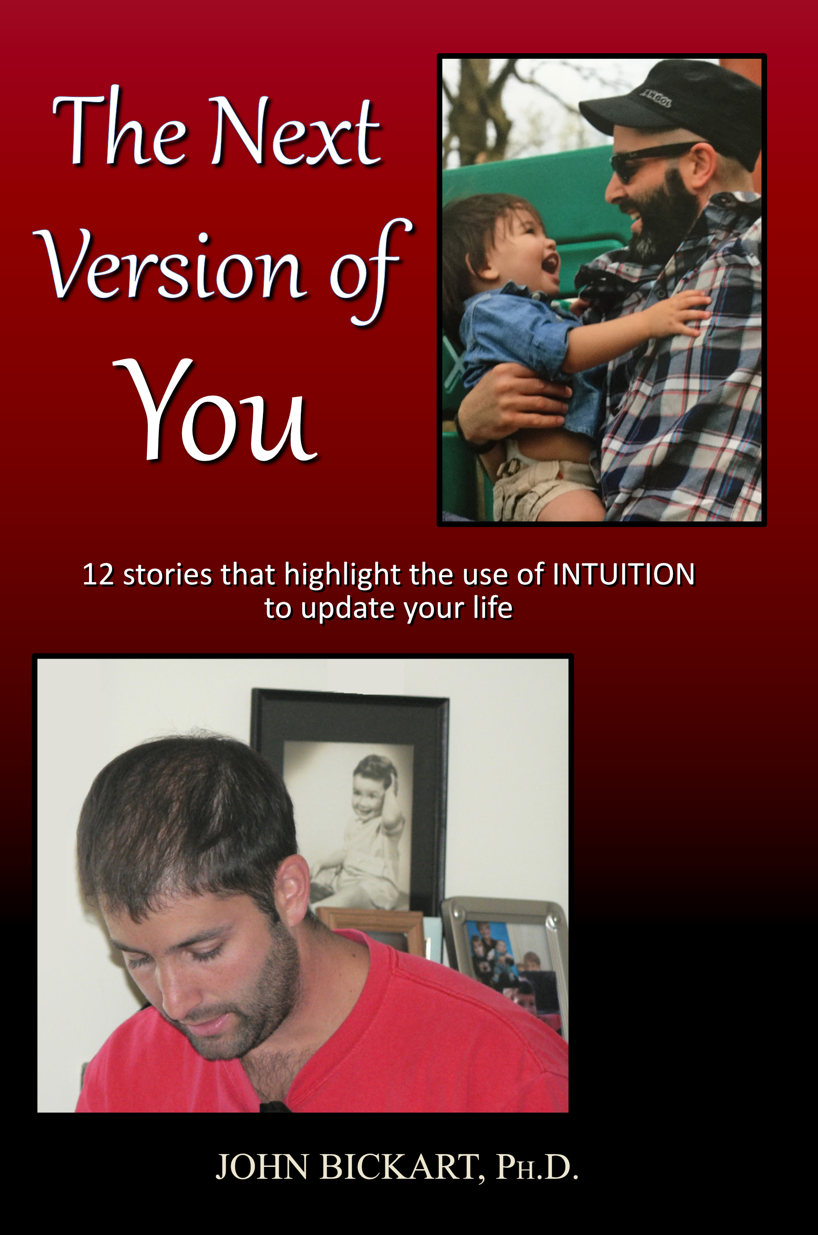
Notes:
***

Slide 3
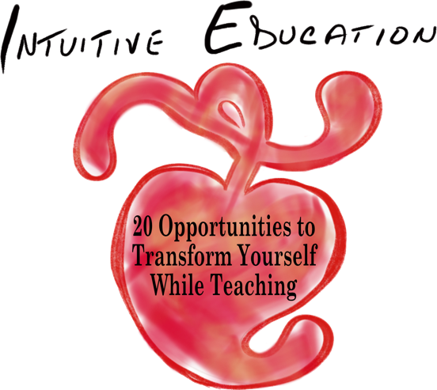
20 Opportunities to Transform Yourself While Teaching
A workshop taken from actual experiences that honor spirituality in education.
Part 1 of 5 - "Reclaiming Your Spirituality"
(Opportunities #1 - #4)
John Bickart, Ph.D.
bickart.org
Notes:
Confirm Title
ONE WAY TO AWAKEN SPIRITUALLY IS - INTUITIVE EDUCATION – THIS MEANS THINKING WITH YOUR HEART FIRST, THEN YOUR HEAD, SECOND
Transform yourself through head/heart integration or left/right brain integration // ed is 180 degrees & kids know it
***

Slide 4
Literature Review as seen on bickart.org
Wisdom Teaching and Practical Exercises (Laozi, 2005/circa 500 BC)
Childhood & Spirituality (Bickart, 2013, 2018, 2020a, 2020b, 2020c, 2022; Hart, 2001, 2010, 2014a, 2014b; L. Miller, 2015; L. W. E. S. Miller, 2021)
Awareness, Mindsight, and Flow (Csikszentmihalyi, 1994; Csikszentmihalyi & Pratt, 2017; Siegel, 2010, 2018)
Mindfulness and Nondual Awareness (Chopra, 2021; Chopra, Ford, & Williamson, 2010; Lantieri, 2008; Palmer, 1993, 1998, 2004; Palmer, Zajonc, & Scribner, 2010)
Emotional and Social Intelligence, Presence (Goleman & Boutsikaris, 2006; Goleman & Senge, 2007; Goleman & Whitener, 2005; Senge, 2000, 2008)
Belief (Dispenza, 2017; Dispenza & Boyce, 2016; Dispenza, Knight, & Encephalon, 2005; B. H. Lipton, 2005, 2006, 2014; B. H. Lipton, Bhaerman, S., 2009)
Right versus Left Brain Dominance (McGilchrist, 2009)
Early Opposition to the Mechanical View of Humans (Dewey, 1910, 1916/2005)
Historically Assumed Separateness (Kuhn, 2004)
Reduced Importance of Childhood (Piaget, 1929/2007, 1950, 1959, 1965, 1973, 1976; Piaget & Inhelder, 1969; Piaget & Valsiner, 1927/2001)
Excessive Testing (Darling-Hammond, 2010; González & Darling-Hammond, 1997; Gurwitz, Darling-Hammond, Pease, Education., & Corporation., 1981; Haggstrom, Darling-Hammond, Grissmer, & Center for the Study of the Teaching Profession (Rand Corporation), 1988; Koppich, Merseth, Darling-Hammond, American Association of Colleges for Teacher Education., & National Commission on Teaching & America's Future (U.S.), 2000; Millman & Darling-Hammond, 1990; Wise, Darling-Hammond, Berry, Profession., & Education, 1987; Wise, Darling-Hammond, & Klein, 1986; Zeichner et al., 2000)
Education: Students-only, Community-centered, Right Answers, Restricted Resources, Not tests, Not algebra, Not control, Not norms, Brick & Mortar Schools, Integrated Disciplines, Inspirational Content (Dintersmith, 2018; Hart, 2001)
1800s Factory Model (Skinner, 1953; Thorndike, 1913/2010)
Notes:
References
Bickart, J. (2013). The possible role of intuition in the child's epistemic beliefs in the Piagetian data set. (Ph.D. Dissertation). UNCC, Charlotte, NC. DAI/A 74-11(E) database. (3589794)
Bickart, J. (2018). The next version of you: 12 stories that highlight the use of intuition to update your life.
Bickart, J. (2020a). Bickart’s Just-in-Time Fables (Vol. 3). Asheville, NC: Red Shirt Interactive Group.
Bickart, J. (2020b). Bickart’s Just-in-Time Fables (Vol. 2). Asheville, NC: Red Shirt Interactive Group.
Bickart, J. (2020c). Bickart’s Just-in-Time Fables (Vol. 1). Asheville, NC: Red Shirt Interactive Group.
Bickart, J. (2022). 20 Opportunities to Transform Yourself While Teaching. Asheville, NC: Red Shirt Interactive Group.
Chopra, D. (2021). METAHUMAN : unleashing your infinite potential. [S.l.]: HARMONY CROWN.
Chopra, D., Ford, D., & Williamson, M. (2010). The shadow effect: Illuminating the hidden power of your true self. New York: HarperOne.
Csikszentmihalyi, M. (1994). Flow : living at the peak of your abilities. Niles, Ill.: Nightingale-Conant Corp.
Csikszentmihalyi, M., & Pratt, S. (2017). Finding flow : [the psychology of engagement with everyday life].
Darling-Hammond, L. (2010). The flat world and education: how America's commitment to equity will determine our future. New York: Teachers College Press.
Dewey, J. (1910). How we think. Boston: D.C. Heath & Co.
Dewey, J. (1916/2005). Democracy and education: An introduction to the philosophy of education. New York: Cosimo Classics.
Dintersmith, T. (2018). What school could be : insights and inspiration from teachers across America.
Dispenza, J. (2017). Becoming supernatural: how common people are doing the uncommon. Carlsbad: Hay House.
Dispenza, J., & Boyce, A. (2016). You Are the Placebo. [United States]: Author's Republic : Made available through hoopla.
Dispenza, J., Knight, J. Z., & Encephalon, L. L. C. (2005). Mastering the art of observation. Rainier, WA: Encephalon.
Goleman, D., & Boutsikaris, D. (2006). Social intelligence the new science of human relationships. New York: Audio Renaissance.
Goleman, D., & Senge, P. M. (2007). Working with presence. New York: Audio Renaissance.
Goleman, D., & Whitener, B. (2005). Emotional intelligence. Prince Frederick, MD: Landmark Audiobooks.
González, J. M., & Darling-Hammond, L. (1997). New concepts for new challenges: Professional development for teachers of immigrant youth. [Washington, D.C.], McHenry, IL: Center for Applied Linguistics ; Delta Systems Co.
Gurwitz, A. S., Darling-Hammond, L., Pease, S. R., Education., U. S. D. o., & Corporation., R. (1981). Maintenance of effort provisions: An instrument of federalism in education. Santa Monica, CA: Rand Corp.
Haggstrom, G. W., Darling-Hammond, L., Grissmer, D. W., & Center for the Study of the Teaching Profession (Rand Corporation). (1988). Assessing teacher supply and demand. Santa Monica, CA: Rand, Center for the Study of the Teaching Profession.
Hart, T. (2001). From information to transformation: Education for the evolution of consciousness. New York: P. Lang.
Hart, T. (2010). The secret spiritual world of children the breakthrough discovery that profoundly alters our conventional view of children's mystical experiences. [S.l.]: New World Library.
Hart, T. (2014a). The four virtues : presence, heart, wisdom, creation. New York: Atria Books/Beyond Words.
Hart, T. (2014b). The integrative mind : transformative education for a world on fire.
Koppich, J., Merseth, K. K., Darling-Hammond, L., American Association of Colleges for Teacher Education., & National Commission on Teaching & America's Future (U.S.). (2000). Studies of excellence in teacher education: Preparation in a five-year program. Washington, DC: AACTE Publications.
Kuhn, T. S. (2004). The structure of scientific revolutions. Chicago [u.a.]: Univ. of Chicago Press.
Lantieri, L. (2008). Building inner resilience. Reclaiming Children and Youth, 17(2), 43-46.
Laozi, D. R. A. C. J. (2005/circa 500 BC). Tao te ching : a new translation & commentary. New York: Barnes & Noble.
Lipton, B. H. (2005). The biology of belief: Unleashing the power of consciousness, matter and miracles. Santa Rosa, CA: Mountain of Love/Elite Books.
Lipton, B. H. (2006). The wisdom of your cells: How your beliefs control your biology. Boulder: Sounds True.
Lipton, B. H. (2014). The honeymoon effect: the science of creating heaven on earth. Boulder, CO: Sounds True.
Lipton, B. H., Bhaerman, S. (2009). Spontaneous evolution: Our positive future (and a way to get there from here). Carlsbad, Calif.: Hay House.
McGilchrist, I. (2009). The master and his emissary: the divided brain and the making of the Western world. New Haven: Yale University Press.
Miller, L. (2015). The spiritual child: The new science on parenting for health and lifelong thriving.
Miller, L. W. E. S. (2021). The awakened brain : the new science of spirituality and our quest for an inspired life.
Millman, J., & Darling-Hammond, L. (1990). The New handbook of teacher evaluation: assessing elementary and secondary school teachers. Newbury Park, Calif.: Sage Publications.
Palmer, P. J. (1993). To know as we are known: Education as a spiritual journey. San Francisco: HarperSanFrancisco.
Palmer, P. J. (1998). The courage to teach: Exploring the inner landscape of a teacher's life. San Francisco, Calif.: Jossey-Bass.
Palmer, P. J. (2004). A hidden wholeness: The journey toward an undivided life: welcoming the soul and weaving community in a wounded world. San Francisco, CA: Jossey-Bass.
Palmer, P. J., Zajonc, A., & Scribner, M. (2010). The heart of higher education: a call to renewal. San Francisco: Jossey-Bass.
Piaget, J. (1929/2007). The child's conception of the world. Lanham, MD: Rowman & Littlefield.
Piaget, J. (1950). The psychology of intelligence. London: Routledge & Paul.
Piaget, J. (1959). The language and thought of the child. New York: Humanities Press.
Piaget, J. (1965). The moral judgment of the child. New York: Free Press.
Piaget, J. (1973). The child and reality; problems of genetic psychology. New York: Grossman Publishers.
Piaget, J. (1976). The grasp of consciousness: action and concept in the young child. Cambridge: Harvard University Press.
Piaget, J., & Inhelder, B. (1969). The psychology of the child. New York: Basic Books.
Piaget, J., & Valsiner, J. (1927/2001). The child's conception of physical causality. New Brunswick (N. J.); London: Transaction Publishers.
Senge, P. M. (2000). Schools that learn: A fifth discipline fieldbook for educators, parents, and everyone who cares about education. New York: Doubleday.
Senge, P. M. (2008). The necessary revolution : how individuals and organizations are working together to create a sustainable world. New York: Doubleday.
Siegel, D. J. (2010). Mindsight: the new science of personal transformation. New York: Bantam Books.
Siegel, D. J. (2018). Aware : the science and practice of presence, a complete guide to the groundbreaking Wheel of Awareness meditation practice.
Skinner, B. F. (1953). Science and human behavior. New York: Macmillan.
Thorndike, E. L. (1913/2010). Educational psychology. [Charleston, SC]: Nabu Press, [BiblioBazaar].
Wise, A. E., Darling-Hammond, L., Berry, B., Profession., R. C. C. f. t. S. o. t. T., & Education, N. I. o. (1987). Effective teacher selection: From recruitment to retention. Santa Monica, CA: Rand, Center for the Study of the Teaching Profession.
Wise, A. E., Darling-Hammond, L., & Klein, S. P. (1986). Evaluating the teaching skills of beginning teachers a report to the Senate Education Committee and House Education Committee. Santa Monica, Calif.: Rand,.
Zeichner, K. M., Miller, L., Silvernail, D. L., Darling-Hammond, L., American Association of Colleges for Teacher Education., & National Commission on Teaching & America's Future (U.S.). (2000). Studies of excellence in teacher education: Preparation in the undergraduate years. Washington, DC: AACTE Publications.
***

Slide 5
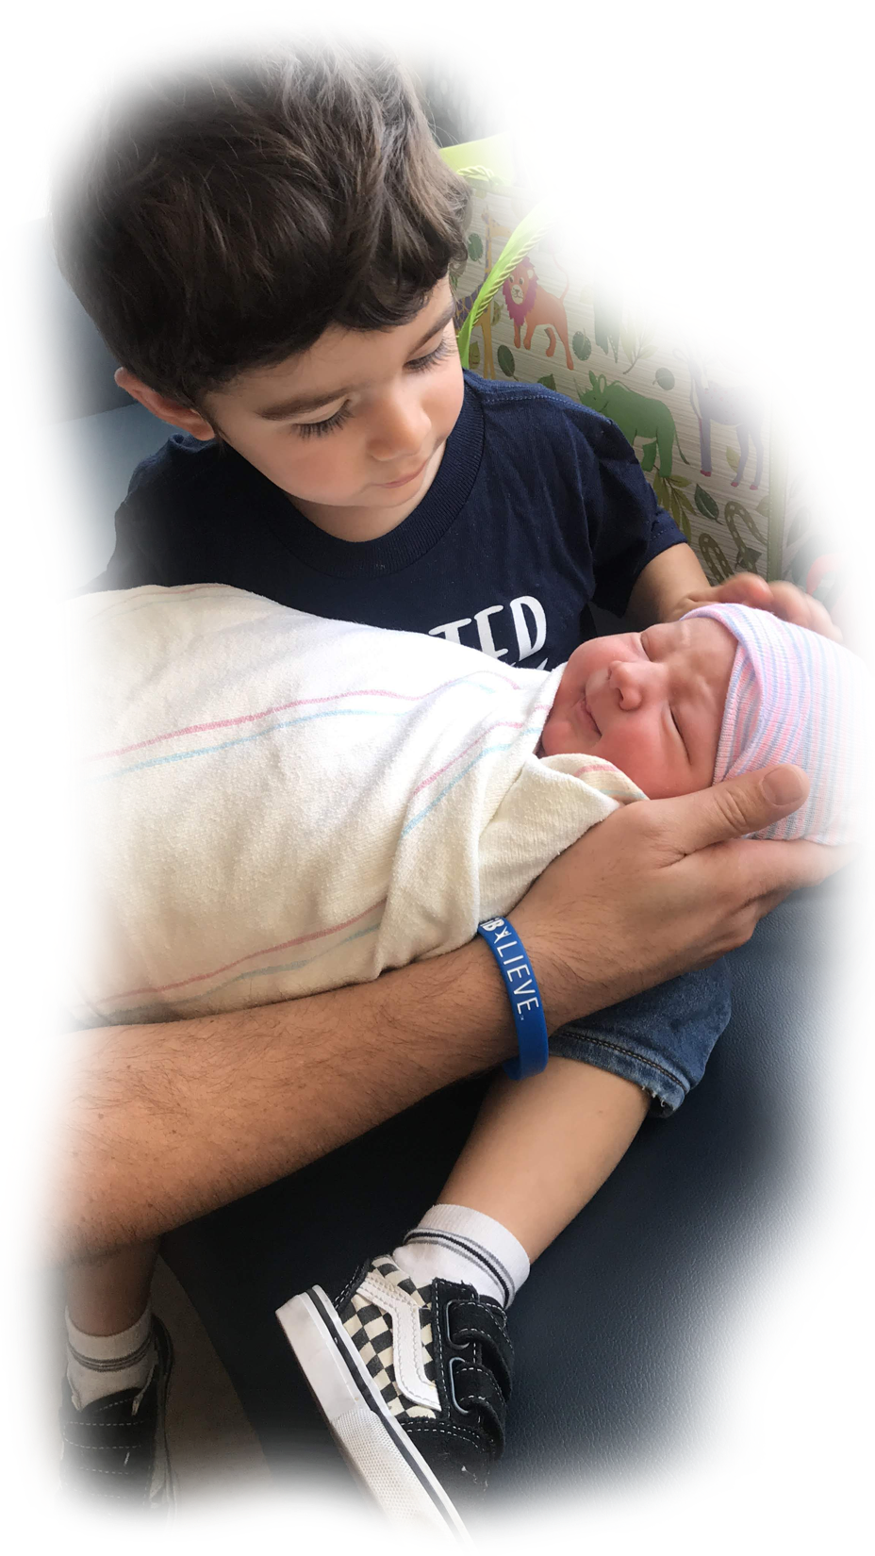
We need to commit! What if we cannot see the next version of humankind by using our heads to analyze our current situation? ​Isn't it time to Awaken, then look again by thinking with our Hearts? We cannot transform the world around us ​until we first transform ourselves.
Notes:
***

Slide 6
Overview
Head | Heart
Left Brain | Right Brain
Analytic | Intuitive
Adult | Child
Moderns | Ancients
West (current N. America & W. Europe)* | East (current Asia)*
“It is very simple to be happy; but it is very difficult to be simple.” - Rabindranath Tagore
*(Nisbett, 2003)
Notes:
***

Slide 7
Overview
Head
Heart
Some Ways to Lead with Your …
analyzing, articulating, solving, being logistical, planning, being right, quick to respond, intensity, heaviness, seriousness, “stop that or else”, “you’re wrong”, “don’t even tell me your way”, “because I said so”.
Some Ways to Lead with Your …
intuiting, observing, connecting, feeling, pausing, centering, touching, empathizing, eye contact, slow to respond, keep it light, playful, humorous, “let’s go another way”, “I see what you’re feeling”, “do you think that will work?”.
Notes:
Lisa Miller describes perceptual field can be seen as Top-down attention vs. Bottom-up perception – or awareness can be achieving or awakened
Dan Siegel describes vertical and horizontal integration of the brain
But as Lisa said, "INTEGRATION IS KEY", she describes Quest orientation as a way to journey through life, perceiving with fresh eyes, and then using new experience to fuel change
***
Lisa Miller said in The Awakened Brain, Top-down attention focuses you on the task at hand you want to achieve, but limits our perceptual field. Bottom-up perception opens you to most salient or emotionally relevant.
In Lisa Miller's Awakened Brain,
she writes a chapter called "THE TWO MODES OF AWARENESS", "﻿As a result of this awakened awareness, our eyes move to meaningful events. In achieving awareness, the stranger who starts talking to us on the bus might be annoying or intrusive, or just invisible. In awakened awareness, we might hear what he says—and even see how it’s relevant to our own lives" (Miller, 2021, p. 165).
then in a chapter called "INTEGRATION IS KEY", "Quest orientation is characterized by a tendency to journey in life: to search for answers to meaningful personal decisions and big existential questions; to perceive doubt as positive; and to be open to change, or more accurately, open to perceiving with fresh eyes, and then using new experience to fuel change. In quest, we open ourselves to the messages from life, take seriously this discovery, and then actively use learning to shape our decisions and actions—our personal operating manual" (Miller, 2021, p. 169).
"In depression, parts of the brain are dysregulated and disconnected. They aren’t functioning optimally or working together. But in quest, the brain is coherent and connected, its regions and networks in harmony. Essentially, the questing brain integrates our achieving and awakened awareness" (Miller, 2021, p. 172).

Slide 8
Opportunities
First, Change Yourself ...
The True Teacher ...
Intuitive Teaching ...
The Test of Awakening ...
Notes:
***

Slide 9
Opportunities
First, Change Yourself ...
The True Teacher ...
Intuitive Teaching ...
The Test of Awakening ...
Picture someone …
with whom you have a problem.
Notes:
Interaction #1
if you don’t have any, I want to know your secret.
- now, picture that somehow, some way, this problem starts getting better – if you two had some difficulty, you are now getting along
- but – and this is important – however this new possibility of your problem disappearing or at least improving - do not try to picture how you got there
- do not think of the logistics the specific changes that healed this problem – just picture moving toward this new possibility
- this act of beginning to move without analyzing how using an opportunity to transform yourself
***

Slide 10
The Teacher's Bill of Rights
permissions to Awaken and Transform yourself ...
1. You have permission to Awaken. You may begin to move toward a new possibility before you see how to get there.
2. Learn something from your student that transforms you, then show your gratitude. In other words, truly teach by modeling true learning!
3. Listen for an intuitive insight - even while you are speaking.
4. Look at something you have seen before. Note whether it looks better, the same, or worse than before. Then look to yourself ... you have just tested your awakened state.
5. Question everything - modeling learning by deconstruction.
6. Sometimes … fall down on the job - then be picked up by your students - in other words, be vulnerable enough to put yourself in their hands.
7. Listen to your students as if their commentary may reveal deeper truth than yours.
8. Have fun - and respect students for wanting to have fun.
9. Accent aspects of the curriculum that you love, so that you model real connection to your material.
10. Be ready to have your thoughts turned in a new, useful direction at any moment.
11. Make yourself accessible - to students - to new knowledge - to your genius.
12. Look at the same student and see no remarkable attributes one time – and striking qualities by looking once again.
13. Let your students forget lessons, so that they pick them up later - perhaps with fresh insights.
14. Be Your Own Teacher ... Receive your student’s offerings and wait … in case an authentic response arises - then, in either case, find and show your gratitude.
15. Respect silence - when a student cannot or does not wish to articulate an impression - and model to the class how to leave room for possible non-language moments of higher order learning.
16. Connect to your student on a level that is deeper than analytic comprehension.
17. Aim more at the transformation of your students through the experiences they have in your class, than the information they may receive.
18. Give permission to your student and yourself to observe something without thinking of conclusions - then, later ... see what thoughts arise.
19. Respect technology, instrumentation, and mechanized measurement without disrespecting the unseen, immeasurable, and non-physical.
20. Allow for the possibility of becoming inspired by a belief prior to its arrival in your conscious mind; but then, check it out analytically to see if it makes sense.
21. Expect wisdom from yourself, your student, or the next unexpected event in your classroom.
22. Be open to receive new ideas while speaking – and note how some are better than what you were going to say.
23. Go ahead and judge the book of nature by her cover - or even a single page - then, at a later time, investigate her many parts for verification - in other words, seek truth of the whole in one part.
24. Be open to inspiration, without necessarily following a mechanical march through a planned lesson.
25. Seek new ways to describe that which machines do not detect, such as space and time or infinity and eternity.
26. Acknowledge the group consciousness of organisms, like: bees, ants, termites, slime mold, genes, DNA, and your students.
27. Resist testing your students and suggest non-measurable, non-invasive evaluations of them.
28. Acknowledge the human mechanical, technological progress of the last several thousand years - while at the same time - acknowledging ancient intuitive abilities that have been lost, temporarily.
29. Rate your own impressions on an equal basis with research evidence, until proven wrong.
30. Hear students and start to believe in them, before actual understanding takes place.
31. Give permission to your student and yourself to receive impressions from a lesson that are too large or too complex to articulate.
32. Watch for questions that 'over-focus' the student, then ask what question is more fun.
33. Awake to the danger of constraining what students see by describing your analysis before the student is done observing.
34. Be mindful of the danger to hurt a subject by taking it apart.
35. End some lessons knowing you may never understand the full meaning because the explanation is too large for your conscious mind.
36. Integrate related subjects during your lessons - even if it strays from the curriculum.
37. Be cognizant that you may be changing that which you observe, just by your presence.
38. Acknowledge the chance that there are non-physical causes to the physical world.
39. Consider both physical facts – as well as – intuitively-based, whole ideas in a discussion.
40. Allow yourself to not know – often.
Notes:
These are hard won RIGHTS or perhaps PERMISSIONS from over a half century of an awakening teacher
you can access them on bickart.org under the ‘20 Opportunities’

Slide 11
The Teacher's Bill of Rights
permissions to Awaken and Transform yourself ...
1. You have permission to Awaken. You may begin to move toward a new possibility before you see how to get there.
2. Learn something from your student that transforms you, then show your gratitude. In other words, truly teach by modeling true learning!
3. Listen for an intuitive insight - even while you are speaking.
4. Look at something you have seen before. Note whether it looks better, the same, or worse than before. Then look to yourself ... you have just tested your awakened state.
5. Question everything - modeling learning by deconstruction.
6. Sometimes … fall down on the job - then be picked up by your students - in other words, be vulnerable enough to put yourself in their hands.
7. Listen to your students as if their commentary may reveal deeper truth than yours.
8. Have fun - and respect students for wanting to have fun.
9. Accent aspects of the curriculum that you love, so that you model real connection to your material.
10. Be ready to have your thoughts turned in a new, useful direction at any moment.
11. Make yourself accessible - to students - to new knowledge - to your genius.
12. Look at the same student and see no remarkable attributes one time – and striking qualities by looking once again.
13. Let your students forget lessons, so that they pick them up later - perhaps with fresh insights.
14. Be Your Own Teacher ... Receive your student’s offerings and wait … in case an authentic response arises - then, in either case, find and show your gratitude.
15. Respect silence - when a student cannot or does not wish to articulate an impression - and model to the class how to leave room for possible non-language moments of higher order learning.
16. Connect to your student on a level that is deeper than analytic comprehension.
17. Aim more at the transformation of your students through the experiences they have in your class, than the information they may receive.
18. Give permission to your student and yourself to observe something without thinking of conclusions - then, later ... see what thoughts arise.
19. Respect technology, instrumentation, and mechanized measurement without disrespecting the unseen, immeasurable, and non-physical.
20. Allow for the possibility of becoming inspired by a belief prior to its arrival in your conscious mind; but then, check it out analytically to see if it makes sense.
21. Expect wisdom from yourself, your student, or the next unexpected event in your classroom.
22. Be open to receive new ideas while speaking – and note how some are better than what you were going to say.
23. Go ahead and judge the book of nature by her cover - or even a single page - then, at a later time, investigate her many parts for verification - in other words, seek truth of the whole in one part.
24. Be open to inspiration, without necessarily following a mechanical march through a planned lesson.
25. Seek new ways to describe that which machines do not detect, such as space and time or infinity and eternity.
26. Acknowledge the group consciousness of organisms, like: bees, ants, termites, slime mold, genes, DNA, and your students.
27. Resist testing your students and suggest non-measurable, non-invasive evaluations of them.
28. Acknowledge the human mechanical, technological progress of the last several thousand years - while at the same time - acknowledging ancient intuitive abilities that have been lost, temporarily.
29. Rate your own impressions on an equal basis with research evidence, until proven wrong.
30. Hear students and start to believe in them, before actual understanding takes place.
31. Give permission to your student and yourself to receive impressions from a lesson that are too large or too complex to articulate.
32. Watch for questions that 'over-focus' the student, then ask what question is more fun.
33. Awake to the danger of constraining what students see by describing your analysis before the student is done observing.
34. Be mindful of the danger to hurt a subject by taking it apart.
35. End some lessons knowing you may never understand the full meaning because the explanation is too large for your conscious mind.
36. Integrate related subjects during your lessons - even if it strays from the curriculum.
37. Be cognizant that you may be changing that which you observe, just by your presence.
38. Acknowledge the chance that there are non-physical causes to the physical world.
39. Consider both physical facts – as well as – intuitively-based, whole ideas in a discussion.
40. Allow yourself to not know – often.
Notes:
These are hard won RIGHTS or perhaps PERMISSIONS from over a half century of an awakening teacher
you can access them on bickart.org under the ‘20 Opportunities’

Slide 12
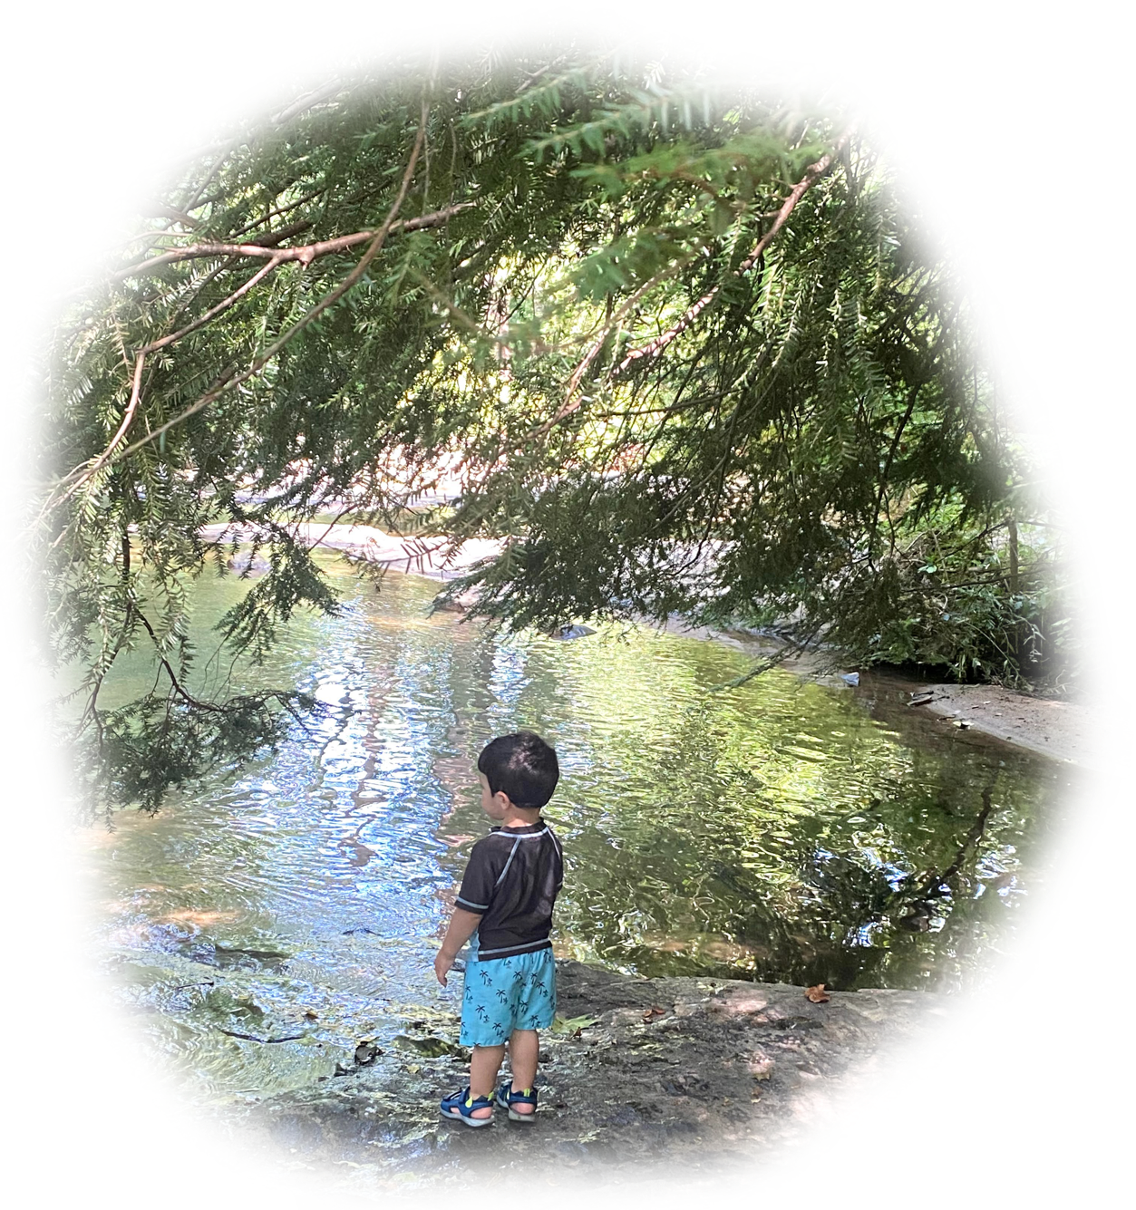
“For out of the overflow of his heart his mouth speaks.”
– Christ (Luke 6:45)
“See the false as false - the true as true. Look into your heart."
- Buddha
Notes:
Story: from World Trade Centers Association in the twin towers in the 1990s, a decade before the tragedy …
In Audre Lorde's Sister Outsider, she introduces the notion that one cannot dismantle the master's house with the master's tools. (Lorde, 1984) I feel that educators are in the position of dismantling what and how we currently teach with our heads as the master, and that we cannot use our heads to do the job. We will need to use our hearts.
Story continues: 9/11/2002, start my new career with a bang, Ray as best, Ray’s reaction, Ray’s admonition that he had to change himself because I changed students.
***

Slide 13
Opportunities
First, Change Yourself ...
The True Teacher ...
Intuitive Teaching ...
The Test of Awakening ...
Remember the student who taught you … ? This week, lie in wait!!!
Notes:
Interaction #2
- have you ever found yourself telling a student or coworker, “whoa, thanks for that! – you just moved me – I did not realize that before quite like that! - you changed me!”
- this week (or even right now, in your mind) wait and watch for something you can learn, something that is really worth changing for, and get ready to express your gratitude
***

Slide 14
The Teacher's Bill of Rights
permissions to Awaken and Transform yourself ...
1. You have permission to Awaken. You may begin to move toward a new possibility before you see how to get there.
2. Learn something from your student that transforms you, then show your gratitude. In other words, truly teach by modeling true learning!
3. Listen for an intuitive insight - even while you are speaking.
4. Look at something you have seen before. Note whether it looks better, the same, or worse than before. Then look to yourself ... you have just tested your awakened state.
5. Question everything - modeling learning by deconstruction.
6. Sometimes … fall down on the job - then be picked up by your students - in other words, be vulnerable enough to put yourself in their hands.
7. Listen to your students as if their commentary may reveal deeper truth than yours.
8. Have fun - and respect students for wanting to have fun.
9. Accent aspects of the curriculum that you love, so that you model real connection to your material.
10. Be ready to have your thoughts turned in a new, useful direction at any moment.
11. Make yourself accessible - to students - to new knowledge - to your genius.
12. Look at the same student and see no remarkable attributes one time – and striking qualities by looking once again.
13. Let your students forget lessons, so that they pick them up later - perhaps with fresh insights.
14. Be Your Own Teacher ... Receive your student’s offerings and wait … in case an authentic response arises - then, in either case, find and show your gratitude.
15. Respect silence - when a student cannot or does not wish to articulate an impression - and model to the class how to leave room for possible non-language moments of higher order learning.
16. Connect to your student on a level that is deeper than analytic comprehension.
17. Aim more at the transformation of your students through the experiences they have in your class, than the information they may receive.
18. Give permission to your student and yourself to observe something without thinking of conclusions - then, later ... see what thoughts arise.
19. Respect technology, instrumentation, and mechanized measurement without disrespecting the unseen, immeasurable, and non-physical.
20. Allow for the possibility of becoming inspired by a belief prior to its arrival in your conscious mind; but then, check it out analytically to see if it makes sense.
21. Expect wisdom from yourself, your student, or the next unexpected event in your classroom.
22. Be open to receive new ideas while speaking – and note how some are better than what you were going to say.
23. Go ahead and judge the book of nature by her cover - or even a single page - then, at a later time, investigate her many parts for verification - in other words, seek truth of the whole in one part.
24. Be open to inspiration, without necessarily following a mechanical march through a planned lesson.
25. Seek new ways to describe that which machines do not detect, such as space and time or infinity and eternity.
26. Acknowledge the group consciousness of organisms, like: bees, ants, termites, slime mold, genes, DNA, and your students.
27. Resist testing your students and suggest non-measurable, non-invasive evaluations of them.
28. Acknowledge the human mechanical, technological progress of the last several thousand years - while at the same time - acknowledging ancient intuitive abilities that have been lost, temporarily.
29. Rate your own impressions on an equal basis with research evidence, until proven wrong.
30. Hear students and start to believe in them, before actual understanding takes place.
31. Give permission to your student and yourself to receive impressions from a lesson that are too large or too complex to articulate.
32. Watch for questions that 'over-focus' the student, then ask what question is more fun.
33. Awake to the danger of constraining what students see by describing your analysis before the student is done observing.
34. Be mindful of the danger to hurt a subject by taking it apart.
35. End some lessons knowing you may never understand the full meaning because the explanation is too large for your conscious mind.
36. Integrate related subjects during your lessons - even if it strays from the curriculum.
37. Be cognizant that you may be changing that which you observe, just by your presence.
38. Acknowledge the chance that there are non-physical causes to the physical world.
39. Consider both physical facts – as well as – intuitively-based, whole ideas in a discussion.
40. Allow yourself to not know – often.
Notes:
These are hard won RIGHTS or perhaps PERMISSIONS from over a half century of an awakening teacher
you can access them on bickart.org under the ‘20 Opportunities’

Slide 15
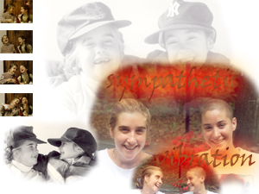
Telling, I became a teacher.
Listening, I became a student.
Thanking, I became a friend.
And lo …
I was Truly Teaching
Notes:
Story: from (2007) Shanghai International Studies University summer program with my brother-in-law and son, so mixed ages – they lean in and I start to cry
- they taught me to look through another’s eyes – to see a middle way
- as I thanked them, I realized I was truly teaching – not how to debate – how to transform myself through learning and be grateful
***

Slide 16
Opportunities
First, Change Yourself ...
The True Teacher ...
Intuitive Teaching ...
The Test of Awakening ...
Observe your hand …
without thought.
Notes:
Interaction #3
- Let’s walk through a very simple, yet powerful technique.
- close your hand and observe it for a moment.
- now, without engaging your thoughts about it, continue observing your hand as you open it.
- now, either close your eyes or just look in your mind and replay this event – just see it in your mind like a movie, complete with any sensations your senses experienced – it is important that you do not touch the movie with any head thoughts like, “why are we doing this?” or “gee my hand looks fatter than it did before the pandemic!”
- you have just done perhaps the most powerful opportunity to transform yourself that I know
- you have learned to clear a still, empty space within yourself to let intuitions come in and you can even do this while you teaching
***

Slide 17
The Teacher's Bill of Rights
permissions to Awaken and Transform yourself ...
1. You have permission to Awaken. You may begin to move toward a new possibility before you see how to get there.
2. Learn something from your student that transforms you, then show your gratitude. In other words, truly teach by modeling true learning!
3. Listen for an intuitive insight - even while you are speaking.
4. Look at something you have seen before. Note whether it looks better, the same, or worse than before. Then look to yourself ... you have just tested your awakened state.
5. Question everything - modeling learning by deconstruction.
6. Sometimes … fall down on the job - then be picked up by your students - in other words, be vulnerable enough to put yourself in their hands.
7. Listen to your students as if their commentary may reveal deeper truth than yours.
8. Have fun - and respect students for wanting to have fun.
9. Accent aspects of the curriculum that you love, so that you model real connection to your material.
10. Be ready to have your thoughts turned in a new, useful direction at any moment.
11. Make yourself accessible - to students - to new knowledge - to your genius.
12. Look at the same student and see no remarkable attributes one time – and striking qualities by looking once again.
13. Let your students forget lessons, so that they pick them up later - perhaps with fresh insights.
14. Be Your Own Teacher ... Receive your student’s offerings and wait … in case an authentic response arises - then, in either case, find and show your gratitude.
15. Respect silence - when a student cannot or does not wish to articulate an impression - and model to the class how to leave room for possible non-language moments of higher order learning.
16. Connect to your student on a level that is deeper than analytic comprehension.
17. Aim more at the transformation of your students through the experiences they have in your class, than the information they may receive.
18. Give permission to your student and yourself to observe something without thinking of conclusions - then, later ... see what thoughts arise.
19. Respect technology, instrumentation, and mechanized measurement without disrespecting the unseen, immeasurable, and non-physical.
20. Allow for the possibility of becoming inspired by a belief prior to its arrival in your conscious mind; but then, check it out analytically to see if it makes sense.
21. Expect wisdom from yourself, your student, or the next unexpected event in your classroom.
22. Be open to receive new ideas while speaking – and note how some are better than what you were going to say.
23. Go ahead and judge the book of nature by her cover - or even a single page - then, at a later time, investigate her many parts for verification - in other words, seek truth of the whole in one part.
24. Be open to inspiration, without necessarily following a mechanical march through a planned lesson.
25. Seek new ways to describe that which machines do not detect, such as space and time or infinity and eternity.
26. Acknowledge the group consciousness of organisms, like: bees, ants, termites, slime mold, genes, DNA, and your students.
27. Resist testing your students and suggest non-measurable, non-invasive evaluations of them.
28. Acknowledge the human mechanical, technological progress of the last several thousand years - while at the same time - acknowledging ancient intuitive abilities that have been lost, temporarily.
29. Rate your own impressions on an equal basis with research evidence, until proven wrong.
30. Hear students and start to believe in them, before actual understanding takes place.
31. Give permission to your student and yourself to receive impressions from a lesson that are too large or too complex to articulate.
32. Watch for questions that 'over-focus' the student, then ask what question is more fun.
33. Awake to the danger of constraining what students see by describing your analysis before the student is done observing.
34. Be mindful of the danger to hurt a subject by taking it apart.
35. End some lessons knowing you may never understand the full meaning because the explanation is too large for your conscious mind.
36. Integrate related subjects during your lessons - even if it strays from the curriculum.
37. Be cognizant that you may be changing that which you observe, just by your presence.
38. Acknowledge the chance that there are non-physical causes to the physical world.
39. Consider both physical facts – as well as – intuitively-based, whole ideas in a discussion.
40. Allow yourself to not know – often.
Notes:
These are hard won RIGHTS or perhaps PERMISSIONS from over a half century of an awakening teacher
you can access them on bickart.org under the ‘20 Opportunities’

Slide 18
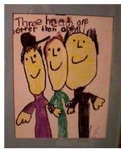
Illustrated by Daniel Bickart
“Three Heads are Better than One”
Notes:
Story: fromThe Waldorf School of Garden City, Long Island, NY (late 1970s)
- A simple, yet powerful observation technique you can do weekly. O/A in science, but also other ways.
- But bigger message is to watch for life to highlight what is speaking to you
***

Slide 19
Observation vs Analysis
Make an (O/A) sheet.
First, Observe. [Heart]
Then, Fantasize what you observed. [Heart]
Then, Draw what you observed. [Heart]
Then, Write what you observed. [Heart]
Finally, Analyze. [Head]
Notes:
Research shows that the 20th century saw education racing to name, categorize, and analyze in order to find right answers. The new paradigms circulate around deeper observations before doing this.
Here’s an exercise to help a student to hold off the tendency to jump to conclusions and analysis too soon. It’s simple. The teacher asks the students remain in a state of observation four different ways before even talking about what they think or analyze. Since the 70s, I have had students make O/As. It’s a great process where the student first does an Observation, then an Analysis – an O/A.
Pretend you are in my science class. You are told that
first, we will observe a science demonstration. I light a candle. Now I take some iron filings and sprinkle them on the flame. They sparkle.
Now you are asked to close your eyes and replay – in your mind – a fantasy movie of what you saw – complete with anything your senses took in - adding or subtracting nothing. Just play it as closely to what actually happened, as possible.
Then you are asked to draw it.
Then you are asked to write it. Note that all this while you are still dealing with Observations. If students start to make deductions or inference or conclusions of any kind, they are told to hold them off for a moment.
Finally, students are asked to share their ideas about what happened. This is the time to finally analyze.
Siegel's Horizontal and Vertical Integration
Horizontal - left integrates with right - if connected you are emotionally intelligent - in order to connect, find the side that is dominating the other side and “CONNECT AND REDIRECT"
Vertical - upper brain: prefrontal cortex integrates with lower brain: limbic & amygdala (K. C. Bickart, Wright, C. I., Dautoff, R. J., Dickerson, B. C., Barrett, L. F., 2011) to connect upper and lower, helping the child to identify the emotion is a key in what Dr. Siegel calls the “NAME IT TO TAME IT” process.
***

Slide 20
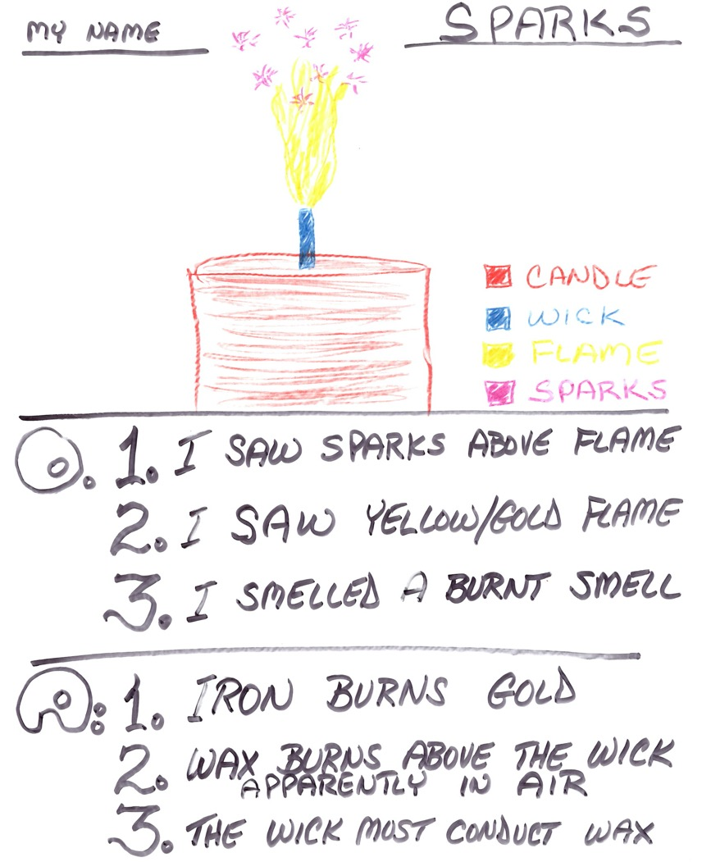
Notes:
Here is a typical Observation/Analysis sheet. After observing the science demonstration, then replaying it in the mind, you see the drawing, then 3 brief observations, followed by 3 analyses.
… [READ SLIDE]
This technique is quite powerful in nurturing the mindfulness it takes to remain in the experience before jumping to left brain activity that articulates about the experience. It can also be done with a literary work or the analysis of a political or economic demonstration, too.
***

Slide 21
Opportunities
First, Change Yourself ...
The True Teacher ...
Intuitive Teaching ...
The Test of Awakening ...
Look at a COLOR
Notes:
Interaction #4
- let’s do the test, then talk about it – ready?
- look around where you are right now for one of your favorite COLORS
- is it better, the same, or worse than another time you have looked at this particular color?
- if it does not look as good as you can remember – if you cannot experience this color so that it moves you - can you summon your awareness to increase your appreciation of it?
- if it starts looking better, you are awakening – transforming – becoming present right now
- YOU ARE AWAKENING just a bit more than a moment ago!
***

Slide 22
The Teacher's Bill of Rights
permissions to Awaken and Transform yourself ...
1. You have permission to Awaken. You may begin to move toward a new possibility before you see how to get there.
2. Learn something from your student that transforms you, then show your gratitude. In other words, truly teach by modeling true learning!
3. Listen for an intuitive insight - even while you are speaking.
4. Look at something you have seen before. Note whether it looks better, the same, or worse than before. Then look to yourself ... you have just tested your awakened state.
5. Question everything - modeling learning by deconstruction.
6. Sometimes … fall down on the job - then be picked up by your students - in other words, be vulnerable enough to put yourself in their hands.
7. Listen to your students as if their commentary may reveal deeper truth than yours.
8. Have fun - and respect students for wanting to have fun.
9. Accent aspects of the curriculum that you love, so that you model real connection to your material.
10. Be ready to have your thoughts turned in a new, useful direction at any moment.
11. Make yourself accessible - to students - to new knowledge - to your genius.
12. Look at the same student and see no remarkable attributes one time – and striking qualities by looking once again.
13. Let your students forget lessons, so that they pick them up later - perhaps with fresh insights.
14. Be Your Own Teacher ... Receive your student’s offerings and wait … in case an authentic response arises - then, in either case, find and show your gratitude.
15. Respect silence - when a student cannot or does not wish to articulate an impression - and model to the class how to leave room for possible non-language moments of higher order learning.
16. Connect to your student on a level that is deeper than analytic comprehension.
17. Aim more at the transformation of your students through the experiences they have in your class, than the information they may receive.
18. Give permission to your student and yourself to observe something without thinking of conclusions - then, later ... see what thoughts arise.
19. Respect technology, instrumentation, and mechanized measurement without disrespecting the unseen, immeasurable, and non-physical.
20. Allow for the possibility of becoming inspired by a belief prior to its arrival in your conscious mind; but then, check it out analytically to see if it makes sense.
21. Expect wisdom from yourself, your student, or the next unexpected event in your classroom.
22. Be open to receive new ideas while speaking – and note how some are better than what you were going to say.
23. Go ahead and judge the book of nature by her cover - or even a single page - then, at a later time, investigate her many parts for verification - in other words, seek truth of the whole in one part.
24. Be open to inspiration, without necessarily following a mechanical march through a planned lesson.
25. Seek new ways to describe that which machines do not detect, such as space and time or infinity and eternity.
26. Acknowledge the group consciousness of organisms, like: bees, ants, termites, slime mold, genes, DNA, and your students.
27. Resist testing your students and suggest non-measurable, non-invasive evaluations of them.
28. Acknowledge the human mechanical, technological progress of the last several thousand years - while at the same time - acknowledging ancient intuitive abilities that have been lost, temporarily.
29. Rate your own impressions on an equal basis with research evidence, until proven wrong.
30. Hear students and start to believe in them, before actual understanding takes place.
31. Give permission to your student and yourself to receive impressions from a lesson that are too large or too complex to articulate.
32. Watch for questions that 'over-focus' the student, then ask what question is more fun.
33. Awake to the danger of constraining what students see by describing your analysis before the student is done observing.
34. Be mindful of the danger to hurt a subject by taking it apart.
35. End some lessons knowing you may never understand the full meaning because the explanation is too large for your conscious mind.
36. Integrate related subjects during your lessons - even if it strays from the curriculum.
37. Be cognizant that you may be changing that which you observe, just by your presence.
38. Acknowledge the chance that there are non-physical causes to the physical world.
39. Consider both physical facts – as well as – intuitively-based, whole ideas in a discussion.
40. Allow yourself to not know – often.
Notes:
These are hard won RIGHTS or perhaps PERMISSIONS from over a half century of an awakening teacher
you can access them on bickart.org under the ‘20 Opportunities’

Slide 23
Øyvind Holmstad
Notes:
Story: from Final Test for the VERA Institute of Justice Pathways Project for Incarcerated Individuals, NC State Prisons (2013)
- Dad would often say, “I can’t wait for tomorrow because I get better looking every day!”
***

Slide 24
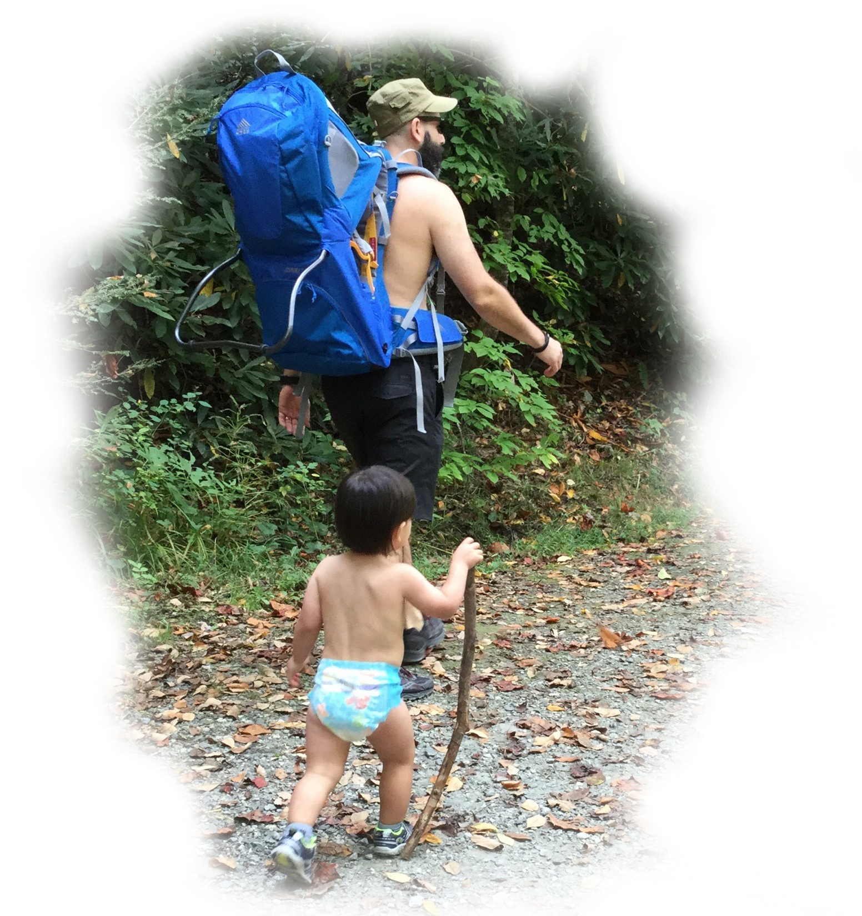
Conclusion to Part 1 of 5
“When you come to a fork in the road, take it.”
- Yogi Berra
Thank You!
Notes:
Thank you.

