Slide 1
Notes:
***

Slide 2
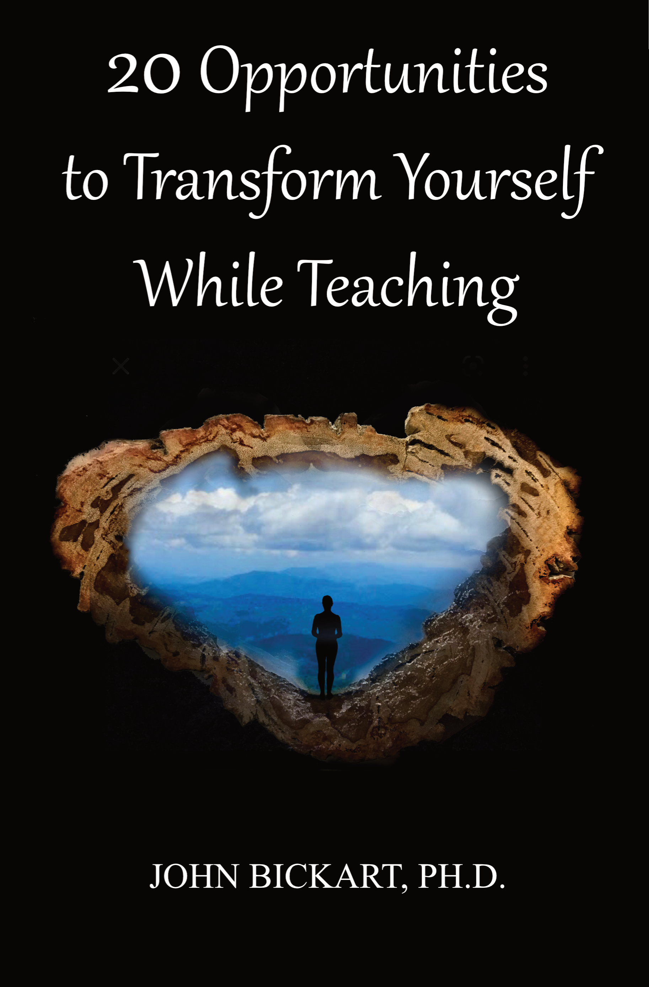
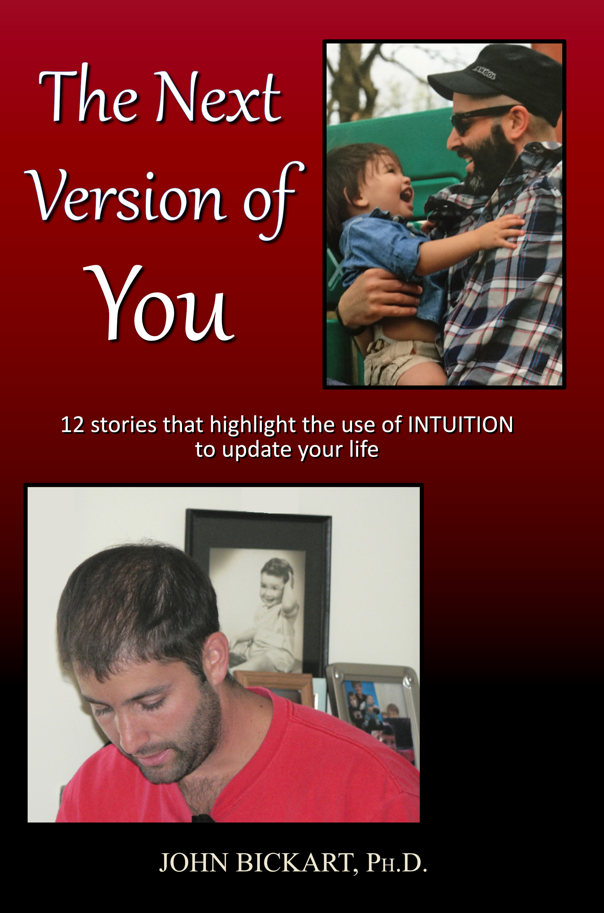
Notes:
***

Slide 3
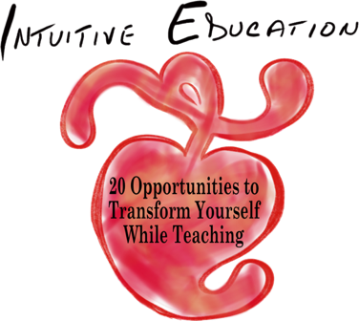
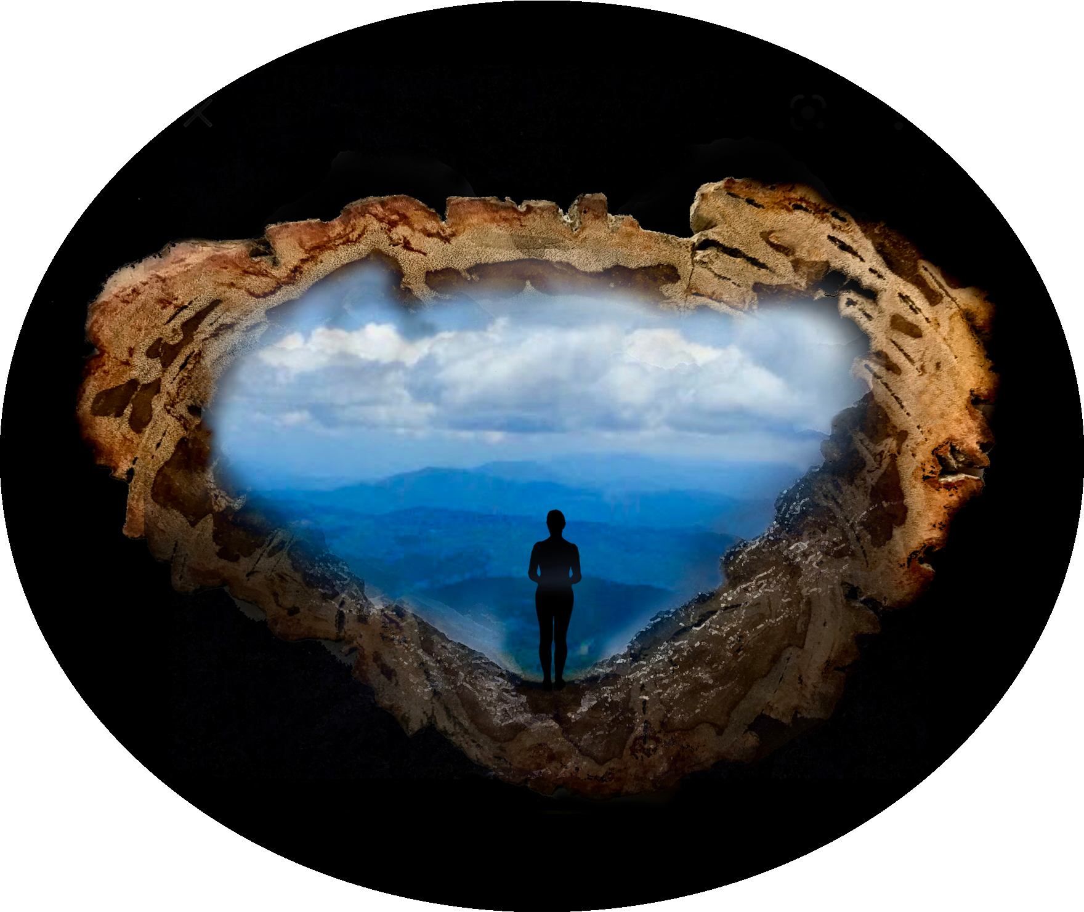
20 Opportunities to Transform Yourself While Teaching
A workshop taken from actual experiences that honor spirituality in education.
Part 3 of 5 - "Recovering Your Childhood in Adulthood"
(Opportunities #9 - #12)
John Bickart, Ph.D.
bickart.org
Notes:
Confirm Title
ONE WAY TO AWAKEN SPIRITUALLY IS - INTUITIVE EDUCATION – THIS MEANS THINKING WITH YOUR HEART FIRST, THEN YOUR HEAD, SECOND
Transform yourself through head/heart integration or left/right brain integration // ed is 180 degrees & kids know it
***

Slide 4
Literature Review as seen on bickart.org
Wisdom Teaching and Practical Exercises (Laozi, 2005/circa 500 BC)
Childhood & Spirituality (Bickart, 2013, 2018, 2020a, 2020b, 2020c, 2022; Hart, 2001, 2010, 2014a, 2014b; L. Miller, 2015; L. W. E. S. Miller, 2021)
Awareness, Mindsight, and Flow (Csikszentmihalyi, 1994; Csikszentmihalyi & Pratt, 2017; Siegel, 2010, 2018)
Mindfulness and Nondual Awareness (Chopra, 2021; Chopra, Ford, & Williamson, 2010; Lantieri, 2008; Palmer, 1993, 1998, 2004; Palmer, Zajonc, & Scribner, 2010)
Emotional and Social Intelligence, Presence (Goleman & Boutsikaris, 2006; Goleman & Senge, 2007; Goleman & Whitener, 2005; Senge, 2000, 2008)
Belief (Dispenza, 2017; Dispenza & Boyce, 2016; Dispenza, Knight, & Encephalon, 2005; B. H. Lipton, 2005, 2006, 2014; B. H. Lipton, Bhaerman, S., 2009)
Right versus Left Brain Dominance (McGilchrist, 2009)
Early Opposition to the Mechanical View of Humans (Dewey, 1910, 1916/2005)
Historically Assumed Separateness (Kuhn, 2004)
Reduced Importance of Childhood (Piaget, 1929/2007, 1950, 1959, 1965, 1973, 1976; Piaget & Inhelder, 1969; Piaget & Valsiner, 1927/2001)
Excessive Testing (Darling-Hammond, 2010; González & Darling-Hammond, 1997; Gurwitz, Darling-Hammond, Pease, Education., & Corporation., 1981; Haggstrom, Darling-Hammond, Grissmer, & Center for the Study of the Teaching Profession (Rand Corporation), 1988; Koppich, Merseth, Darling-Hammond, American Association of Colleges for Teacher Education., & National Commission on Teaching & America's Future (U.S.), 2000; Millman & Darling-Hammond, 1990; Wise, Darling-Hammond, Berry, Profession., & Education, 1987; Wise, Darling-Hammond, & Klein, 1986; Zeichner et al., 2000)
Education: Students-only, Community-centered, Right Answers, Restricted Resources, Not tests, Not algebra, Not control, Not norms, Brick & Mortar Schools, Integrated Disciplines, Inspirational Content (Dintersmith, 2018; Hart, 2001)
1800s Factory Model (Skinner, 1953; Thorndike, 1913/2010)
Notes:
References
Bickart, J. (2013). The possible role of intuition in the child's epistemic beliefs in the Piagetian data set. (Ph.D. Dissertation). UNCC, Charlotte, NC. DAI/A 74-11(E) database. (3589794)
Bickart, J. (2018). The next version of you: 12 stories that highlight the use of intuition to update your life.
Bickart, J. (2020a). Bickart’s Just-in-Time Fables (Vol. 3). Asheville, NC: Red Shirt Interactive Group.
Bickart, J. (2020b). Bickart’s Just-in-Time Fables (Vol. 2). Asheville, NC: Red Shirt Interactive Group.
Bickart, J. (2020c). Bickart’s Just-in-Time Fables (Vol. 1). Asheville, NC: Red Shirt Interactive Group.
Bickart, J. (2022). 20 Opportunities to Transform Yourself While Teaching. Asheville, NC: Red Shirt Interactive Group.
Chopra, D. (2021). METAHUMAN : unleashing your infinite potential. [S.l.]: HARMONY CROWN.
Chopra, D., Ford, D., & Williamson, M. (2010). The shadow effect: Illuminating the hidden power of your true self. New York: HarperOne.
Csikszentmihalyi, M. (1994). Flow : living at the peak of your abilities. Niles, Ill.: Nightingale-Conant Corp.
Csikszentmihalyi, M., & Pratt, S. (2017). Finding flow : [the psychology of engagement with everyday life].
Darling-Hammond, L. (2010). The flat world and education: how America's commitment to equity will determine our future. New York: Teachers College Press.
Dewey, J. (1910). How we think. Boston: D.C. Heath & Co.
Dewey, J. (1916/2005). Democracy and education: An introduction to the philosophy of education. New York: Cosimo Classics.
Dintersmith, T. (2018). What school could be : insights and inspiration from teachers across America.
Dispenza, J. (2017). Becoming supernatural: how common people are doing the uncommon. Carlsbad: Hay House.
Dispenza, J., & Boyce, A. (2016). You Are the Placebo. [United States]: Author's Republic : Made available through hoopla.
Dispenza, J., Knight, J. Z., & Encephalon, L. L. C. (2005). Mastering the art of observation. Rainier, WA: Encephalon.
Goleman, D., & Boutsikaris, D. (2006). Social intelligence the new science of human relationships. New York: Audio Renaissance.
Goleman, D., & Senge, P. M. (2007). Working with presence. New York: Audio Renaissance.
Goleman, D., & Whitener, B. (2005). Emotional intelligence. Prince Frederick, MD: Landmark Audiobooks.
González, J. M., & Darling-Hammond, L. (1997). New concepts for new challenges: Professional development for teachers of immigrant youth. [Washington, D.C.], McHenry, IL: Center for Applied Linguistics ; Delta Systems Co.
Gurwitz, A. S., Darling-Hammond, L., Pease, S. R., Education., U. S. D. o., & Corporation., R. (1981). Maintenance of effort provisions: An instrument of federalism in education. Santa Monica, CA: Rand Corp.
Haggstrom, G. W., Darling-Hammond, L., Grissmer, D. W., & Center for the Study of the Teaching Profession (Rand Corporation). (1988). Assessing teacher supply and demand. Santa Monica, CA: Rand, Center for the Study of the Teaching Profession.
Hart, T. (2001). From information to transformation: Education for the evolution of consciousness. New York: P. Lang.
Hart, T. (2010). The secret spiritual world of children the breakthrough discovery that profoundly alters our conventional view of children's mystical experiences. [S.l.]: New World Library.
Hart, T. (2014a). The four virtues : presence, heart, wisdom, creation. New York: Atria Books/Beyond Words.
Hart, T. (2014b). The integrative mind : transformative education for a world on fire.
Koppich, J., Merseth, K. K., Darling-Hammond, L., American Association of Colleges for Teacher Education., & National Commission on Teaching & America's Future (U.S.). (2000). Studies of excellence in teacher education: Preparation in a five-year program. Washington, DC: AACTE Publications.
Kuhn, T. S. (2004). The structure of scientific revolutions. Chicago [u.a.]: Univ. of Chicago Press.
Lantieri, L. (2008). Building inner resilience. Reclaiming Children and Youth, 17(2), 43-46.
Laozi, D. R. A. C. J. (2005/circa 500 BC). Tao te ching : a new translation & commentary. New York: Barnes & Noble.
Lipton, B. H. (2005). The biology of belief: Unleashing the power of consciousness, matter and miracles. Santa Rosa, CA: Mountain of Love/Elite Books.
Lipton, B. H. (2006). The wisdom of your cells: How your beliefs control your biology. Boulder: Sounds True.
Lipton, B. H. (2014). The honeymoon effect: the science of creating heaven on earth. Boulder, CO: Sounds True.
Lipton, B. H., Bhaerman, S. (2009). Spontaneous evolution: Our positive future (and a way to get there from here). Carlsbad, Calif.: Hay House.
McGilchrist, I. (2009). The master and his emissary: the divided brain and the making of the Western world. New Haven: Yale University Press.
Miller, L. (2015). The spiritual child: The new science on parenting for health and lifelong thriving.
Miller, L. W. E. S. (2021). The awakened brain : the new science of spirituality and our quest for an inspired life.
Millman, J., & Darling-Hammond, L. (1990). The New handbook of teacher evaluation: assessing elementary and secondary school teachers. Newbury Park, Calif.: Sage Publications.
Palmer, P. J. (1993). To know as we are known: Education as a spiritual journey. San Francisco: HarperSanFrancisco.
Palmer, P. J. (1998). The courage to teach: Exploring the inner landscape of a teacher's life. San Francisco, Calif.: Jossey-Bass.
Palmer, P. J. (2004). A hidden wholeness: The journey toward an undivided life: welcoming the soul and weaving community in a wounded world. San Francisco, CA: Jossey-Bass.
Palmer, P. J., Zajonc, A., & Scribner, M. (2010). The heart of higher education: a call to renewal. San Francisco: Jossey-Bass.
Piaget, J. (1929/2007). The child's conception of the world. Lanham, MD: Rowman & Littlefield.
Piaget, J. (1950). The psychology of intelligence. London: Routledge & Paul.
Piaget, J. (1959). The language and thought of the child. New York: Humanities Press.
Piaget, J. (1965). The moral judgment of the child. New York: Free Press.
Piaget, J. (1973). The child and reality; problems of genetic psychology. New York: Grossman Publishers.
Piaget, J. (1976). The grasp of consciousness: action and concept in the young child. Cambridge: Harvard University Press.
Piaget, J., & Inhelder, B. (1969). The psychology of the child. New York: Basic Books.
Piaget, J., & Valsiner, J. (1927/2001). The child's conception of physical causality. New Brunswick (N. J.); London: Transaction Publishers.
Senge, P. M. (2000). Schools that learn: A fifth discipline fieldbook for educators, parents, and everyone who cares about education. New York: Doubleday.
Senge, P. M. (2008). The necessary revolution : how individuals and organizations are working together to create a sustainable world. New York: Doubleday.
Siegel, D. J. (2010). Mindsight: the new science of personal transformation. New York: Bantam Books.
Siegel, D. J. (2018). Aware : the science and practice of presence, a complete guide to the groundbreaking Wheel of Awareness meditation practice.
Skinner, B. F. (1953). Science and human behavior. New York: Macmillan.
Thorndike, E. L. (1913/2010). Educational psychology. [Charleston, SC]: Nabu Press, [BiblioBazaar].
Wise, A. E., Darling-Hammond, L., Berry, B., Profession., R. C. C. f. t. S. o. t. T., & Education, N. I. o. (1987). Effective teacher selection: From recruitment to retention. Santa Monica, CA: Rand, Center for the Study of the Teaching Profession.
Wise, A. E., Darling-Hammond, L., & Klein, S. P. (1986). Evaluating the teaching skills of beginning teachers a report to the Senate Education Committee and House Education Committee. Santa Monica, Calif.: Rand,.
Zeichner, K. M., Miller, L., Silvernail, D. L., Darling-Hammond, L., American Association of Colleges for Teacher Education., & National Commission on Teaching & America's Future (U.S.). (2000). Studies of excellence in teacher education: Preparation in the undergraduate years. Washington, DC: AACTE Publications.
***

Slide 5
Overview
Head | Heart
Left Brain | Right Brain
Analytic | Intuitive
Adult | Child
Moderns | Ancients
West (current N. America & W. Europe)* | East (current Asia)*
“It is very simple to be happy; but it is very difficult to be simple.” - Rabindranath Tagore
*(Nisbett, 2003)
Notes:
***

Slide 6
Recovering Your Childhood
in Adulthood
Opportunities
IX. Reawakening the child in the adult.
X. Heart Thought
XI. Teach Yourself
XII. Moving Toward and Away
Notes:
Now comes my advice – my truths – please know that I know – these are for me – these are what I have spent 50 years trying to learn
In Claire Blatchford's Turning, give love and seek truth, not the other way around (Blatchford, C. H. (2001). Turning : words heard from within. Great Barrington, MA: Lindisfarne Books.
***

Slide 7
Opportunities
IX. Reawakening the child in the adult.
X. Heart Thought
XI. Teach Yourself
XII. Moving Toward and Away
Notes:
Interaction #9 (slide 1 of 3) Staring like a child.
***

Slide 8
Notes:
Interaction #9 (slide 2 of 3)
Stare at the red circle as if you can become merged with it.
***

Slide 9
The Teacher's Bill of Rights
permissions to Awaken and Transform yourself ...
1. You have permission to Awaken. You may begin to move toward a new possibility before you see how to get there.
2. Learn something from your student that transforms you, then show your gratitude. In other words, truly teach by modeling true learning!
3. Listen for an intuitive insight - even while you are speaking.
4. Look at something you have seen before. Note whether it looks better, the same, or worse than before. Then look to yourself ... you have just tested your awakened state.
5. Question everything - modeling learning by deconstruction.
6. Sometimes … fall down on the job - then be picked up by your students - in other words, be vulnerable enough to put yourself in their hands.
7. Listen to your students as if their commentary may reveal deeper truth than yours.
8. Have fun - and respect students for wanting to have fun.
9. Accent aspects of the curriculum that you love, so that you model real connection to your material.
10. Be ready to have your thoughts turned in a new, useful direction at any moment.
11. Make yourself accessible - to students - to new knowledge - to your genius.
12. Look at the same student and see no remarkable attributes one time – and striking qualities by looking once again.
13. Let your students forget lessons, so that they pick them up later - perhaps with fresh insights.
14. Be Your Own Teacher ... Receive your student’s offerings and wait … in case an authentic response arises - then, in either case, find and show your gratitude.
15. Respect silence - when a student cannot or does not wish to articulate an impression - and model to the class how to leave room for possible non-language moments of higher order learning.
16. Connect to your student on a level that is deeper than analytic comprehension.
17. Aim more at the transformation of your students through the experiences they have in your class, than the information they may receive.
18. Give permission to your student and yourself to observe something without thinking of conclusions - then, later ... see what thoughts arise.
19. Respect technology, instrumentation, and mechanized measurement without disrespecting the unseen, immeasurable, and non-physical.
20. Allow for the possibility of becoming inspired by a belief prior to its arrival in your conscious mind; but then, check it out analytically to see if it makes sense.
21. Expect wisdom from yourself, your student, or the next unexpected event in your classroom.
22. Be open to receive new ideas while speaking – and note how some are better than what you were going to say.
23. Go ahead and judge the book of nature by her cover - or even a single page - then, at a later time, investigate her many parts for verification - in other words, seek truth of the whole in one part.
24. Be open to inspiration, without necessarily following a mechanical march through a planned lesson.
25. Seek new ways to describe that which machines do not detect, such as space and time or infinity and eternity.
26. Acknowledge the group consciousness of organisms, like: bees, ants, termites, slime mold, genes, DNA, and your students.
27. Resist testing your students and suggest non-measurable, non-invasive evaluations of them.
28. Acknowledge the human mechanical, technological progress of the last several thousand years - while at the same time - acknowledging ancient intuitive abilities that have been lost, temporarily.
29. Rate your own impressions on an equal basis with research evidence, until proven wrong.
30. Hear students and start to believe in them, before actual understanding takes place.
31. Give permission to your student and yourself to receive impressions from a lesson that are too large or too complex to articulate.
32. Watch for questions that 'over-focus' the student, then ask what question is more fun.
33. Awake to the danger of constraining what students see by describing your analysis before the student is done observing.
34. Be mindful of the danger to hurt a subject by taking it apart.
35. End some lessons knowing you may never understand the full meaning because the explanation is too large for your conscious mind.
36. Integrate related subjects during your lessons - even if it strays from the curriculum.
37. Be cognizant that you may be changing that which you observe, just by your presence.
38. Acknowledge the chance that there are non-physical causes to the physical world.
39. Consider both physical facts – as well as – intuitively-based, whole ideas in a discussion.
40. Allow yourself to not know – often.
Notes:
These are hard won RIGHTS or perhaps PERMISSIONS from over a half century of an awakening teacher
you can access them on bickart.org under the ‘20 Opportunities’

Slide 10
The Teacher's Bill of Rights
permissions to Awaken and Transform yourself ...
1. You have permission to Awaken. You may begin to move toward a new possibility before you see how to get there.
2. Learn something from your student that transforms you, then show your gratitude. In other words, truly teach by modeling true learning!
3. Listen for an intuitive insight - even while you are speaking.
4. Look at something you have seen before. Note whether it looks better, the same, or worse than before. Then look to yourself ... you have just tested your awakened state.
5. Question everything - modeling learning by deconstruction.
6. Sometimes … fall down on the job - then be picked up by your students - in other words, be vulnerable enough to put yourself in their hands.
7. Listen to your students as if their commentary may reveal deeper truth than yours.
8. Have fun - and respect students for wanting to have fun.
9. Accent aspects of the curriculum that you love, so that you model real connection to your material.
10. Be ready to have your thoughts turned in a new, useful direction at any moment.
11. Make yourself accessible - to students - to new knowledge - to your genius.
12. Look at the same student and see no remarkable attributes one time – and striking qualities by looking once again.
13. Let your students forget lessons, so that they pick them up later - perhaps with fresh insights.
14. Be Your Own Teacher ... Receive your student’s offerings and wait … in case an authentic response arises - then, in either case, find and show your gratitude.
15. Respect silence - when a student cannot or does not wish to articulate an impression - and model to the class how to leave room for possible non-language moments of higher order learning.
16. Connect to your student on a level that is deeper than analytic comprehension.
17. Aim more at the transformation of your students through the experiences they have in your class, than the information they may receive.
18. Give permission to your student and yourself to observe something without thinking of conclusions - then, later ... see what thoughts arise.
19. Respect technology, instrumentation, and mechanized measurement without disrespecting the unseen, immeasurable, and non-physical.
20. Allow for the possibility of becoming inspired by a belief prior to its arrival in your conscious mind; but then, check it out analytically to see if it makes sense.
21. Expect wisdom from yourself, your student, or the next unexpected event in your classroom.
22. Be open to receive new ideas while speaking – and note how some are better than what you were going to say.
23. Go ahead and judge the book of nature by her cover - or even a single page - then, at a later time, investigate her many parts for verification - in other words, seek truth of the whole in one part.
24. Be open to inspiration, without necessarily following a mechanical march through a planned lesson.
25. Seek new ways to describe that which machines do not detect, such as space and time or infinity and eternity.
26. Acknowledge the group consciousness of organisms, like: bees, ants, termites, slime mold, genes, DNA, and your students.
27. Resist testing your students and suggest non-measurable, non-invasive evaluations of them.
28. Acknowledge the human mechanical, technological progress of the last several thousand years - while at the same time - acknowledging ancient intuitive abilities that have been lost, temporarily.
29. Rate your own impressions on an equal basis with research evidence, until proven wrong.
30. Hear students and start to believe in them, before actual understanding takes place.
31. Give permission to your student and yourself to receive impressions from a lesson that are too large or too complex to articulate.
32. Watch for questions that 'over-focus' the student, then ask what question is more fun.
33. Awake to the danger of constraining what students see by describing your analysis before the student is done observing.
34. Be mindful of the danger to hurt a subject by taking it apart.
35. End some lessons knowing you may never understand the full meaning because the explanation is too large for your conscious mind.
36. Integrate related subjects during your lessons - even if it strays from the curriculum.
37. Be cognizant that you may be changing that which you observe, just by your presence.
38. Acknowledge the chance that there are non-physical causes to the physical world.
39. Consider both physical facts – as well as – intuitively-based, whole ideas in a discussion.
40. Allow yourself to not know – often.
Notes:
These are hard won RIGHTS or perhaps PERMISSIONS from over a half century of an awakening teacher
you can access them on bickart.org under the ‘20 Opportunities’

Slide 11
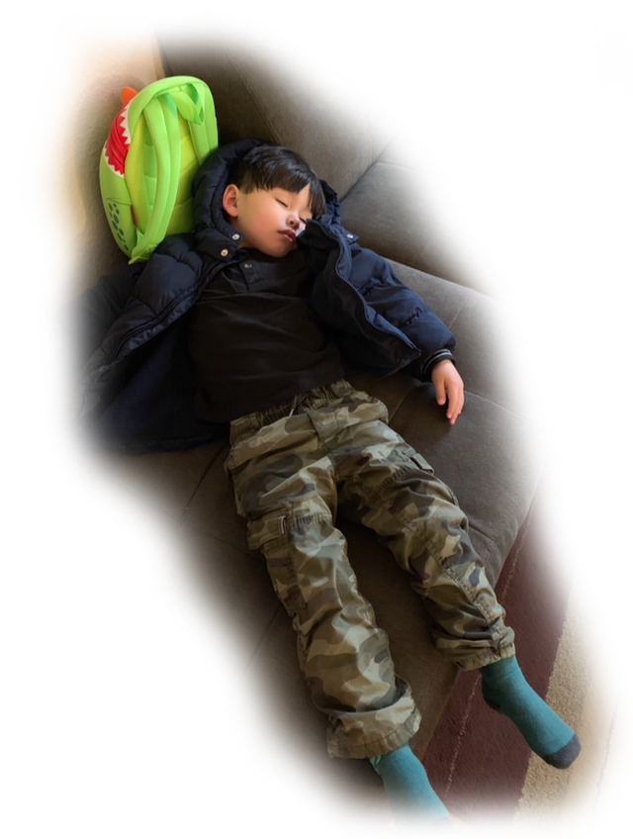
Get Back to the Garden
Notes:
Story: from Marine Corps Base Quantico, Triangle, VA (~1990)
I drew a freehand circle, then asked the marines in my class to inspect the circle to find where it is not perfectly round. Then I asked these questions.
How did you know what round is?
When did your first learn roundness?
Have you ever seen something that is round?
Is it possible that some things are known by children a priori? Kant said that a priori knowledge is “knowledge that is absolutely independent of all experience.”
Fable #102 The First Favorite … GET BACK TO THE GARDEN
***

Slide 12
Opportunities
IX. Reawakening the child in the adult.
X. Heart Thought
XI. Teach Yourself
XII. Moving Toward and Away
Notes:
gvc Interaction #10
Using Lisa Miller’s "quest orientation" (Miller, 2021, p. 169), catch yourself several times a day with "doubts and downers" and look for life's deeper messages.
Lisa Miller said in The Awakened Brain, Top-down attention focuses you on the task at hand you want to achieve, but limits our perceptual field. Bottom-up perception opens you to most salient or emotionally relevant.
In Lisa Miller's Awakened Brain,
she writes a chapter called "THE TWO MODES OF AWARENESS", "﻿As a result of this awakened awareness, our eyes move to meaningful events. In achieving awareness, the stranger who starts talking to us on the bus might be annoying or intrusive, or just invisible. In awakened awareness, we might hear what he says—and even see how it’s relevant to our own lives" (Miller, 2021, p. 165).
then in a chapter called "INTEGRATION IS KEY", "Quest orientation is characterized by a tendency to journey in life: to search for answers to meaningful personal decisions and big existential questions; to perceive doubt as positive; and to be open to change, or more accurately, open to perceiving with fresh eyes, and then using new experience to fuel change. In quest, we open ourselves to the messages from life, take seriously this discovery, and then actively use learning to shape our decisions and actions—our personal operating manual" (Miller, 2021, p. 169).
"In depression, parts of the brain are dysregulated and disconnected. They aren’t functioning optimally or working together. But in quest, the brain is coherent and connected, its regions and networks in harmony. Essentially, the questing brain integrates our achieving and awakened awareness" (Miller, 2021, p. 172).
***

Slide 13
The Teacher's Bill of Rights
permissions to Awaken and Transform yourself ...
1. You have permission to Awaken. You may begin to move toward a new possibility before you see how to get there.
2. Learn something from your student that transforms you, then show your gratitude. In other words, truly teach by modeling true learning!
3. Listen for an intuitive insight - even while you are speaking.
4. Look at something you have seen before. Note whether it looks better, the same, or worse than before. Then look to yourself ... you have just tested your awakened state.
5. Question everything - modeling learning by deconstruction.
6. Sometimes … fall down on the job - then be picked up by your students - in other words, be vulnerable enough to put yourself in their hands.
7. Listen to your students as if their commentary may reveal deeper truth than yours.
8. Have fun - and respect students for wanting to have fun.
9. Accent aspects of the curriculum that you love, so that you model real connection to your material.
10. Be ready to have your thoughts turned in a new, useful direction at any moment.
11. Make yourself accessible - to students - to new knowledge - to your genius.
12. Look at the same student and see no remarkable attributes one time – and striking qualities by looking once again.
13. Let your students forget lessons, so that they pick them up later - perhaps with fresh insights.
14. Be Your Own Teacher ... Receive your student’s offerings and wait … in case an authentic response arises - then, in either case, find and show your gratitude.
15. Respect silence - when a student cannot or does not wish to articulate an impression - and model to the class how to leave room for possible non-language moments of higher order learning.
16. Connect to your student on a level that is deeper than analytic comprehension.
17. Aim more at the transformation of your students through the experiences they have in your class, than the information they may receive.
18. Give permission to your student and yourself to observe something without thinking of conclusions - then, later ... see what thoughts arise.
19. Respect technology, instrumentation, and mechanized measurement without disrespecting the unseen, immeasurable, and non-physical.
20. Allow for the possibility of becoming inspired by a belief prior to its arrival in your conscious mind; but then, check it out analytically to see if it makes sense.
21. Expect wisdom from yourself, your student, or the next unexpected event in your classroom.
22. Be open to receive new ideas while speaking – and note how some are better than what you were going to say.
23. Go ahead and judge the book of nature by her cover - or even a single page - then, at a later time, investigate her many parts for verification - in other words, seek truth of the whole in one part.
24. Be open to inspiration, without necessarily following a mechanical march through a planned lesson.
25. Seek new ways to describe that which machines do not detect, such as space and time or infinity and eternity.
26. Acknowledge the group consciousness of organisms, like: bees, ants, termites, slime mold, genes, DNA, and your students.
27. Resist testing your students and suggest non-measurable, non-invasive evaluations of them.
28. Acknowledge the human mechanical, technological progress of the last several thousand years - while at the same time - acknowledging ancient intuitive abilities that have been lost, temporarily.
29. Rate your own impressions on an equal basis with research evidence, until proven wrong.
30. Hear students and start to believe in them, before actual understanding takes place.
31. Give permission to your student and yourself to receive impressions from a lesson that are too large or too complex to articulate.
32. Watch for questions that 'over-focus' the student, then ask what question is more fun.
33. Awake to the danger of constraining what students see by describing your analysis before the student is done observing.
34. Be mindful of the danger to hurt a subject by taking it apart.
35. End some lessons knowing you may never understand the full meaning because the explanation is too large for your conscious mind.
36. Integrate related subjects during your lessons - even if it strays from the curriculum.
37. Be cognizant that you may be changing that which you observe, just by your presence.
38. Acknowledge the chance that there are non-physical causes to the physical world.
39. Consider both physical facts – as well as – intuitively-based, whole ideas in a discussion.
40. Allow yourself to not know – often.
Notes:
These are hard won RIGHTS or perhaps PERMISSIONS from over a half century of an awakening teacher
you can access them on bickart.org under the ‘20 Opportunities’

Slide 14
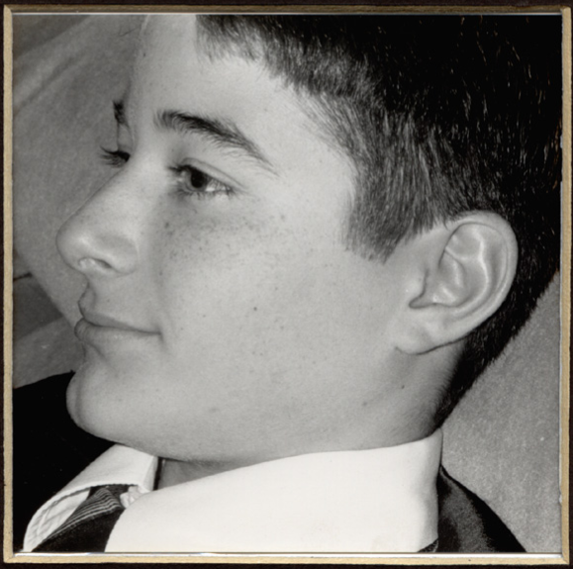
a good answer is worth answering many times
Notes:
Story: from INSS (International Network for the Study of Spirituality), St. Johns U. in York, UK (June 2021)
I gave a workshop on Intuitive Education, then found myself criticizing the university level academics for their very strong accent on left brain tasks and weak nurturing of the right brain. This was most of the audience. During the question and answer portion, an instructor from a Spanish university explained how he wished he could avoid an overload of what I had described as head thought and could help his students move toward more heart thought. As he spoke, I began to answer as an actual intuition about academic papers came to me. I found myself saying that he might try allowing academic papers to include citations on intuitions that the student felt might be useful. After all, isn't it possible that the source of the intuition is from a genuinely good source?
***

Slide 15
Opportunities
IX. Reawakening the child in the adult.
X. Heart Thought
XI. Teach Yourself
XII. Moving Toward and Away
Notes:
Interaction #11
Seeing humankind as a child in the Tao Te Ching, perform the exercise of comparing the life of humankind to one life to one day in your life.
Early human vs early childhood vs early morning of your day
Modern humankind vs adolescence vs middle of your day
Next Version of humankind vs mature adult vs end of your day
Then ask yourself where was humankind, your life, and your day before waking?
***

Slide 16
The Teacher's Bill of Rights
permissions to Awaken and Transform yourself ...
1. You have permission to Awaken. You may begin to move toward a new possibility before you see how to get there.
2. Learn something from your student that transforms you, then show your gratitude. In other words, truly teach by modeling true learning!
3. Listen for an intuitive insight - even while you are speaking.
4. Look at something you have seen before. Note whether it looks better, the same, or worse than before. Then look to yourself ... you have just tested your awakened state.
5. Question everything - modeling learning by deconstruction.
6. Sometimes … fall down on the job - then be picked up by your students - in other words, be vulnerable enough to put yourself in their hands.
7. Listen to your students as if their commentary may reveal deeper truth than yours.
8. Have fun - and respect students for wanting to have fun.
9. Accent aspects of the curriculum that you love, so that you model real connection to your material.
10. Be ready to have your thoughts turned in a new, useful direction at any moment.
11. Make yourself accessible - to students - to new knowledge - to your genius.
12. Look at the same student and see no remarkable attributes one time – and striking qualities by looking once again.
13. Let your students forget lessons, so that they pick them up later - perhaps with fresh insights.
14. Be Your Own Teacher ... Receive your student’s offerings and wait … in case an authentic response arises - then, in either case, find and show your gratitude.
15. Respect silence - when a student cannot or does not wish to articulate an impression - and model to the class how to leave room for possible non-language moments of higher order learning.
16. Connect to your student on a level that is deeper than analytic comprehension.
17. Aim more at the transformation of your students through the experiences they have in your class, than the information they may receive.
18. Give permission to your student and yourself to observe something without thinking of conclusions - then, later ... see what thoughts arise.
19. Respect technology, instrumentation, and mechanized measurement without disrespecting the unseen, immeasurable, and non-physical.
20. Allow for the possibility of becoming inspired by a belief prior to its arrival in your conscious mind; but then, check it out analytically to see if it makes sense.
21. Expect wisdom from yourself, your student, or the next unexpected event in your classroom.
22. Be open to receive new ideas while speaking – and note how some are better than what you were going to say.
23. Go ahead and judge the book of nature by her cover - or even a single page - then, at a later time, investigate her many parts for verification - in other words, seek truth of the whole in one part.
24. Be open to inspiration, without necessarily following a mechanical march through a planned lesson.
25. Seek new ways to describe that which machines do not detect, such as space and time or infinity and eternity.
26. Acknowledge the group consciousness of organisms, like: bees, ants, termites, slime mold, genes, DNA, and your students.
27. Resist testing your students and suggest non-measurable, non-invasive evaluations of them.
28. Acknowledge the human mechanical, technological progress of the last several thousand years - while at the same time - acknowledging ancient intuitive abilities that have been lost, temporarily.
29. Rate your own impressions on an equal basis with research evidence, until proven wrong.
30. Hear students and start to believe in them, before actual understanding takes place.
31. Give permission to your student and yourself to receive impressions from a lesson that are too large or too complex to articulate.
32. Watch for questions that 'over-focus' the student, then ask what question is more fun.
33. Awake to the danger of constraining what students see by describing your analysis before the student is done observing.
34. Be mindful of the danger to hurt a subject by taking it apart.
35. End some lessons knowing you may never understand the full meaning because the explanation is too large for your conscious mind.
36. Integrate related subjects during your lessons - even if it strays from the curriculum.
37. Be cognizant that you may be changing that which you observe, just by your presence.
38. Acknowledge the chance that there are non-physical causes to the physical world.
39. Consider both physical facts – as well as – intuitively-based, whole ideas in a discussion.
40. Allow yourself to not know – often.
Notes:
These are hard won RIGHTS or perhaps PERMISSIONS from over a half century of an awakening teacher
you can access them on bickart.org under the ‘20 Opportunities’

Slide 17
Learn to Speak in Fables
(Bickart, 2020, Bickart’s Just-in-Time Fables (Volume 3), Fable #133 Speaking in Fables )
Notes:
Story: from The Collaborative for Spirituality in Education, Columbia U. in NYC, NY (Nov. 2019)
The school of hard knocks is full of paradox.
- “We can see in retrospect that events in our past which we resented, felt undeserved, etc. were just what we needed. We can thereby appreciate the “wisdom of fate.” That gives rise to gratitude toward the past. Expectancy– not to be confused with specific expectations – is a mood of gratitude toward the future: a dynamic of appreciative alertness to the unknown which comes toward us from the future. It is a non-intellectual light shining into the approaching unknown and can offset our automatic fear of the dark.” – Andy Leaf
- Two Wolves: Is it time to re-write some legends in order to wake up to greater inclusion and transformation?
- "LEADERS There are four types of leaders. The best leader is indistinguishable from the will of those who selected her. The next best leader enjoys the love and praise of the people. The poor leader rules through coercion and fear. And the worst leader is a tyrant despised by the multitudes who are the victims of his power. What a world of difference among these leaders! In the last two types, what is done is without sincerity or trust - only coercion. In the second type, there is harmony between the leader and the people. In the first type, whatever is done happens so naturally that no one presumes to take credit!" (Laozi, 2005/circa 500 BC, Verse 17 Leaders, Tao te ching : a new translation & commentary)
***

Slide 18
Before: Choose Good over Evil … Two Wolves
An old Cherokee was teaching his grandson about life. "A fight is going on inside me," he said to the boy. "It is a terrible fight and it is between two wolves. One is evil, the other is good. The same fight is going on inside you – and inside every other person, too." The grandson thought about it for a minute and then asked his grandfather, "Which wolf will win?" The old Cherokee simply replied, "The one you feed." - an Ancient Cherokee Legend
Notes:
The before is an ancient story the Cherokee of North America pass down. It’s about good and evil. I’d like to read it – then, offer an alternative way to look at it. Listen carefully as I read it and see if you can hear anything you might change.
… [READ SLIDE]
My new version of this legend is a little different. In teaching emotionally disturbed NJ high school students, then in the Chinese school system, then the NC prisons, my views of good and bad people changed. Something shifted. Lately, I have been teaching the children of incarcerated individuals. So, with this scaffolding, I give you Two Wolves II …
***

Slide 19
After: Beyond Good & Evil to Inclusion …
Two Wolves II
Two wolves live inside of me. One is trapped the other free. The two of them just want to be. They fight sometimes. Now good, now bad. The trapped one wants what the other had. I feel this fight when I am sad. Grandpa said, “Watch who you feed. He will win. He’ll take the lead.” I hope some day that both are freed.
- John Bickart 2011, inspired by an Ancient Cherokee Legend
Notes:
Should we touch ancient legends? I apologize if this offends … but it seems that we humans stand at an important moment in our history. There is a question as to whether or not we will survive the great change that is upon us. Perhaps many of us will step up or maybe not. And if stepping up means re-writing the codes we have lived by for thousands of years – then so be it.
What old ways should we leave behind? What is the blood and guts of a new story?
Perhaps the new way has something to do with inclusion … perhaps we will find a way to include both the light and the dark … an honoring of the light, while transforming the dark.
***

Slide 20
Opportunities
IX. Reawakening the child in the adult.
X. Heart Thought
XI. Teach Yourself
XII. Moving Toward and Away
Notes:
Interaction #12
We put away criminals, we avoid bank foreclosures, homeless people, unsightly images. But sometimes, the more we push them away, the more we give energy to the pain they cause. This exercise is designed to use ability to face and sometimes even appreciate such things.
So, let's begin. Use your imagination to picture a 'bad break' that you have had. See the image of it in your consciousness, complete with the feelings it produces. Now, instead of wishing to push this image away, intensify your focus on it. Increase your interest in it and move toward whatever distaste or pain it causes as if you are studying your 'bad break'. Now, if you wish, say, "Thank you."
- For a long-term exercise, ask yourself, "Can I find any good in this event? Can I find myself Loving What Is (Katie, 2016), after all, it is what it is?"
***

Slide 21
The Teacher's Bill of Rights
permissions to Awaken and Transform yourself ...
1. You have permission to Awaken. You may begin to move toward a new possibility before you see how to get there.
2. Learn something from your student that transforms you, then show your gratitude. In other words, truly teach by modeling true learning!
3. Listen for an intuitive insight - even while you are speaking.
4. Look at something you have seen before. Note whether it looks better, the same, or worse than before. Then look to yourself ... you have just tested your awakened state.
5. Question everything - modeling learning by deconstruction.
6. Sometimes … fall down on the job - then be picked up by your students - in other words, be vulnerable enough to put yourself in their hands.
7. Listen to your students as if their commentary may reveal deeper truth than yours.
8. Have fun - and respect students for wanting to have fun.
9. Accent aspects of the curriculum that you love, so that you model real connection to your material.
10. Be ready to have your thoughts turned in a new, useful direction at any moment.
11. Make yourself accessible - to students - to new knowledge - to your genius.
12. Look at the same student and see no remarkable attributes one time – and striking qualities by looking once again.
13. Let your students forget lessons, so that they pick them up later - perhaps with fresh insights.
14. Be Your Own Teacher ... Receive your student’s offerings and wait … in case an authentic response arises - then, in either case, find and show your gratitude.
15. Respect silence - when a student cannot or does not wish to articulate an impression - and model to the class how to leave room for possible non-language moments of higher order learning.
16. Connect to your student on a level that is deeper than analytic comprehension.
17. Aim more at the transformation of your students through the experiences they have in your class, than the information they may receive.
18. Give permission to your student and yourself to observe something without thinking of conclusions - then, later ... see what thoughts arise.
19. Respect technology, instrumentation, and mechanized measurement without disrespecting the unseen, immeasurable, and non-physical.
20. Allow for the possibility of becoming inspired by a belief prior to its arrival in your conscious mind; but then, check it out analytically to see if it makes sense.
21. Expect wisdom from yourself, your student, or the next unexpected event in your classroom.
22. Be open to receive new ideas while speaking – and note how some are better than what you were going to say.
23. Go ahead and judge the book of nature by her cover - or even a single page - then, at a later time, investigate her many parts for verification - in other words, seek truth of the whole in one part.
24. Be open to inspiration, without necessarily following a mechanical march through a planned lesson.
25. Seek new ways to describe that which machines do not detect, such as space and time or infinity and eternity.
26. Acknowledge the group consciousness of organisms, like: bees, ants, termites, slime mold, genes, DNA, and your students.
27. Resist testing your students and suggest non-measurable, non-invasive evaluations of them.
28. Acknowledge the human mechanical, technological progress of the last several thousand years - while at the same time - acknowledging ancient intuitive abilities that have been lost, temporarily.
29. Rate your own impressions on an equal basis with research evidence, until proven wrong.
30. Hear students and start to believe in them, before actual understanding takes place.
31. Give permission to your student and yourself to receive impressions from a lesson that are too large or too complex to articulate.
32. Watch for questions that 'over-focus' the student, then ask what question is more fun.
33. Awake to the danger of constraining what students see by describing your analysis before the student is done observing.
34. Be mindful of the danger to hurt a subject by taking it apart.
35. End some lessons knowing you may never understand the full meaning because the explanation is too large for your conscious mind.
36. Integrate related subjects during your lessons - even if it strays from the curriculum.
37. Be cognizant that you may be changing that which you observe, just by your presence.
38. Acknowledge the chance that there are non-physical causes to the physical world.
39. Consider both physical facts – as well as – intuitively-based, whole ideas in a discussion.
40. Allow yourself to not know – often.
Notes:
These are hard won RIGHTS or perhaps PERMISSIONS from over a half century of an awakening teacher
you can access them on bickart.org under the ‘20 Opportunities’

Slide 22
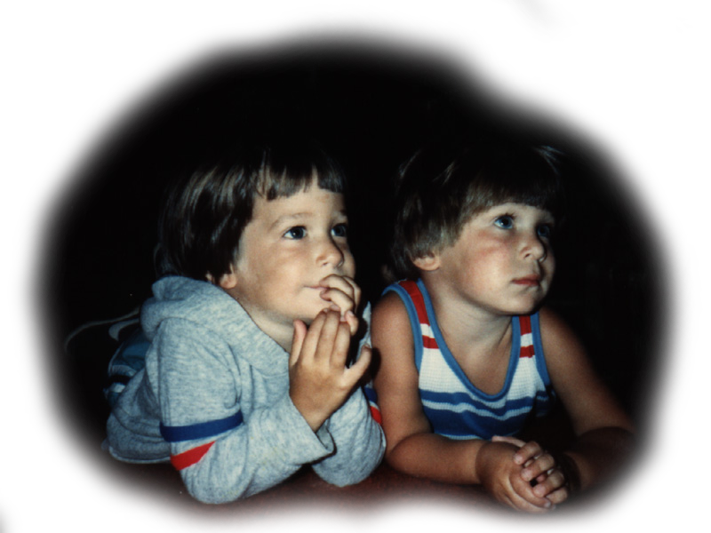
“Schooling stuffs the brains of our children with trivia.
The more trivia, the more their anxieties.
They indoctrinate the children to believe that the consequences are grave
when they fail to distinguish "good" from "evil", and agreement from disagreement.
What gross nonsense!”
(Tao Te Ching , Verse 20 The Sadness of Superficialities and of The Unfulfilled Great Integrity)
Notes:
Story: from Rainbow Institute, Asheville, NC (2018)
- "It is sometimes deeply depressing to be a rebel,
knowing that we can never share most people's way of life, nor can they share ours.
Schooling stuffs the brains of our children with trivia.
The more trivia, the more their anxieties.
They indoctrinate the children to believe that the consequences are grave
when they fail to distinguish "good" from "evil", and agreement from disagreement.
What gross nonsense!
To escape the rubbish of all this so-called knowledge,
in the winter people run to the great feasts of lamb, pork, and ox,
and they climb high in the mountains to view the first signs of spring.
We are so different! Having no desire for the trivialities,
nor for their compensations, we are like infants not yet knowing how to laugh!
Ever wandering, and having no home to which we may return.
While most people are obsessed with superficialities, we feel empty.
While most people feel they know so much, we feel simple-minded.
While most people believe they live happily in the best of all possible worlds,
we are depressed to witness this world!
It is so painful to know that we will always be outsiders,
endlessly moving like the ocean, aimlessly blowing like the wind.
While we fear what others fear, we don't treasure what others treasure.
Our treasure is the Great Integrity.
However, until it is shared, it will not be the Universal Integrity,
for we are part of them, and they are part of us."
(Laozi, 2005/circa 500 BC, Verse 20 The Sadness of Superficialities and of The Unfulfilled Great Integrity, Tao te ching : a new translation & commentary)
- Rainbow students handling fire in portable propane containers, having never done so.
- Cutting my finger when cutting shingles on the roof when I was 11 years old, I went toward the pain and blood and kept my balance.
***

Slide 23
”It ain't over 'til it's over.”
- Yogi Berra
Notes:
***

