Slide 1
Notes:
***

Slide 2
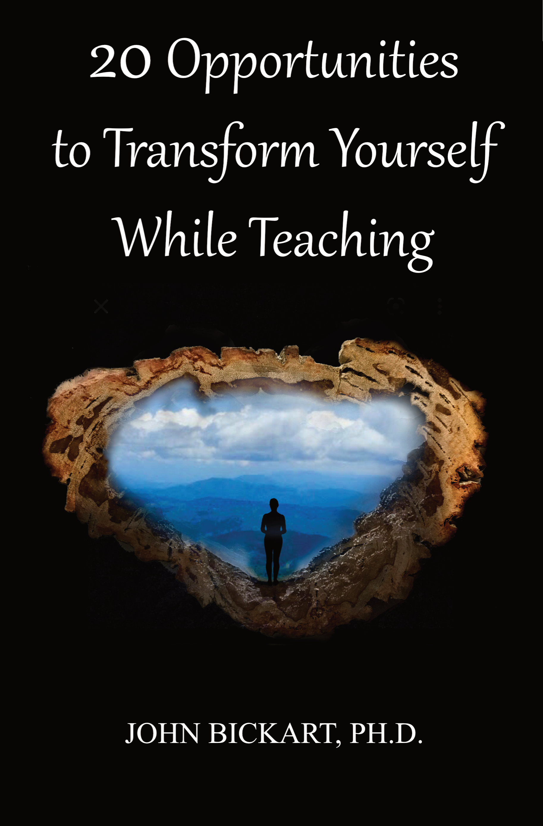
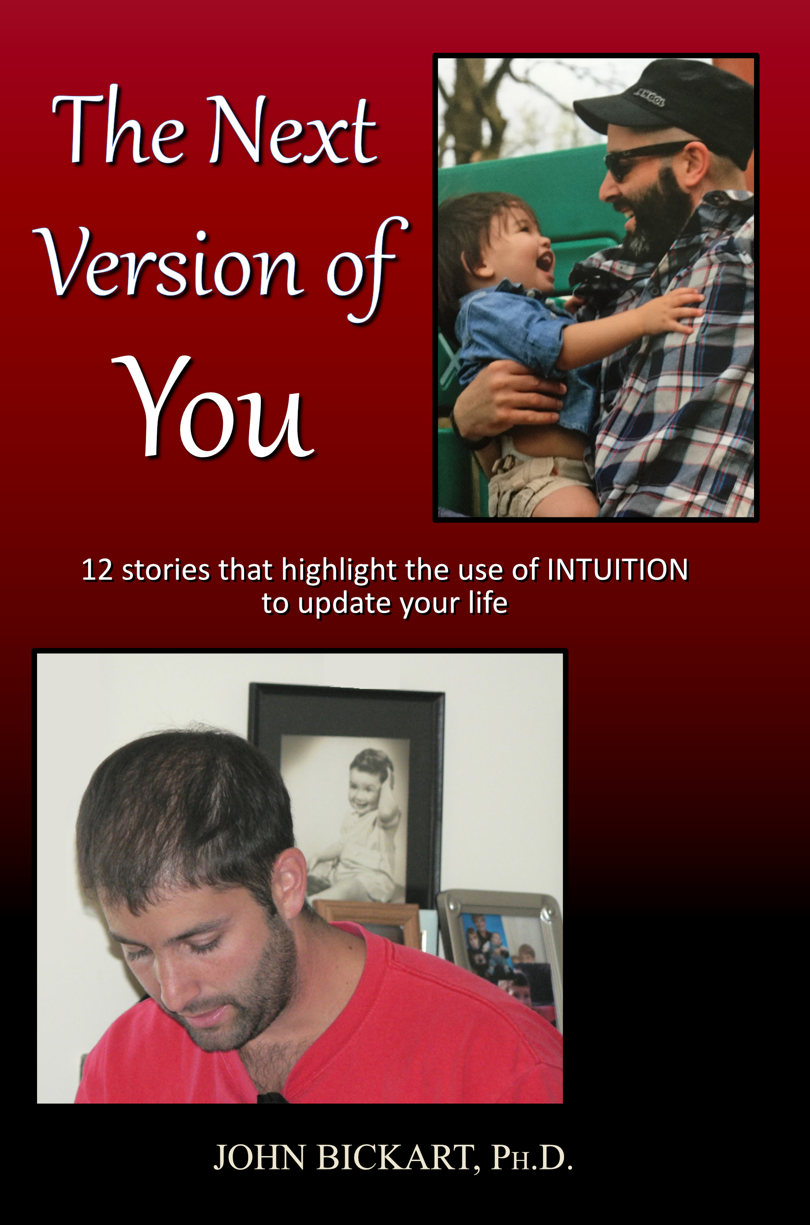
Notes:
***

Slide 3
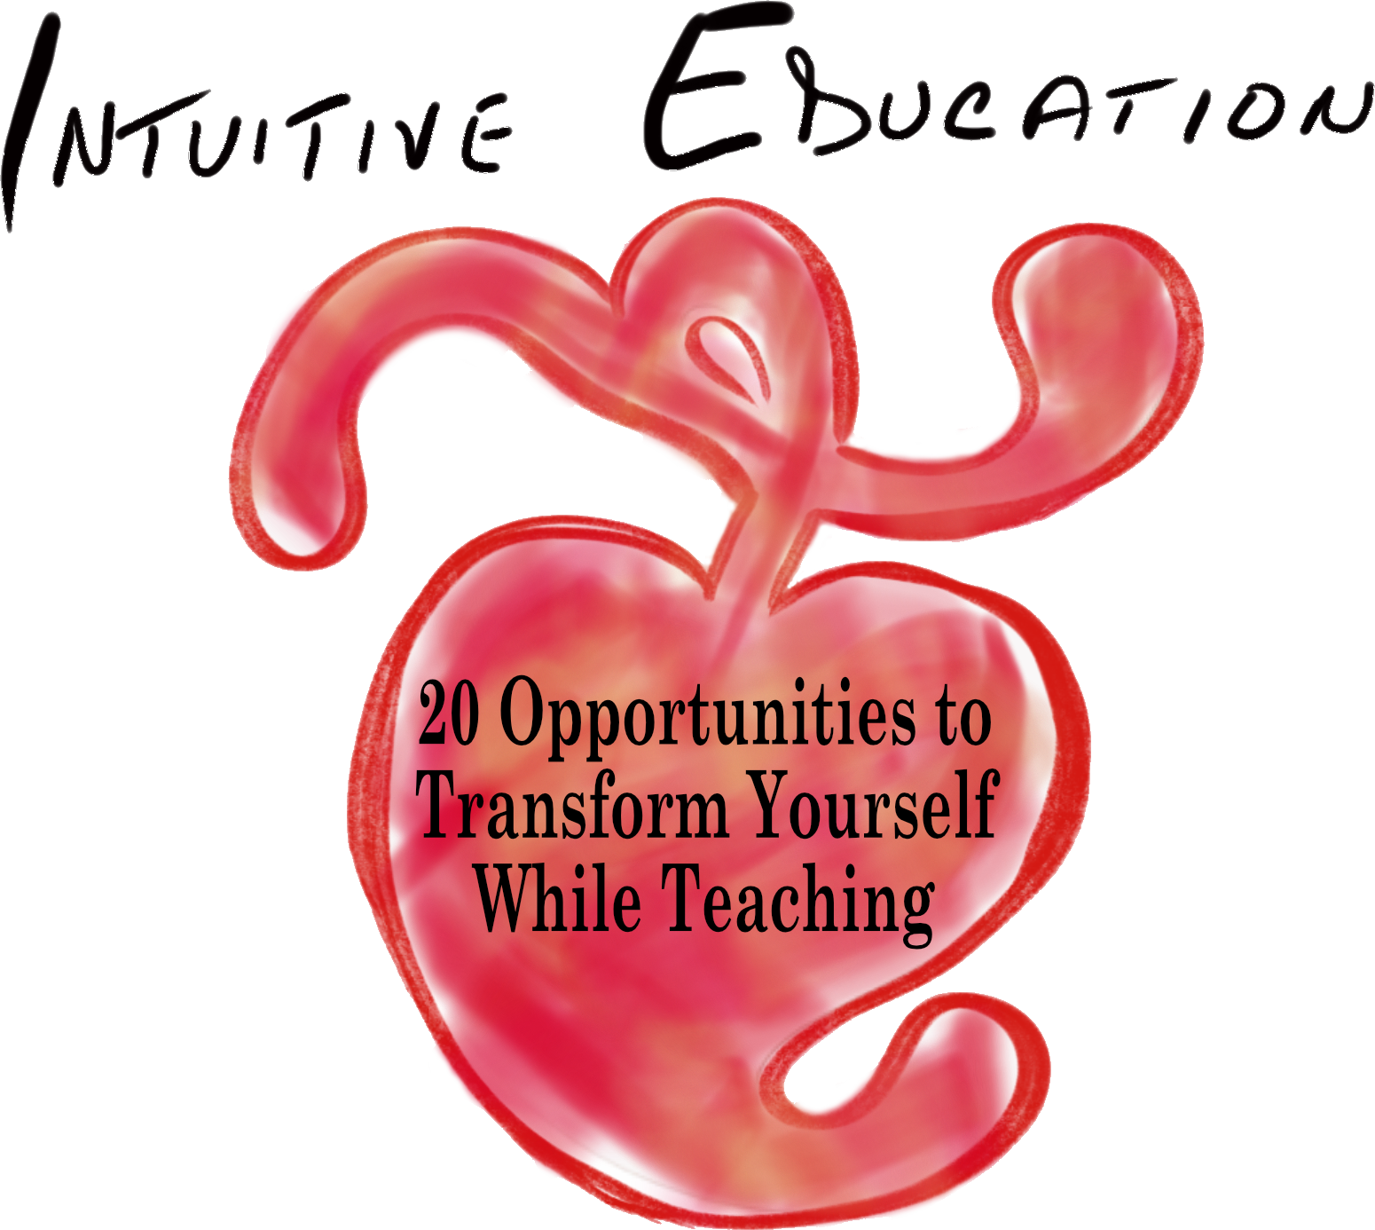
20 Opportunities to Transform Yourself While Teaching
A workshop taken from actual experiences that honor spirituality in education.
Part 4 of 5 - "Revitalizing Your Ability to Lead"
(Opportunities #13 - #16)
John Bickart, Ph.D.
bickart.org
Notes:
Confirm Title
ONE WAY TO AWAKEN SPIRITUALLY IS - INTUITIVE EDUCATION – THIS MEANS THINKING WITH YOUR HEART FIRST, THEN YOUR HEAD, SECOND
Transform yourself through head/heart integration or left/right brain integration // ed is 180 degrees & kids know it
***

Slide 4
Literature Review as seen on bickart.org
Wisdom Teaching and Practical Exercises (Laozi, 2005/circa 500 BC)
Childhood & Spirituality (Bickart, 2013, 2018, 2020a, 2020b, 2020c, 2022; Hart, 2001, 2010, 2014a, 2014b; L. Miller, 2015; L. W. E. S. Miller, 2021)
Awareness, Mindsight, and Flow (Csikszentmihalyi, 1994; Csikszentmihalyi & Pratt, 2017; Siegel, 2010, 2018)
Mindfulness and Nondual Awareness (Chopra, 2021; Chopra, Ford, & Williamson, 2010; Lantieri, 2008; Palmer, 1993, 1998, 2004; Palmer, Zajonc, & Scribner, 2010)
Emotional and Social Intelligence, Presence (Goleman & Boutsikaris, 2006; Goleman & Senge, 2007; Goleman & Whitener, 2005; Senge, 2000, 2008)
Belief (Dispenza, 2017; Dispenza & Boyce, 2016; Dispenza, Knight, & Encephalon, 2005; B. H. Lipton, 2005, 2006, 2014; B. H. Lipton, Bhaerman, S., 2009)
Right versus Left Brain Dominance (McGilchrist, 2009)
Early Opposition to the Mechanical View of Humans (Dewey, 1910, 1916/2005)
Historically Assumed Separateness (Kuhn, 2004)
Reduced Importance of Childhood (Piaget, 1929/2007, 1950, 1959, 1965, 1973, 1976; Piaget & Inhelder, 1969; Piaget & Valsiner, 1927/2001)
Excessive Testing (Darling-Hammond, 2010; González & Darling-Hammond, 1997; Gurwitz, Darling-Hammond, Pease, Education., & Corporation., 1981; Haggstrom, Darling-Hammond, Grissmer, & Center for the Study of the Teaching Profession (Rand Corporation), 1988; Koppich, Merseth, Darling-Hammond, American Association of Colleges for Teacher Education., & National Commission on Teaching & America's Future (U.S.), 2000; Millman & Darling-Hammond, 1990; Wise, Darling-Hammond, Berry, Profession., & Education, 1987; Wise, Darling-Hammond, & Klein, 1986; Zeichner et al., 2000)
Education: Students-only, Community-centered, Right Answers, Restricted Resources, Not tests, Not algebra, Not control, Not norms, Brick & Mortar Schools, Integrated Disciplines, Inspirational Content (Dintersmith, 2018; Hart, 2001)
1800s Factory Model (Skinner, 1953; Thorndike, 1913/2010)
Notes:
References
Bickart, J. (2013). The possible role of intuition in the child's epistemic beliefs in the Piagetian data set. (Ph.D. Dissertation). UNCC, Charlotte, NC. DAI/A 74-11(E) database. (3589794)
Bickart, J. (2018). The next version of you: 12 stories that highlight the use of intuition to update your life.
Bickart, J. (2020a). Bickart’s Just-in-Time Fables (Vol. 3). Asheville, NC: Red Shirt Interactive Group.
Bickart, J. (2020b). Bickart’s Just-in-Time Fables (Vol. 2). Asheville, NC: Red Shirt Interactive Group.
Bickart, J. (2020c). Bickart’s Just-in-Time Fables (Vol. 1). Asheville, NC: Red Shirt Interactive Group.
Bickart, J. (2022). 20 Opportunities to Transform Yourself While Teaching. Asheville, NC: Red Shirt Interactive Group.
Chopra, D. (2021). METAHUMAN : unleashing your infinite potential. [S.l.]: HARMONY CROWN.
Chopra, D., Ford, D., & Williamson, M. (2010). The shadow effect: Illuminating the hidden power of your true self. New York: HarperOne.
Csikszentmihalyi, M. (1994). Flow : living at the peak of your abilities. Niles, Ill.: Nightingale-Conant Corp.
Csikszentmihalyi, M., & Pratt, S. (2017). Finding flow : [the psychology of engagement with everyday life].
Darling-Hammond, L. (2010). The flat world and education: how America's commitment to equity will determine our future. New York: Teachers College Press.
Dewey, J. (1910). How we think. Boston: D.C. Heath & Co.
Dewey, J. (1916/2005). Democracy and education: An introduction to the philosophy of education. New York: Cosimo Classics.
Dintersmith, T. (2018). What school could be : insights and inspiration from teachers across America.
Dispenza, J. (2017). Becoming supernatural: how common people are doing the uncommon. Carlsbad: Hay House.
Dispenza, J., & Boyce, A. (2016). You Are the Placebo. [United States]: Author's Republic : Made available through hoopla.
Dispenza, J., Knight, J. Z., & Encephalon, L. L. C. (2005). Mastering the art of observation. Rainier, WA: Encephalon.
Goleman, D., & Boutsikaris, D. (2006). Social intelligence the new science of human relationships. New York: Audio Renaissance.
Goleman, D., & Senge, P. M. (2007). Working with presence. New York: Audio Renaissance.
Goleman, D., & Whitener, B. (2005). Emotional intelligence. Prince Frederick, MD: Landmark Audiobooks.
González, J. M., & Darling-Hammond, L. (1997). New concepts for new challenges: Professional development for teachers of immigrant youth. [Washington, D.C.], McHenry, IL: Center for Applied Linguistics ; Delta Systems Co.
Gurwitz, A. S., Darling-Hammond, L., Pease, S. R., Education., U. S. D. o., & Corporation., R. (1981). Maintenance of effort provisions: An instrument of federalism in education. Santa Monica, CA: Rand Corp.
Haggstrom, G. W., Darling-Hammond, L., Grissmer, D. W., & Center for the Study of the Teaching Profession (Rand Corporation). (1988). Assessing teacher supply and demand. Santa Monica, CA: Rand, Center for the Study of the Teaching Profession.
Hart, T. (2001). From information to transformation: Education for the evolution of consciousness. New York: P. Lang.
Hart, T. (2010). The secret spiritual world of children the breakthrough discovery that profoundly alters our conventional view of children's mystical experiences. [S.l.]: New World Library.
Hart, T. (2014a). The four virtues : presence, heart, wisdom, creation. New York: Atria Books/Beyond Words.
Hart, T. (2014b). The integrative mind : transformative education for a world on fire.
Koppich, J., Merseth, K. K., Darling-Hammond, L., American Association of Colleges for Teacher Education., & National Commission on Teaching & America's Future (U.S.). (2000). Studies of excellence in teacher education: Preparation in a five-year program. Washington, DC: AACTE Publications.
Kuhn, T. S. (2004). The structure of scientific revolutions. Chicago [u.a.]: Univ. of Chicago Press.
Lantieri, L. (2008). Building inner resilience. Reclaiming Children and Youth, 17(2), 43-46.
Laozi, D. R. A. C. J. (2005/circa 500 BC). Tao te ching : a new translation & commentary. New York: Barnes & Noble.
Lipton, B. H. (2005). The biology of belief: Unleashing the power of consciousness, matter and miracles. Santa Rosa, CA: Mountain of Love/Elite Books.
Lipton, B. H. (2006). The wisdom of your cells: How your beliefs control your biology. Boulder: Sounds True.
Lipton, B. H. (2014). The honeymoon effect: the science of creating heaven on earth. Boulder, CO: Sounds True.
Lipton, B. H., Bhaerman, S. (2009). Spontaneous evolution: Our positive future (and a way to get there from here). Carlsbad, Calif.: Hay House.
McGilchrist, I. (2009). The master and his emissary: the divided brain and the making of the Western world. New Haven: Yale University Press.
Miller, L. (2015). The spiritual child: The new science on parenting for health and lifelong thriving.
Miller, L. W. E. S. (2021). The awakened brain : the new science of spirituality and our quest for an inspired life.
Millman, J., & Darling-Hammond, L. (1990). The New handbook of teacher evaluation: assessing elementary and secondary school teachers. Newbury Park, Calif.: Sage Publications.
Palmer, P. J. (1993). To know as we are known: Education as a spiritual journey. San Francisco: HarperSanFrancisco.
Palmer, P. J. (1998). The courage to teach: Exploring the inner landscape of a teacher's life. San Francisco, Calif.: Jossey-Bass.
Palmer, P. J. (2004). A hidden wholeness: The journey toward an undivided life: welcoming the soul and weaving community in a wounded world. San Francisco, CA: Jossey-Bass.
Palmer, P. J., Zajonc, A., & Scribner, M. (2010). The heart of higher education: a call to renewal. San Francisco: Jossey-Bass.
Piaget, J. (1929/2007). The child's conception of the world. Lanham, MD: Rowman & Littlefield.
Piaget, J. (1950). The psychology of intelligence. London: Routledge & Paul.
Piaget, J. (1959). The language and thought of the child. New York: Humanities Press.
Piaget, J. (1965). The moral judgment of the child. New York: Free Press.
Piaget, J. (1973). The child and reality; problems of genetic psychology. New York: Grossman Publishers.
Piaget, J. (1976). The grasp of consciousness: action and concept in the young child. Cambridge: Harvard University Press.
Piaget, J., & Inhelder, B. (1969). The psychology of the child. New York: Basic Books.
Piaget, J., & Valsiner, J. (1927/2001). The child's conception of physical causality. New Brunswick (N. J.); London: Transaction Publishers.
Senge, P. M. (2000). Schools that learn: A fifth discipline fieldbook for educators, parents, and everyone who cares about education. New York: Doubleday.
Senge, P. M. (2008). The necessary revolution : how individuals and organizations are working together to create a sustainable world. New York: Doubleday.
Siegel, D. J. (2010). Mindsight: the new science of personal transformation. New York: Bantam Books.
Siegel, D. J. (2018). Aware : the science and practice of presence, a complete guide to the groundbreaking Wheel of Awareness meditation practice.
Skinner, B. F. (1953). Science and human behavior. New York: Macmillan.
Thorndike, E. L. (1913/2010). Educational psychology. [Charleston, SC]: Nabu Press, [BiblioBazaar].
Wise, A. E., Darling-Hammond, L., Berry, B., Profession., R. C. C. f. t. S. o. t. T., & Education, N. I. o. (1987). Effective teacher selection: From recruitment to retention. Santa Monica, CA: Rand, Center for the Study of the Teaching Profession.
Wise, A. E., Darling-Hammond, L., & Klein, S. P. (1986). Evaluating the teaching skills of beginning teachers a report to the Senate Education Committee and House Education Committee. Santa Monica, Calif.: Rand,.
Zeichner, K. M., Miller, L., Silvernail, D. L., Darling-Hammond, L., American Association of Colleges for Teacher Education., & National Commission on Teaching & America's Future (U.S.). (2000). Studies of excellence in teacher education: Preparation in the undergraduate years. Washington, DC: AACTE Publications.
***

Slide 5
Opportunities
XIII. Learn to Return
XIV. The Servant Leader
XV. Language Reduces Experience
XVI. Separateness is a Subtle Deception of Physical Life
Notes:
Now comes my advice – my truths – please know that I know – these are for me – these are what I have spent 50 years trying to learn
In Claire Blatchford's Turning, give love and seek truth, not the other way around (Blatchford, C. H. (2001). Turning : words heard from within. Great Barrington, MA: Lindisfarne Books.
***

Slide 6
Opportunities
XIII. Learn to Return
XIV. The Servant Leader
XV. Language Reduces Experience
XVI. Separateness is a Subtle Deception of Physical Life
Notes:
Interaction #13
- As I gave physical education to Doug M. in high school, tossing balls, kicking huge crab soccer balls and playing ping pong while talking ... simply toss an object from one hand to the other.
- The first and last exercise is always Meditation - let go of time and mind thought, returning to heart thought - return to the ever-present-here and the eternal-now.
- "time is always against us" (The Matrix)
***

Slide 7
The Teacher's Bill of Rights
permissions to Awaken and Transform yourself ...
1. You have permission to Awaken. You may begin to move toward a new possibility before you see how to get there.
2. Learn something from your student that transforms you, then show your gratitude. In other words, truly teach by modeling true learning!
3. Listen for an intuitive insight - even while you are speaking.
4. Look at something you have seen before. Note whether it looks better, the same, or worse than before. Then look to yourself ... you have just tested your awakened state.
5. Question everything - modeling learning by deconstruction.
6. Sometimes … fall down on the job - then be picked up by your students - in other words, be vulnerable enough to put yourself in their hands.
7. Listen to your students as if their commentary may reveal deeper truth than yours.
8. Have fun - and respect students for wanting to have fun.
9. Accent aspects of the curriculum that you love, so that you model real connection to your material.
10. Be ready to have your thoughts turned in a new, useful direction at any moment.
11. Make yourself accessible - to students - to new knowledge - to your genius.
12. Look at the same student and see no remarkable attributes one time – and striking qualities by looking once again.
13. Let your students forget lessons, so that they pick them up later - perhaps with fresh insights.
14. Be Your Own Teacher ... Receive your student’s offerings and wait … in case an authentic response arises - then, in either case, find and show your gratitude.
15. Respect silence - when a student cannot or does not wish to articulate an impression - and model to the class how to leave room for possible non-language moments of higher order learning.
16. Connect to your student on a level that is deeper than analytic comprehension.
17. Aim more at the transformation of your students through the experiences they have in your class, than the information they may receive.
18. Give permission to your student and yourself to observe something without thinking of conclusions - then, later ... see what thoughts arise.
19. Respect technology, instrumentation, and mechanized measurement without disrespecting the unseen, immeasurable, and non-physical.
20. Allow for the possibility of becoming inspired by a belief prior to its arrival in your conscious mind; but then, check it out analytically to see if it makes sense.
21. Expect wisdom from yourself, your student, or the next unexpected event in your classroom.
22. Be open to receive new ideas while speaking – and note how some are better than what you were going to say.
23. Go ahead and judge the book of nature by her cover - or even a single page - then, at a later time, investigate her many parts for verification - in other words, seek truth of the whole in one part.
24. Be open to inspiration, without necessarily following a mechanical march through a planned lesson.
25. Seek new ways to describe that which machines do not detect, such as space and time or infinity and eternity.
26. Acknowledge the group consciousness of organisms, like: bees, ants, termites, slime mold, genes, DNA, and your students.
27. Resist testing your students and suggest non-measurable, non-invasive evaluations of them.
28. Acknowledge the human mechanical, technological progress of the last several thousand years - while at the same time - acknowledging ancient intuitive abilities that have been lost, temporarily.
29. Rate your own impressions on an equal basis with research evidence, until proven wrong.
30. Hear students and start to believe in them, before actual understanding takes place.
31. Give permission to your student and yourself to receive impressions from a lesson that are too large or too complex to articulate.
32. Watch for questions that 'over-focus' the student, then ask what question is more fun.
33. Awake to the danger of constraining what students see by describing your analysis before the student is done observing.
34. Be mindful of the danger to hurt a subject by taking it apart.
35. End some lessons knowing you may never understand the full meaning because the explanation is too large for your conscious mind.
36. Integrate related subjects during your lessons - even if it strays from the curriculum.
37. Be cognizant that you may be changing that which you observe, just by your presence.
38. Acknowledge the chance that there are non-physical causes to the physical world.
39. Consider both physical facts – as well as – intuitively-based, whole ideas in a discussion.
40. Allow yourself to not know – often.
Notes:
These are hard won RIGHTS or perhaps PERMISSIONS from over a half century of an awakening teacher
you can access them on bickart.org under the ‘20 Opportunities’

Slide 8
The Teacher's Bill of Rights
permissions to Awaken and Transform yourself ...
1. You have permission to Awaken. You may begin to move toward a new possibility before you see how to get there.
2. Learn something from your student that transforms you, then show your gratitude. In other words, truly teach by modeling true learning!
3. Listen for an intuitive insight - even while you are speaking.
4. Look at something you have seen before. Note whether it looks better, the same, or worse than before. Then look to yourself ... you have just tested your awakened state.
5. Question everything - modeling learning by deconstruction.
6. Sometimes … fall down on the job - then be picked up by your students - in other words, be vulnerable enough to put yourself in their hands.
7. Listen to your students as if their commentary may reveal deeper truth than yours.
8. Have fun - and respect students for wanting to have fun.
9. Accent aspects of the curriculum that you love, so that you model real connection to your material.
10. Be ready to have your thoughts turned in a new, useful direction at any moment.
11. Make yourself accessible - to students - to new knowledge - to your genius.
12. Look at the same student and see no remarkable attributes one time – and striking qualities by looking once again.
13. Let your students forget lessons, so that they pick them up later - perhaps with fresh insights.
14. Be Your Own Teacher ... Receive your student’s offerings and wait … in case an authentic response arises - then, in either case, find and show your gratitude.
15. Respect silence - when a student cannot or does not wish to articulate an impression - and model to the class how to leave room for possible non-language moments of higher order learning.
16. Connect to your student on a level that is deeper than analytic comprehension.
17. Aim more at the transformation of your students through the experiences they have in your class, than the information they may receive.
18. Give permission to your student and yourself to observe something without thinking of conclusions - then, later ... see what thoughts arise.
19. Respect technology, instrumentation, and mechanized measurement without disrespecting the unseen, immeasurable, and non-physical.
20. Allow for the possibility of becoming inspired by a belief prior to its arrival in your conscious mind; but then, check it out analytically to see if it makes sense.
21. Expect wisdom from yourself, your student, or the next unexpected event in your classroom.
22. Be open to receive new ideas while speaking – and note how some are better than what you were going to say.
23. Go ahead and judge the book of nature by her cover - or even a single page - then, at a later time, investigate her many parts for verification - in other words, seek truth of the whole in one part.
24. Be open to inspiration, without necessarily following a mechanical march through a planned lesson.
25. Seek new ways to describe that which machines do not detect, such as space and time or infinity and eternity.
26. Acknowledge the group consciousness of organisms, like: bees, ants, termites, slime mold, genes, DNA, and your students.
27. Resist testing your students and suggest non-measurable, non-invasive evaluations of them.
28. Acknowledge the human mechanical, technological progress of the last several thousand years - while at the same time - acknowledging ancient intuitive abilities that have been lost, temporarily.
29. Rate your own impressions on an equal basis with research evidence, until proven wrong.
30. Hear students and start to believe in them, before actual understanding takes place.
31. Give permission to your student and yourself to receive impressions from a lesson that are too large or too complex to articulate.
32. Watch for questions that 'over-focus' the student, then ask what question is more fun.
33. Awake to the danger of constraining what students see by describing your analysis before the student is done observing.
34. Be mindful of the danger to hurt a subject by taking it apart.
35. End some lessons knowing you may never understand the full meaning because the explanation is too large for your conscious mind.
36. Integrate related subjects during your lessons - even if it strays from the curriculum.
37. Be cognizant that you may be changing that which you observe, just by your presence.
38. Acknowledge the chance that there are non-physical causes to the physical world.
39. Consider both physical facts – as well as – intuitively-based, whole ideas in a discussion.
40. Allow yourself to not know – often.
Notes:
These are hard won RIGHTS or perhaps PERMISSIONS from over a half century of an awakening teacher
you can access them on bickart.org under the ‘20 Opportunities’

Slide 9
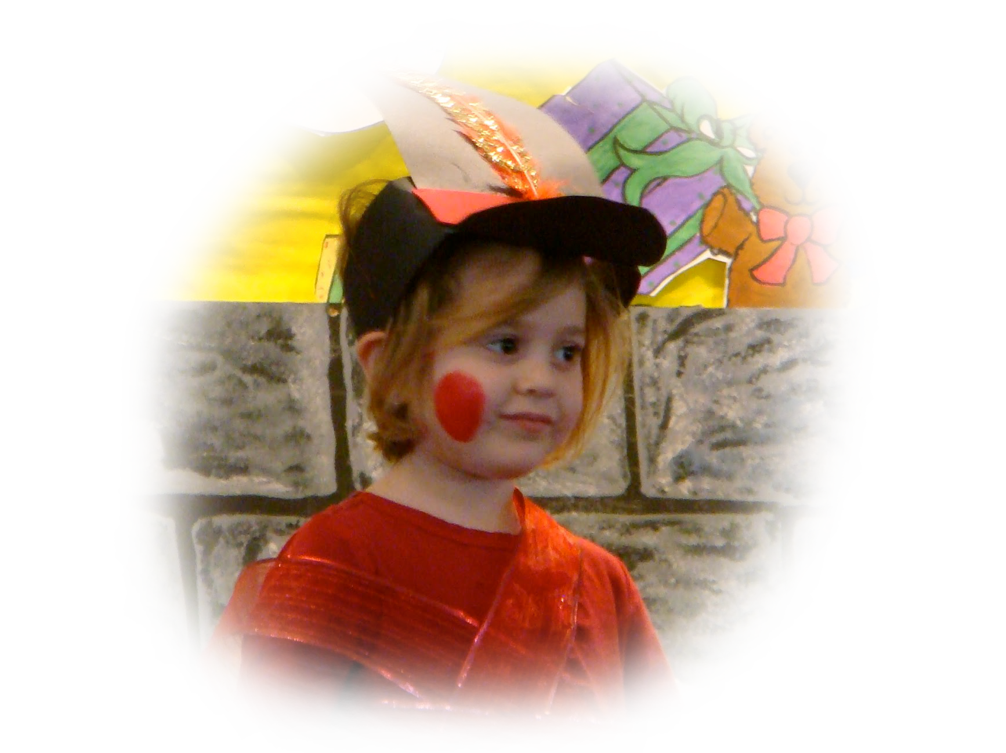
It is said that Time for those of us who are physical
is Space for spirituals
"time is always against us"
(The Matrix)
Notes:
Story: from Meditation Ashram, Haridwar, India (1971)
The Matrix movie - spiritual world - latest one makes me think that we have to repeat lessons until we learn from them
basically school of hard knocks - karma is not punishment, just repetition
- Fable ​#23 The Fairy Gate … THE WHERE AND WHEN IS HERE AND NOW - "TIME for the princess was SPACE for the fairy."
***

Slide 10
Opportunities
XIII. Learn to Return
XIV. The Servant Leader
XV. Language Reduces Experience
XVI. Separateness is a Subtle Deception of Physical Life
Notes:
Interaction #14
Picture a personal dysfunction, then take the Test with 3 Questions.
Do you believe that life is good?
Do you believe this dysfunction is part of your life?
Is this truly a problem?
***

Slide 11
The Teacher's Bill of Rights
permissions to Awaken and Transform yourself ...
1. You have permission to Awaken. You may begin to move toward a new possibility before you see how to get there.
2. Learn something from your student that transforms you, then show your gratitude. In other words, truly teach by modeling true learning!
3. Listen for an intuitive insight - even while you are speaking.
4. Look at something you have seen before. Note whether it looks better, the same, or worse than before. Then look to yourself ... you have just tested your awakened state.
5. Question everything - modeling learning by deconstruction.
6. Sometimes … fall down on the job - then be picked up by your students - in other words, be vulnerable enough to put yourself in their hands.
7. Listen to your students as if their commentary may reveal deeper truth than yours.
8. Have fun - and respect students for wanting to have fun.
9. Accent aspects of the curriculum that you love, so that you model real connection to your material.
10. Be ready to have your thoughts turned in a new, useful direction at any moment.
11. Make yourself accessible - to students - to new knowledge - to your genius.
12. Look at the same student and see no remarkable attributes one time – and striking qualities by looking once again.
13. Let your students forget lessons, so that they pick them up later - perhaps with fresh insights.
14. Be Your Own Teacher ... Receive your student’s offerings and wait … in case an authentic response arises - then, in either case, find and show your gratitude.
15. Respect silence - when a student cannot or does not wish to articulate an impression - and model to the class how to leave room for possible non-language moments of higher order learning.
16. Connect to your student on a level that is deeper than analytic comprehension.
17. Aim more at the transformation of your students through the experiences they have in your class, than the information they may receive.
18. Give permission to your student and yourself to observe something without thinking of conclusions - then, later ... see what thoughts arise.
19. Respect technology, instrumentation, and mechanized measurement without disrespecting the unseen, immeasurable, and non-physical.
20. Allow for the possibility of becoming inspired by a belief prior to its arrival in your conscious mind; but then, check it out analytically to see if it makes sense.
21. Expect wisdom from yourself, your student, or the next unexpected event in your classroom.
22. Be open to receive new ideas while speaking – and note how some are better than what you were going to say.
23. Go ahead and judge the book of nature by her cover - or even a single page - then, at a later time, investigate her many parts for verification - in other words, seek truth of the whole in one part.
24. Be open to inspiration, without necessarily following a mechanical march through a planned lesson.
25. Seek new ways to describe that which machines do not detect, such as space and time or infinity and eternity.
26. Acknowledge the group consciousness of organisms, like: bees, ants, termites, slime mold, genes, DNA, and your students.
27. Resist testing your students and suggest non-measurable, non-invasive evaluations of them.
28. Acknowledge the human mechanical, technological progress of the last several thousand years - while at the same time - acknowledging ancient intuitive abilities that have been lost, temporarily.
29. Rate your own impressions on an equal basis with research evidence, until proven wrong.
30. Hear students and start to believe in them, before actual understanding takes place.
31. Give permission to your student and yourself to receive impressions from a lesson that are too large or too complex to articulate.
32. Watch for questions that 'over-focus' the student, then ask what question is more fun.
33. Awake to the danger of constraining what students see by describing your analysis before the student is done observing.
34. Be mindful of the danger to hurt a subject by taking it apart.
35. End some lessons knowing you may never understand the full meaning because the explanation is too large for your conscious mind.
36. Integrate related subjects during your lessons - even if it strays from the curriculum.
37. Be cognizant that you may be changing that which you observe, just by your presence.
38. Acknowledge the chance that there are non-physical causes to the physical world.
39. Consider both physical facts – as well as – intuitively-based, whole ideas in a discussion.
40. Allow yourself to not know – often.
Notes:
These are hard won RIGHTS or perhaps PERMISSIONS from over a half century of an awakening teacher
you can access them on bickart.org under the ‘20 Opportunities’

Slide 12
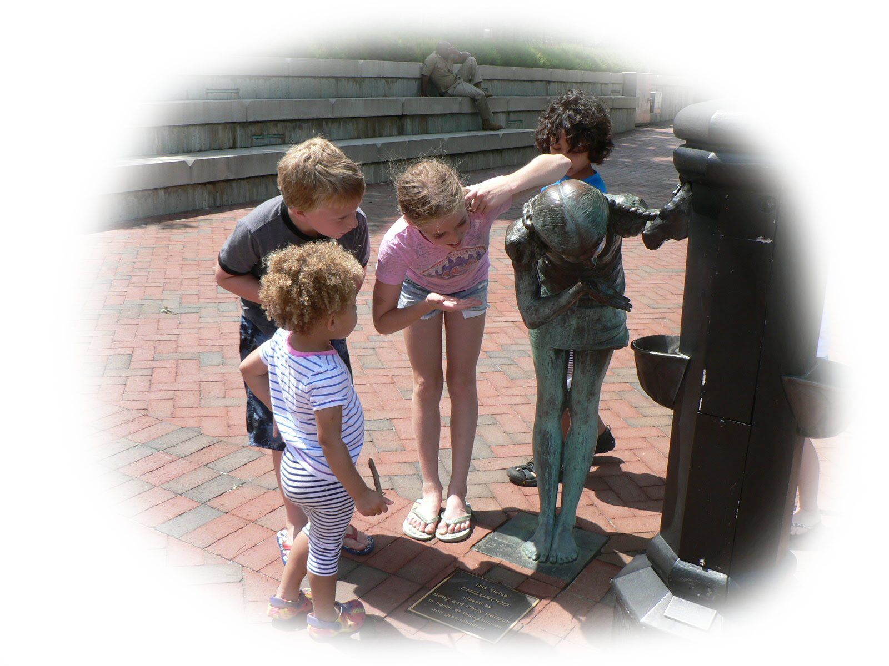
TRUE TEACHERS
MAY LOOK
LIKE FOLLOWERS
Notes:
Story: from Uplook School, Greenfield, MA (~2000)
- student groups to have a teaching performance in 3 parts:
Story
Experiential
Reflect on Deeper Message
- Fable #77 The First Teacher … TRUE TEACHERS MAY LOOK LIKE FOLLOWERS
- Fable #132 The Lamb Prodigy … YOU ARE YOUR OWN BEST TEACHER
***

Slide 13
Opportunities
XIII. Learn to Return
XIV. The Servant Leader
XV. Language Reduces Experience
XVI. Separateness is a Subtle Deception of Physical Life
Notes:
Interaction #15
Another test of how awake you are is to ask these 3 questions of yourself
Am I a noun or a verb?
Am I a human being, a human doing, or a human becoming?
Can I embody the paradox of being both and neither?
***

Slide 14
The Teacher's Bill of Rights
permissions to Awaken and Transform yourself ...
1. You have permission to Awaken. You may begin to move toward a new possibility before you see how to get there.
2. Learn something from your student that transforms you, then show your gratitude. In other words, truly teach by modeling true learning!
3. Listen for an intuitive insight - even while you are speaking.
4. Look at something you have seen before. Note whether it looks better, the same, or worse than before. Then look to yourself ... you have just tested your awakened state.
5. Question everything - modeling learning by deconstruction.
6. Sometimes … fall down on the job - then be picked up by your students - in other words, be vulnerable enough to put yourself in their hands.
7. Listen to your students as if their commentary may reveal deeper truth than yours.
8. Have fun - and respect students for wanting to have fun.
9. Accent aspects of the curriculum that you love, so that you model real connection to your material.
10. Be ready to have your thoughts turned in a new, useful direction at any moment.
11. Make yourself accessible - to students - to new knowledge - to your genius.
12. Look at the same student and see no remarkable attributes one time – and striking qualities by looking once again.
13. Let your students forget lessons, so that they pick them up later - perhaps with fresh insights.
14. Be Your Own Teacher ... Receive your student’s offerings and wait … in case an authentic response arises - then, in either case, find and show your gratitude.
15. Respect silence - when a student cannot or does not wish to articulate an impression - and model to the class how to leave room for possible non-language moments of higher order learning.
16. Connect to your student on a level that is deeper than analytic comprehension.
17. Aim more at the transformation of your students through the experiences they have in your class, than the information they may receive.
18. Give permission to your student and yourself to observe something without thinking of conclusions - then, later ... see what thoughts arise.
19. Respect technology, instrumentation, and mechanized measurement without disrespecting the unseen, immeasurable, and non-physical.
20. Allow for the possibility of becoming inspired by a belief prior to its arrival in your conscious mind; but then, check it out analytically to see if it makes sense.
21. Expect wisdom from yourself, your student, or the next unexpected event in your classroom.
22. Be open to receive new ideas while speaking – and note how some are better than what you were going to say.
23. Go ahead and judge the book of nature by her cover - or even a single page - then, at a later time, investigate her many parts for verification - in other words, seek truth of the whole in one part.
24. Be open to inspiration, without necessarily following a mechanical march through a planned lesson.
25. Seek new ways to describe that which machines do not detect, such as space and time or infinity and eternity.
26. Acknowledge the group consciousness of organisms, like: bees, ants, termites, slime mold, genes, DNA, and your students.
27. Resist testing your students and suggest non-measurable, non-invasive evaluations of them.
28. Acknowledge the human mechanical, technological progress of the last several thousand years - while at the same time - acknowledging ancient intuitive abilities that have been lost, temporarily.
29. Rate your own impressions on an equal basis with research evidence, until proven wrong.
30. Hear students and start to believe in them, before actual understanding takes place.
31. Give permission to your student and yourself to receive impressions from a lesson that are too large or too complex to articulate.
32. Watch for questions that 'over-focus' the student, then ask what question is more fun.
33. Awake to the danger of constraining what students see by describing your analysis before the student is done observing.
34. Be mindful of the danger to hurt a subject by taking it apart.
35. End some lessons knowing you may never understand the full meaning because the explanation is too large for your conscious mind.
36. Integrate related subjects during your lessons - even if it strays from the curriculum.
37. Be cognizant that you may be changing that which you observe, just by your presence.
38. Acknowledge the chance that there are non-physical causes to the physical world.
39. Consider both physical facts – as well as – intuitively-based, whole ideas in a discussion.
40. Allow yourself to not know – often.
Notes:
These are hard won RIGHTS or perhaps PERMISSIONS from over a half century of an awakening teacher
you can access them on bickart.org under the ‘20 Opportunities’

Slide 15
“Words that are strictly true seem to be paradoxical.”
(Tzu, 2012/circa 500 BC, Tao Te Ching, Verse 78. Savannah, GA: Green King Press.)
Notes:
Story: from School of Living Arts, Candler, NC (2020)
- Find a way to say, "Watch out for listening too literally to great teachers or great books."
- The HOPI language can outside the separation of subject and predicate, and the use of tenses.
- “Only then, will you transcend tense
To fully be here now.
Only then, no harm
will the universe proffer
nor you to her,
for you will be
not you but she
and both – the universal Great Integrity.”
(Laozi, 2005/circa 500 BC, Verse 13 Identity, Tao te ching : a new translation & commentary)
***

Slide 16
‘Primitive’ Languages: Case in point - The Hopi
Before:
The Hopi say “flash” instead of “the light flashes” or “the light flashed”.
Lack of subject / predicate separation
Lack of verb tense separation
Historically seen as primitive
Notes:
Let’s look at other people’s stories (what the U.S. calls Social Studies or the study of History).
Before, in the old school view of ancients and indigenous, we used the word ‘Primitive’ to describe peoples who were ‘not civilized’ . Research describes this as a projection of modern head thinking onto: ancients, indigenous, and also onto children. We used to jump to the conclusion that if a culture did not use grammar like us, then they were somehow inferior.
Here is an example from the terrific set of interviews of Benjamin Lee Whorf (later to launch the Sapir Whorf Hypothesis) of how the North American Hopi would communicate about a flash or spark from a fire …
[READ SLIDE]
Perhaps we could see the lack of separation as an acknowledgement of UNITY or ONENESS.
In meditation we see that the unity of time is necessary in order to be here, now – increase our presence.
In quantum physics we need to imagine the objects of the physical world connected in order to make sense of entanglement and the observer effect.
“The thoughts of a Hopi about events always include both space and time, for neither is found alone in his world view. Thus his language gets along adequately without tenses for its verbs, and permits him to think habitually in terms of space-time. Properly to understand Einstein's relativity a Westerner must abandon his spoken tongue and take to the language of calculus. But a Hopi, Whorf implies, has a sort of calculus built into him.” (Whorf & Carroll, 1964, p. viii)
Perhaps we could teach that the Hopi were - and are to this day - quite advanced in their lack of separation of subject and predicate in grammar. According to linguistic research, several ancient cultures did not see human beings as nouns. Neither did they see us as verbs – human doings. Perhaps if we could learn from them, we could move forward as a species to see ourselves as human becomings.
Perhaps we could learn to move forward with both legs, with both lobes of the brain, with both head and heart.
***

Slide 17
“Only then, will you transcend tense
To fully be here now.
Only then, no harm
will the universe proffer
nor you to her,
for you will be
not you but she
and both – the universal Great Integrity.”
- Lao Tzu (Tao Te Ching, Verse 13 Identity)
Notes:
"Verse 20
THE SADNESS OF SUPERFICIALITIES AND OF THE UNFULFILLED GREAT INTEGRITY
It is sometimes deeply depressing to be a rebel,
knowing that we can never share most people's way of life, nor can they share ours.
Schooling stuffs the brains of our children with trivia.
The more trivia, the more their anxieties.
They indoctrinate the children to believe that the consequences are grave
when they fail to distinguish "good" from "evil", and agreement from disagreement.
What gross nonsense!
To escape the rubbish of all this so-called knowledge,
in the winter people run to the great feasts of lamb, pork, and ox,
and they climb high in the mountains to view the first signs of spring.
We are so different! Having no desire for the trivialities,
nor for their compensations, we are like infants not yet knowing how to laugh!
Ever wandering, and having no home to which we may return.
While most people are obsessed with superficialities, we feel empty.
While most people feel they know so much, we feel simple-minded.
While most people believe they live happily in the best of all possible worlds,
we are depressed to witness this world!
It is so painful to know that we will always be outsiders,
endlessly moving like the ocean, aimlessly blowing like the wind.
While we fear what others fear, we don't treasure what others treasure.
Our treasure is the Great Integrity.
However, until it is shared, it will not be the Universal Integrity,
for we are part of them, and they are part of us."
Laozi, D. R. A. C. J. (2005/circa 500 BC). Tao te ching : a new translation & commentary. New York: Barnes & Noble.

Slide 18
After:
Meditate to stay in the present - outside of Time and Space.
Achieve greater comprehension and possible advances in Quantum Physics.
Consider ourselves neither to be human beings as nouns, nor human doings as verbs – instead, perhaps human becomings as both.

Slide 19
Exercise:
Be the Hopi!
Start from your Heart
Notes:
… see the tree as a subject and predicate … see the tree as all tenses - the whole life of the tree – ironically, it’s a flash
The beauty is that we have representatives of ancient and indigenous wisdom right in our midst – the children.
***
Lao Tzu
“All things alike go through their processes of activity, and we see them return. When things have displayed their luxuriant growth, we see each of them return to its root. This returning to their root is what we call the state of stillness; and that stillness may be called a reporting that they have fulfilled their appointed end.” (Tzu, 2012/circa 500 BC, p. Verse 16)
William James
“And the faculty of voluntarily bringing back a wandering attention, over and over again, is the very root of judgment, character, and will. ... An education which should improve this faculty would be the education par excellence.” - William James
Incarcerated Individuals
(On giving advice to a child)
"Don't do anything in the dark you wouldn't want to come to light." J. Powell
"Remember you are always loved. Love is gold. Give your gold to everyone you meet, just as it was given to you but never with a price. This is your treasure, nothing more, nothing less." J. LeJeune
"We all make mistakes. When you get knocked down you have to get back up. 'Fake it until you become it'" (A. Kempeny).
"I had people all the time telling me what I should do or shouldn't do, but I had to learn the hard way. My advice to you is always be honest regardless if it hurts someone's feelings because once the pain goes away they will respect you for your honesty. Never forget to be yourself, don't do things because everyone else is doing them, because when you get out of your character you will about 8 times out of 10 find yourself in an awkward situation. Young man the most important thing I can tell you is to love. Love your friends and family - even love your enemies. When you love, things you say and things you do for people won't go unnoticed because they'll know it came from a sincere heart. And always remember to love yourself, because you can't love others until you love yourself first." C. Barnes
"I've learned to not take family, friends or freedom for granted, at any given time any of these can be taken from you. ... my grandmother always told me, 'worrying is like rocking in a rocking chair, you can do it for days and never get anywhere.'" T. Lackey
"We all make mistakes. When you get knocked down you have to get back up. 'Fake it until you become it.'" A. Kempeny
"Son, do this for me if you can. Be a simple kind of man. Be someone people can love and understand. Be strong, tough and work hard, but also be caring, loving and sympathetic for those who are weaker than you. Always remember that family comes first. Take care and protect them with your love and compassion." T. Joynes

Slide 20
Opportunities
XIII. Learn to Return
XIV. The Servant Leader
XV. Language Reduces Experience
XVI. Separateness is a Subtle Deception of Physical Life
Notes:
Interaction #16
- Exercise: Spend your next dollar as a gift - thinking of what it might do for the other.
Separateness leads to ownership which leads to separateness
We can overcome separateness with gifting ... those dollars do not have to be "mine-not-yours certificates", each one of them can be a gift, just waiting to be given.
- Fable ​#122 The Koala Kingdom … IS SHARING REALLY INCONCEIVABLE?
***

Slide 21
The Teacher's Bill of Rights
permissions to Awaken and Transform yourself ...
1. You have permission to Awaken. You may begin to move toward a new possibility before you see how to get there.
2. Learn something from your student that transforms you, then show your gratitude. In other words, truly teach by modeling true learning!
3. Listen for an intuitive insight - even while you are speaking.
4. Look at something you have seen before. Note whether it looks better, the same, or worse than before. Then look to yourself ... you have just tested your awakened state.
5. Question everything - modeling learning by deconstruction.
6. Sometimes … fall down on the job - then be picked up by your students - in other words, be vulnerable enough to put yourself in their hands.
7. Listen to your students as if their commentary may reveal deeper truth than yours.
8. Have fun - and respect students for wanting to have fun.
9. Accent aspects of the curriculum that you love, so that you model real connection to your material.
10. Be ready to have your thoughts turned in a new, useful direction at any moment.
11. Make yourself accessible - to students - to new knowledge - to your genius.
12. Look at the same student and see no remarkable attributes one time – and striking qualities by looking once again.
13. Let your students forget lessons, so that they pick them up later - perhaps with fresh insights.
14. Be Your Own Teacher ... Receive your student’s offerings and wait … in case an authentic response arises - then, in either case, find and show your gratitude.
15. Respect silence - when a student cannot or does not wish to articulate an impression - and model to the class how to leave room for possible non-language moments of higher order learning.
16. Connect to your student on a level that is deeper than analytic comprehension.
17. Aim more at the transformation of your students through the experiences they have in your class, than the information they may receive.
18. Give permission to your student and yourself to observe something without thinking of conclusions - then, later ... see what thoughts arise.
19. Respect technology, instrumentation, and mechanized measurement without disrespecting the unseen, immeasurable, and non-physical.
20. Allow for the possibility of becoming inspired by a belief prior to its arrival in your conscious mind; but then, check it out analytically to see if it makes sense.
21. Expect wisdom from yourself, your student, or the next unexpected event in your classroom.
22. Be open to receive new ideas while speaking – and note how some are better than what you were going to say.
23. Go ahead and judge the book of nature by her cover - or even a single page - then, at a later time, investigate her many parts for verification - in other words, seek truth of the whole in one part.
24. Be open to inspiration, without necessarily following a mechanical march through a planned lesson.
25. Seek new ways to describe that which machines do not detect, such as space and time or infinity and eternity.
26. Acknowledge the group consciousness of organisms, like: bees, ants, termites, slime mold, genes, DNA, and your students.
27. Resist testing your students and suggest non-measurable, non-invasive evaluations of them.
28. Acknowledge the human mechanical, technological progress of the last several thousand years - while at the same time - acknowledging ancient intuitive abilities that have been lost, temporarily.
29. Rate your own impressions on an equal basis with research evidence, until proven wrong.
30. Hear students and start to believe in them, before actual understanding takes place.
31. Give permission to your student and yourself to receive impressions from a lesson that are too large or too complex to articulate.
32. Watch for questions that 'over-focus' the student, then ask what question is more fun.
33. Awake to the danger of constraining what students see by describing your analysis before the student is done observing.
34. Be mindful of the danger to hurt a subject by taking it apart.
35. End some lessons knowing you may never understand the full meaning because the explanation is too large for your conscious mind.
36. Integrate related subjects during your lessons - even if it strays from the curriculum.
37. Be cognizant that you may be changing that which you observe, just by your presence.
38. Acknowledge the chance that there are non-physical causes to the physical world.
39. Consider both physical facts – as well as – intuitively-based, whole ideas in a discussion.
40. Allow yourself to not know – often.
Notes:
These are hard won RIGHTS or perhaps PERMISSIONS from over a half century of an awakening teacher
you can access them on bickart.org under the ‘20 Opportunities’

Slide 22
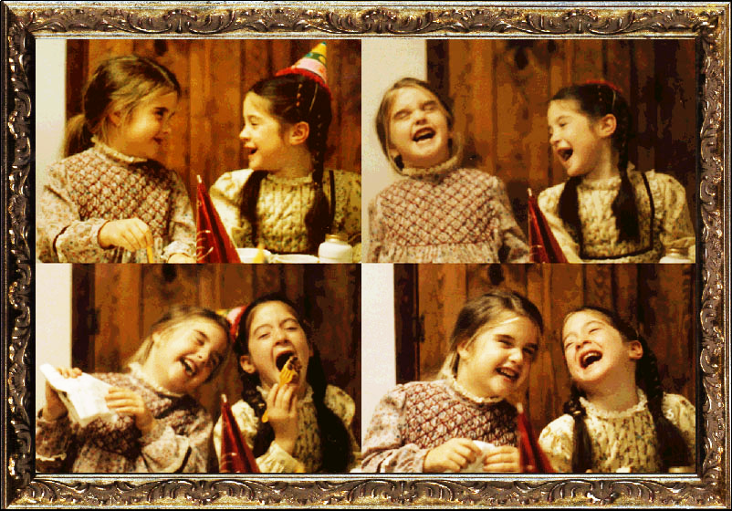
"it is the world that has been pulled over your eyes to blind you from the truth"
(The Matrix)
Notes:
Story: from The Canadian Federal Government, Ottawa, Canada (~1990)
- "it is the world that has been pulled over your eyes to blind you from the truth" (The Matrix)
- Fable #19 The 5 Rules of Living … SEPARATENESS IS A SUBTLE DECEPTION OF LIFE ON EARTH
Fable #14 The Ox and the Mule … WE NEED TO PULL TOGETHER
***

Slide 23
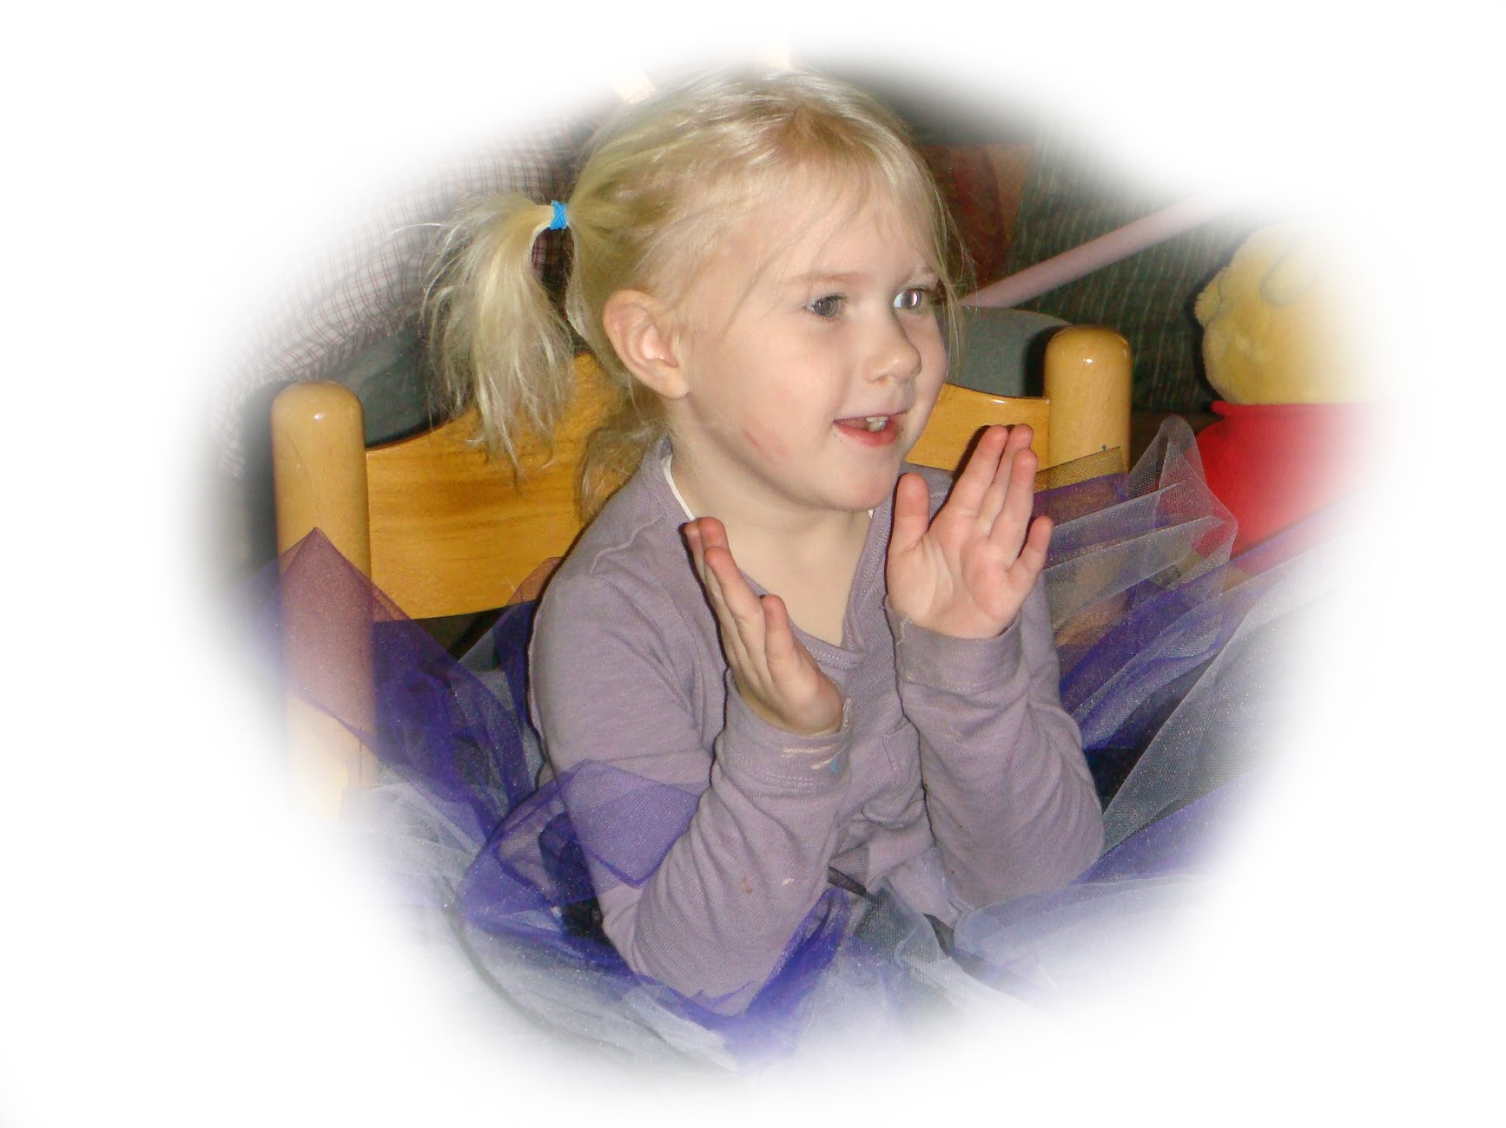
Conclusion to Part 4 of 5
”You can observe a lot by just watching.”
- Yogi Berra
Thank You!
Notes:
***

