Slide 1
What do you do when something terrible happens? Do you think of taking care of yourself first? You should. Then, do you seek the students? That’s what they want. After trauma, we all seek predictable, kind environments – in each other’s company – and teachers are nothing less than pure gold, here. Do you constantly love teaching? Or are you like the rest of us – falling in and out of love? We teachers need forgiveness, accolades, compassion, and understanding. How will we get this? By looking through the eyes of our students!
Reawakening Your Love of Teaching
Notes:
I don't know about you, but I went to the school of hard knocks. When I was very young, everything looked good. As I got older, not so much. I guess the hard knocks got to me. Life brought difficulties, responsibilities, good days, and hard ones, too. Then, I started teaching. The youth I taught have given me a fresh start! If I consciously use their eyes to perceive the world, I have a window into the beautiful and the good. Yes, I have to make the effort, but it works. I believe that it works because the world is inherently good and the youth are innately wise enough to know this. They have a spiritual knowing that is true. They KNOW that the world is good. So, when I need to reawaken my love of teaching, I look into their eyes and through their eyes ... and there it is - the knowing that I had temporarily forgotten.

Slide 2
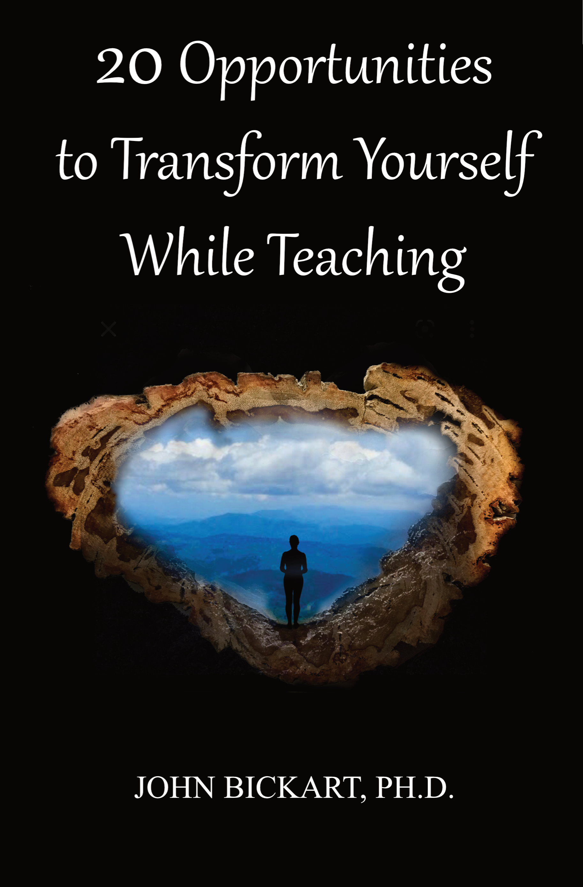
Reawakening Your Love of Teaching
(taken from chapters V-VIII)
Notes:
***

Slide 3
Literature Review as seen on bickart.org
Wisdom Teaching and Practical Exercises (Laozi, 2005/circa 500 BC)
Childhood & Spirituality (Bickart, 2013, 2018, 2020a, 2020b, 2020c, 2022; Hart, 2001, 2010, 2014a, 2014b; L. Miller, 2015; L. W. E. S. Miller, 2021)
Awareness, Mindsight, and Flow (Csikszentmihalyi, 1994; Csikszentmihalyi & Pratt, 2017; Siegel, 2010, 2018)
Mindfulness and Nondual Awareness (Chopra, 2021; Chopra, Ford, & Williamson, 2010; Lantieri, 2008; Palmer, 1993, 1998, 2004; Palmer, Zajonc, & Scribner, 2010)
Emotional and Social Intelligence, Presence (Goleman & Boutsikaris, 2006; Goleman & Senge, 2007; Goleman & Whitener, 2005; Senge, 2000, 2008)
Belief (Dispenza, 2017; Dispenza & Boyce, 2016; Dispenza, Knight, & Encephalon, 2005; B. H. Lipton, 2005, 2006, 2014; B. H. Lipton, Bhaerman, S., 2009)
Right versus Left Brain Dominance (McGilchrist, 2009)
Early Opposition to the Mechanical View of Humans (Dewey, 1910, 1916/2005)
Historically Assumed Separateness (Kuhn, 2004)
Reduced Importance of Childhood (Piaget, 1929/2007, 1950, 1959, 1965, 1973, 1976; Piaget & Inhelder, 1969; Piaget & Valsiner, 1927/2001)
Excessive Testing (Darling-Hammond, 2010; González & Darling-Hammond, 1997; Gurwitz, Darling-Hammond, Pease, Education., & Corporation., 1981; Haggstrom, Darling-Hammond, Grissmer, & Center for the Study of the Teaching Profession (Rand Corporation), 1988; Koppich, Merseth, Darling-Hammond, American Association of Colleges for Teacher Education., & National Commission on Teaching & America's Future (U.S.), 2000; Millman & Darling-Hammond, 1990; Wise, Darling-Hammond, Berry, Profession., & Education, 1987; Wise, Darling-Hammond, & Klein, 1986; Zeichner et al., 2000)
Education: Students-only, Community-centered, Right Answers, Restricted Resources, Not tests, Not algebra, Not control, Not norms, Brick & Mortar Schools, Integrated Disciplines, Inspirational Content (Dintersmith, 2018; Hart, 2001)
1800s Factory Model (Skinner, 1953; Thorndike, 1913/2010)
Notes:
References
Bickart, J. (2013). The possible role of intuition in the child's epistemic beliefs in the Piagetian data set. (Ph.D. Dissertation). UNCC, Charlotte, NC. DAI/A 74-11(E) database. (3589794)
Bickart, J. (2018). The next version of you: 12 stories that highlight the use of intuition to update your life.
Bickart, J. (2020a). Bickart’s Just-in-Time Fables (Vol. 3). Asheville, NC: Red Shirt Interactive Group.
Bickart, J. (2020b). Bickart’s Just-in-Time Fables (Vol. 2). Asheville, NC: Red Shirt Interactive Group.
Bickart, J. (2020c). Bickart’s Just-in-Time Fables (Vol. 1). Asheville, NC: Red Shirt Interactive Group.
Bickart, J. (2022). 20 Opportunities to Transform Yourself While Teaching. Asheville, NC: Red Shirt Interactive Group.
Chopra, D. (2021). METAHUMAN : unleashing your infinite potential. [S.l.]: HARMONY CROWN.
Chopra, D., Ford, D., & Williamson, M. (2010). The shadow effect: Illuminating the hidden power of your true self. New York: HarperOne.
Csikszentmihalyi, M. (1994). Flow : living at the peak of your abilities. Niles, Ill.: Nightingale-Conant Corp.
Csikszentmihalyi, M., & Pratt, S. (2017). Finding flow : [the psychology of engagement with everyday life].
Darling-Hammond, L. (2010). The flat world and education: how America's commitment to equity will determine our future. New York: Teachers College Press.
Dewey, J. (1910). How we think. Boston: D.C. Heath & Co.
Dewey, J. (1916/2005). Democracy and education: An introduction to the philosophy of education. New York: Cosimo Classics.
Dintersmith, T. (2018). What school could be : insights and inspiration from teachers across America.
Dispenza, J. (2017). Becoming supernatural: how common people are doing the uncommon. Carlsbad: Hay House.
Dispenza, J., & Boyce, A. (2016). You Are the Placebo. [United States]: Author's Republic : Made available through hoopla.
Dispenza, J., Knight, J. Z., & Encephalon, L. L. C. (2005). Mastering the art of observation. Rainier, WA: Encephalon.
Goleman, D., & Boutsikaris, D. (2006). Social intelligence the new science of human relationships. New York: Audio Renaissance.
Goleman, D., & Senge, P. M. (2007). Working with presence. New York: Audio Renaissance.
Goleman, D., & Whitener, B. (2005). Emotional intelligence. Prince Frederick, MD: Landmark Audiobooks.
González, J. M., & Darling-Hammond, L. (1997). New concepts for new challenges: Professional development for teachers of immigrant youth. [Washington, D.C.], McHenry, IL: Center for Applied Linguistics ; Delta Systems Co.
Gurwitz, A. S., Darling-Hammond, L., Pease, S. R., Education., U. S. D. o., & Corporation., R. (1981). Maintenance of effort provisions: An instrument of federalism in education. Santa Monica, CA: Rand Corp.
Haggstrom, G. W., Darling-Hammond, L., Grissmer, D. W., & Center for the Study of the Teaching Profession (Rand Corporation). (1988). Assessing teacher supply and demand. Santa Monica, CA: Rand, Center for the Study of the Teaching Profession.
Hart, T. (2001). From information to transformation: Education for the evolution of consciousness. New York: P. Lang.
Hart, T. (2010). The secret spiritual world of children the breakthrough discovery that profoundly alters our conventional view of children's mystical experiences. [S.l.]: New World Library.
Hart, T. (2014a). The four virtues : presence, heart, wisdom, creation. New York: Atria Books/Beyond Words.
Hart, T. (2014b). The integrative mind : transformative education for a world on fire.
Koppich, J., Merseth, K. K., Darling-Hammond, L., American Association of Colleges for Teacher Education., & National Commission on Teaching & America's Future (U.S.). (2000). Studies of excellence in teacher education: Preparation in a five-year program. Washington, DC: AACTE Publications.
Kuhn, T. S. (2004). The structure of scientific revolutions. Chicago [u.a.]: Univ. of Chicago Press.
Lantieri, L. (2008). Building inner resilience. Reclaiming Children and Youth, 17(2), 43-46.
Laozi, D. R. A. C. J. (2005/circa 500 BC). Tao te ching : a new translation & commentary. New York: Barnes & Noble.
Lipton, B. H. (2005). The biology of belief: Unleashing the power of consciousness, matter and miracles. Santa Rosa, CA: Mountain of Love/Elite Books.
Lipton, B. H. (2006). The wisdom of your cells: How your beliefs control your biology. Boulder: Sounds True.
Lipton, B. H. (2014). The honeymoon effect: the science of creating heaven on earth. Boulder, CO: Sounds True.
Lipton, B. H., Bhaerman, S. (2009). Spontaneous evolution: Our positive future (and a way to get there from here). Carlsbad, Calif.: Hay House.
McGilchrist, I. (2009). The master and his emissary: the divided brain and the making of the Western world. New Haven: Yale University Press.
Miller, L. (2015). The spiritual child: The new science on parenting for health and lifelong thriving.
Miller, L. W. E. S. (2021). The awakened brain : the new science of spirituality and our quest for an inspired life.
Millman, J., & Darling-Hammond, L. (1990). The New handbook of teacher evaluation: assessing elementary and secondary school teachers. Newbury Park, Calif.: Sage Publications.
Palmer, P. J. (1993). To know as we are known: Education as a spiritual journey. San Francisco: HarperSanFrancisco.
Palmer, P. J. (1998). The courage to teach: Exploring the inner landscape of a teacher's life. San Francisco, Calif.: Jossey-Bass.
Palmer, P. J. (2004). A hidden wholeness: The journey toward an undivided life: welcoming the soul and weaving community in a wounded world. San Francisco, CA: Jossey-Bass.
Palmer, P. J., Zajonc, A., & Scribner, M. (2010). The heart of higher education: a call to renewal. San Francisco: Jossey-Bass.
Piaget, J. (1929/2007). The child's conception of the world. Lanham, MD: Rowman & Littlefield.
Piaget, J. (1950). The psychology of intelligence. London: Routledge & Paul.
Piaget, J. (1959). The language and thought of the child. New York: Humanities Press.
Piaget, J. (1965). The moral judgment of the child. New York: Free Press.
Piaget, J. (1973). The child and reality; problems of genetic psychology. New York: Grossman Publishers.
Piaget, J. (1976). The grasp of consciousness: action and concept in the young child. Cambridge: Harvard University Press.
Piaget, J., & Inhelder, B. (1969). The psychology of the child. New York: Basic Books.
Piaget, J., & Valsiner, J. (1927/2001). The child's conception of physical causality. New Brunswick (N. J.); London: Transaction Publishers.
Senge, P. M. (2000). Schools that learn: A fifth discipline fieldbook for educators, parents, and everyone who cares about education. New York: Doubleday.
Senge, P. M. (2008). The necessary revolution : how individuals and organizations are working together to create a sustainable world. New York: Doubleday.
Siegel, D. J. (2010). Mindsight: the new science of personal transformation. New York: Bantam Books.
Siegel, D. J. (2018). Aware : the science and practice of presence, a complete guide to the groundbreaking Wheel of Awareness meditation practice.
Skinner, B. F. (1953). Science and human behavior. New York: Macmillan.
Thorndike, E. L. (1913/2010). Educational psychology. [Charleston, SC]: Nabu Press, [BiblioBazaar].
Wise, A. E., Darling-Hammond, L., Berry, B., Profession., R. C. C. f. t. S. o. t. T., & Education, N. I. o. (1987). Effective teacher selection: From recruitment to retention. Santa Monica, CA: Rand, Center for the Study of the Teaching Profession.
Wise, A. E., Darling-Hammond, L., & Klein, S. P. (1986). Evaluating the teaching skills of beginning teachers a report to the Senate Education Committee and House Education Committee. Santa Monica, Calif.: Rand,.
Zeichner, K. M., Miller, L., Silvernail, D. L., Darling-Hammond, L., American Association of Colleges for Teacher Education., & National Commission on Teaching & America's Future (U.S.). (2000). Studies of excellence in teacher education: Preparation in the undergraduate years. Washington, DC: AACTE Publications.
***

Slide 4
Opportunities
Points of View ...
Vulnerability ...
The Unseen ...
Fun ...
Notes:
Wake Up Call #7a
The Unseen
"Looking & Listening"
Ok. This one's about the unseen - a wake up call to see the unseen. Oh yeah. Why not. What about those things we call ideas? I mean, there's so many things that are unseen, but what about ideas? Ideas are unseen and sometimes, ideas come to us that are really good, and we wish that we could go get those ideas on demand - navigate that world of ideas. Where is that? What are they? How do you go there?
Well, I've got an exercise for accessing the world of ideas today. But wait. Let me make a point before you go do the exercise. Could it be that ideas (I heard this) have us? I heard that maybe they have us. I heard that maybe ideas are kind of alive - they are some kind of being.
Let's play a game and pretend that for a minute.
So, the rules of the game are that ideas are alive. They come to us. We don't have them - "Oh, I have an idea!" - no - we don't have them. Maybe they have us. Ok? There's the idea for today. There's a BIG IDEA.
We're going to now look and listen for ... "What is THE idea or AN idea that has me?" It's in that other world - that world of ideas. So, the game is: you pretend that they are alive and some idea comes to you repeatedly. And you try to say, "What is that idea? Why are you coming to me? What do you want me to express in the world?" Maybe the idea is coming to you to have itself expressed in the world. Your job - in the game - is to tell everybody about it, so you've got to see what it is. So, are you ready?
It's a one minute exercise. It's very simple. Although you would probably do it over and over. Take yourself to a state where you are listening for a question like, "What am I to do with my life, next - What's the next thing I want to do with my life?" Then, you blank out your mind. Now, note what ideas come into your mind ... but, whatever comes - don't touch it. Don't try to figure out what it means. Don't analyze or categorize or finalize or advertise it (thank you, Bob Dylan). Just leave it alone. You respect that if it's a real being, then it's not up to you to handle it. It's up to you to listen. So, you look and you listen. That's your job. You take the unseen and you let it come in and work. Work how? Well, you do this exercise - which maybe took a minute - several times over the next week, and you notice if there is a pattern among the words or phrases you noted. Once again, do not over examine them and don't overthink anything. Just note it - maybe write it down - or type it or say it, so that you see the different ways the idea came in over the next week. Maybe there's a pattern - a synchronicity that is one big idea coming to you from several ways that it appears.
And now, you are looking at the unseen! It's a little abstract, but it's a kind of fun game.
I had this happen to me. When I was a boy, I would go to the mailbox and walk up the driveway to bring the mail into the house. And I kept on thinking, "Why can't I know what is in the letter before I open it? - Isn't there a way to know about this?" And then I thought about intuition all through grammar school and high school. And then in college I started writing notes to myself about intuition. And then, I went to get the Ph.D.! Guess what it was on? Intuitive Education! That idea HAD ME - I think - my whole life! I think I had an idea trying to express itself through me. And now I do these wake up calls and I talk about intuition all the time. And I have intuitions. While I'm teaching, intuitive thoughts come to my mind that I did not see coming, and they come out of my mouth. Maybe I'm expressing an IDEA in the world.
You may also see the unseen.
Well, that's today's wake up call. I'll see you in one of those tomorrows.

Slide 5
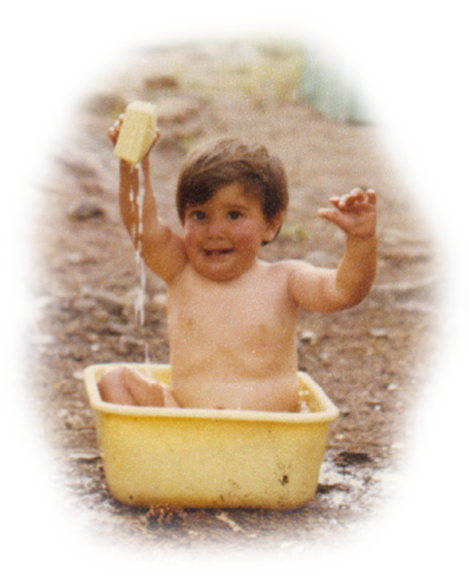
The Milk Maiden
Notes:
Story #7b
The Unseen
7. Listen to your students as if their commentary may reveal deeper truth than yours.
(The Teacher's Bill of Rights)
The Unseen. You know Helen Keller said, "The best and most beautiful things in the world cannot be seen or even touched. They must be felt with the heart." So today, I'm going to tell you a story that I told at the wonderful Rainbow Community School, here in Asheville, NC in 2017. I was guest teaching science lessons and a science club. One day, we paused doing science experiments for the following story. It's one of my favorites. It was first told to me in a room full of adults. So, it was told to adults, but it's about a story told to children. It comes, inspired by a story from Laurens Van der Post in his book The Heart of the Hunter (1961). But I've changed it over the years and for almost half a century now, I've been telling this story to children. It's my absolute favorite story. I've also told it to adults, so I'm telling it to you today. It's about the unseen.
"The Milk Maiden" Once, there was a story. The story was for adults, but in the story, you hear about another story that was told to children. It was told over and over. It was told by a babysitter in the Kalahari, a semi-arid desert in Southern Africa. Every time the babysitter came, the children asked her to tell their favorite story. Now, I will tell you the one she told the children.
Once upon a time, there was a young farm boy. His job was to watch over the cows as they grazed. Every day, he took the cows to the same place. It was a pasture up on the side of the mountain. Over the pasture was a cliff that hung in the air just above the cows. Every day, the boy brought the cows and looked up at the rock cliff to wonder what lay beyond. On the whole, he was happy. But then there came this one different day. Today, the boy brought the cows to the pasture, as he had always done, without any knowledge that on this occasion, his life would change forever.
The pasture looked the same. The cows started to graze as they always did. The boy sat down as he usually would, but then a singular event occurred. A rope descended from the rock cliff just above the pasture. Then, to the boy’s continuing amazement, a young girl started to climb down the rope. She was holding a stool and a bucket.
The boy hid behind a large rock in the pasture. The girl reached the pasture floor, walked over to the cows, and sat on her stool, placing her bucket under a cow, and coaxed the milk from the cow. When the cow had filled her bucket, she proceeded to the rope and ascended. The boy watched with incredulity.
All the rest of that day and into that night, the boy wondered about the strange girl from the cliff above. What was she doing? Where was she from? Why would she take the milk from the cows - milk that clearly belonged to someone else? Finally, after turning these ideas over and over in his mind, he resolved to watch and wait for the milk maiden to see if she would come back.
She did. The very next day, just after he arrived at the pasture, she came down the rope and milked a cow. Then, she left as abruptly as she came.
On the third day, the boy's observational focus had become extreme. He was now making up his mind that if she came again, he would detain her. He genuinely needed to find out what was going on.
She came. The boy leaped out from his hiding rock and apprehended her.
"What are you doing? That is the milk of the farmer," he said, "and you are just taking it without permission."
The milk maiden said nothing. She looked intently into the farm boy's eyes for what seemed like an eternity, then simply said, "I will come to live with you, if you allow me to go back up the rope once more."
The boy did not know what to say. He was not expecting this. She would live with him? He did not ask this. He just wanted to know what she was doing? After all, she was stealing milk. And now, instead of explaining herself, she said that she would live with him? So, the boy just stood and stared. Suddenly, he found his mouth saying, "Alright."
So, the girl proceeded to milk a cow and go back up the rope.
Another day passed, then another. On the third day, she came back. This time she climbed down the rope without the milking pail or the stool. But she did have a small box, about the size of a book. She came over to the boy and explained, "I will stay with you as long as you do not look into this box until I say."
The boy agreed, and so they lived together ... in the same room, for quite some time.
On many days, the girl would leave the room and the boy would stare at the box she had brought and wonder what it contained. But he never, never looked inside, until this one day.
She was gone and the boy could wait no longer. He crossed the room, opened the box, and looked inside. Afraid that she would come into the room and see him, he quickly closed the box and put it back just as it had been.
The girl came back into the room, looked at the boy, then the box, then spoke directly to the boy, saying, "I must leave." Taking up the box, she walked out toward the setting sun and was never seen again.
____________________
At this point the babysitter would always say to the children, "And do you know why the milk maiden left?" The she would add emphatically, "It was not because the farm boy looked into the box!" Then, with a dramatic pause, she would finish, "It was because he didn't see anything in the box."
____________________
With that, the babysitter was finished. Now, I personally need to add something. When I was told this story, I was in a room of adults. I'm pretty sure that none of us knew exactly what the story meant. And I'm also pretty sure that we all had the same questions. First of all, how did she know he had looked in the box. Was there something or things in the box? If there was, why didn't he see anything? And most of all, why would his not seeing be grounds for her to leave?
____________________
This beautiful, mysterious story has stirred in me for almost half a century, now. So, I give it to you. I don't have the answers. But it makes me respect the unseen and watch and look at life even more carefully than ever before. It causes me to wonder.
____________________
References
Van der Post, L. (1961). The Heart of the Hunter ... With drawings by Maurice Wilson. Pp. 254. Hogarth Press: London.

Slide 6
Ray, (2022, veteran alternative school administrator, educational consultant)
”she still thinks a school shooting – or in a store - might happen sometime in her life - she still thinks a loud bang may be a gun. Adverse Childhood Experiences (ACEs) – this problem includes us - relationship causes far less likelihood to suicide.”
Ella, (2022, freshman high school student)
“difference after covid? - positives: mostly get you to talk - some negatives are not caring as much … just some teachers”
Matt, (2022, administrator encouraging restorative practices)
“mainly do proactive work before it gets bad: check in with kids, see their genius, build that relationship - genuinely – so they feel safe
…
teachers proactively need faculty time to check in with each other - emotional intelligence - not just student learning.”
Notes:
***

Slide 7
Charlie, (2022, 11th grade high school student) “sometimes teachers are not ok with you going to a social worker - but emotional health is important - one kid killed himself, so that should have been a wake-up call - whether you like it or not, it's really life or death”
Liam, (2022, senior high school student) “girl's soccer (he knows coach) have a really good team and have each others' backs - not like politics - more than just the game - you can feel the energy - very cool - coach loves soccer he says, ‘win or lose, at the end of the day, they're all one’ - my school is not a good place - it's just low morale - no one wants to be there - now it's just a building and you can feel it”
Amy, (2022, first-year teacher) “I may take a break (she did not – she has come back) - my friends are saying: across the board – parent support lacking – administrative support lacking - I love my kids - it keeps me going - people don't understand you're working overtime - PAY is nothing!! - I get my own supplies - I have a third grader who cannot read.”
Ben, (2022, 33-year teacher in 7th poorest town in the U.S., classroom is in sight of Tijuana)
“Mr. ___, we are Mexican. We have humor.”
Notes:
***

Slide 8
Dr. Abiola Farinde-Wu, (2022, assistant professor of urban education and the graduate program director of the Urban Education, Leadership, and Policy Studies doctoral program)
“policy drives practice”
John, (2022, NJ private / educational social worker)
“I tell parents, mentors and mentees that they should act like we have just been attacked and we need to huddle together, confide in each other, support one another.”
Tess, (2022, middle scholoer)
“I’m not just excited to see the kids, I’m also excited to see the teachers. We have Cougar Cash – for being nice, helping out classmates - you can get stuff at the school store - candy & snacks.”
Notes:
***

Slide 9
Opportunities
Points of View ...
Vulnerability ...
The Unseen ...
Fun ...
Notes:
Wake Up Call #5a
Points of View
"Us & Them"
You know how we're always wishing we could have looked better at the other person's point of view? Well, here is an easy technique to sharpen that ability - to wake that muscle up. You could use this right before a meeting or conversation with that other person. By the way, this what I call spiritually awakening - simply practicing what we really want to do.
My wife and I watched this video, but it doesn't work for us. I think the reason has something to do with the fact that I can usually see where her point of view is wrong. And I tell her. Then she tells me what's wrong with my point of view. It often ends with an "Us & Them" - where we haven't convinced each other. At that point, she says, "Well, that's your opinion."
So, this exercise is to help you be more awake than I am.
To do this exercise, you simply spend sixty seconds to access a time when you entertained a viewpoint that you thought you couldn't. Right now, I'll give you a crazy viewpoint, so you could access this one if you want. Take the idea that the earth goes around the sun. Everybody knows that! Scientists used to think that the sun went around the earth, then they learned better. Well, your test today - in order to exercise your ability to be spiritually awake and entertain an alternate point of view - is to try to accept the possibility that there is yet another view - that maybe we do not know everything, yet.
I was given this view back in the mid-seventies. I was teaching in a Waldorf school and a visiting master teacher was giving a talk. He said that there is a way to see the sun going around the earth. He said that ancient scientists had a point of view that basically stood on the earth and thought the sun rose and set every day by going around the earth. Then he told us that modern scientists changed their viewpoint to a position as if they were standing on the sun, as it were. From there they could see that the earth went around the sun - along with the other planets. Then, he blew my mind! He suggested that there are a multitude of views - not just these two. He threw out one alternative by having us imagine that we moved our viewpoint past the earth, past the sun, out into our galaxy. He said that out there we would see our whole solar system rotating and flying through space. He said that out there, we could find a point of view that moved - a moving path of view - where we would see the sun going around the earth!
I was flabbergasted. Is flabbergasted really a word? If it is, I was. That happened to me fifty years ago. I access it often when I need to awaken myself to appreciate someone's weird point of view or when I want to help others to consider new alternatives.
For example, two nights ago I was speaking to a doctor who was asked to give a webinar to a group of former NFL football players. They were concerned about head injuries because there is a lot of negative press about it right now and the players wanted a medical perspective. The doctor was asked to give a balanced picture to encourage them. I love what he did because it followed exactly what we just spoke about. He gave an alternate view to what they had seen in the media. He started with the actual medical conditions of former NFL football players with head injuries. Then he showed the men the doctors' descriptions that were given to the media. Then he researched media pieces that reported on these findings. In many cases, they could see how the articles misrepresented conditions as more alarming than they really were. In the end, the players were relieved and quite grateful to see for themselves a more positive point of view than the media gave them to believe.
So, that's it. The exercise was that you took sixty seconds to remember an alternate point of view. Now you can access it the next time you want to wake up that muscle. And me? Don't worry ... in the end I think my wife and I are getting a little better. The other day, I could almost entertain her point of view (even though it was kind of wrong). I had asked her if she had any suggestions for this video, and she said, "You're doing good, just be yourself - just not too much." And I said, "Ok."
Oh well, that's our wake up call for today. See you in one of those tomorrows.

Slide 10
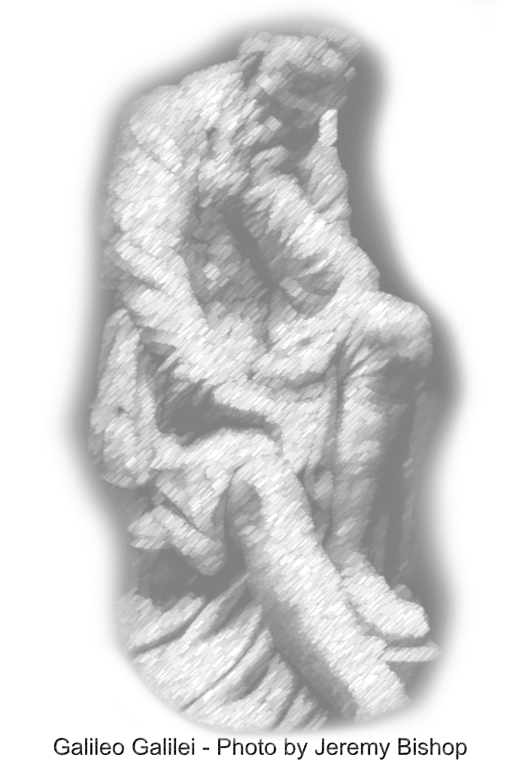
The Townspeople
Notes:
Story #5b
Points of View
"The Townspeople"
5. Question everything - modeling learning by deconstruction.
(The Teacher's Bill of Rights)
Al Tomlinson, as mentioned in Story #3 Intuitive Teaching, was a mentor to me about half a century ago. He told me the story I'm about to tell you and I've been telling it ever since. It is an exercise in trying to overcome biased points of view. Come with me in your imagination to my classroom in a North Carolina prison and watch me tell it again ...
____________________________________________________
Here's a great question ... "How can we step outside of a bias of our time, even if a great majority of people have this bias?" For example, right now, there is an "us and them" orientation. We seem to be lining up with people who see our point of view and feeling quite opposed to people who have another view. Must we be polarized and decide where we stand when a different point of view is expressed? Instead, could we try - whether we agree or not - to see the other point of view from the other's eyes?
____________________________________________________
"The Townspeople"
You've heard of Galileo? You know that he is considered by many to be the father of PHYSICS. He said that you need to get physical evidence to see if something is scientifically true. The church put him through an inquisition and then, an eventual arrest because they said that that was not how they wanted to see if something was true. They said, "We don't want to check physical evidence. We don't want to look through your telescope. We don't want to see your measurements. We want to go by what has already been said by Aristotle and written in books. We will go by tradition."
So, you see that Galileo was revolutionary. And everyone brings up this example as something we would never do in our time. Modern people think that now we know better and therefore know something to be true if there is physical evidence! Moderns say that this is what science goes by now.
Well ... it depends on your point of view. It's possible that there was a bias to Galileo's time ... but is it possible that there is also a bias to our time? A little-known fact is that it wasn't just the church who was against Galileo. He was giving public lectures to the townspeople, and they didn't want to see his experiments either. It was a bias of their entire time not to look at physical evidence. It wasn't that he was being picked on by administrations, only. It was also the townspeople! Everybody! Their time did not want to hear physical evidence to prove if something was true or not.
What about our time? Do we have biases? Do we have points of view that we cannot fathom - and we think there is an "us and them"? And we're right and they're wrong? Oh yeah. Do you know what one of ours is, right in this time - a bias that we the townspeople have? We don't want spiritual evidence to see if something is true. For instance, if you hear that somebody supposedly knows that it is true that one can hear what the mountain said. There are many spiritual people who would say, "I hear the trees. I hear the rocks. I hear the birds. I am sensing, spiritually, an intuitive thought that is coming to me. And these spiritual people get together and verify with each other if the intuitive thoughts that they independently heard are repeatable across different individuals. They ask each other, "What did you hear, what did you hear, and what did you hear?" And, when it is repeatable to that group - who is of the bias that you can have spiritual evidence of truth - they find truths. But people who are not of a spiritual movement would say, "Oh no, they have no idea what they are talking about. I don't want to hear about their evidence. I don't want to hear that the rocks have consciousness. No, no, no. Don't even show me." And that is just like what happened to Galileo when the townspeople said, "Don't show me physical evidence."
So, every time has its bias. If you want to appreciate points of view, you have to walk a mile in the other's shoes - see where they are coming from. And whether you agree or not ... is a whole other point.
So, there is a lesson there. If you want to transform, try to entertain other points of view. Thank you very much. I'll see you in one of those tomorrows.

Slide 11
Opportunities
Points of View ...
Vulnerability ...
The Unseen ...
Fun ...
Notes:
Wake Up Call #6a
Vulnerability
"Falling"
This wake up call is about vulnerability. Do you go to the school of hard knocks? I do. Everything goes wrong and I fall and fail continually. I love those people who seek the vulnerability of falling and failing. They look at it - not like, "Something bad happened to me, oh, poor me - I'm miserable because of it - Why is this happening to me? - I'm a victim of life!" Instead, they look at it as an opportunity. Why? Because, when something bad happens, you can learn something. In fact, isn't that how we learn? Do you ever learn by doing something right the first time? You basically do it wrong, then do it right. It's the school of hard knocks.
The best person I know who can do this is my son Kevin. When he was six, he was in the hospital for a short time, and then got a staph infection, so he was there for a long time. He ended up five weeks in the hospital - and he had to go into quarantine. Here's a six-year-old kid, not allowed to see anybody except the nurses and doctors ... and me. They let me in.
So, he and I made a chart on the wall that had a square for every day that he would be in quarantine. Then, we invented a new game - that had never been done on the earth before - for each day. He was so excited about it. He has the greatest attitude of anybody I know. He is this vulnerable person! He liked the food. He liked the nurses and doctors. He asked them a thousand questions. He wanted to learn all about it. (He has now become a doctor - a neurologist and a psychiatrist!) He loved the whole experience. When his brother got cancer, he said, "Oh yay, let's go to the hospital! Those are great places!" He thought hospitals are these places where you have lots and lots of fun.
So, his attitude was to use the experience to go forward. To fall, in order to go forward. That is the lesson for today - the wake up call for today. But, to cement the idea, let's do an actual physical exercise, because it will put the image into us.
Are you ready? We're going to fall. I'll show you how to fall 2,000 times a day. Ready? Stand up. Lean forward, farther, farther, farther, until you fall. What did you just do? You took a step, didn't you. If you take a step forward, it's the way to recover from falling. It's called walking. And you do it all day long. How many steps do you take a day? Well, that's how many times you fell and got back up and THAT is how to move forward! So, it's like a reminder - if you wish it to be - that you're not falling - you're proceeding - you're going forward - you're waking up - you're making progress.
That's my wake up call for today. I'll see you in one of those tomorrows.

Slide 12
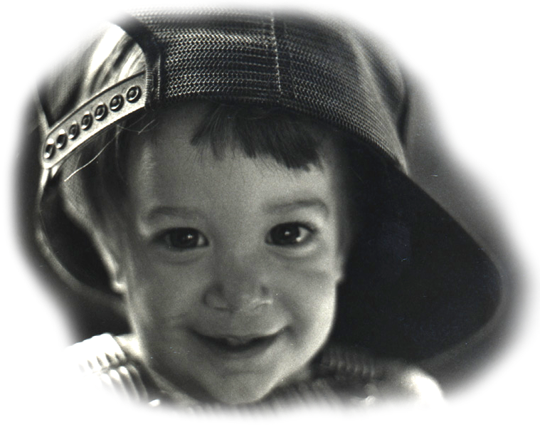
The Abundance of Teachers
Notes:
Story #6b
Vulnerability
6. Sometimes … fall down on the job - then be picked up by your students - in other words, be vulnerable enough to
put yourself in their hands.
(The Teacher's Bill of Rights)
One day, at YTL (Youth Transformed for Life), Asheville, NC (Oct. 2021) I told the students the same thing I had told the incarcerated individuals - some of whom could have been relatives or friends of the youth. It is the same thing I told other students for the last half century, namely: "sometimes it's good to fall - you can use it!"
Is not Falling one of the things we do best?
Walking is Falling
We Fall in love
Planets are Falling in their orbits
And perhaps one of our best abilities is to Fall for a joke
....................
(By the way, have you ever thought of why so many human records of physical accomplishments are Falling so fast and so far at this very time?)
....................
In life, basically what goes around, comes around. So, you have to be vulnerable enough to fall.
One way to fall while teaching is to be vulnerable enough to see the abundance of teachers in the room! Who are these teachers? The students! Every student is a teacher who can show everyone else in the room something new and useful at any time.
And that also has to do with making mistakes. You have to be vulnerable enough to make mistakes in order to learn. In fact, you could say, "There are no mistakes." So, here's a fable from my third volume of Bickart's Just-in-Time Fables (Bickart, 2020, #118).
#118 The First Mistake
A young beaver was working at felling a tree. His father was watching, so as to instruct. “Father, I am afraid to make a mistake cutting the tree,” said the youth. His father adjusted his technique and encouraged him not to be afraid. A second time the young one worried about his chopping and his father showed him the right way, reminding him that he is just learning. A third time, the son asked for alteration, for fear of dropping the tree in the wrong direction, and once again, his father gently obliged with advice, saying, “The only error you are making my son is that you are afraid to make an error.” The little beaver chuckled, then looked up at his father with admiration and relief, asking his father how he knew so much. His father just laughed and said, “In my life, I have already tried all of the ways to fell a tree that do not work.”
DO NOT FEAR MISTAKES
THERE ARE NONE
____________________
"They say ev'ry man needs protection They say ev'ry man must fall Yet I swear I see my reflection Some place so high above this wall I see my light come shining From the west unto the east Any day now, any day now I shall be released"
- Bob Dylan (I Shall Be Released)
So that's it for today. I'll see you in one of those tomorrows.
References
Bickart, J. (2020). Bickart’s Just-in-Time Fables (Vol. 3). Asheville, NC: Red Shirt Interactive Group.

Slide 13
Opportunities
Points of View ...
Vulnerability ...
The Unseen ...
Fun ...
Notes:
Wake Up Call #8a
Fun
"Work & Play"
You know when people say, "I've got to work harder at having more fun?" Well, that's a very interesting mix of work and fun. If you want to make a change to yourself, do you have to work harder? You're probably not lazy. You probably do work. Maybe you need to look at this differently.
I'm going to come into this from a different door, then put it all together.
What about giving a gift - when you are gifting. How about when you are giving the gift of your attention. You know, that is considered one of the highest spiritual things you can do. It is a - or THE - foundation of spiritual growth - to give your loving attention to something.
How about when you give gifts? I know a person - this woman who is very close to me - who feeds 20 to 40 people every other week. She buys all of the food, she has the entire set of freezers and cooking equipment in her home. She cooks it all, then delivers it to homeless shelters. That's a gift of love, a labor of love. She's laboring - she's working, but she's loving doing it, because she wants to, right? She's also feeding a specific family every week and gives them enough food for the next few days.
Where is that balance? When you're looking to make a gift for somebody - or buy a gift, where you have to go find it for them - or create a party for your friends - you aren't thinking in terms of work versus play. You're playing! But where was that boundary between work and play? It's in the passion, right? It's when you have passion for something.
When you decide to give the gift, you're having fun. The boundary between work and play disappears and now your ARE having fun. So, one way to have fun is to go back to the giving of the gift.
So, I have an exercise for you. Try in this next week, to go to your real work - the work that you really don't want to do - and try to give that labor. Consciously make a switch and say, "I'm going to give my next hour as a labor of love - it's a gift." And see what happens. It's like mindfully walking - at first, you're just walking, and now, you're meditating. Maybe your day goes up and maybe something good happens. You've given the gift of labor.
Well, that's it for today. I'll see you in one of those tomorrows.

Slide 14
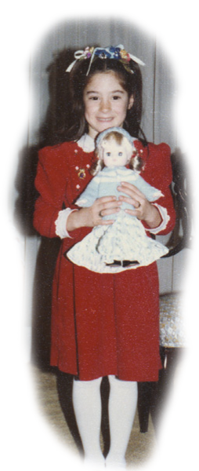
You are The Gift
Notes:
Story #8b
Fun
8. Have fun - and respect students for wanting to have fun.
(The Teacher's Bill of Rights)
At the 3rd International Holistic Teaching and Learning Conference at Southern Oregon U. in Ashland, OR (Oct. 2021), I described having fun in terms of Plato’s eudaimonia, a way of living with an all-encompassing joy whether you are working or playing. This reminds me of a story that is a prequel to the story I told previously, called The Milk Maiden. This prequel fantasizes about beings taking care of the human race, in particular, the farm boy from the previous story. Unbeknownst to the boy, these beings hold the great responsibility for his wellbeing in their hands, all the while exemplifying a way to live in Plato's joy. They are beyond distinguishing between work and play.
"The Milk Maiden Prequel" Did you ever wonder how your life would be if you could see feelings and intentions just like you can see flowers and trees? Well, the folks in this story can. They can see the feelings that come into them from the highest of high. So, of course, they always stay in a state of joy, because they can see that everything sent from above is always good in the end. So, that's how the story opens.
Picture a young girl who is living with her mother. But don’t picture them as human beings; they are Sun beings - beings made out of light. Like humans, they have two bodies. They have a physical body and they have a non-physical body or consciousness. If you want to picture one of them, think of a physical body made of light that is of such high frequency that if we humans tried to see her, we would just see a flash of light. And of course, we probably would not yet be able to see her non-physical consciousness. If you could, you would see that it was where she kept her feelings and pure ideas, like what she intended to do today. And this is where our story begins.
___________________
Today, the girl wanted to learn about the humans on Earth. She asked her mother, “Can I visit those Earth beings? I’ve been watching them. Their light bodies have such delightfully slow vibrations that they are almost like the plants and rocks and animals. And mother, what's more interesting is that they use their physical bodies to run and play and climb trees and interact with the animals!”
Her mom agreed, but suggested that before they visit, she might observe an Earthling a little closer. “Here, look at this one," her mother entreated. "He’s a boy about your age. Today is the anniversary of the day he got his slow-light body. Here, watch him having fun with his mother and father.”
As they watched the celebration, the light-girl asked, “What are those little Sun drops on that cake he is blowing on? They seem to make him almost as happy as we are.”
“Those are candles. Look closer. Keep an eye on the feelings in the humans' hearts. The candles are a symbol of how the parents want to make him happy. They might even sing a song about wishing him to be happy on this anniversary day of his birth. But learn, my daughter, it is not simply the symbolic candles and song that make him happy; it is the feelings the parents are sharing that delight the boy. Can you see the feelings?” The girl observed the feelings moving from the parent's hearts to the boy's heart. Her mother continued, “Most Earthlings cannot see feelings directly yet, so they are reminded to sense the feelings by using symbols.”
As the light-girl continued to observe, she probed, “Now the boy seems quite excited about a box that is wrapped in beautiful paper that his parents have just given him. Why does he like the box so much?"
“Look closer," her mother replied. "Do you see that he is anticipating that inside the box, there is something he really wants? His parents knew what he wanted, hid it in the box, and waited until the right time to give it to him.”
“I see," said the girl. "I like this boy. I want to visit him. I want to bring him a box. I know, I’ll slow my light down to an Earth-like body, fill a box with the best feelings I have, and bring it to him.”
“Alright," replied her mother. "That’s fine. But be warned. If you do not wait for the right time, he may not be ready to see what is in the box. And if he cannot, you must not blame him or feel bad, yourself."
"Yes, mother," answered the girl.
"Well then, if you want to go to Earth, you must promise me that if the boy cannot see your present, you will come straight home to the Sun. If you assure me that you will do this, then I pledge to you that you may have permission to go back, just as soon as he is ready.”
And so, the girl promised and went to Earth. And, if you have heard "The Milk Maiden" story, I think you know the next thing that happened … except for the ending. But the truth is, I don’t know the ending either. I do wish however, that someday the farm boy learns to see feelings and the light-girl gets to go to him.
___________________
Charles Eisenstein reminds us that ...
“As we do unto others,
we are already doing unto ourselves.”
___________________
“In theory there is no difference between theory and practice.
In practice there is.” - Yogi Berra
___________________
So, that's the story for today. I'll see you in one of those tomorrows.

Slide 15
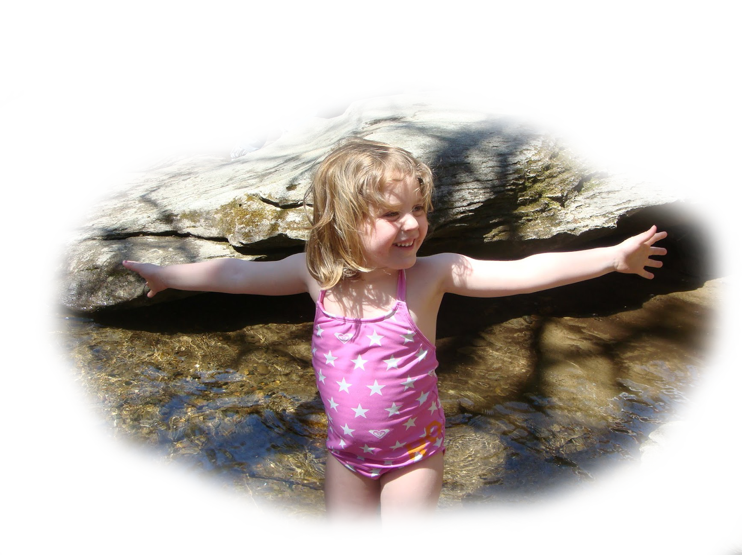
Conclusion
“You know you're in love when you can't fall asleep because reality is finally better than your dreams.” ― Dr. Seuss
Notes:
***

